Slide 1
Section 12.3
Inference about Two Population Means: Dependent Samples
(Paired Difference)

Slide 2
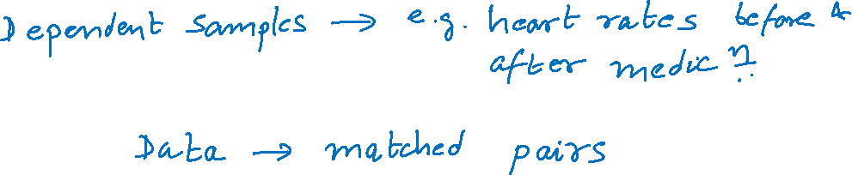
Inference about Two Means: Dependent Samples (Paired Difference)

Slide 3
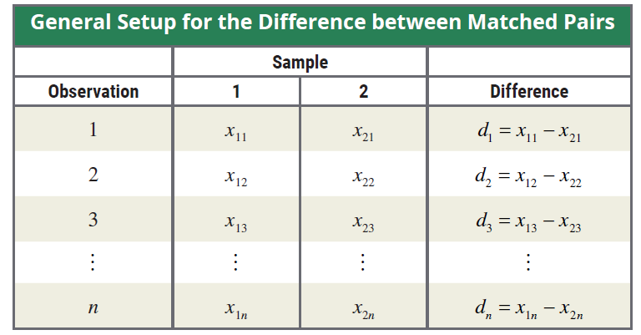
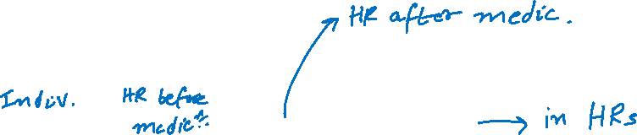
Difference between Matched Pairs

Slide 4
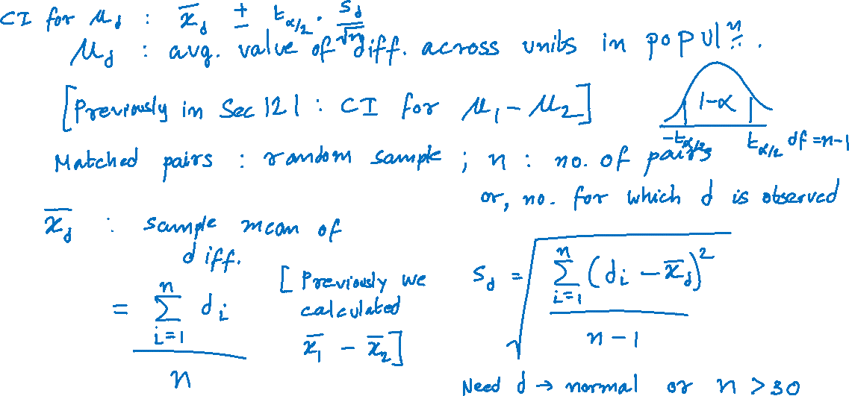
100(1 − α)% Confidence Interval for μ_{d}

Slide 5
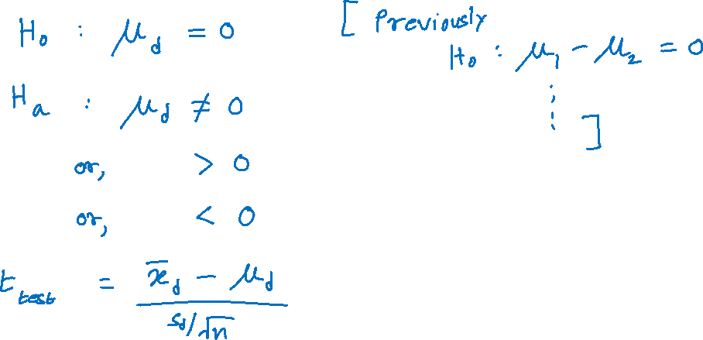
Testing a Hypothesis about Two Dependent Population Means

Slide 6
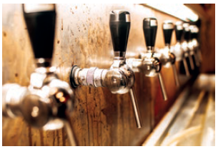

Example
Bull & Bones Brewhaus is a microbrewery that has two restaurants located within 15 miles of each other. The owner of the microbrewery wants to compare the average daily food sales of the two restaurants. To do so, the owner randomly selects 10 days over a five-month period (college football season) and records the daily food sales. The results are
given in the following table.

Slide 7
Example (cont.)
Calculate a 95% confidence interval for the mean difference in restaurant sales.
The owner wants to know if there is evidence of a difference between the average daily food sales of the two restaurants. Test using α = 0.01.
Daily Food Sales for Two Restaurants ($)
Day | Restaurant 1 | Restaurant 2 | Difference = Restaurant 1 – Restaurant 2
1 | 5828 | 7894 | −2066
2 | 9836 | 11,573 | −1737
3 | 3984 | 5319 | −1335
4 | 5845 | 6389 | −544

Slide 8
Example (cont.)
Daily Food Sales for Two Restaurants ($)
Day | Restaurant 1 | Restaurant 2 | Difference = Restaurant 1 – Restaurant 2
5 | 5210 | 6055 | −845
6 | 9668 | 10,631 | −963
7 | 6768 | 7866 | −1098
8 | 6726 | 7976 | −1250
9 | 4399 | 5652 | −1253
10 | 6692 | 8083 | −1391

Slide 9
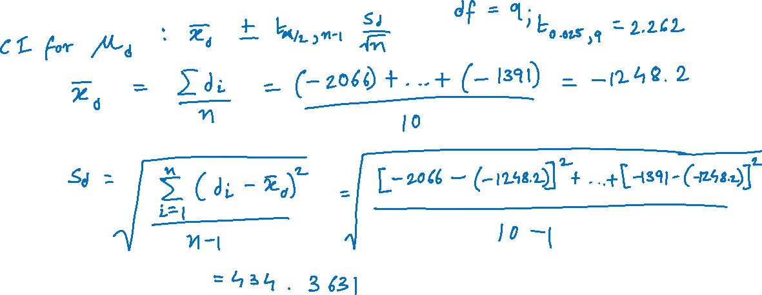
Example (cont.)

Slide 10
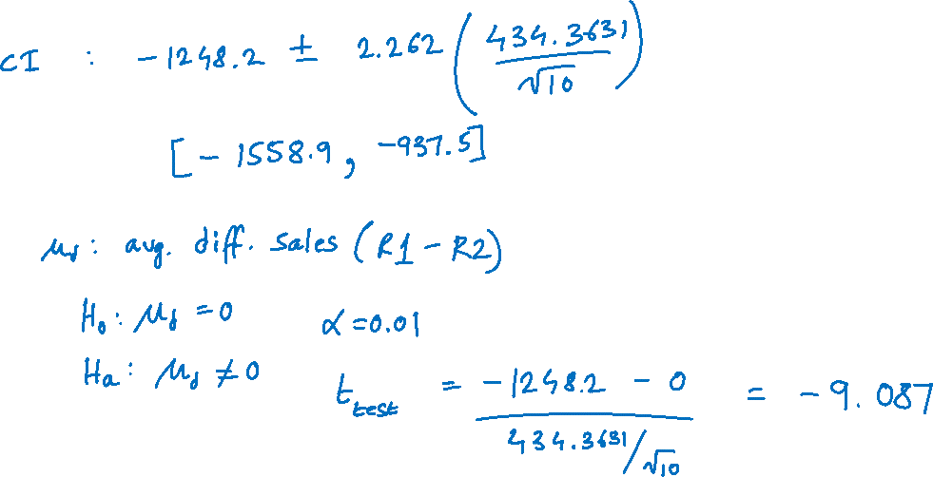
Example (cont.)

Slide 11
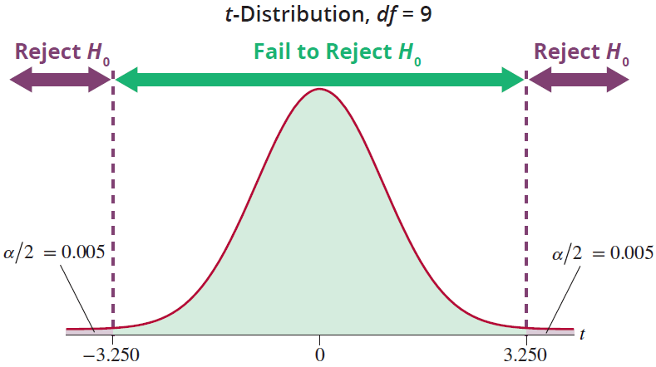
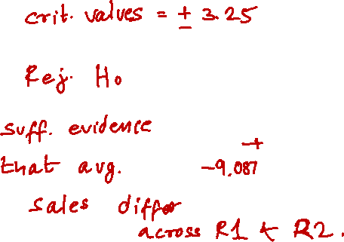
Example (cont.)

Slide 12
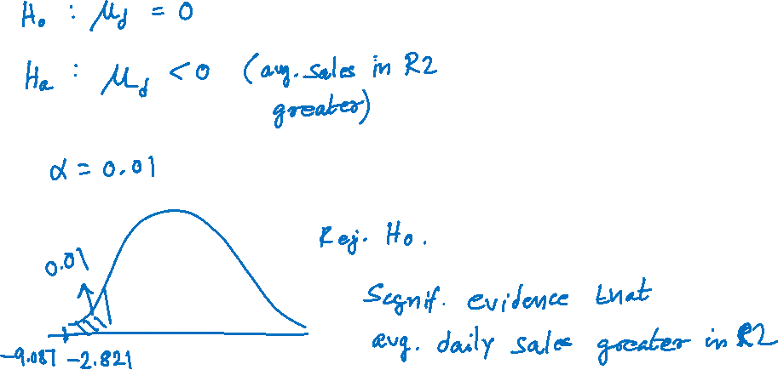
Example (cont.)

