Slide 1
Section 12.1
Inference about Two Means: Independent Samples , σ₁ and σ₂ Known

Slide 2
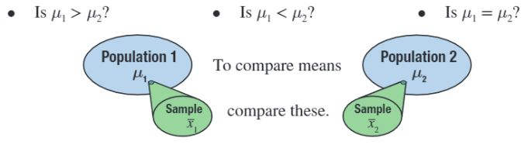
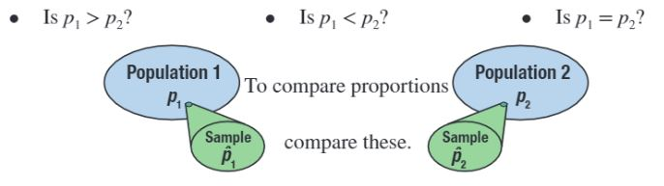
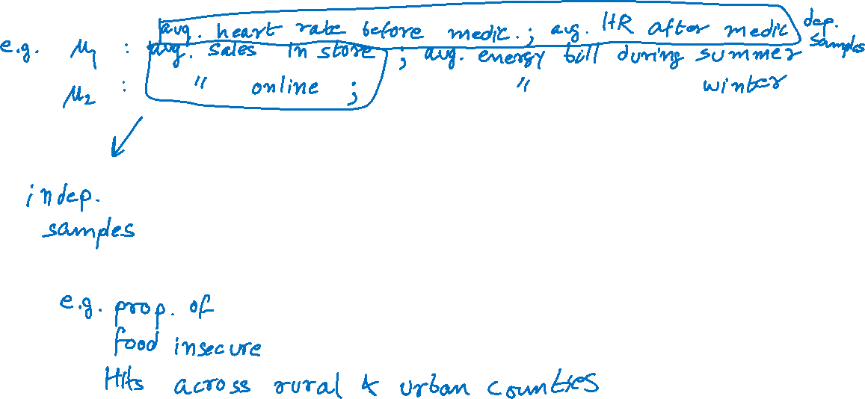
Inferences About Two Samples

Slide 3
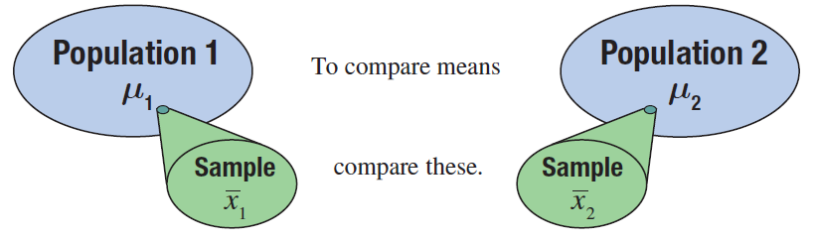
Inferences about the Means of Two Independent Populations, σ₁ and σ₂ Known

Slide 4
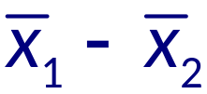
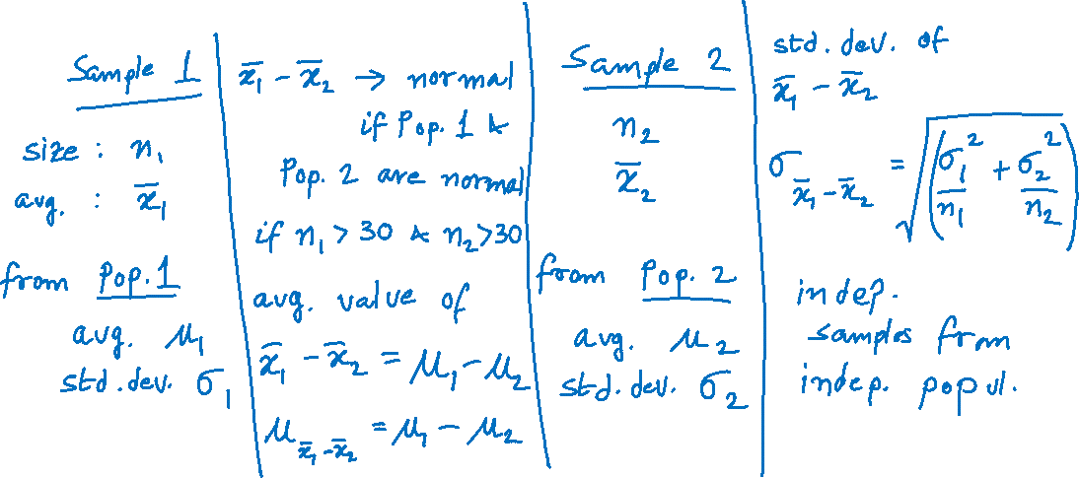
Properties of the Sampling Distribution of

Slide 5
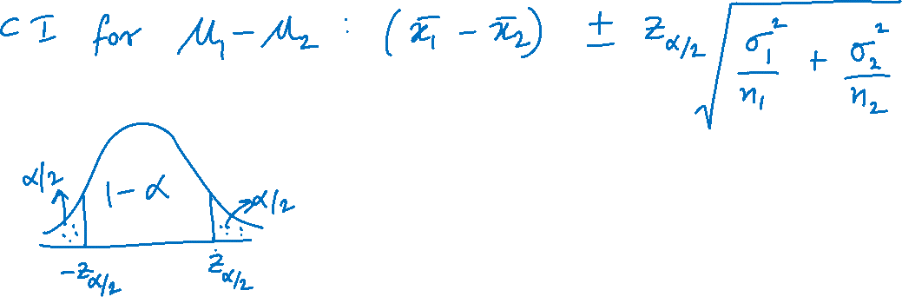
100(1 − α)% Confidence Interval for μ₁ − μ₂

Slide 6
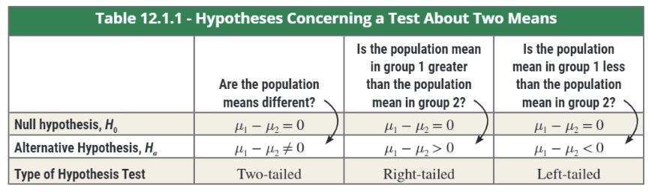
Hypothesis Testing

Slide 7
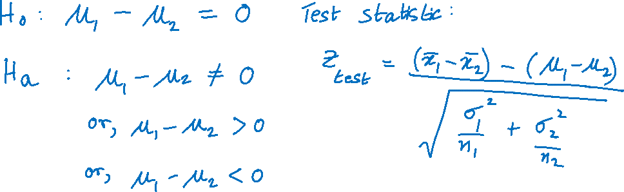
Testing a Hypothesis about Two Independent Population Means, σ₁ and σ₂ Known

Slide 8

Example
A telecommunications analyst is interested in knowing if there is a significant difference in the average service outage times between cable television subscribers and satellite television subscribers. She randomly selects 50 cable subscribers and 50 satellite subscribers for the study.
She gives each subscriber a survey and asks them to record the length of time of each service outage for a month. She summarizes the results of the survey and calculates the mean outage for each television service. The results of the study are shown in the following table.

Slide 9

Example (cont.)
Service Outage Time (in minutes)
 | n |  | σ
Cable | 50 | 8.8 | 3
Satellite | 50 | 9.5 | 2
Calculate a 95% confidence interval for the mean difference in average service outage time between cable and satellite subscribers.
Is there persuasive evidence for the analyst to conclude at α = 0.05 that there is a difference in mean service outage time between cable and satellite subscribers?

Slide 10
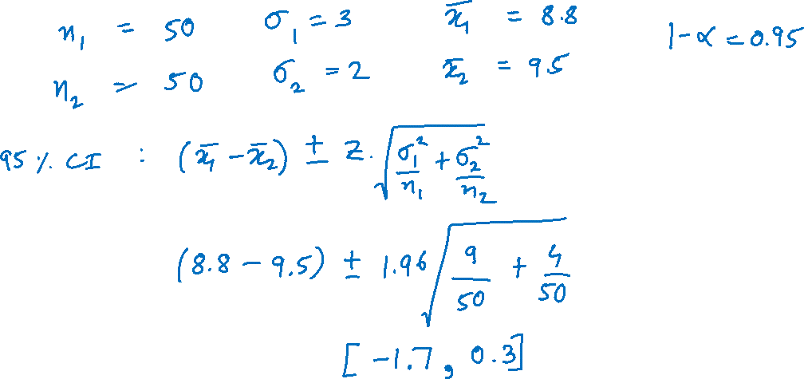
Example (cont.)

Slide 11
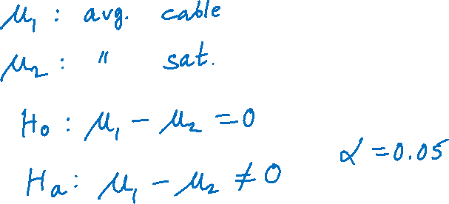
Example (cont.)

Slide 12
Example (cont.)

