Slide 1
Section 11.5
Testing a Hypothesis about a Population Proportion

Slide 2
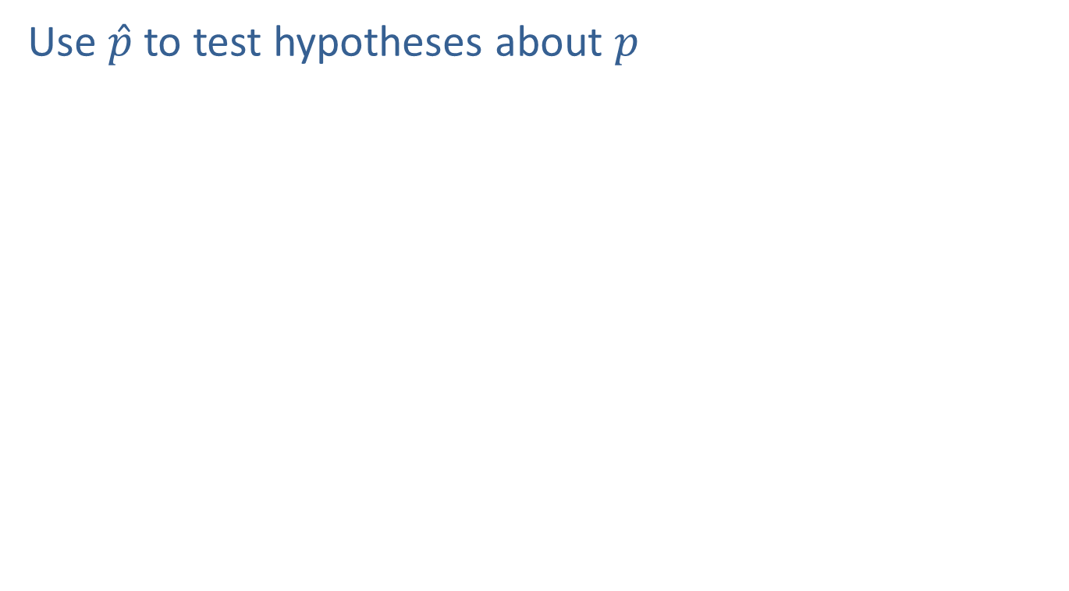
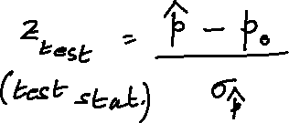
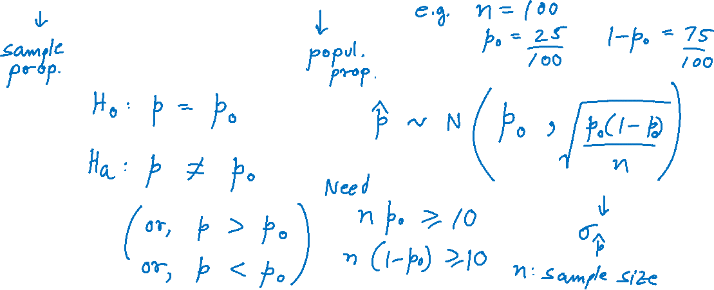
Testing a Hypothesis about a Population Proportion
Use $\hat{p}$ to test hypotheses about $p$

Slide 3
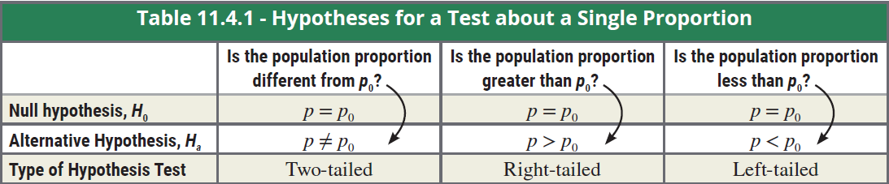
Hypotheses for a Test about a Single Proportion

Slide 4
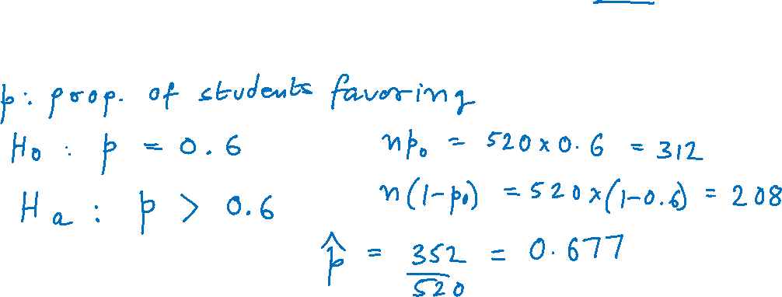
Example
A college is trying a new student registration system and wants to know if there is sufficient evidence to conclude that more than 60% of the students favor it. In a random sample of 520 students, 352 said that the new registration system is superior. Say α = 0.05.

Slide 5
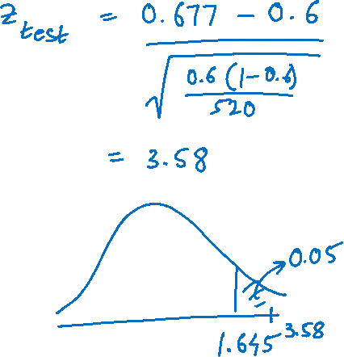

Example (cont.)

Slide 6
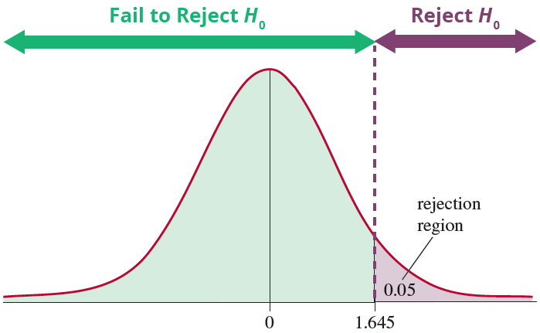
Example (cont.)

Slide 7
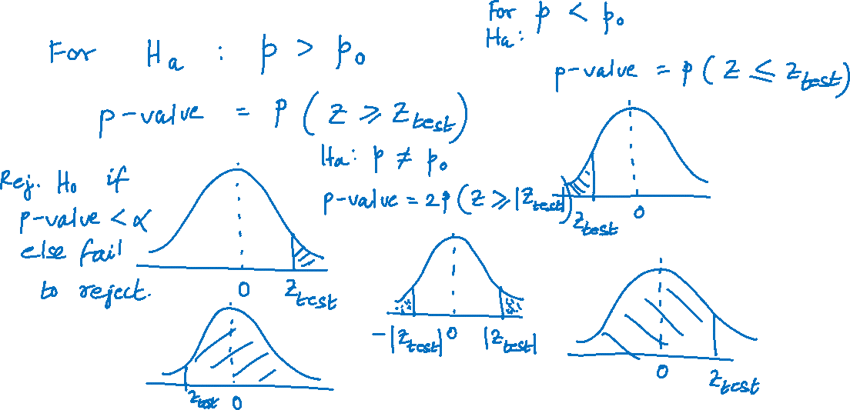
Calculating P-Values for a Hypothesis Test for a Proportion

Slide 8
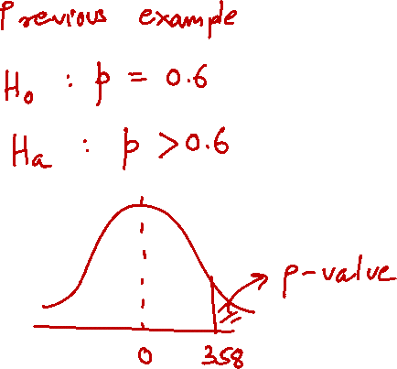
Example (cont.)

Slide 9
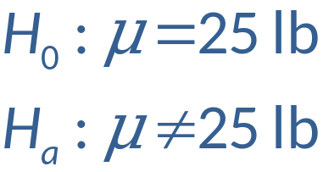
Practical vs. Statistical Significance: Example
Suppose a dog food manufacturer wants to know if the proper amount of dog food is being placed in the 25 pound bags. Hypotheses:
A sample of 2000 bags was selected with the following results:

Slide 10
Example (cont.)

