Slide 1
Section 11.4
The Relationship Between Confidence Interval Estimation and Hypothesis Testing

Slide 2
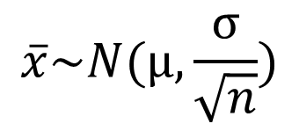
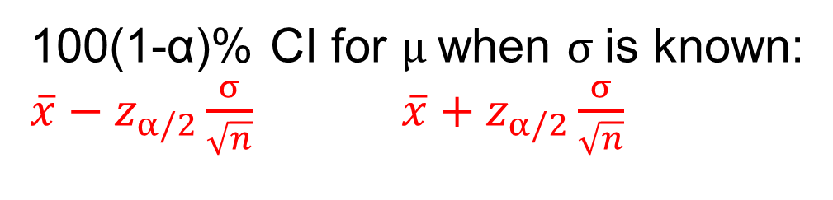


$$\overline{x}\sim N(μ, \frac{σ}{\sqrt{n}})$$
1-α
α/2
α/2
$$\overline{x_{1}}$$
$$\overline{x_{2}}$$
100(1-α)% CI for $μ$when $σ$is known:
$\overline{x}−z_{α/2}\frac{σ}{\sqrt{n}}$ $\overline{x}+z_{α/2}\frac{σ}{\sqrt{n}}$

Slide 3

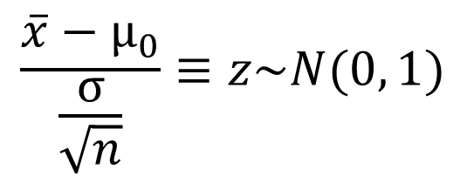




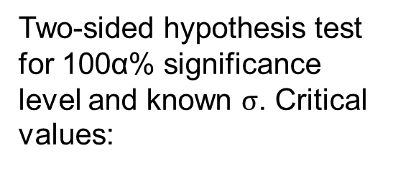
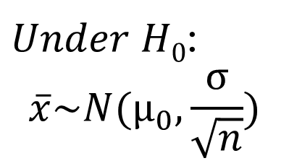
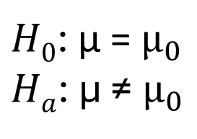
$Under H0$:
$$\overline{x}\sim N(μ_{0}, \frac{σ}{\sqrt{n}})$$
$H0$: μ = $μ_{0}$
$Ha$: μ ≠ $μ_{0}$
α/2
α/2
$$\overline{x_{low}}$$
$${\text{μ}}_{0}$$
$$\overline{x_{high}}$$
Two-sided hypothesis test for 100α% significance level and known $σ$. Critical values:
$$\frac{\overline{x}−μ_{0}}{\frac{σ}{\sqrt{n}}}≡z\sim N(0, 1)$$
α/2
α/2
$$z_{low}$$
0
$$z_{high}$$

Slide 4
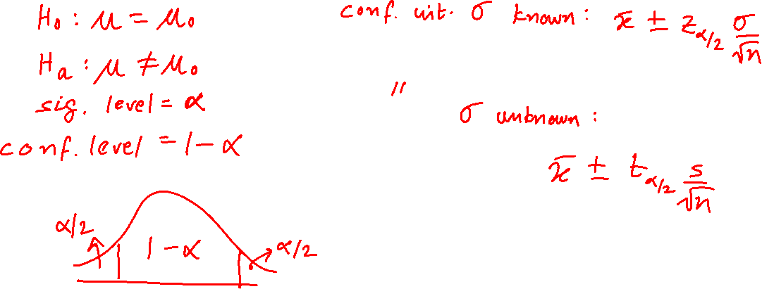
Using a Confidence Interval to Test a Two-Sided Hypothesis

Slide 5
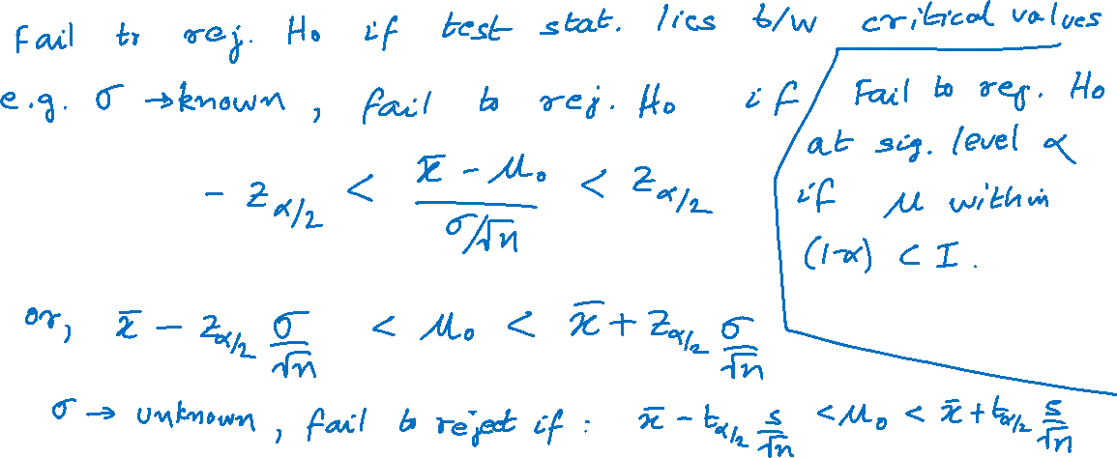
Using a Confidence Interval to Test a Two-Sided Hypothesis (cont.)

Slide 6
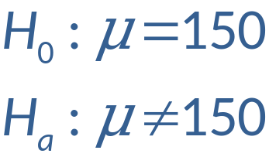
Example
Suppose the average national reading level for high school sophomores is 150 words per minute with σ=15.
Want to know if sophomore students at Lincoln High School read at a different level. The level of the test is 0.05. A random sample size of 100 students yields an average of 154 words per minute.

Slide 7
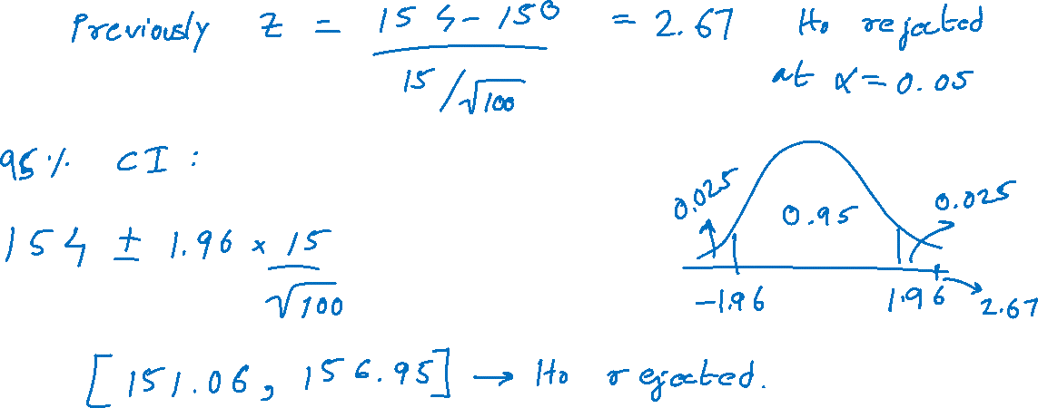
Example (cont.)

