Slide 1
Section 11.3
Testing a Hypothesis about a Population Mean with σ Unknown

Slide 2
Testing a Hypothesis About a Mean, σ Unknown

Slide 3
Example
A personnel researcher has designed a questionnaire she believes will take an average time of 35 minutes to complete. Suppose she randomly samples 20 employees and finds that the mean time to take the test is 29 minutes with a standard deviation of s = 8 minutes. Determine if there is sufficient evidence to conclude that the completion time of the newly designed test differs from its intended duration. Conduct the test at the 0.05 level. Assume the sample comes from a normally distributed population.

Slide 4
Example (cont.)

Slide 5
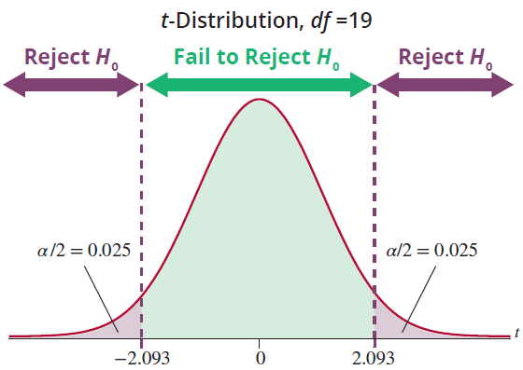
Example (cont.)

Slide 6
Example
The Alexander Bolt Company produces half-inch A-class stainless steel bolts that have a mean tensile strength of more than 4000 pounds per square inch (psi), the specified quality standard. The company wants to be sure that its A-class product is above the quality standard. A sample of 25 bolts is to be randomly selected from stock and tested for tensile strength.

Slide 7
Example (cont.)
Design a test of hypothesis to determine if there is overwhelming evidence that the bolts are better than the specified quality standard.
Sample values:
4023 3993 4009 4006 4039 3984 4003 4007
4007 4055 4004 4049 4000 3995 4019 4003 4029
4009 4041 4021 4012 3984 4040 4025 3986

Slide 8
Example (cont.)

Slide 9
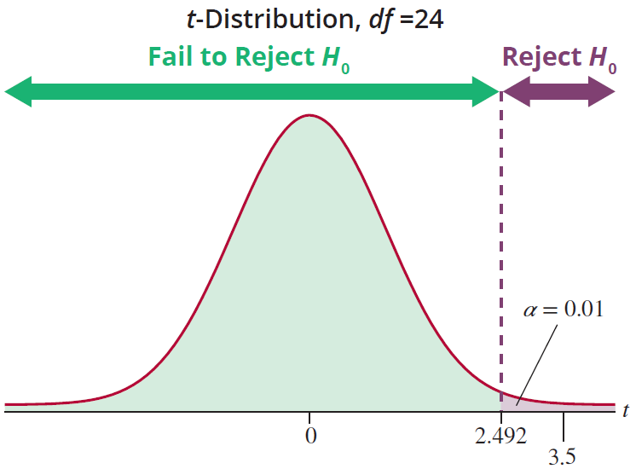
Example (cont.)

Slide 10
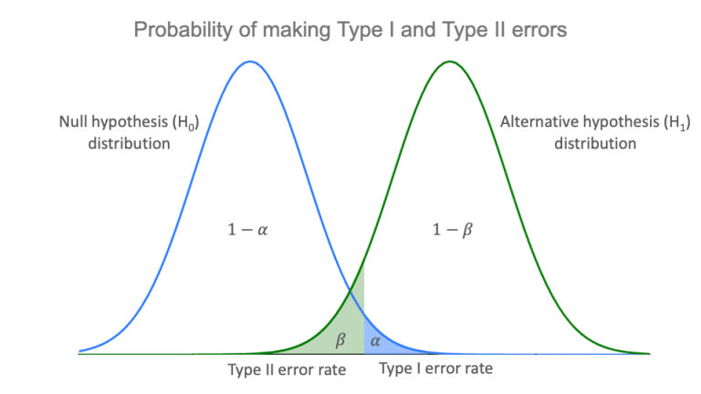
Why Not Make Both α and β as Small as Possible?
https://www.scribbr.com/statistics/type-i-and-type-ii-errors/

