Slide 1
Section 10.4
Estimating the Population Proportion

Slide 2
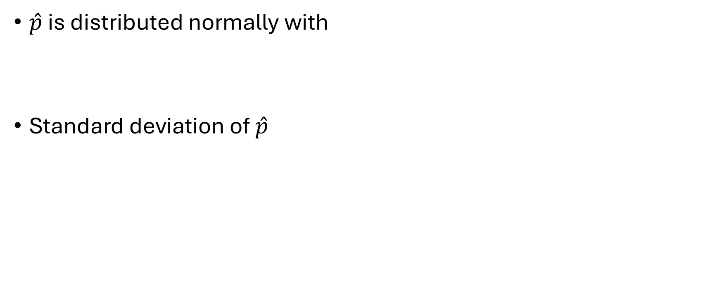
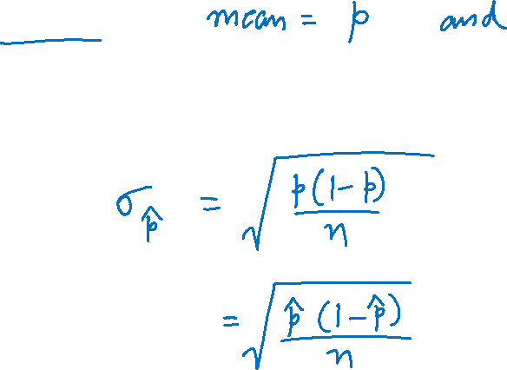
Interval Estimation of a Population Attribute
$\hat{p}$ is distributed normally with
Standard deviation of $\hat{p}$

Slide 3
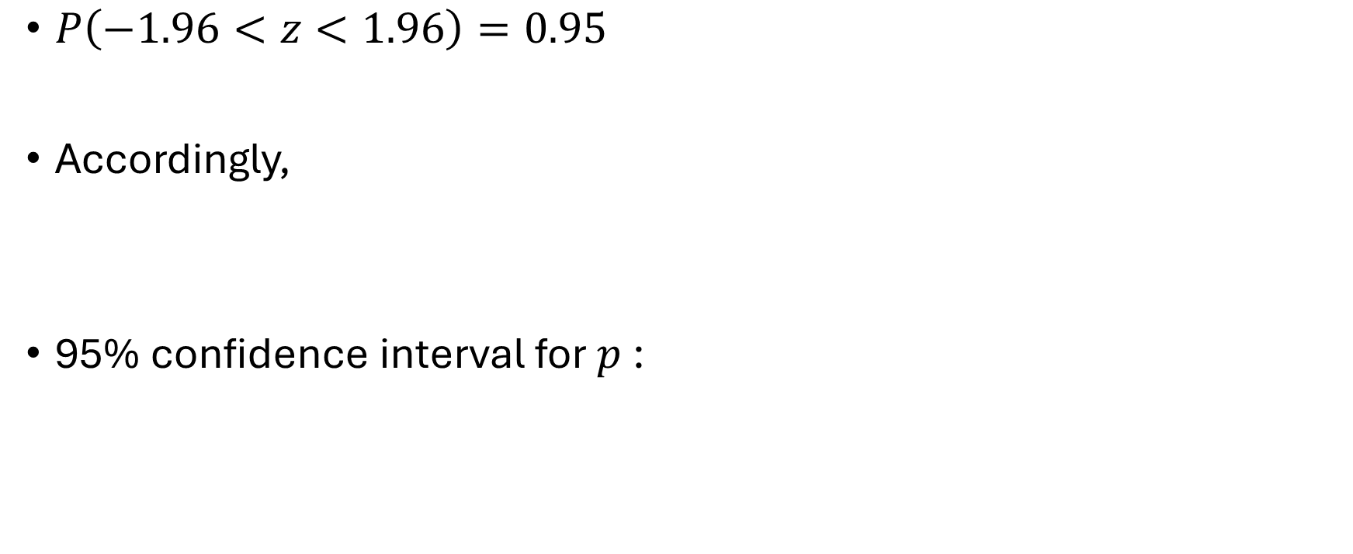
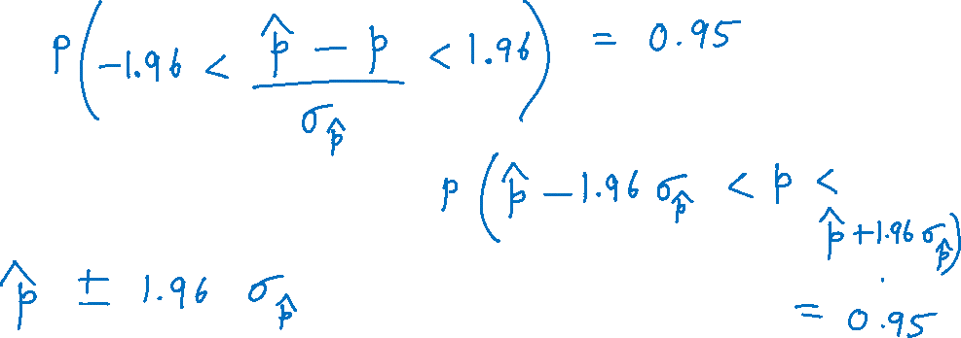
Interval Estimation of a Population Attribute (cont.)
$P\left(−1.96<z<1.96\right)=0.95$
Accordingly,
95% confidence interval for $p$:

Slide 4
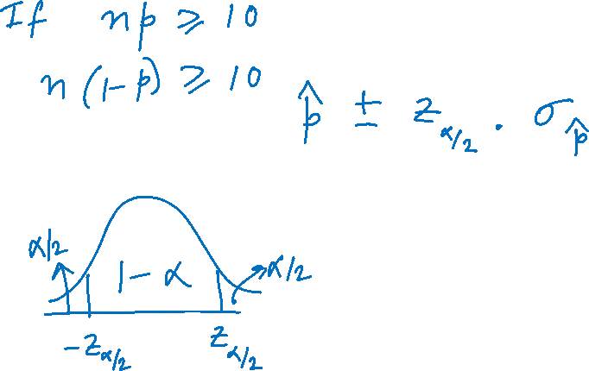
100(1 − α)% Confidence Interval for the Population Proportion

Slide 5
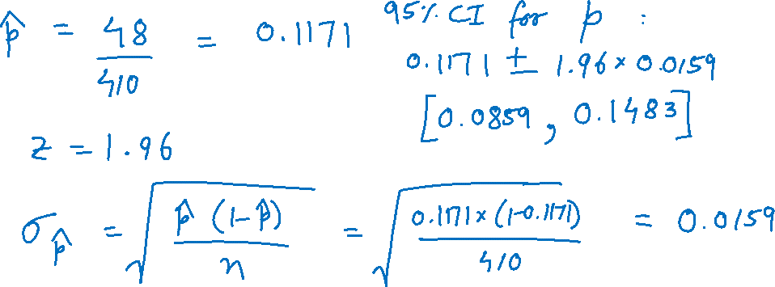
Example
Suppose a sample of 410 randomly selected radio listeners revealed that 48 listened to WFDD. Find a 95% confidence interval for the proportion of radio listeners that listen to WFDD.

Slide 6
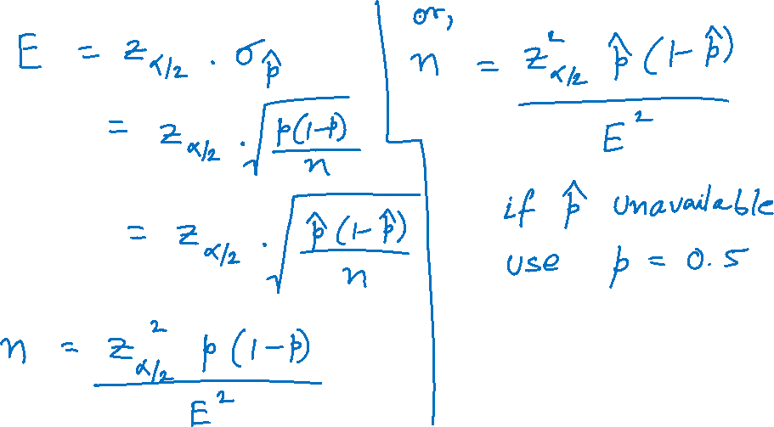
Sample Size Determination for Estimating a Population Proportion

Slide 7
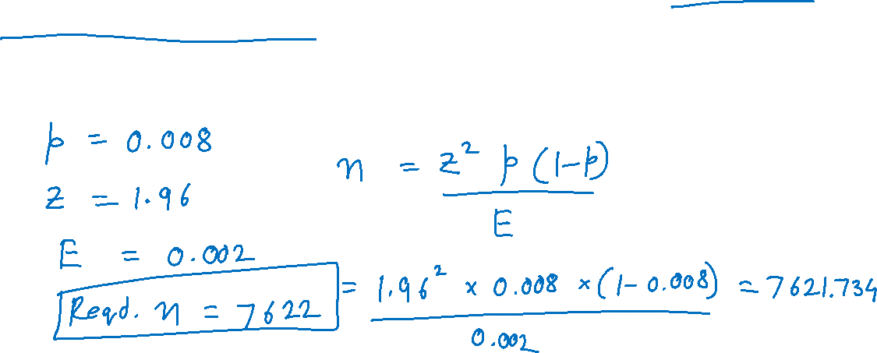

Example
How large a sample would be required to estimate the proportion of buyers on a mailing list with an accuracy of 0.002 and a 95% degree of confidence, if the true proportion is approximately 0.008?

