Slide 1
Section 9.4
The Distribution of the Sample Proportion

Slide 2
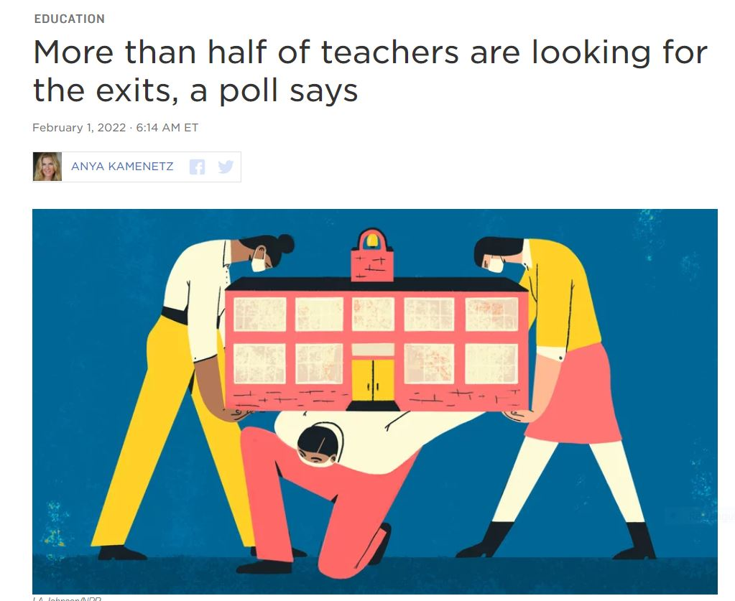
Sample Proportion
https://www.npr.org/2022/02/01/1076943883/teachers-quitting-burnout

Slide 3
Sample Proportion (cont.)
Population proportion:
Sample proportion:

Slide 4
Expected Value and Standard Deviation of the Sample Proportion
Unbiasedness
Standard deviation of $\hat{p}$

Slide 5
Expected Value and Standard Deviation of the Sample Proportion (cont.)
$σ_{\hat{p}}$ maximized at
If p is unknown, $σ_{\hat{p}}$ is approximated by

Slide 6
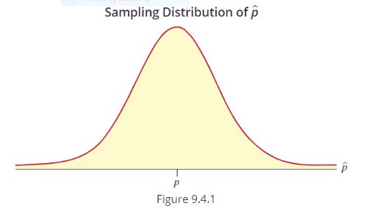
Sampling Distribution of the Sample Proportion
Sampling distribution of $\hat{p}$ approaches normality as $n$ becomes sufficiently large and
http://digitalfirst.bfwpub.com/stats_applet/generic_stats_applet_24_sampdistprop.html

Slide 7
Example 9.4.1
Suppose a sample of 400 persons is used to perform a taste test. If the true fraction in the population that prefers Pepsi is really 0.5, what is the probability that less than 0.44 of the persons in the sample will prefer Pepsi?
Solution

