Slide 1
Section 10.2
Interval Estimation of the Population Mean

Slide 2

Interval Estimator and Confidence Interval
Interval estimator
Example: $\overline{x}−E, \overline{x}+E$
https://www.npr.org/sections/health-shots/2018/05/29/615120123/study-puts-puerto-rico-death-toll-at-5-000-from-hurricane-maria-in-2017

Slide 3


Interval Estimator and Confidence Interval (cont.)
Central Limit Theorem:
$$\overline{x}\sim N\left(μ, σ_{\overline{x}}\right), i.e., \overline{x}\sim N(μ, \frac{σ}{\sqrt{n}})$$
Sampling Distribution
of $\overline{x}$
$$\overline{x}$$
μ

Slide 4


Interval Estimator and Confidence Interval (cont.)
For $N\left(0, 1\right)$
$$P\left(−1.96<z<1.96\right)=$$
0.95
$$z$$
0.025
0.025
-1.96
0
1.96

Slide 5




Interval Estimator and Confidence Interval (cont.)
From $P\left(−1.96<\frac{\overline{x}−μ}{σ_{\overline{x}}}<1.96\right)=$
Sampling Distribution
of $\overline{x}$
0.95
$$\overline{x}$$
0.025
0.025
μ
$$μ+1.96σ_{\overline{x}}$$
$$μ−1.96σ_{\overline{x}}$$

Slide 6

Interval Estimator and Confidence Interval (cont.)
Since $P\left(μ−1.96σ_{\overline{x}}<\overline{x}<μ+1.96σ_{\overline{x}}\right)=$
Also have $P\left(\overline{x}−1.96σ_{\overline{x}}<μ<\overline{x}+1.96σ_{\overline{x}}\right)=$

Slide 7


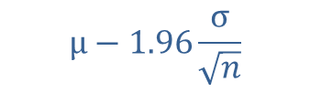



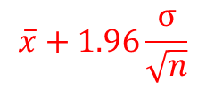
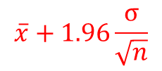
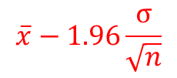
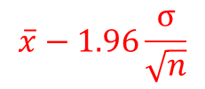
$$\overline{x}−1.96\frac{σ}{\sqrt{n}}$$
$$μ+1.96\frac{σ}{\sqrt{n}}$$
$$\overline{x}+1.96\frac{σ}{\sqrt{n}}$$
$$μ−1.96\frac{σ}{\sqrt{n}}$$
$$\overline{x}$$
μ
$$μ−1.96\frac{σ}{\sqrt{n}}$$
$$μ+1.96\frac{σ}{\sqrt{n}}$$
$$\overline{x}−1.96\frac{σ}{\sqrt{n}}$$
$$\overline{x}$$
$$\overline{x}+1.96\frac{σ}{\sqrt{n}}$$
μ

Slide 8

Interval Estimator and Confidence Interval (cont.)
$P\left(\overline{x}−1.96σ_{\overline{x}}<μ<\overline{x}+1.96σ_{\overline{x}}\right)=$
$P\left(\overline{x}−1.96\frac{σ}{\sqrt{n}}<μ<\overline{x}+1.96\frac{σ}{\sqrt{n}}\right)=$

Slide 9
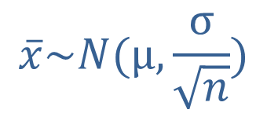
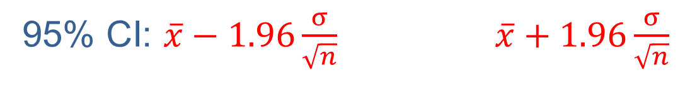


$$\overline{x}\sim N(μ, \frac{σ}{\sqrt{n}})$$
0.95
0.025
0.025
$$\overline{x_{1}}$$
$$\overline{x_{2}}$$
95% CI: $\overline{x}−1.96\frac{σ}{\sqrt{n}}$ $\overline{x}+1.96\frac{σ}{\sqrt{n}}$

Slide 10

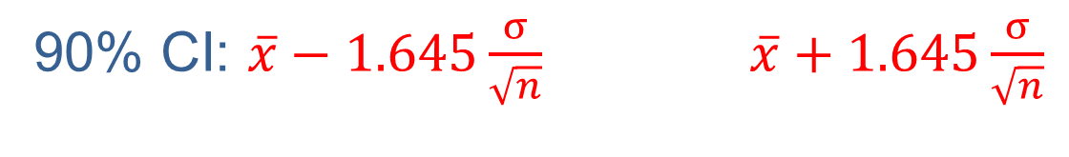


$$\overline{x}\sim N(μ, \frac{σ}{\sqrt{n}})$$
0.90
0.05
0.05
$$\overline{x_{1}}$$
$$\overline{x_{2}}$$
90% CI: $\overline{x}−1.645\frac{σ}{\sqrt{n}}$ $\overline{x}+1.645\frac{σ}{\sqrt{n}}$

Slide 11
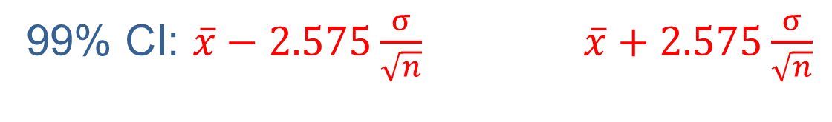
$$\overline{x}\sim N(μ, \frac{σ}{\sqrt{n}})$$
0.99
0.005
0.005
$$\overline{x_{1}}$$
$$\overline{x_{2}}$$
99% CI: $\overline{x}−2.575\frac{σ}{\sqrt{n}}$ $\overline{x}+2.575\frac{σ}{\sqrt{n}}$

Slide 12
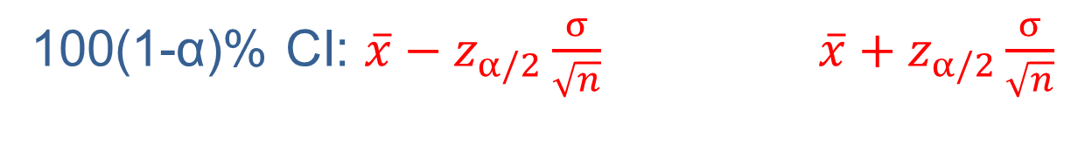
$$\overline{x}\sim N(μ, \frac{σ}{\sqrt{n}})$$
1-α
α/2
α/2
$$\overline{x_{1}}$$
$$\overline{x_{2}}$$
100(1-α)% CI: $\overline{x}−z_{α/2}\frac{σ}{\sqrt{n}}$ $\overline{x}+z_{α/2}\frac{σ}{\sqrt{n}}$

Slide 13
100(1 − α)% Confidence Interval for the Population Mean, σ Known

Slide 14
Example 10.2.1
A random sample of 100 car engines has a mean weight of 425 pounds. Construct the 80% confidence interval for the population mean if the standard deviation of the population is 900.
Solution

Slide 15

Maximum Error and Margin of Error, E
$$z_{α/2}\frac{σ}{\sqrt{n}}$$

Slide 16
Interval Estimation of the Population Mean for a Normal Population with σ Unknown

Slide 17



Student’s t-Distribution
t-distribution: like normal distribution with slightly thicker tails.
Approaches the normal distribution as …
$$z$$
$$t (df=12)$$
$$t (df=6)$$
0

Slide 18


$$z$$
0.025
0.025
-1.96
0
1.96
$$t (df=6)$$
0.025
0.025
-2.45
0
2.45
https://www.guinness-storehouse.com/content/pdf/archive-factsheets/general-history/wsgosset-and-students-t-test.pdf

Slide 19
100(1 − α)% Confidence Interval for the Population Mean, σ Unknown

Slide 20
Example 10.2.3
A random sample of hours worked in a week by student interns is drawn from a normal population with unknown mean and variance. The seven data values sampled are as follows.
25, 19, 37, 29, 40, 28, 31
Construct a 95% confidence interval for the population mean.
Solution

Slide 21
Example 10.2.4
A manufacturing company is interested in the amount of time it takes to complete a certain stage of the production process. The project manager randomly samples 10 products as they come from the production line and notes the time of completion. The average completion time is 23.45 minutes with a sample standard deviation of 4.32 minutes. Based on this sample, construct a 95% confidence interval for the average completion time for that stage in the production process.

Slide 22
Example 10.2.4 (cont.)
Assume that the population distribution of the completion times is approximately normal.
Solution

Slide 23
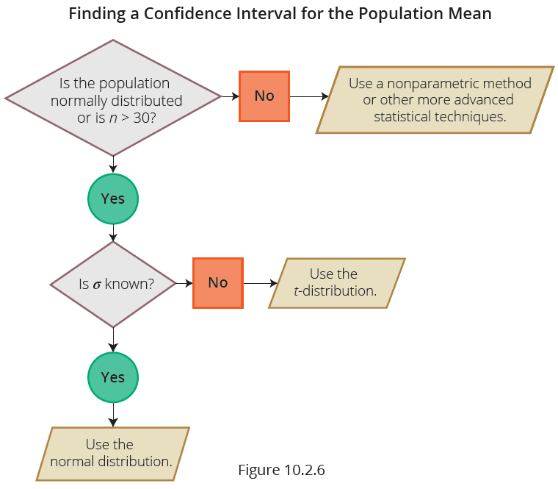
Interval Estimation of the Population Mean: A Summary

Slide 24
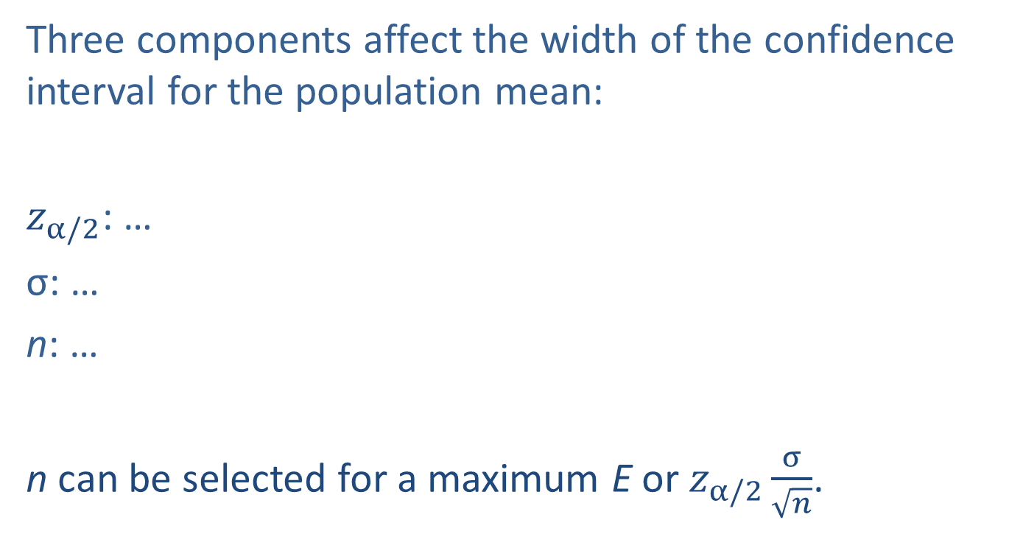
Sample Size Determination for Estimating a Population Mean for σ Known
Three components affect the width of the confidence interval for the population mean:
$z_{α/2}$: …
σ: …
n: …
n can be selected for a maximum E or $z_{α/2}\frac{σ}{\sqrt{n}}$.

Slide 25
Sample Size Determination for Estimating a Population Mean for σ Known (cont.)

Slide 26
Example 10.2.6
Suppose that a quality control manager at Argon Chemical Company wishes to measure the average amount of cleaning fluid the company is placing in their 12 ounce bottles. From previous studies, they believe their population standard deviation to be 0.3 ounces. How large a sample must be taken in order to be 95% confident of estimating the mean cleaning fluid in a 12 ounce bottle to within 0.05 ounces?
Solution

Slide 27
Sample Size Determination for Estimating a Population Mean for σ Unknown

Slide 28
Example 10.2.7
An airline’s maintenance manager desires to estimate the average time (in hours) required to replace a jet engine in a Boeing 767. How large a sample would be necessary if the manager wishes to be 95% confident of estimating the mean to within one-quarter of an hour (E = 0.25). Assume a preliminary sample of size n = 31 has an average replacement time of 16.7 hours with a standard deviation of 4.3 hours.
Solution

