Slide 1
The Bourbon Reforms
Americanos and Independence
Today’s class:
A. Sources
B. Europe in the 18th Century
C. Bourbon Reforms
D. Social reasons for Independence
E. Upset the Fruitbasket
F. Process of Independence
G. Distinct Periods of Violence
H. Leaders
I. Results
J. Conclusions

Slide 2
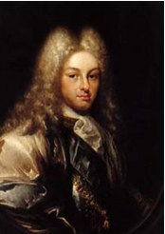
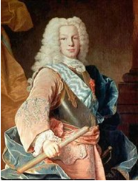
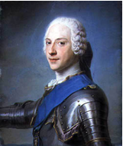
A. Political Situation in Europe by the 18th Century
1702-1713 War of Spanish Succession
Bourbon Monarchs:
Phillip V (1700-1746)
Son Ferdinand VI (1746-59)
Son Charles III (1759-88)

Slide 3
Small Group Analysis
The last two Bourbon monarchs embarked upon an energetic and forceful program of reforms for their colonies in the Americas.
Small Group Challenge: Given what you have learned about Col. Latin America so far,
Why might the new Bourbon rulers have wanted to reform Spanish system?
What does Chasteen write about these reasons? Pps. 84-85
How could the Bourbon monarchs have accomplished those goals?

Slide 4
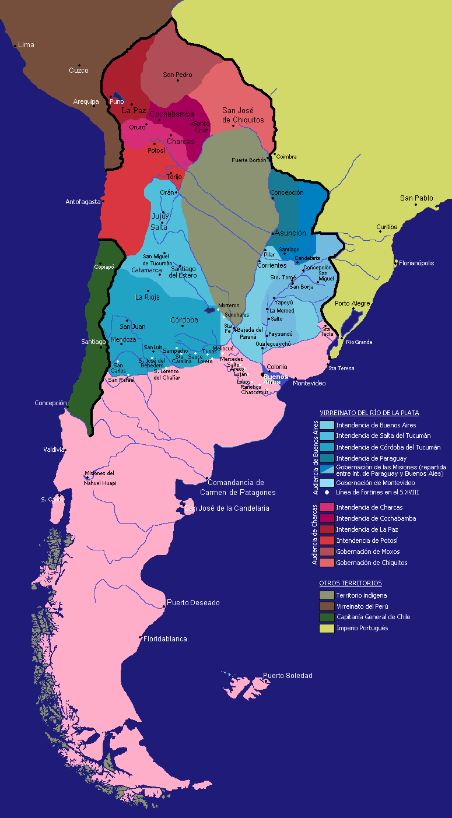
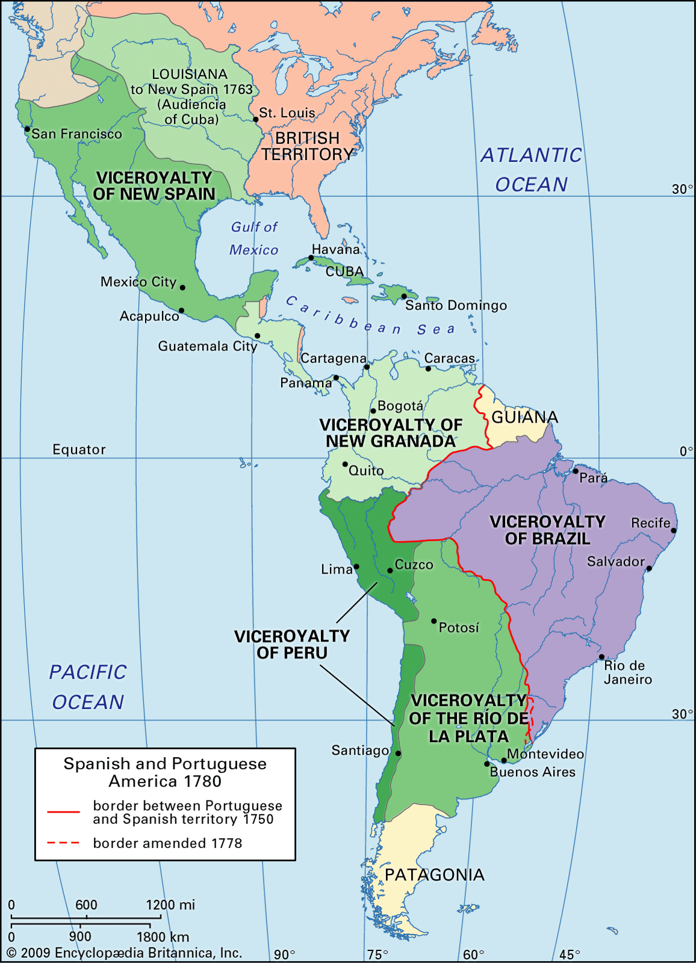
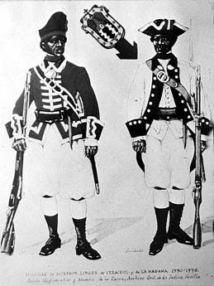
B. Bourbon Reforms: Political
1. Political: Efficiency and Greater Control
a. Two new Viceroyalties: New Granada 1717, La Plata 1776
b. System of Intendencies to improve local rule, make system more efficient
Colonial Militia in 1760s
Militia in Veracruz & Havana

Slide 5
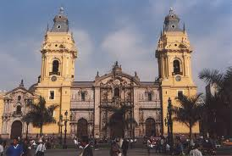
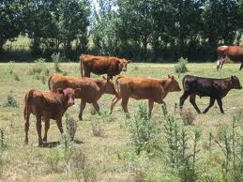
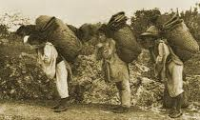
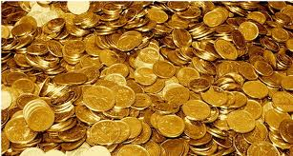
2. Economic Reforms: To Raise money
Encouraged trade between colonies
a. Increased taxes on commerce
b. 1800 Royal decree prohibited manufactures in the colonies (Why?)
c. Who was the banking institution in Colonial Latin America?
Consolidation decree of 1804

Slide 6
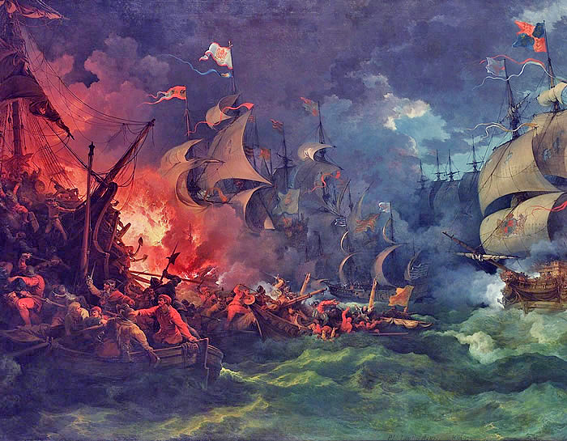
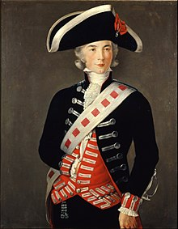
World Historical EVents
World events again heightened the crisis
Anglo-Spanish War of 1796-1802, 1804-1808, Catastrophic for Spain
Part of the French Revolutionary Wars and the Napoleonic Wars
Spanish Prime Minister Godoy faced a decision: continue to fight Revolutionary France or to join the French side and hope for better times.
Treaty of San Ildefonso in 1796, Spain joined France
Think Pair to discuss:
Long-term results of Spanish alliance with France?
How might this war have affected Colonies?
If you were an elite mestizo, how might you have responded Bourbon Reforms?
Effects: B. Reforms alienated local elite who controlled mining, properties, ranching
-Weakened church, curtailed privileges of elite Americanos and military

Slide 7
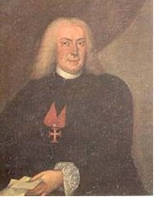
Portuguese Pombaline Reforms
Marquis of Pombal (1706-1750), analogous reforms in Portugal
Make Portugal an economically self-sufficient and commercially strong nation
Expanded Brazilian territory, streamlined the administration of Brazil
Fiscal and economic reforms in the colony and in Portugal.

Slide 8
C. Social Reasons for Independence
1. European Enlightenment ideas to LA
2. Conflict between Creoles and Peninsulares
3. Racial considerations
4. Peasant Uprisings and Social Unrest

Slide 9
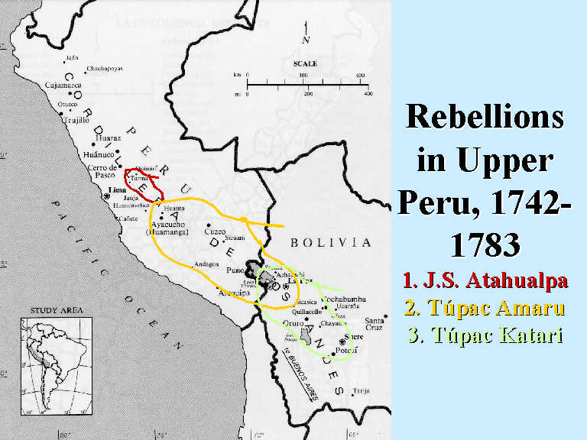
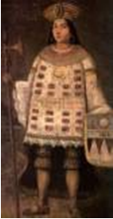
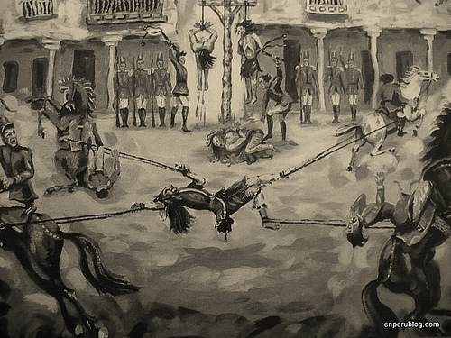
1. Peru 1730-1780 128 rebellions
1780 José Gabriel Condorcanqui (Tupac Amaru II)

Slide 10
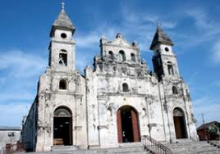
2. New Granada (1781)
Revolt of Comuneros
Intolerable economic conditions, creoles and mestizos

Slide 11
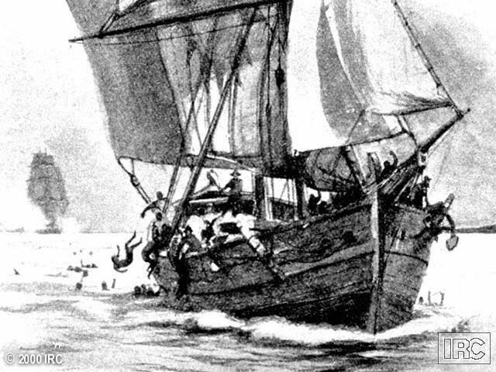
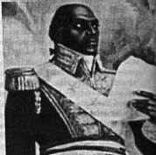
3. Santo Domingo (1791)
Massive slave revolt, proclaimed Haiti, first republic in Americas
Toussaint L’Overture

Slide 12
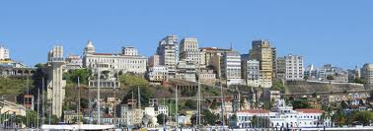
4. Bahia (1798)
Pop. Classes, spoke
of free trade, against excessive taxation, restrictions

Slide 13
D. Upset the Fruit Basket
1. Number off by 6, divide into groups:
1. Espanioles (Spanish-Peninsulars) (dark blue)
2. Americanos (Europeans born in the Americas) (pink)
3. African descended people currently slaves (light green)
4. Indigenous people (light blue)
5. Mestizos (orange)
6. Mulatos (white)
2. How did the Bourbon Reforms affect your group?

Slide 14
Upset the Fruit basket
Form a new basket with one representative of each of the six groups.
Answer the question as a group, each contribute from original position
3. Come to a consensus!
1. How did the Bourbon Reforms affect Latin American society?
2. When Napoleon took King Carlos IV prisoner in 1807, what to do?
3. What did the prospect of independence mean for Latin America?

Slide 15
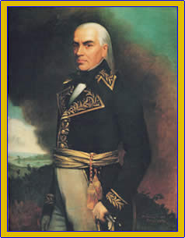
D. Independence
The Process of Independence
Crisis and Outbreak of Violence
Free Trade and Elite Revolutions from above:
-Caracas, April 19, 1810
-Buenos Aires, May 25, 1810
Francisco de Miranda, Venezuela

Slide 16
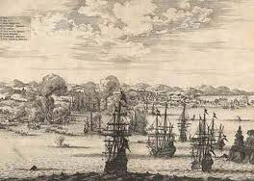
D. Three Distinct Periods of Violence
1. 1810-1814: Outbreak and expansion of movement
2. 1814-1816: Royalist scramble to overcome Americano armies
3. 1817-1826: completion of independence in most countries.
Last battle in 1826 Callao, Peru

Slide 17
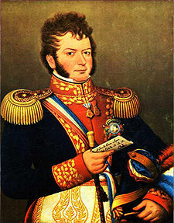
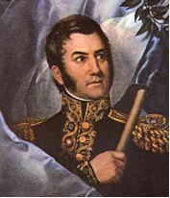
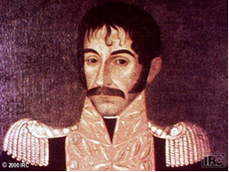
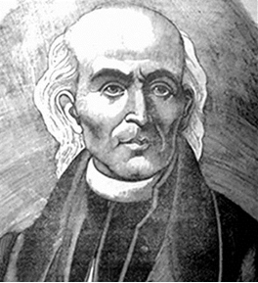
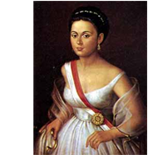
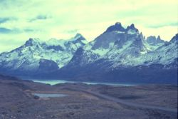
F. Revolutionary Leaders
1. Toussaint L’Overture Haiti, 1791-1804
2. Father Miguel Hidalgo, “The Cry of Dolores,” Mexico Se 16, 1810
3. Simón Bolivar, Venezuela, Manuela Saenz
4. Jose’ de San Martin, La Plata & Bernard O’Higgins Chile

Slide 18
G. Results of the Wars for Independence
-Wars destroyed many economic structures, mines, ranches
-Brought to the fore differences between leaders, classes, institutions, regions
TP: Compare to a relationship
-1810-1825 all Spanish territories on American mainland achieved independence
-In Caribbean, Cuba and PR remained under Sp til 1898
Haiti occupied Hispaniola 1822-1844. Jamaica and Trin to Br. 1655, 1797
-Enlightenment, potency of human reason, change normal state of being
-Most concrete issue was free trade
-Crisis of 1808, culmination of two decades of depression and war for Spain

Slide 19
Conclusions
Bolivar, Independence, The Rise of the Caudillos
What is a Caudillo?
(pronounced ko̵u t̸hē′ lyō̂, or say cow-dee-jo)
the Caribbean Arawak term kassequa, adopted into Spanish as cacique, or chief, so it was originally an Indigenous term. By the nineteenth century, a caudillo was someone who ruled over a number of caciques. These strongmen became presidents of nations, or else their principal opponents, but either way they were usually large landowners with enough resources to staff their own army and to keep a large number of supporters.
Here is what we focused on today:
What is your main takeaway?

