Slide 1
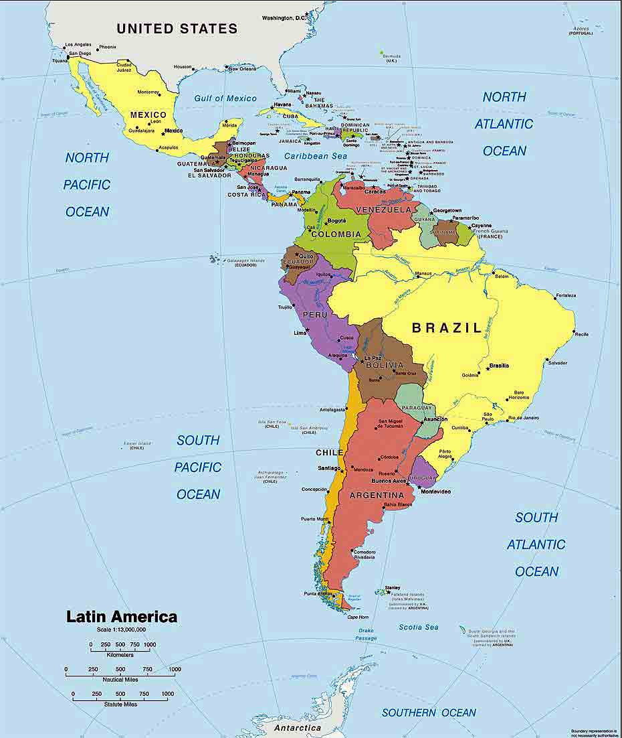
Latin America: The View from Below
HIS 2302 Modern Latin America
Introduction to Latin America and our class

Slide 2
A. Latin America
When you hear “Latin America” what comes to mind first?
So names matter
What are your names? Introduce each other…
René Harder Horst

Slide 3
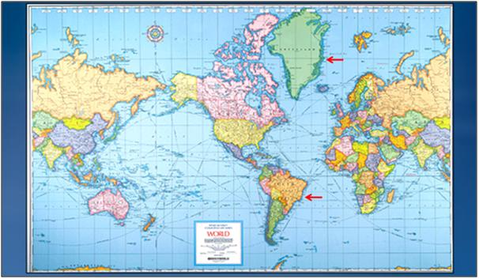
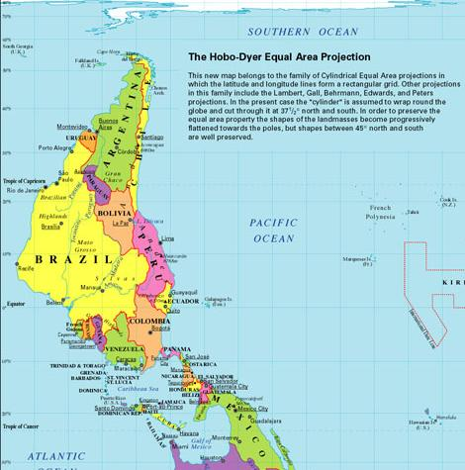
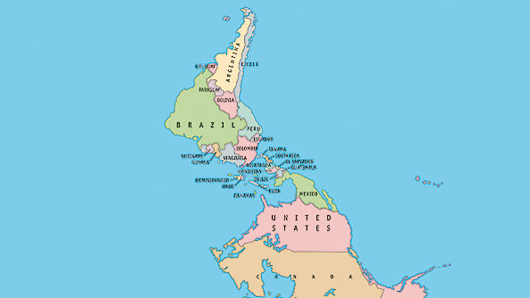
Some Geography:
Size Matters

Slide 4
Peters Projection
US 48 Continental States = 8,080,464 km2
Brazil 26 States = 8, 516,000 km2

Slide 5
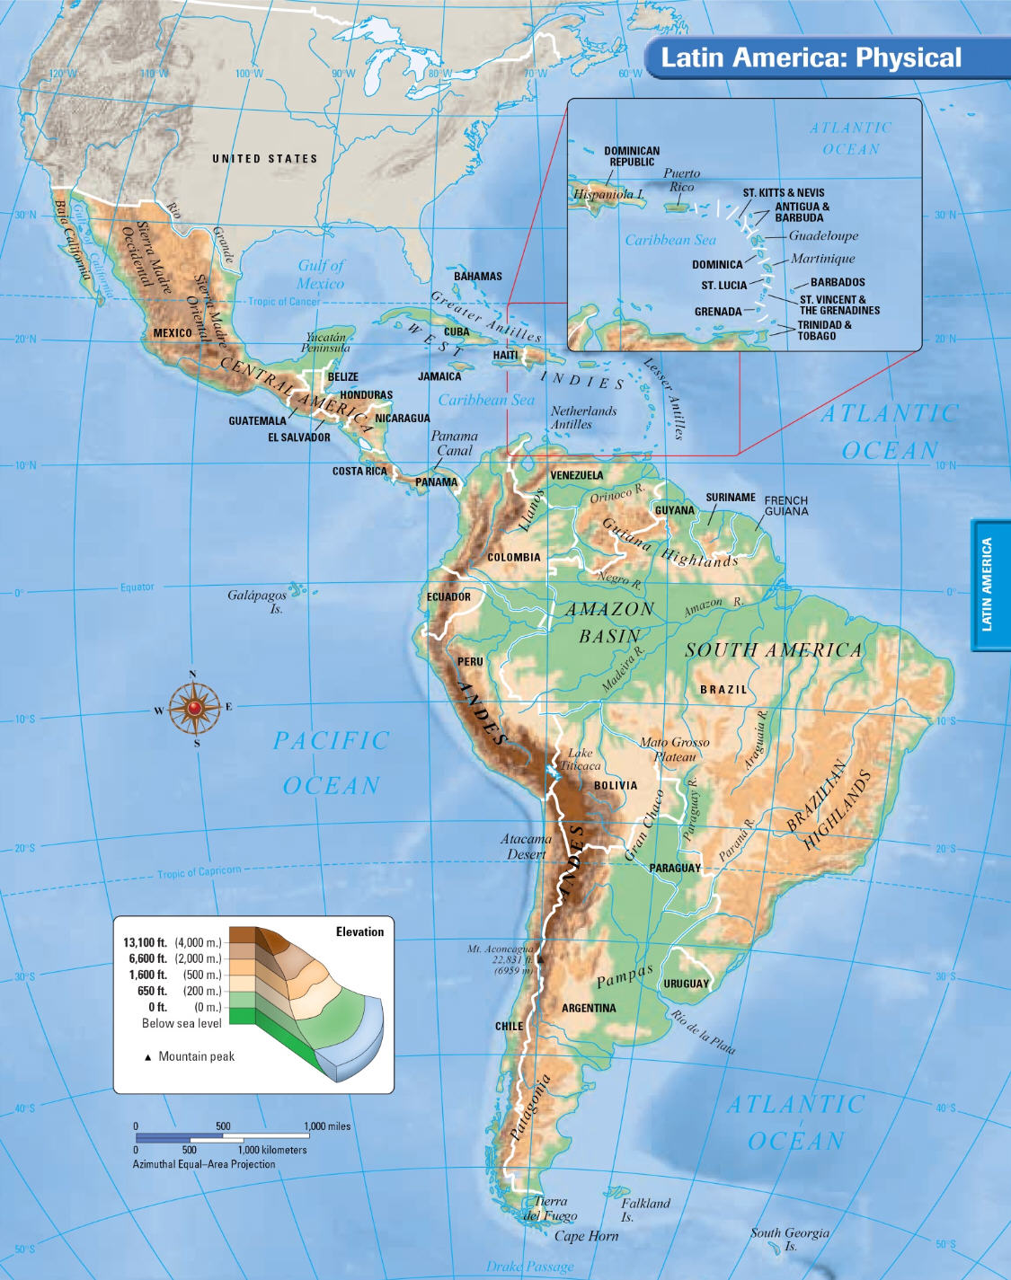
Latin America

Slide 6
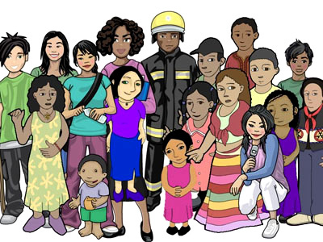
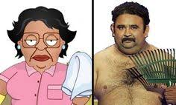
B. U.S. Stereotypes of Latin Americans
SG: what stereotypes of Latinx people have you heard?
What stereotypes do you share? Analyze them as we go…

Slide 7
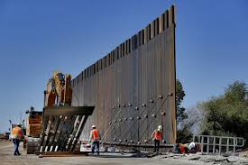
What does your president think?
https://www.bbc.com/news/av/world-us-canada-37230916/drug-dealers-criminals-rapists-what-trump-thinks-of-mexicans

Slide 16
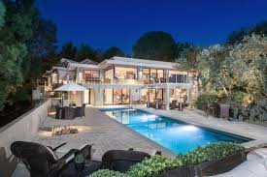
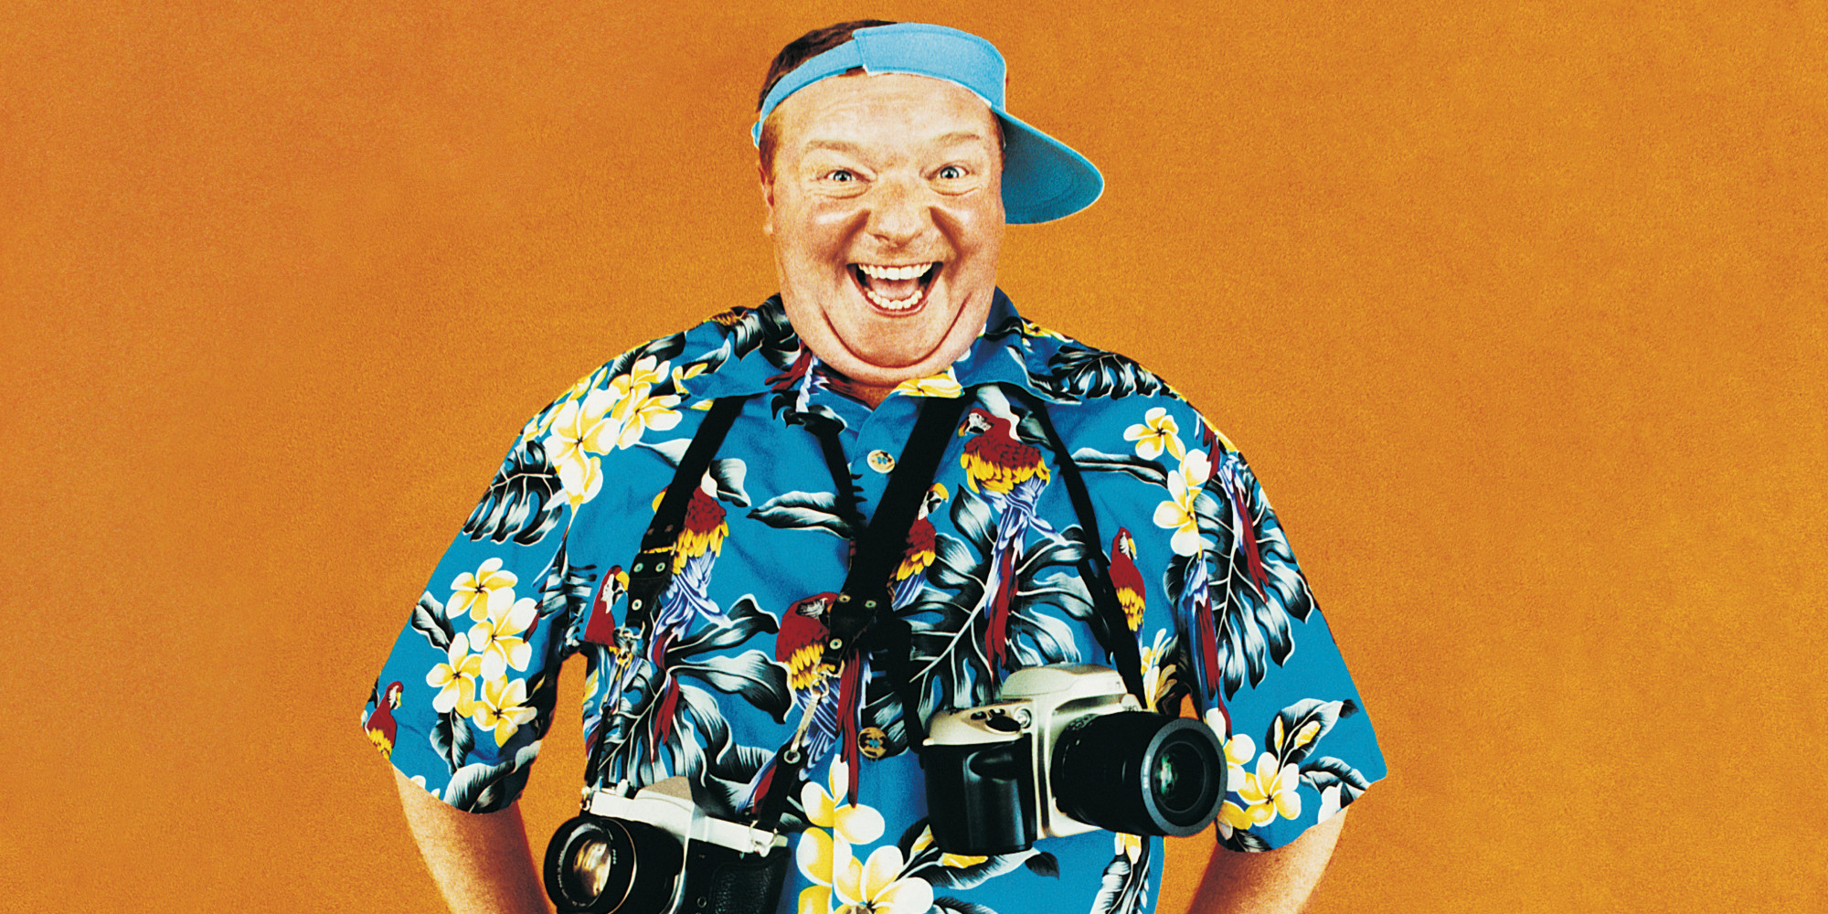
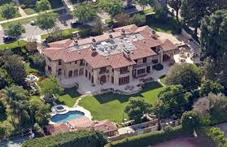
C. Latin American stereotypes of Gringos (North Americans)…?
Share them…

Slide 17
Group Analysis of Stereotypes
Where do these stereotypes come from?
Why are they hurtful?
How should we deal with stereotypes?
How are stereotypes, prejudice and violence all interrelated?

Slide 18
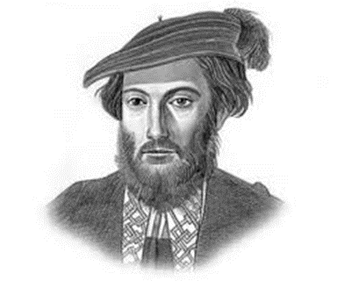
D. Some Definitions
Why has the US traditionally ignored Latin America?
Region rich in resources, but also in paradox
So what is “America”? What does the term mean?
Who was Amerigo Vespucci?
SG figure out who he was and why he relates to our continent
So even the term “Latin” was invented!
Like Roman Empire, a Grand Mixture of Peoples from all over!

Slide 19
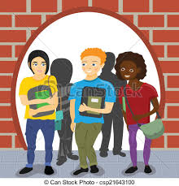
E. Current Events: What is happening these days in L. Am.? Short Reports on Contemporary Latin America
Group Reports and Discussion:
Join in groups by first letter of your last name
Prepare a 2 minute report for the class
First letters of last name
Group One: What is happening in Latin America these days? A-D
Group Two: Why is Venezuelan Society so Divided? E-I
Group Three: What is “Build the Wall” and how is that going? J-M
Group Four: How is Sebastián Piñera doing? N-Q
Group Five: Why are Haitians upset? R-T
Group Six: What is dengue? U-Z
The Jets Siler City
DVD: https://www.huffpost.com/entry/los-jets-nuvotv_n_5706059

Slide 20
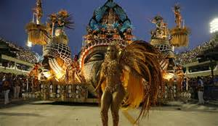
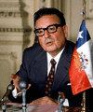
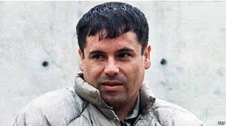
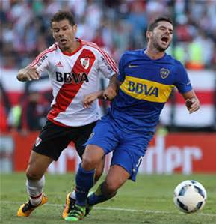
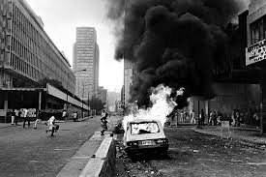
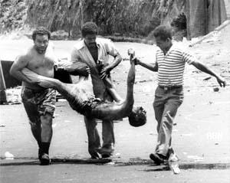
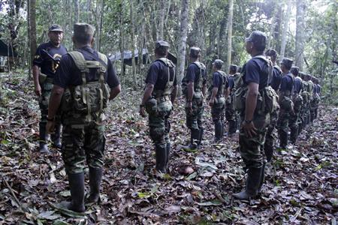
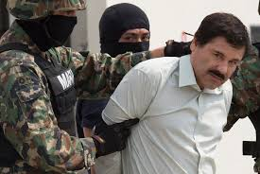
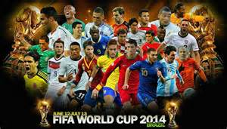
F. Some Historical Events

Slide 21
G. Startling and extreme physical contrasts
The Continent is Rich in Resources, yet many people impoverished
Latin America’s resources have had a significant impact on the world; HOW?
Different forms of governments over the years
How and why has the U.S. achieved more political stability?
Are many more Latin Americans religious than Unitedstatians?

Slide 22
H. Course Expectations and Requirements
How do I find the syllabus and course requirements?
What are the Course Rules?
How do I earn an “A” in this class?
What if I don’t speak Spanish?
What if my English is not great?
Be sure to sign the attendance every class!

Slide 23
I. Getting Engaged With History! Learning History in the 21st Century Excellent Learning and Excellent Teaching
What does it mean to be an excellent student?
What does it mean to be an excellent teacher?
His 2302 Learning-Teaching Contracts Spring 2019
Please sign your copy and drop them on my desk as you leave

Slide 24
J. What did you learn today?
What will you prepare for next class?
2 chapters, choice of 2 films
Apocalypto, or Warriors of the Amazon
Blood and Fire, Ch. 1
Bartolomé, Ch. 1
Conclusions: what did you learn?

