Slide 1
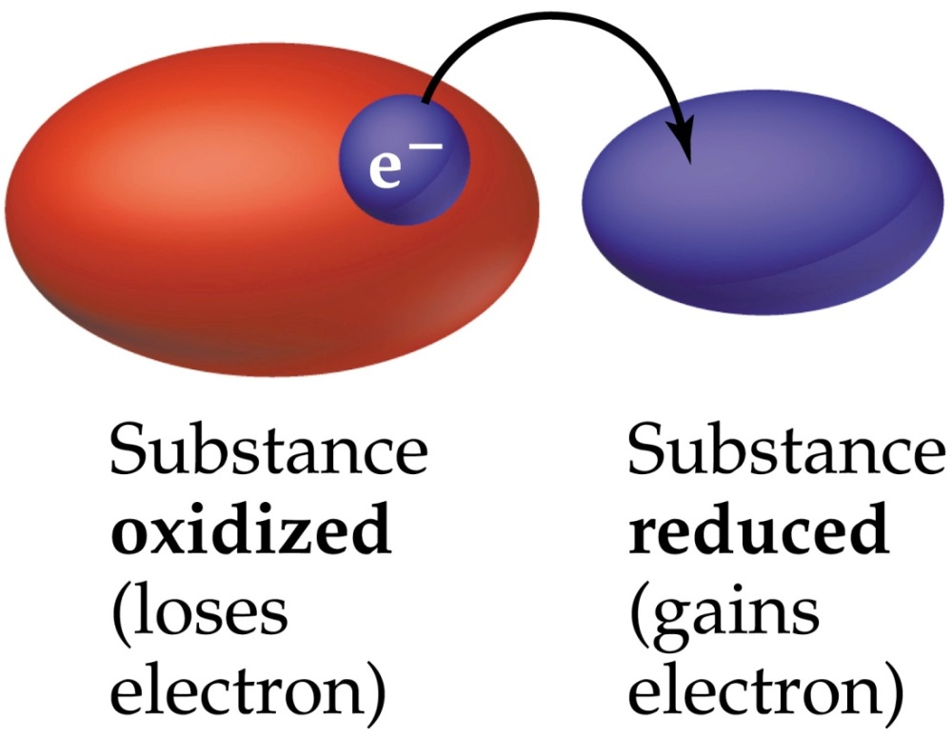
Oxidation-Reduction reactions
oxidation – something loses electrons (gets oxidized)
reduction – something gains electrons (gets reduced)
redox reactions – reactions where electrons are transferred from one species to another
oxidation and reduction always occur together

Slide 2
Mg (s) + ½ O₂ (g)
MgO (s)
Mg Mg²⁺
Mg lost 2 e⁻
Mg got oxidized
O O²⁻
Oxy gained 2 e⁻
Oxy got reduced
oxidizing agent – reactant which removes electrons from another species (causes another species to get oxidized)
reducing agent – reactant which gives electrons to another species (causes another species to get reduced)

Slide 3
Balancing Redox Reactions via the “Method of ½ Rxns”
For an acidic solution
1. Break the unbalanced reaction up into ½ reactions
2. For each ½ rxn, add coefficients to balance all elements, except hydrogen, H and oxygen, O
3. For each ½ rxn, balance oxygen by adding H₂O
4. For each ½ rxn, balance hydrogen by adding H⁺
5. For each ½ rxn, balance charges by adding e⁻
6. Multiply one (or both) ½ rxns by integers so that e⁻ will cancel when ½ rxns are added

Slide 4
Balancing Redox Reactions via the “Method of ½ Rxns”
For a basic solution
1. Balance the reaction in an acidic solution
2. Add same amount of OH⁻ to both sides to cancel H⁺

