Slide 1
Notes:
Figure: 11-T01

Slide 2
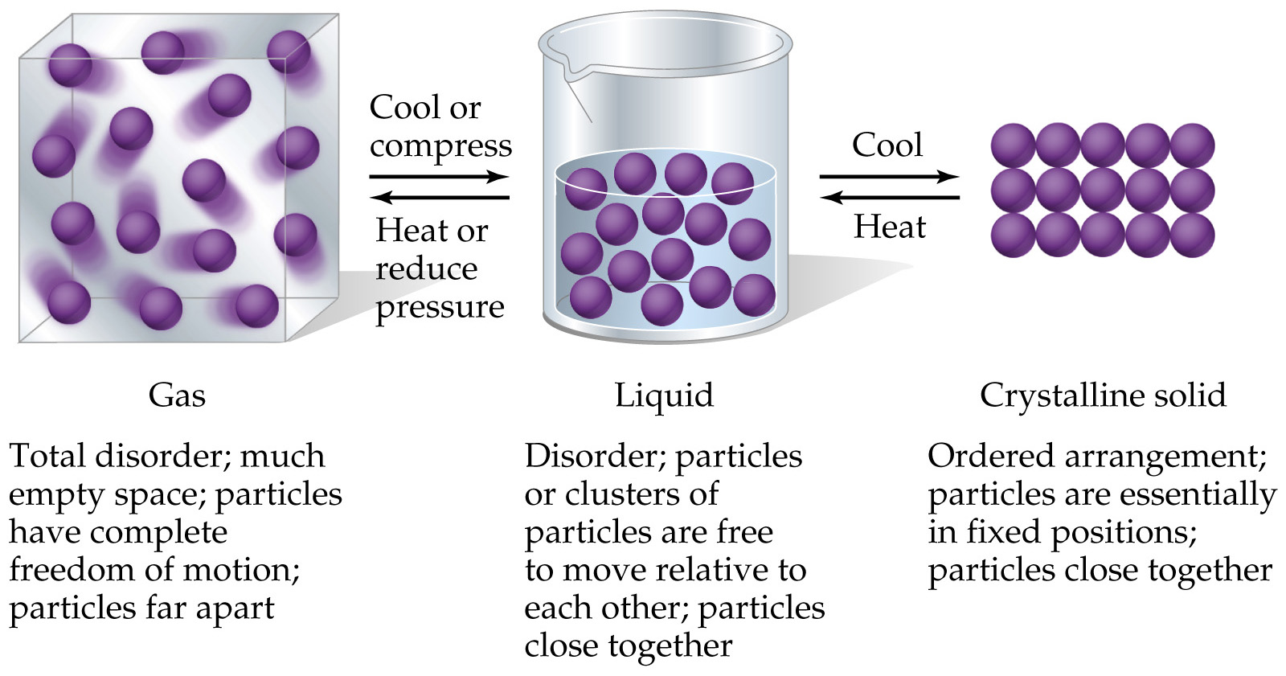
Notes:
Figure: 11-01

Slide 3
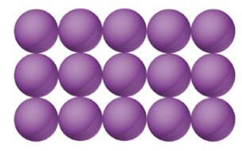
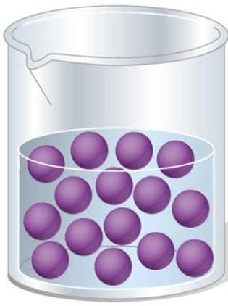
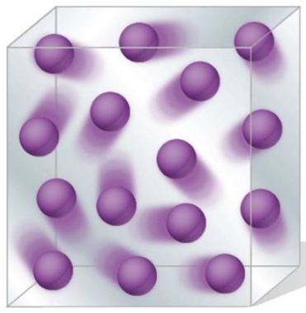
– What is happening on the molecular level that causes a solid to be a solid ?
– What is happening on the molecular level that causes a liquid to be a liquid ?
– What is happening on the molecular level that causes a gas to be a gas ?
Intermolecular forces – the attractive forces between molecules

Slide 4
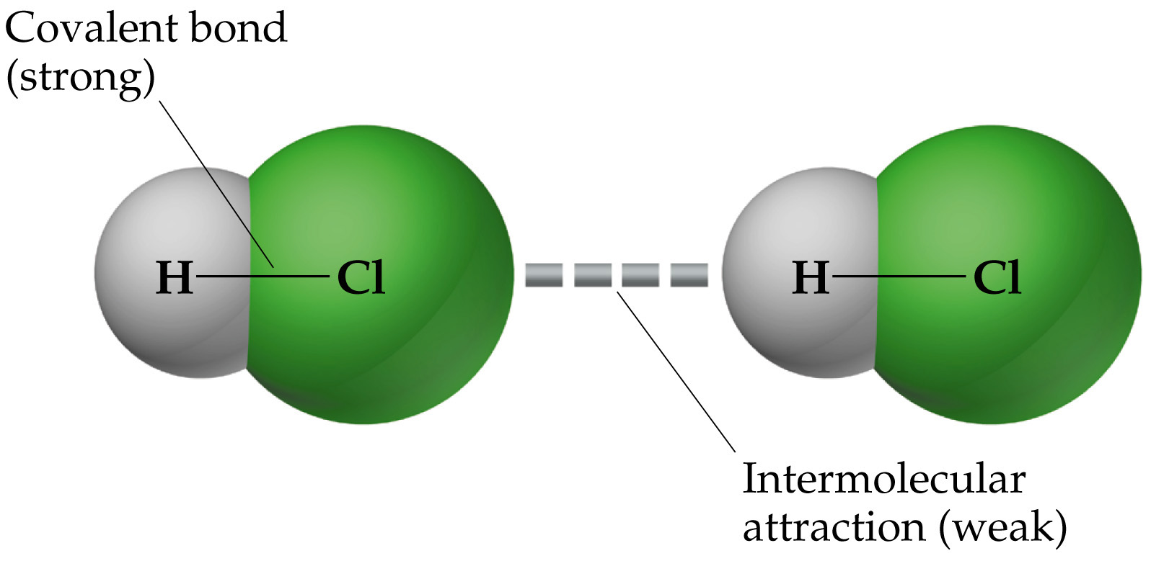
Notes:
Figure: 11-02

Slide 5
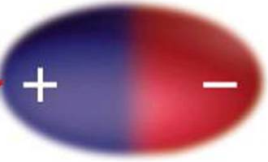
Types of Intermolecular forces
1. dipole - dipole – the attractive forces between polar molecules
δ⁺
δ⁻
Br-Cl is a polar molecule with a permanent dipole moment

Slide 6
dipole-dipole IM attractive force
since unlike charges attract, polar molecules are attracted to each other on the molecular level

Slide 7
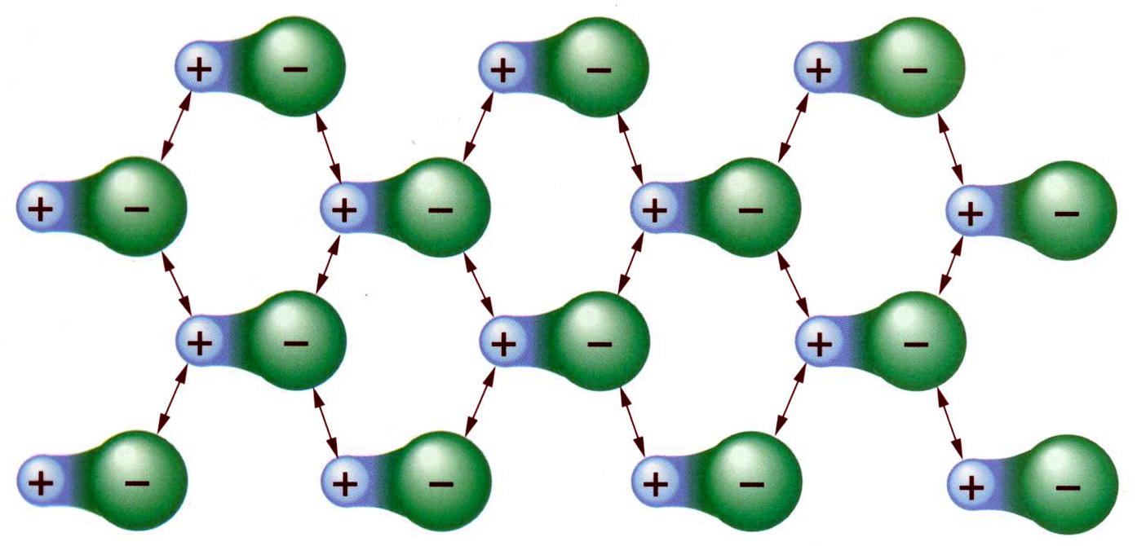
dipole-dipole interactions cause molecules to orient to maximize attractive forces between molecules
molecules line up and assume a somewhat “ordered” state

Slide 8
The quantitative measure of the extent of Intermolecular forces is reflected in the molecules melting point or boiling point !
A
B
solid at 25 °C
liquid at 25 °C
Which possesses a greater degree of order ?
A
MP of A > 25 °C while MP of B < 25 °C
Substance A exhibits more IM attractive forces vs. B

Slide 9
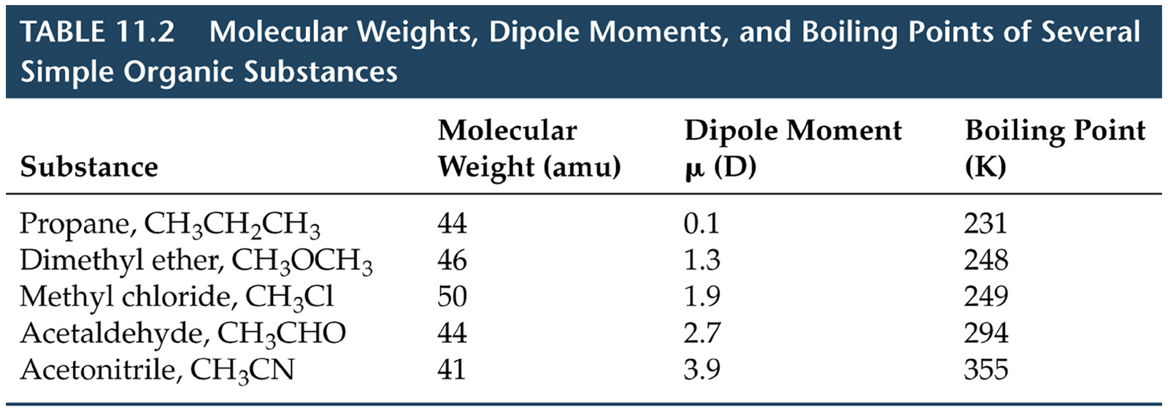
The higher the boiling point, the more order the substance exhibits …..(in other words)…. The higher the boiling point, the greater the extent of the intermolecular forces between molecules
Notes:
Figure: 11-T02

Slide 10
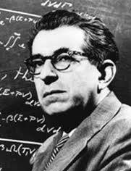
Types of Intermolecular forces
2. London dispersion forces – the very short lived attractive forces caused by the instantaneous displacement of electrons
Fritz London 1900 – 1954

Slide 11
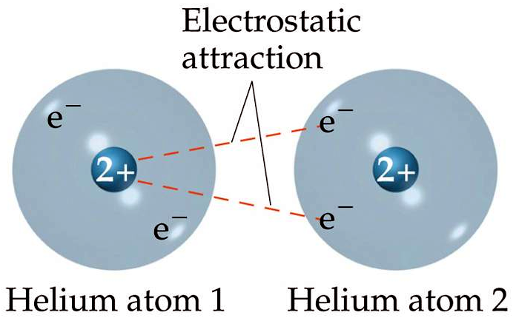
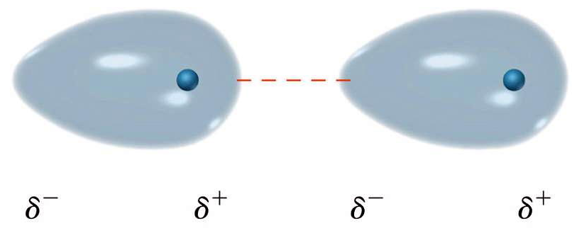
electron clouds momentarily distorts to give rise to non-symmetric electron cloud producing an instantaneous dipole
Notes:
Figure: 11-04

Slide 12
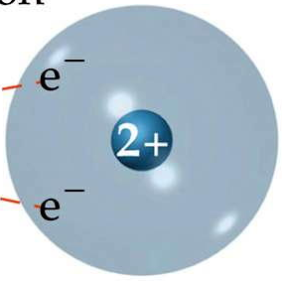
instantaneous dipole – distorted electrons give rise to a temporary dipole
before instantaneous dipoles: He nonpolar
instantaneous dipoles occurring: He slightly polar
instantaneous dipoles provide some additional intermolecular ordering on the molecular level

Slide 13
Extent of London dispersion is determined by MW
London dispersion increases as MW increases
Notes:
Figure: 11-T03

Slide 14
Arrange the following in order of increasing boiling points; C₃H₈ , CH₄ , C₈H₁₈

Slide 15
Arrange the following in order of increasing boiling point; F₂ , H₂S

Slide 16
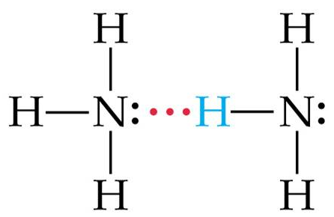
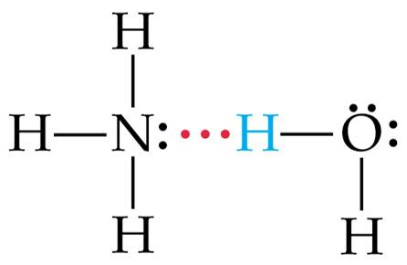
Types of Intermolecular forces
3. Hydrogen bonding – occurs between polar molecules that contain a hydrogen atom that is attached to a F, or O, or N
“H–F” or “H–O” or “H–N”
H-bonding is an unusually strong dipole-dipole that provides more order on the molecular level than a routine dipole-dipole

Slide 17
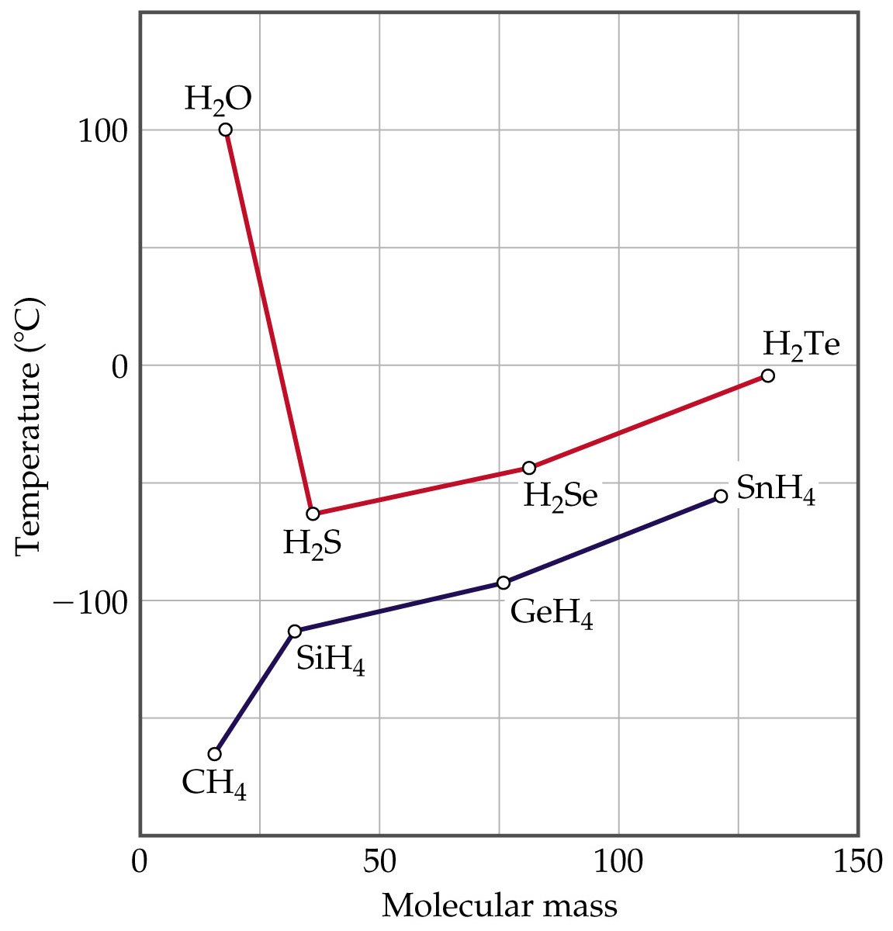
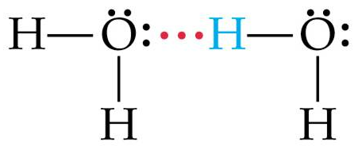
Notes:
Figure: 11-07

Slide 18
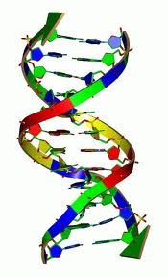
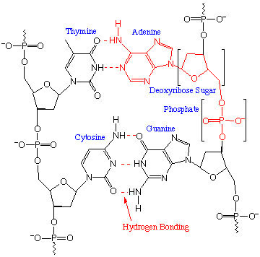
H-bonding is responsible for holding the two strands of DNA together !

Slide 19
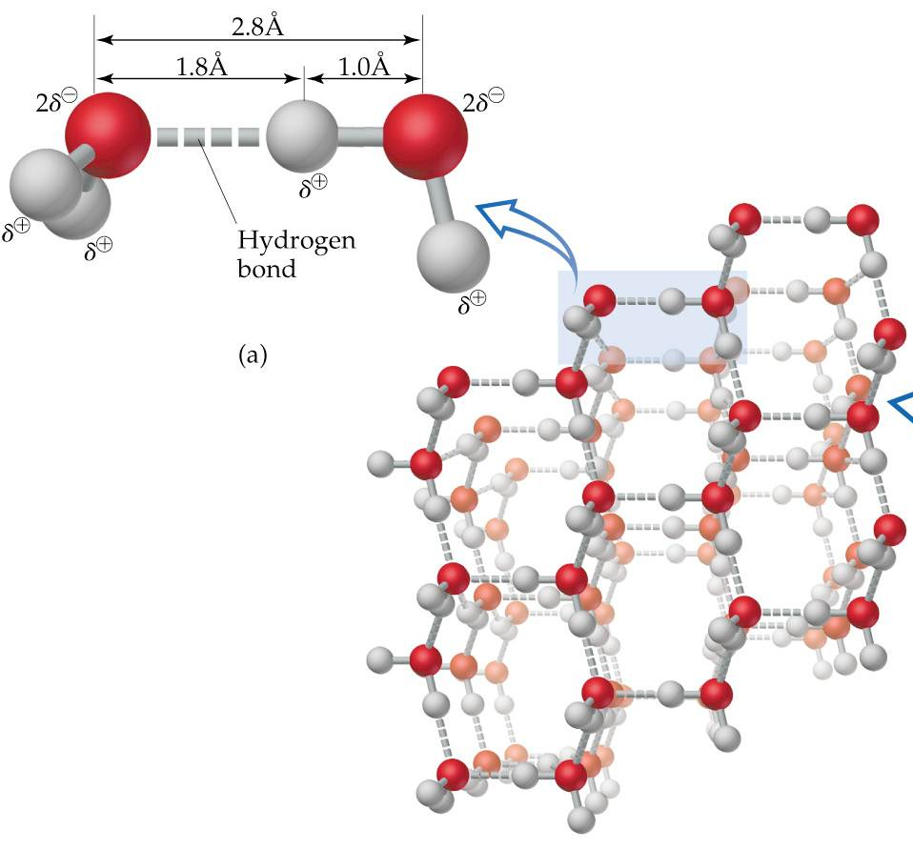
H-bonding gives rise to the “open structure” of ice, thus H₂O (s) is less dense than H₂O () and thus, ice floats
Notes:
Figure: 11-10

Slide 20
London dispersion forces are present in all substances and increases with increasing MW
H-bonding > dipole-dipole
Notes:
Figure: 11-08

Slide 21
Arrange the following in order of increasing boiling point; Kr, H₂S, NaCl, Ne, NH₃, F₂

Slide 22
viscosity – a liquids resistance to flow. The greater the viscosity, the slower the liquid flows
viscosity increases with increasing intermolecular attractive forces
viscosity decreases with increasing temperature

Slide 23
Which species has the greater viscosity ? C₆H₁₄ () or CH₃CH₂CH₂CH₂CH₂OH ()

Slide 24
Which species is more viscous (the greater viscosity) ? CH₃OH () at 15 °C or CH₃OH () at 45 °C

Slide 25
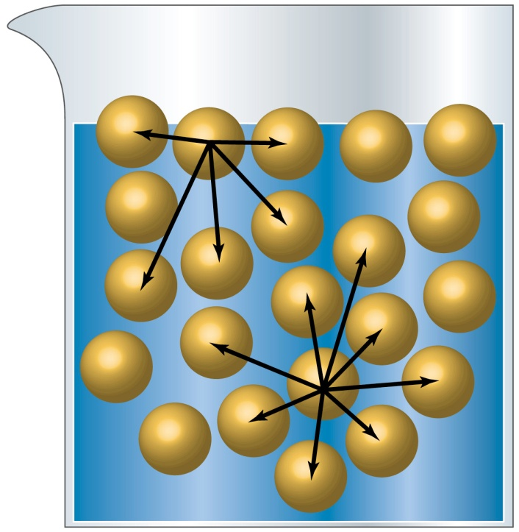
surface tension – the characteristic “skin” a liquids surface develops
surface tension increases with increasing intermolecular attractive forces
surface tension decreases with increasing temperature

Slide 26
Which species has the greater surface tension ? H₂O () at 15 °C or H₂O () at 45 °C

Slide 27
Which species has the greater surface tension 25 °C ? CH₃CH₂CH₂OH () or HOCH₂CH₂OH ()

Slide 28
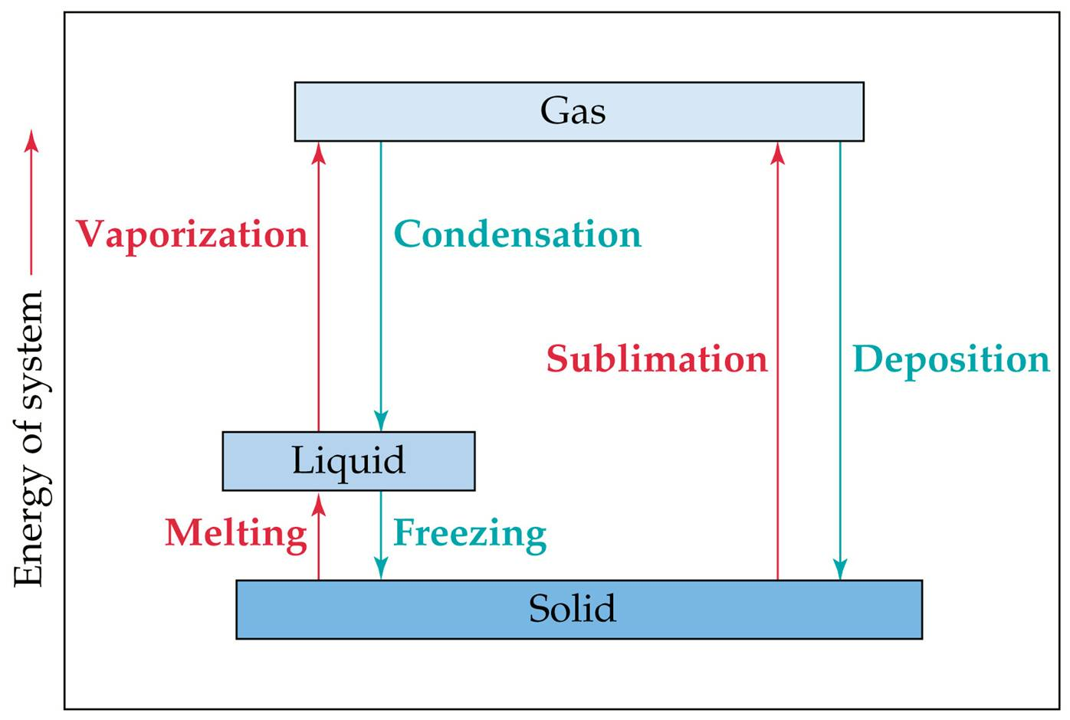
Phase changes
Notes:
Figure: 11-T04

Slide 29
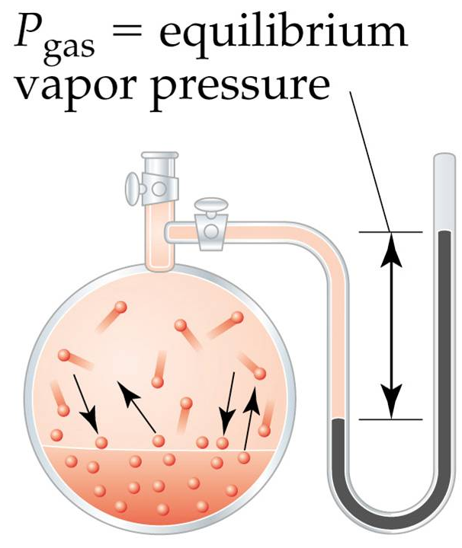
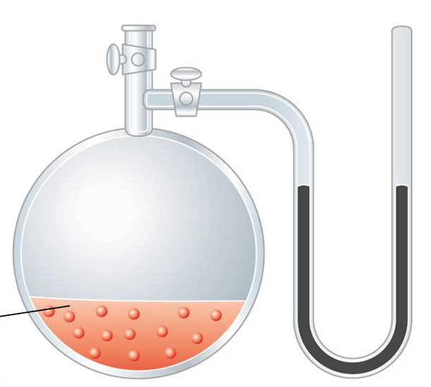
vapor pressure – the partial pressure vapor molecules exert at equilibrium
h
liquid
h = height of the Hg = vapor pressure, VP
VP_{water} = 17.5 mm Hg VP_{methanol} = 46.0 mm Hg
at 20 °C
Notes:
Figure: 11-14

Slide 30
VP H₂O < VP CH₃OH
VP increases as intermolecular forces decrease
VP increases as temperature increases
Which species has the higher vapor pressure at 25 °C ? CH₃CH₂CH₂OH () or HOCH₂CH₂OH ()
Higher VP

Slide 31
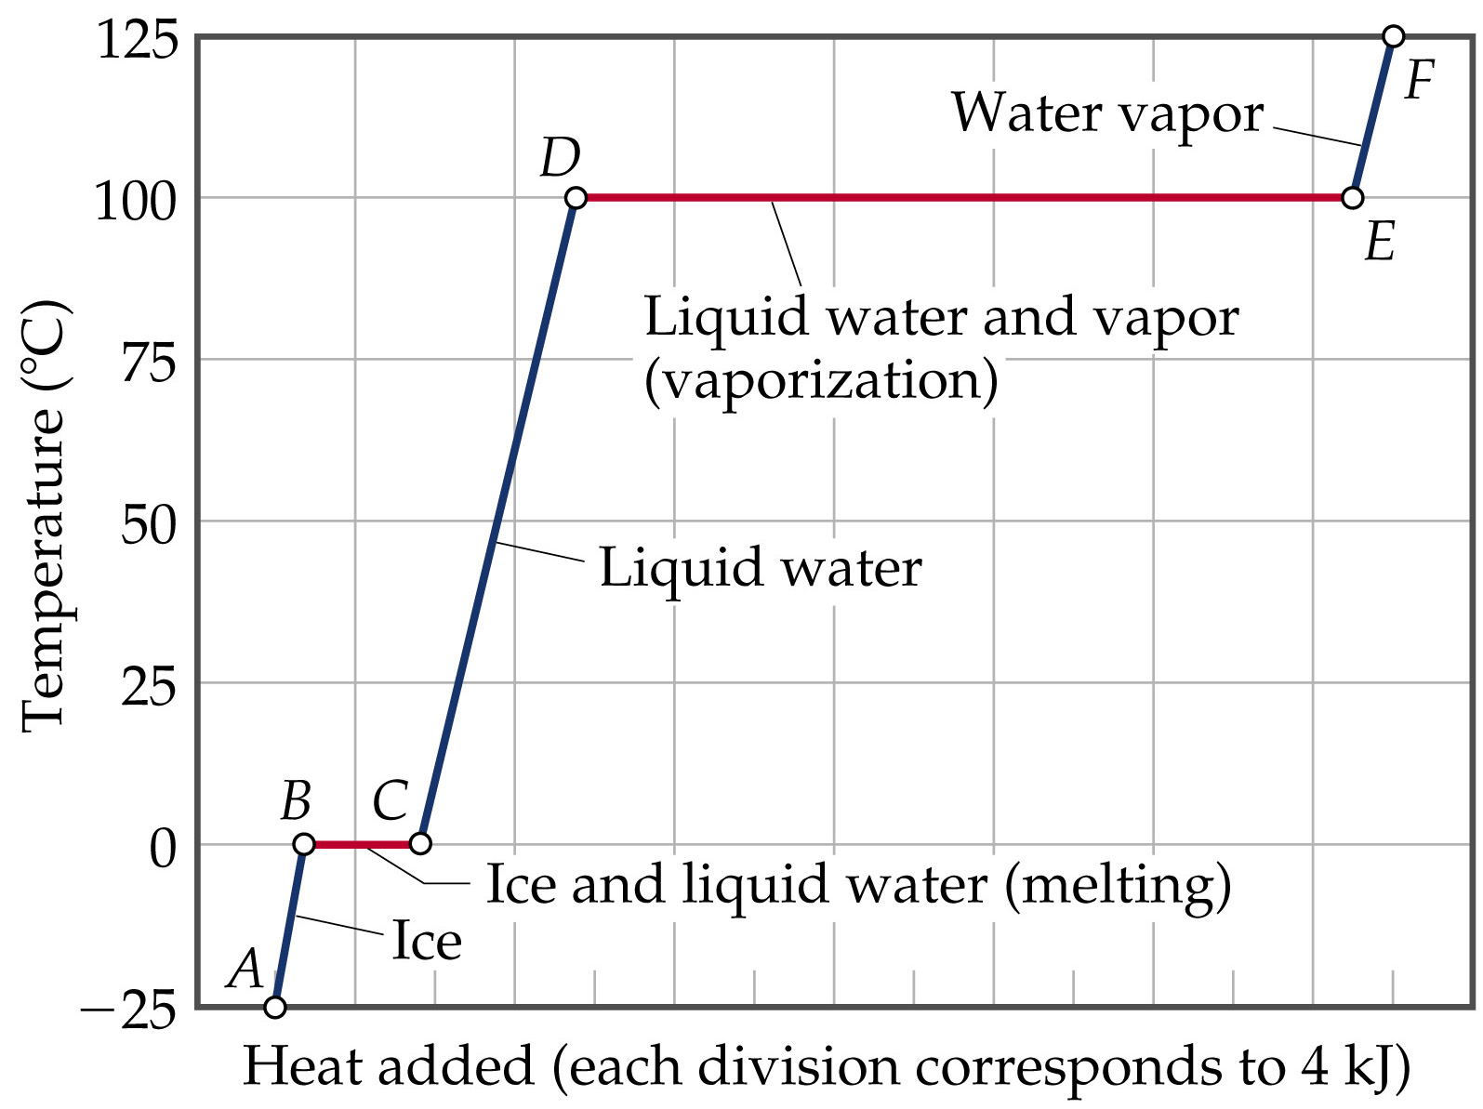
Notes:
Figure: 11-19

Slide 32
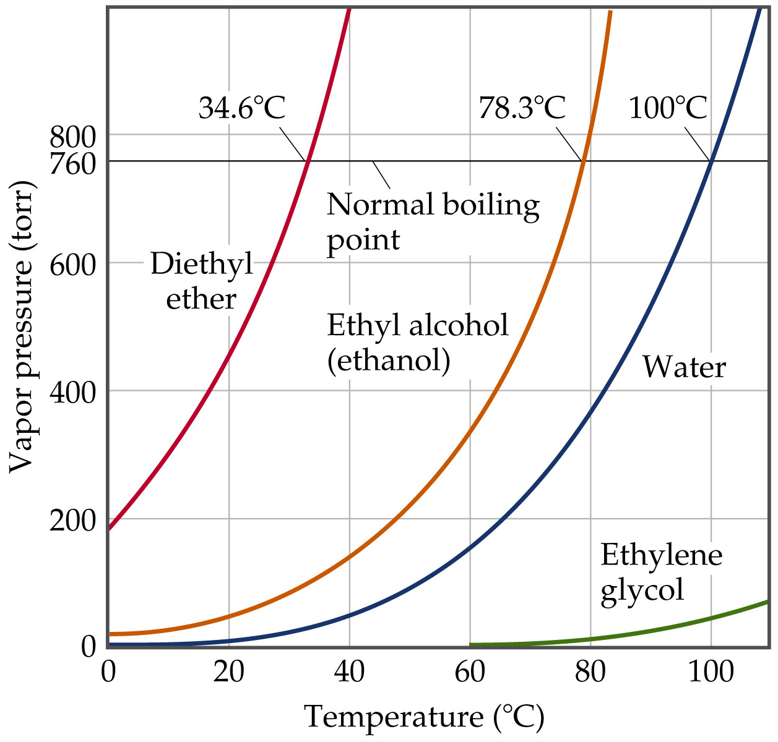
boiling point – temperature where the vapor pressure of the liquid is equal to the applied pressure
normal BP – temp of the boiling point at 1 atm
Notes:
Figure: 11-24a,b

Slide 33
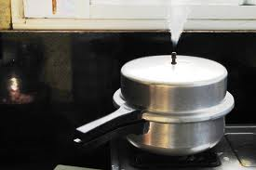
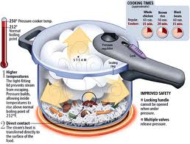
pressure cooker

Slide 34
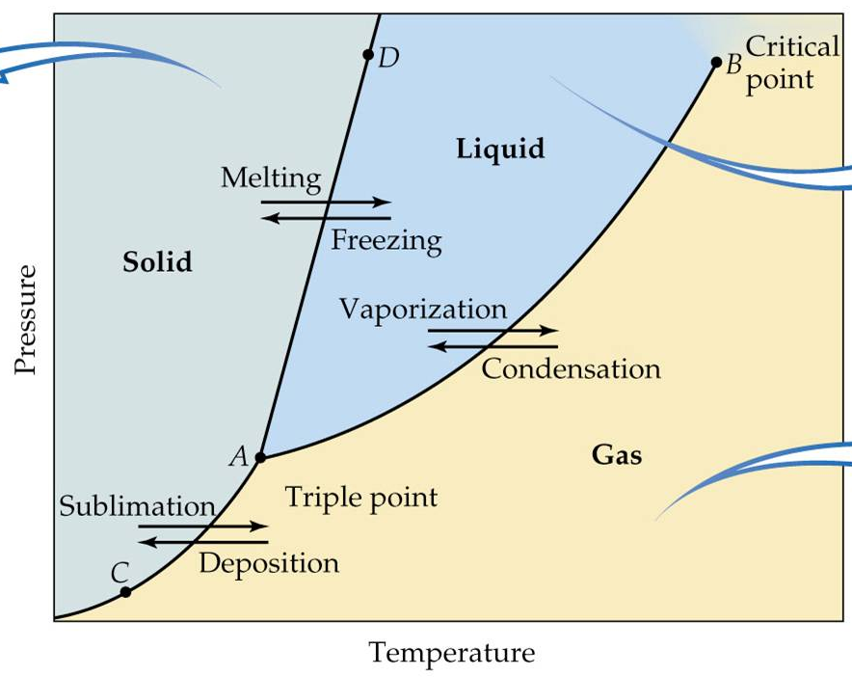
phase diagrams – graphs of pressure and temperature phase changes
Notes:
Figure: 11-20

Slide 35
line AD represents melting or freezing point of substance
line AB represents boiling point of substance
line AC represents sublimation of substance
Notes:
Figure: 11-21

Slide 36
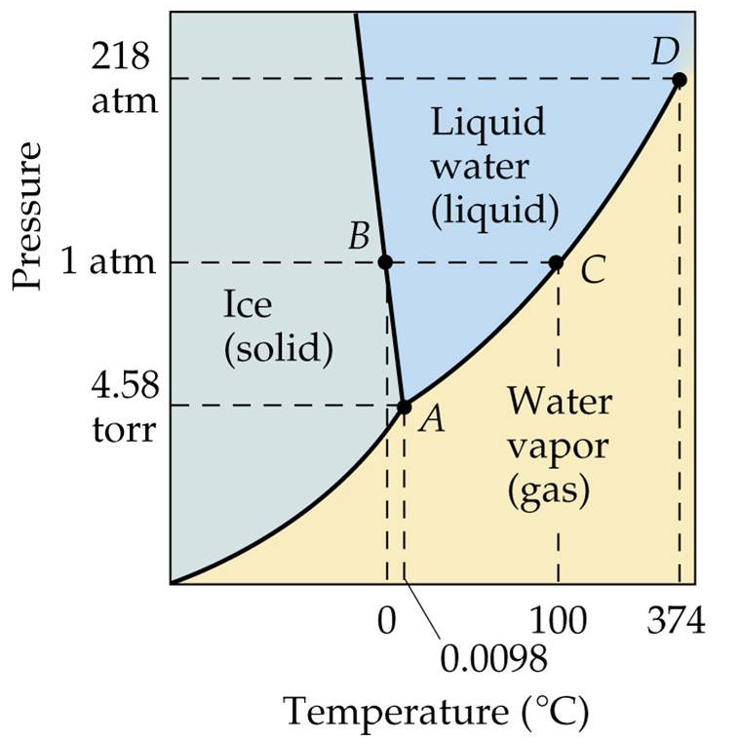
how does water exist at 100 °C and 5 atm ?
liquid
how does water exist at 100 °C and 0.5 atm ?
gas
can you boil water at 50 °C ?
yes
can you boil water at -5 °C ?
no
can ice exist at +2 °C ?
no
Notes:
Figure: 11-28

Slide 37
How do you make a snowball ?
What is happening at point A ?
triple point – all three phases coexist together
Notes:
Figure: 11-28

Slide 38
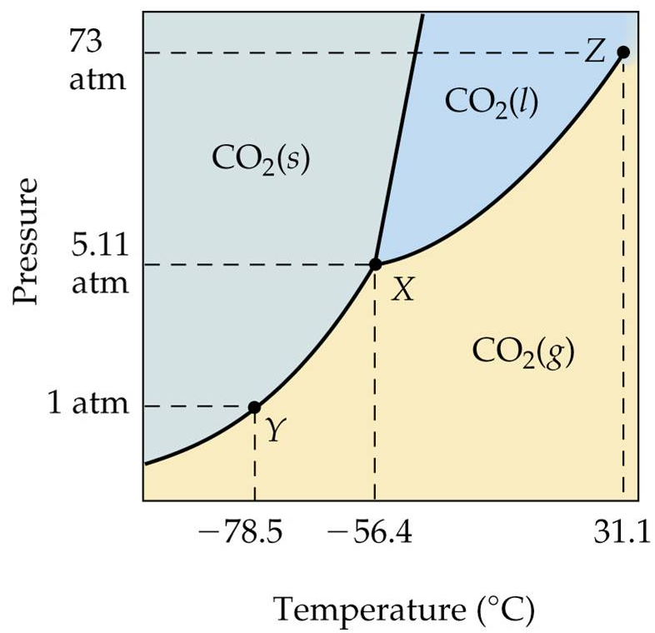
How does CO₂ exist at -40 °C and 7 atm ?
liquid
What temp does CO₂ boil ?
depends
Can CO₂ melt at 4 atm ?
No
What is the normal BP ?
doesn’t have one
What is the triple point ?
-56.4 °C, 5.11 atm
What is happening at point Z ?
Notes:
Figure: 11-26

Slide 39
critical point – no distinct difference between liquid and gas states at temperature and pressure above this point
supercritical fluid – a state that is inbetween a liquid and gas phase

Slide 40
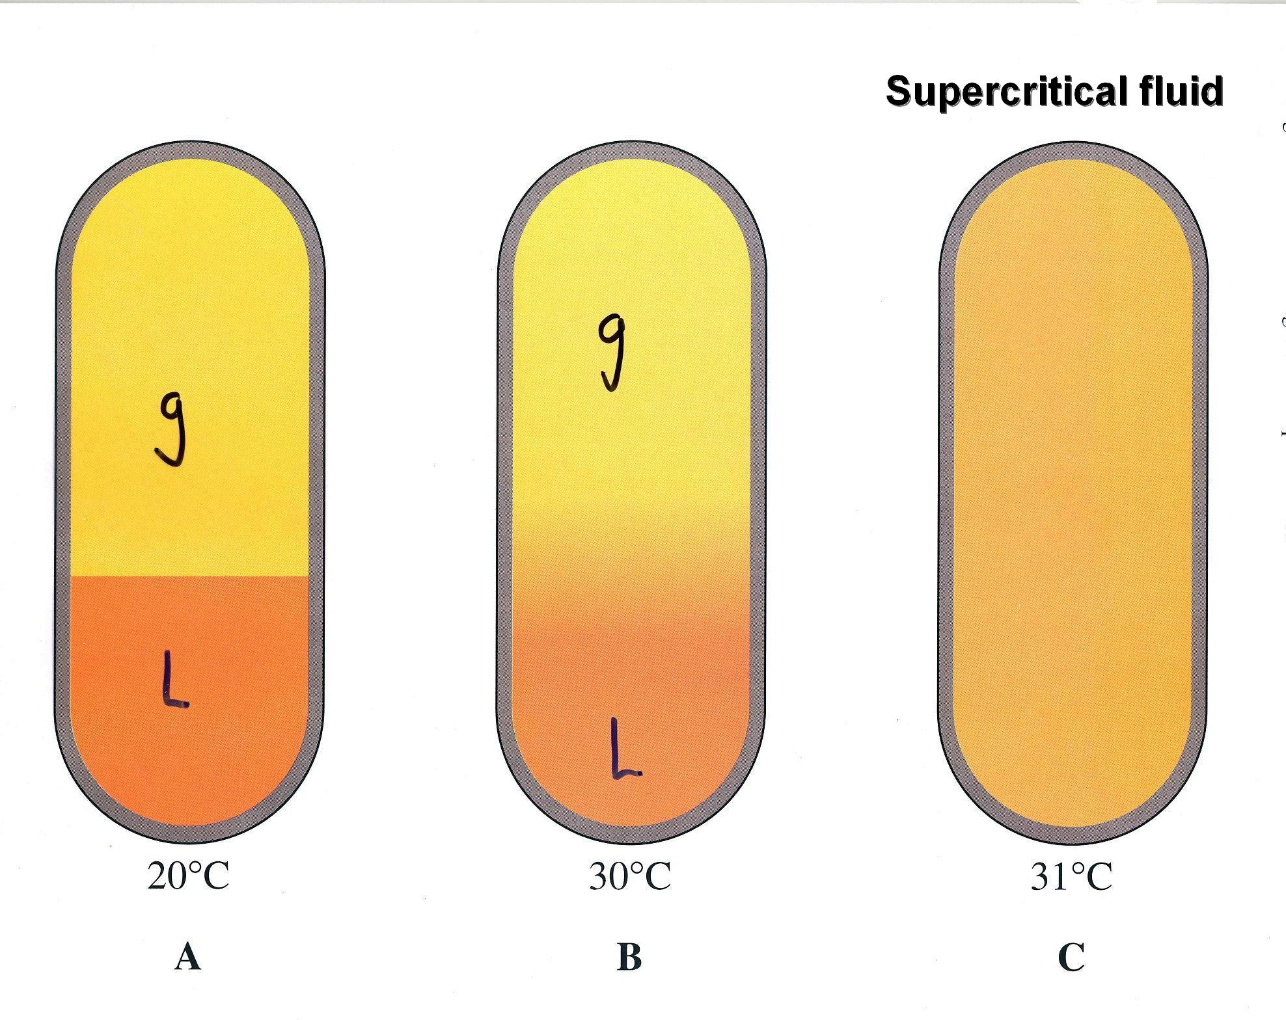

Slide 41
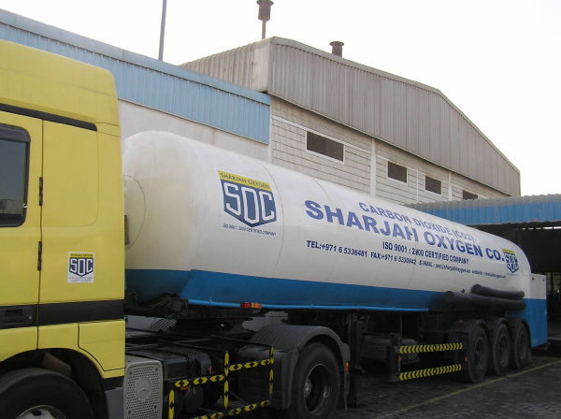
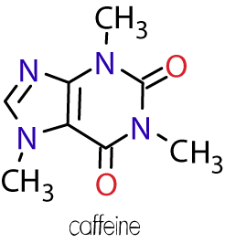

Slide 42
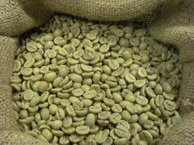
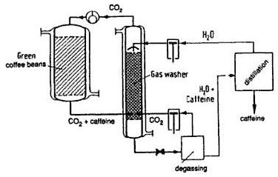
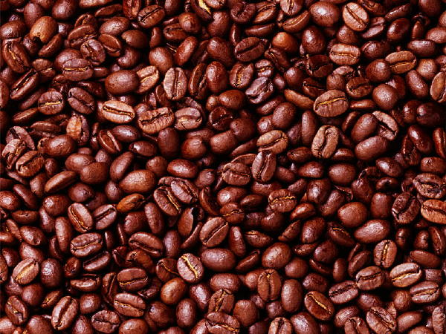
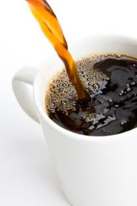
green coffee beans are immersed in supercritical CO₂ at 90 °C and about 180 atm. The caffeine dissolves into the CO₂ supercritical fluid and is extracted and removed

