Slide 1
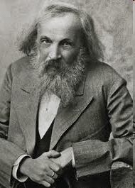
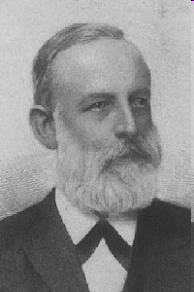
Lothar Meyer 1830 - 1895
Dmitri Mendeleev 1834 – 1907

Slide 2
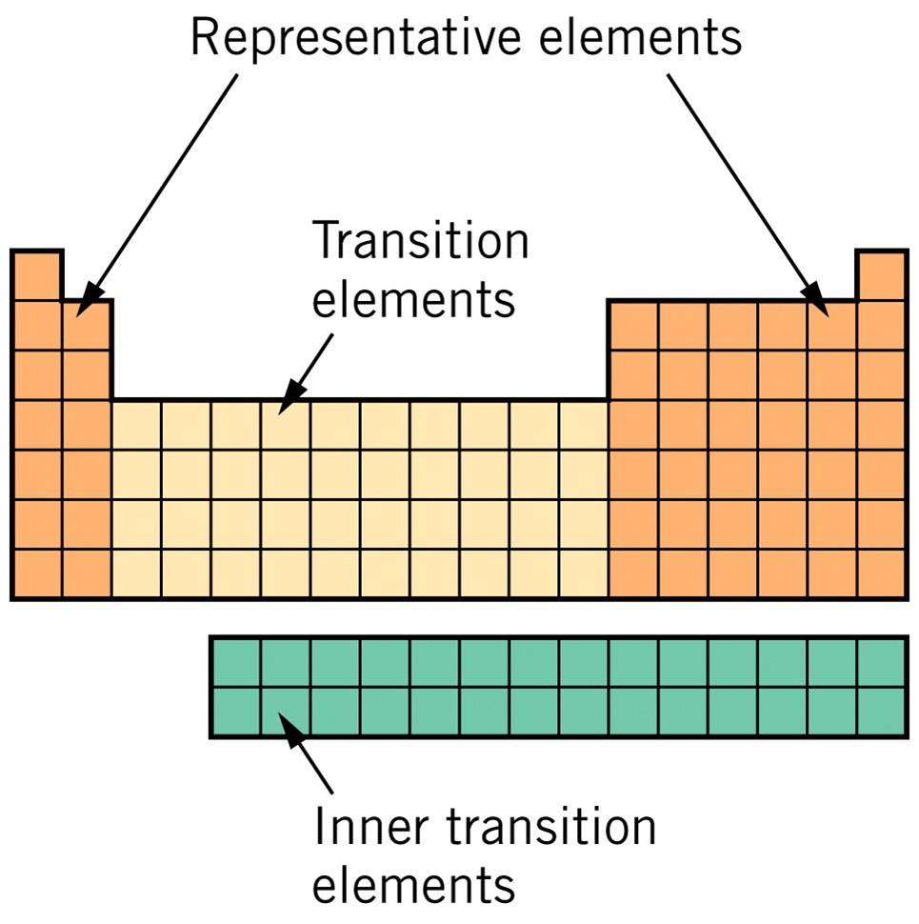
main group elements
lanthanides 
actinides 

Slide 3
The “Real” Periodic Table

Slide 4
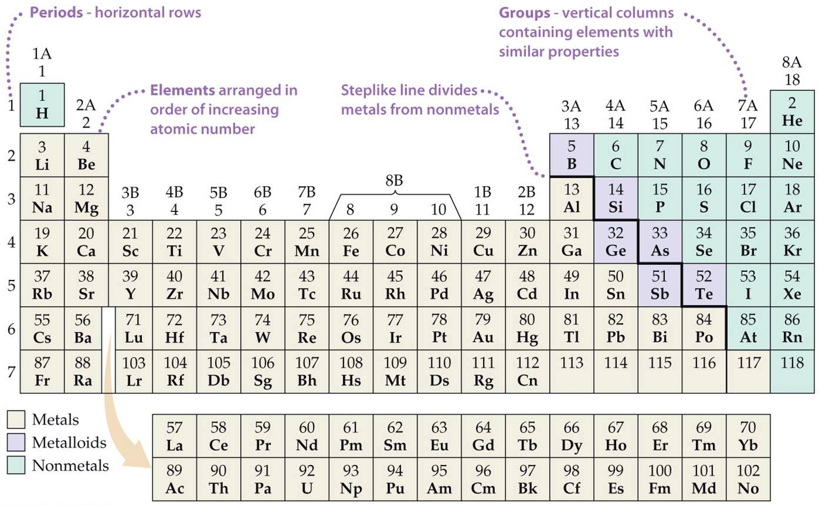

Slide 5
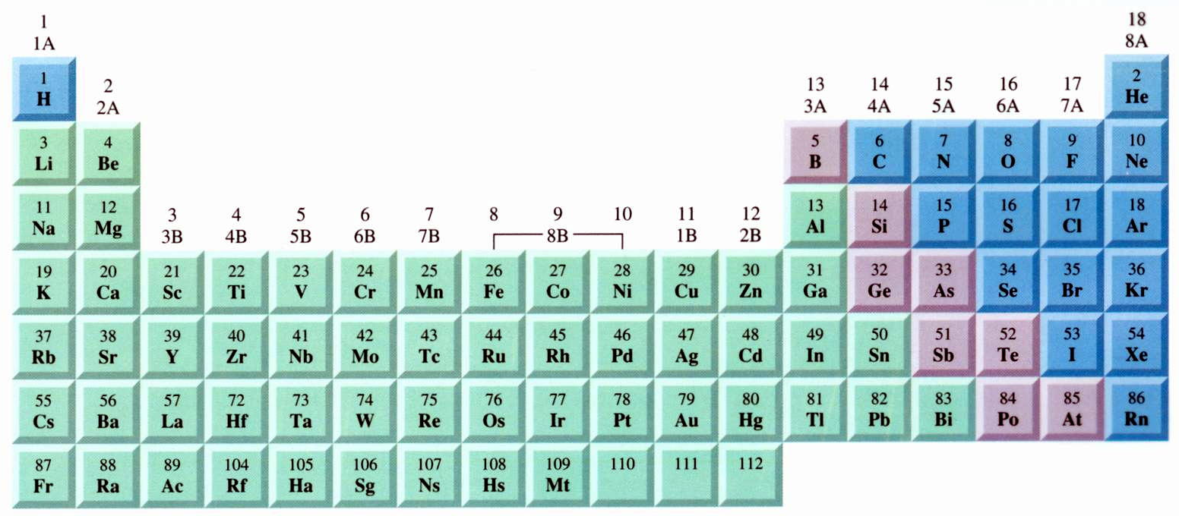
Notes:
Figure: 02-T03
Title:
Table 2.3
Caption:
Names of Some Groups in the Periodic Table

Slide 6
3 kinds of elements on Periodic Table
metals – malleable, shiny, conduct heat and electricity well
nonmetals – not malleable, not shiny, does not conduct heat and electricity well
metalloids – have properties of both metals and nonmetals. B, Si, Ge, As, Sb, Te, Po, At

Slide 7
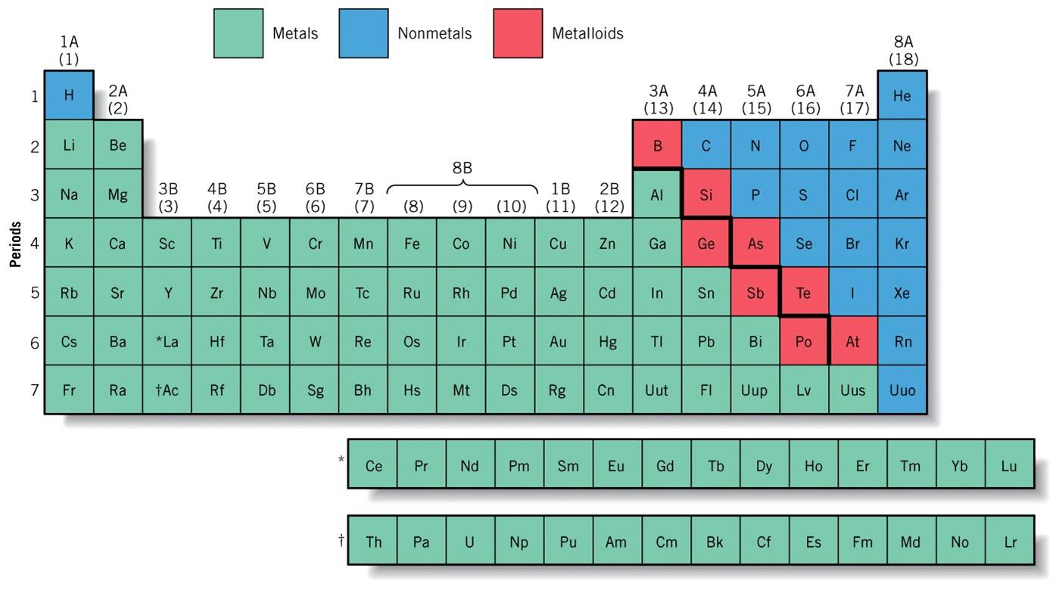

Slide 8
molecule – atoms bound together in a neutral, “discrete unit”
chemical formula – an expression which (molecular formula) shows the ratio of atoms in the molecule
subscripts – tells the # atoms in a chemical formula
coefficients – number that tells how many molecules

Slide 9
diatomic molecules – molecules that contain two atoms
O₂
N₂
Cl₂
homonuclear diatomic – molecule that contains two identical atoms
CO
HCl
heteronuclear diatomic – molecule that contains two different atoms

Slide 10
hydrates – compounds that contain loosely-bound water molecules
CaCl₂·2H₂O
Na₂SO₄·7H₂O

Slide 11
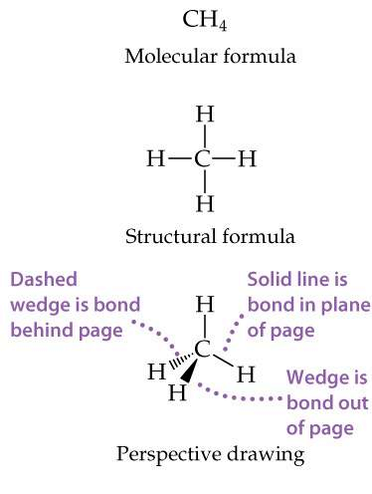
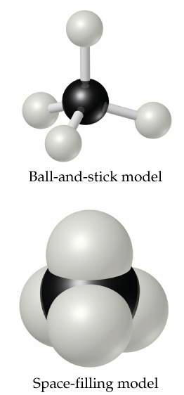
structural formula – shows how atoms are joined in molecule
Notes:
Figure: 02-21
Title:
Different representations of the methane (CH₄) molecule.
Caption:
Structural formulas, perspective drawings, ball-and-stick models, and space-filling models each help us visualize the ways atoms are attached to each other in molecules. In the perspective drawing, solid lines represent bonds in the plane of the paper, the solid wedge represents a bond that extends out from the plane of the paper, and dashed lines represent bonds behind the paper.

Slide 12
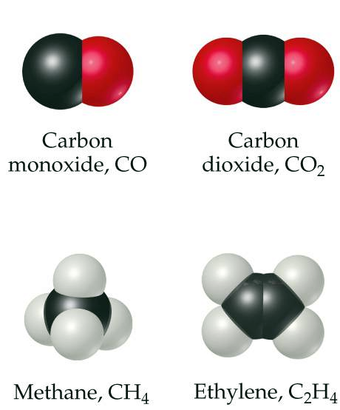
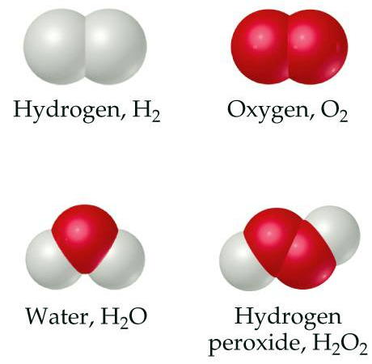
Notes:
Figure: 02-20
Title:
Molecular models of some simple molecules.
Caption:
Notice how the chemical formulas of these substances correspond to their composition.

Slide 13
ions – atoms possessing a charge
cations – positively charged ions
anions – negatively charged ions

Slide 14
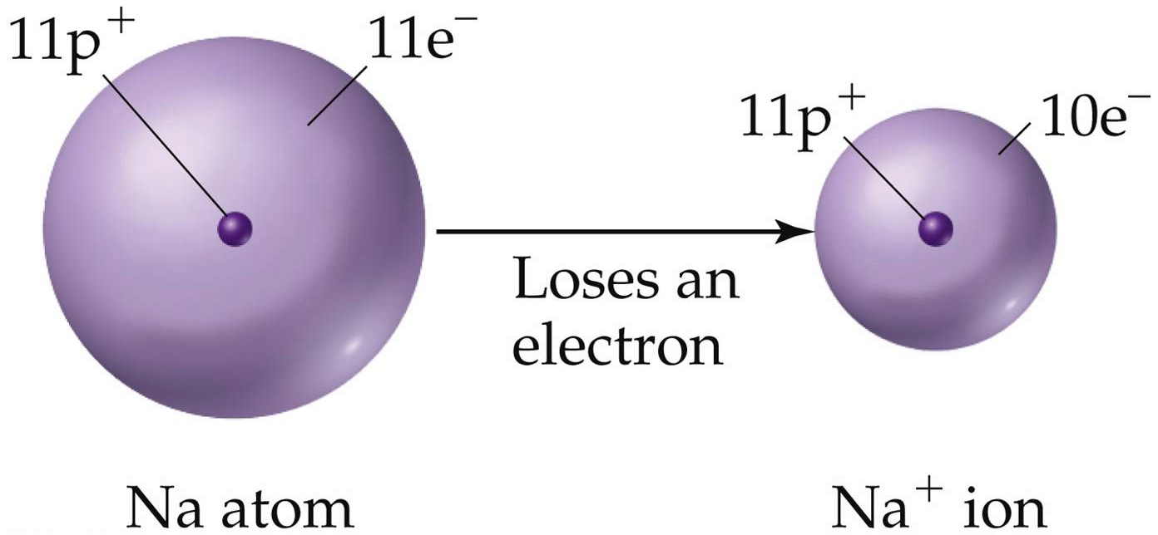
Notes:
Figure: 02-21-03UN
Title:
Formation of a chloride ion.
Caption:
A chlorine atom gains an electron to form a chloride ion.

Slide 15
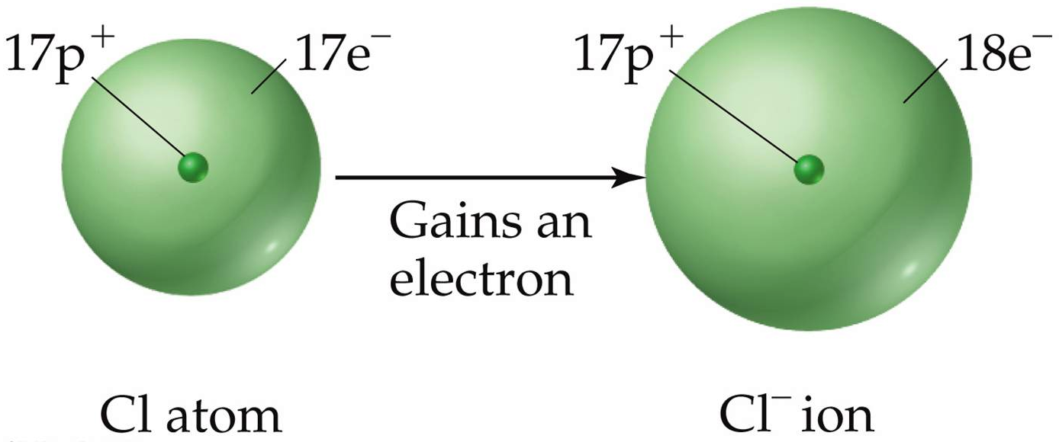
Notes:
Figure: 02-21-02UN
Title:
Ionization of sodium.
Caption:
A sodium atom loses an electron to form a sodium ion.

Slide 16
Notes:
Figure: 02-22
Title:
Charges of some common ions.
Caption:
Notice that the steplike line that divides metals from nonmetals also separates cations from anions.

Slide 17
ionic compounds – compounds made up of (salts) ions
crystal lattice structure – ionic compounds exist in a 3-dimensional extended arrays of repetitive sequences of ions

Slide 18
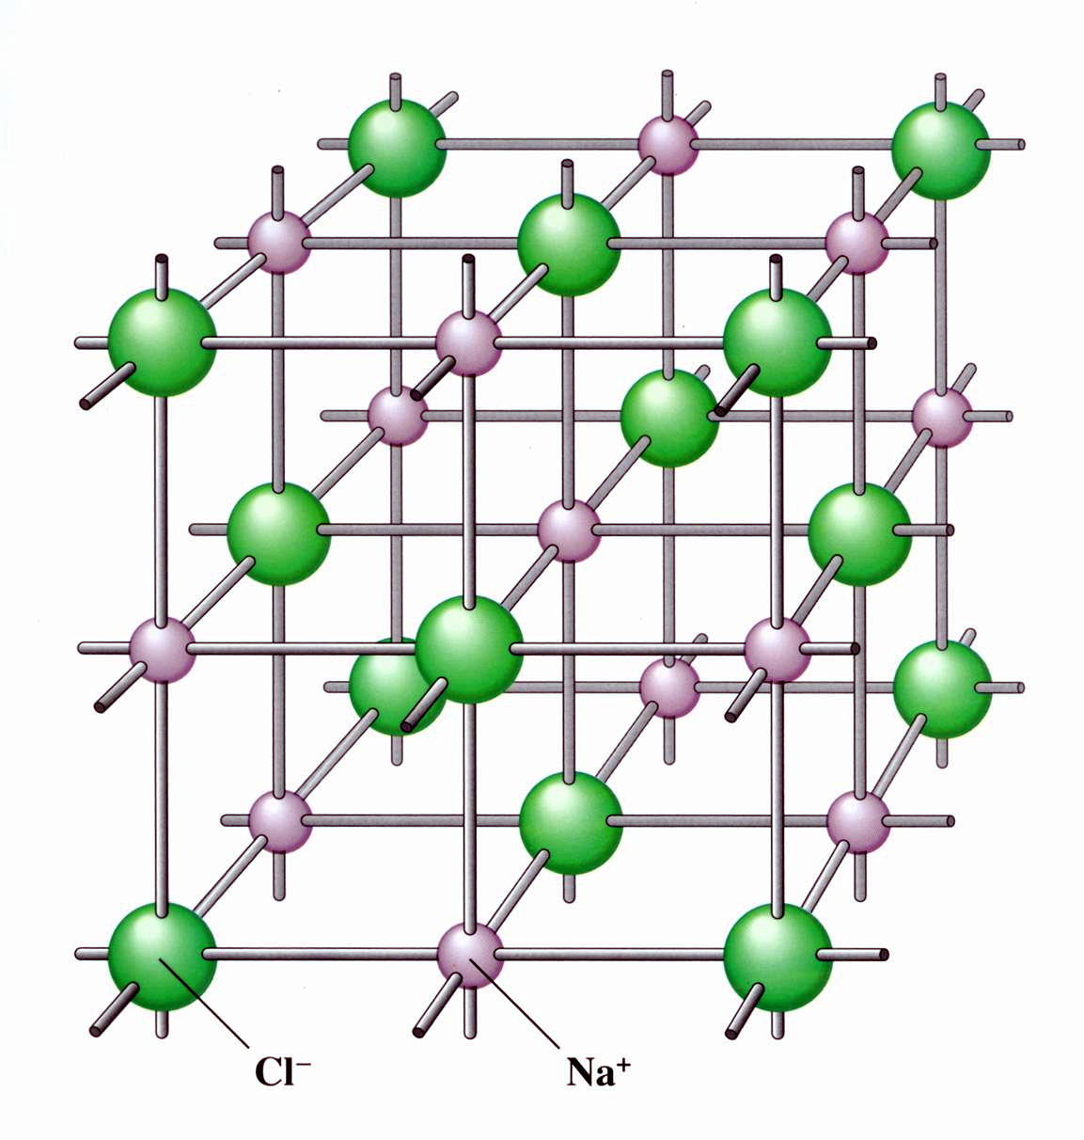

Slide 19
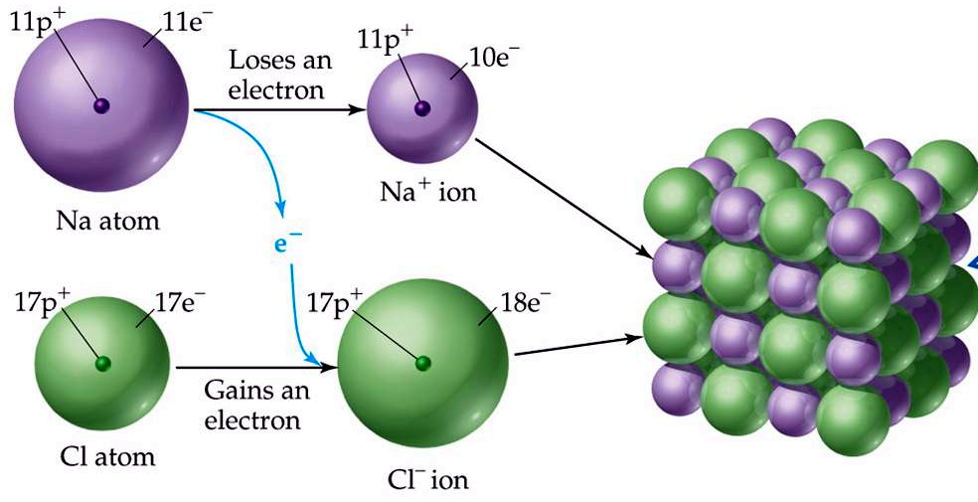
charge neutrality – combination of cations and anions make an overall neutral species
Notes:
Figure: 02-23
Title:
The formation of an ionic compound.
Caption:
(a) The transfer of an electron from a neutral Na atom to a neutral Cl atom leads to the formation of an Na⁺ and a Cl⁻ ion. (b) Arrangement of these ions in solid sodium chloride (NaCl). (c) A sample of sodium chloride crystals.

Slide 20
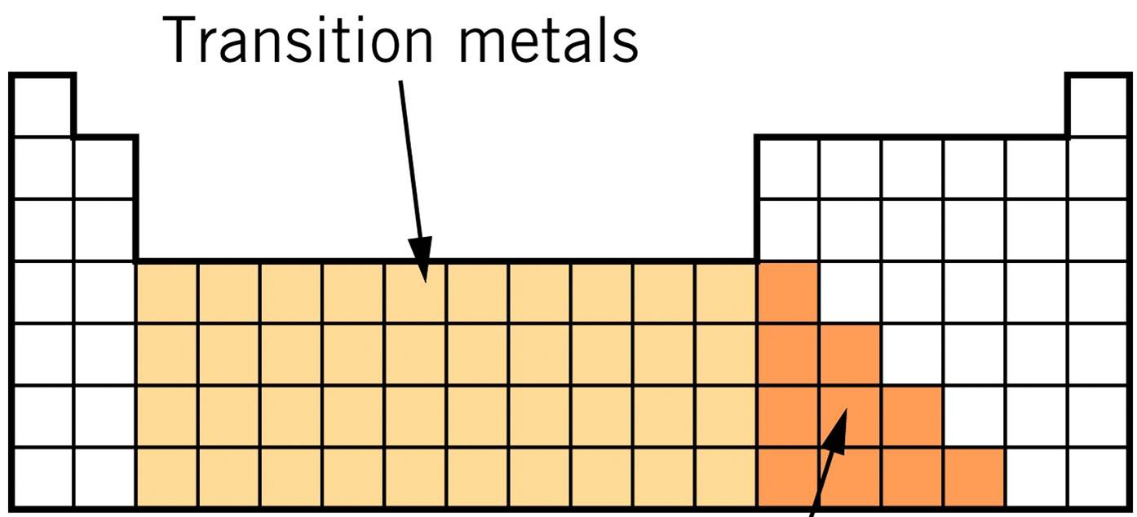

Slide 21
1a. Simple Binary Ionic Compounds (main group metal cation + anion)
a. name the cation first
b. name anion second (often gets an –ide ending)

Slide 22
KCl
potassium chloride
CaCl₂
calcium chloride
Na₂O
sodium oxide
lithium bromide
LiBr
magnesium iodide
MgI₂
polyatomics – made up of more than one kind of atom

Slide 23
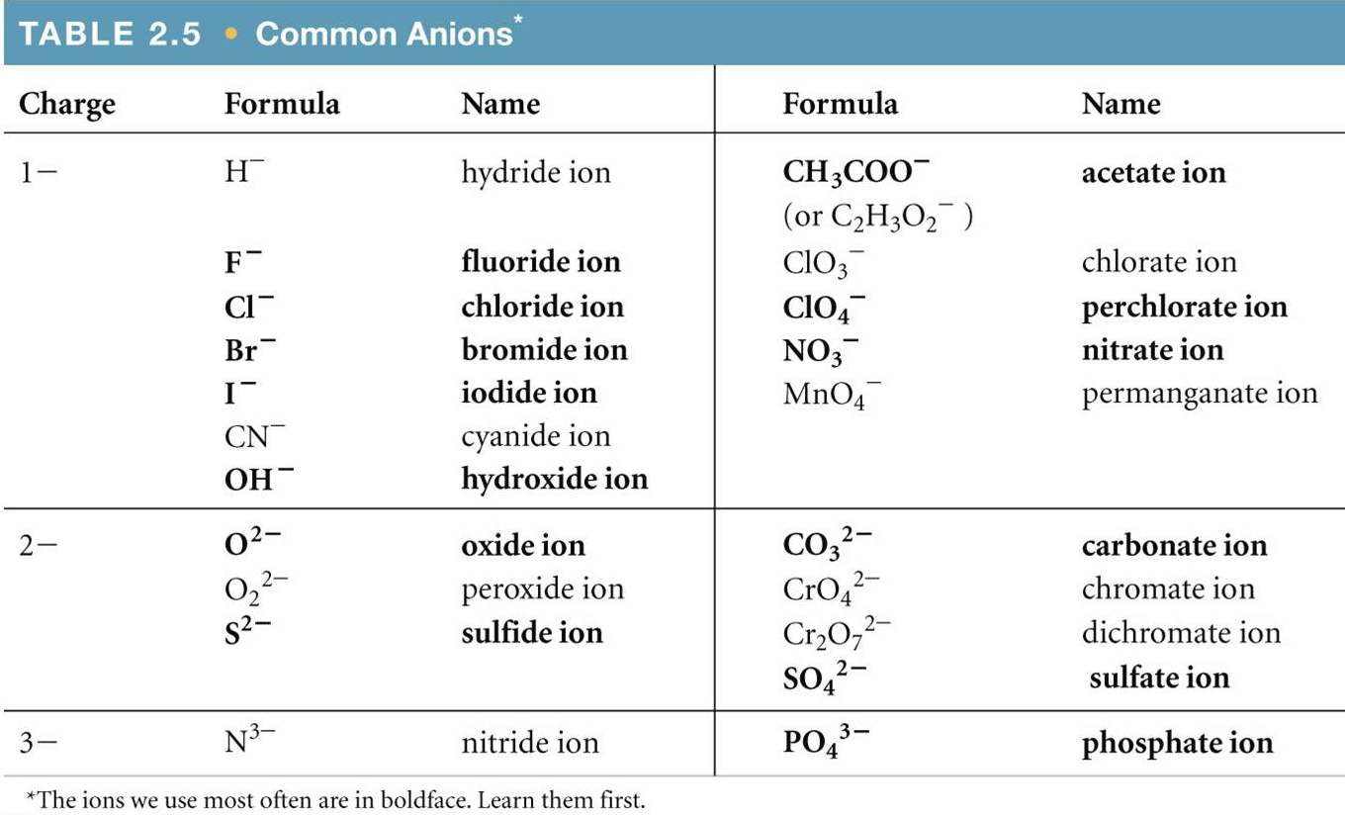
Notes:
Figure: 02-T05
Title:
Table 2.5
Caption:
Common Anions

Slide 24
Li₂CO₃
lithium carbonate
NH₄Cl
ammonium chloride
sodium sulfide
Na₂S
ammonium sulfate
(NH₄)₂SO₄
sodium phosphate
Na₃PO₄

Slide 25
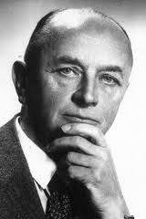
1b. Simple Transition Metal Ionic Compounds (transition metal cation + anion)
The Stock System: Nomenclature for Simple Ionic Compounds containing Transition Metals cations
Alfred Stock 1876 – 1946

Slide 26
1b. Simple Transition Metal Ionic Compounds (transition metal cation + anion)
a. name the transition metal cation first, followed by the charge of the metal (as a Roman numeral in parenthesis). There is NO space between the metal and charge in parenthesis
b. name the anion second
Apply Stock System to Tin, Sn and Lead, Pb even though they are not transition metals
Silver, Ag (always +1); Zinc, Zn (always +2) are transition metals that do NOT require Stock System

Slide 27
CuCl
copper(I) chloride
CuCl₂
copper(II) chloride
FeO
iron(II) oxide
Fe₂O₃
iron(III) oxide
cobalt(II) nitrate
Co(NO₃)₂
BaCl₂
barium chloride
nickel(II) phosphate
Ni₃(PO₄)₂

Slide 28
V₂S₅
vanadium(V) sulfide
mercury(II) iodide
HgI₂
Sr(OH)₂
strontium hydroxide
silver sulfate
Ag₂SO₄
PbO₂
lead(IV) oxide
ZnO
zinc oxide

Slide 29
molecular compounds – compounds made of neutral molecules
molecule – atoms bound together in a neutral, “discrete unit”
molecular compounds vs. ionic compounds
neutral
charged ions
discrete
3-d crystal lattice
nonmetals
metal + nonmetals

Slide 30
CF₄
molecular
K₂O
ionic
NCl₃
molecular
FeCl₂
ionic
GeO₂
ionic
SiO₂
molecular

Slide 31
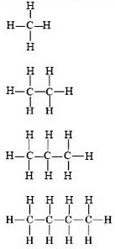
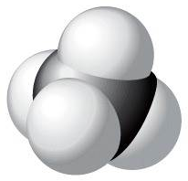
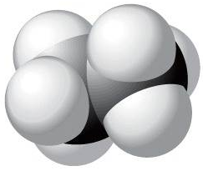
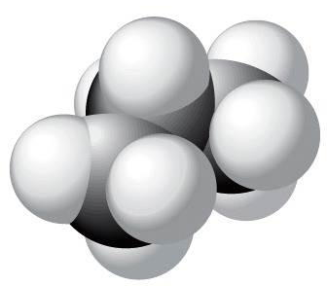
organic cmpds – contains C, H and maybe O, N
hydrocarbons – cmpds contain only C & H
methane CH₄ ethane C₂H₆ propane C₃H₈ butane C₄H₁₀

Slide 32
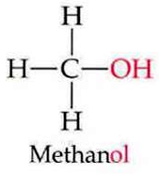
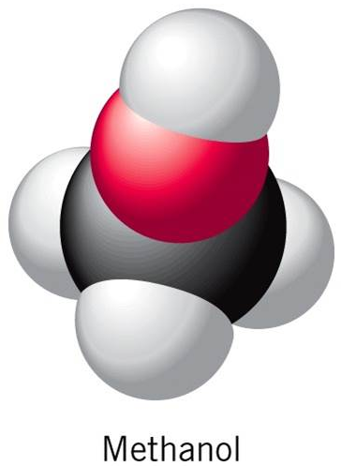
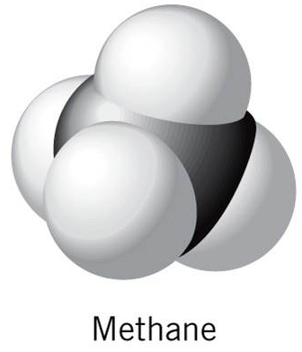
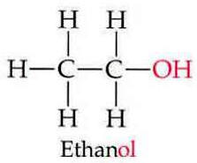
alcohol – contains an “–OH” group
CH₄
CH₃OH
C₂H₅OH
ethane, C₂H₆
CH₃CH₂OH

Slide 33
2. Simple Binary Molecular Compounds
a. name the element furthest to the left on P.T. first or if both elements in the same group, name the lower one first (oxygen & fluorine are named last regardless)
b. specify the number of each element with correct prefix (omit mono- on first element)

Slide 34
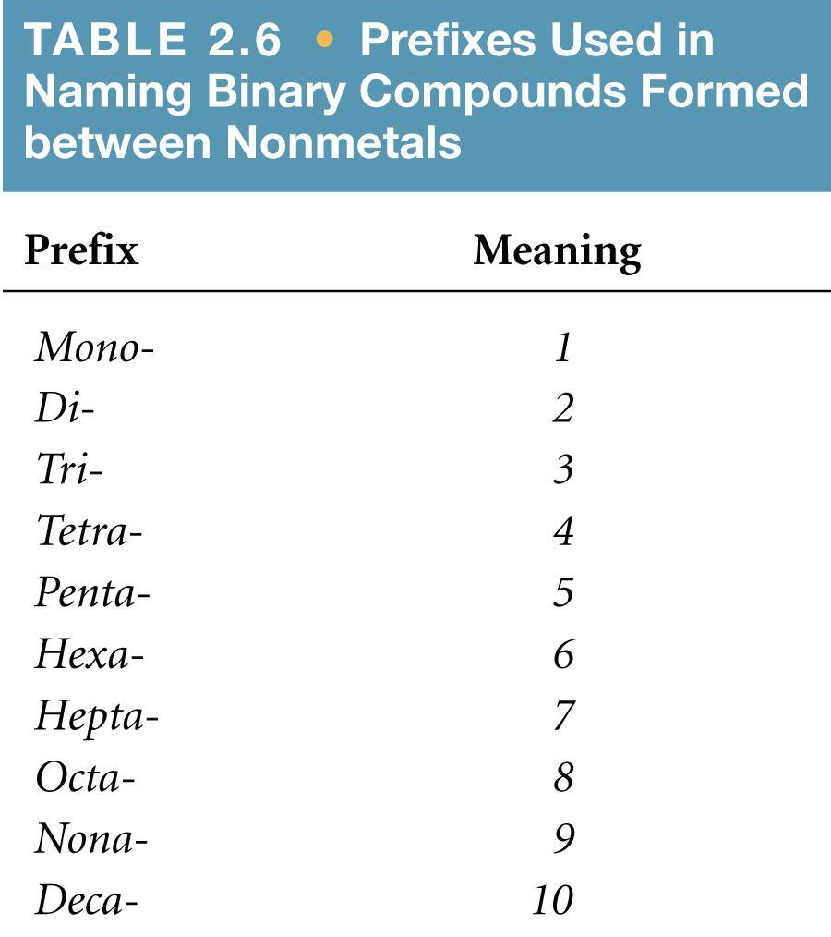
Notes:
Figure: 02-T06
Title:
Table 2.6
Caption:
Prefixes Used in Naming Binary Compounds Formed Between Nonmetals

Slide 35
2. Simple Binary Molecular Compounds
a. name the element furthest to the left on P.T. first or if both elements in the same group, name the lower one first (oxygen & fluorine are named last regardless)
b. specify the number of each element with correct prefix (omit mono- on first element)
c. name the second element (often gets an –ide ending)
* when an element begins w/vowel & prefix of # ends in “a” or “o”, drop the “a” or “o” for pronunciation

Slide 36
CF₄
carbon tetrafluoride
SO₂
sulfur dioxide
Cl₂O₇
dichlorine heptoxide
Na₂O
sodium oxide
CO
carbon monoxide
N₂O₄
dinitrogen tetroxide

Slide 37
3. Hydrates
a. name the ionic portion by the appropriate rules
b. followed by “hydrate” (for water) with the correct prefix specifying the number of waters
CaBr₂·2H₂O
calcium bromide dihydrate
FeCl₃·9H₂O
iron(III) chloride nonahydrate
magnesium nitrate hexahydrate
Mg(NO₃)₂·6H₂O

