Slide 1
Land Snails of Bedoup National Park Lam Dong Province, Vietnam
Robert Wayne Van Devender
Department of Biology
Appalachian State University
Boone, North Carolina

Slide 2
Families of Land Snails
Agriolimacidae – 1 species
Ariophantidae – 7-9 species
Bradybaenidae – 1 species
Camaenidae – 3 species
Cyclophoridae – 3 species
Philomycidae – 1-2 species
Veronicellidae - 1 species from near Dalat
Family unknown – 2 species
Total – 19-22 species

Slide 3
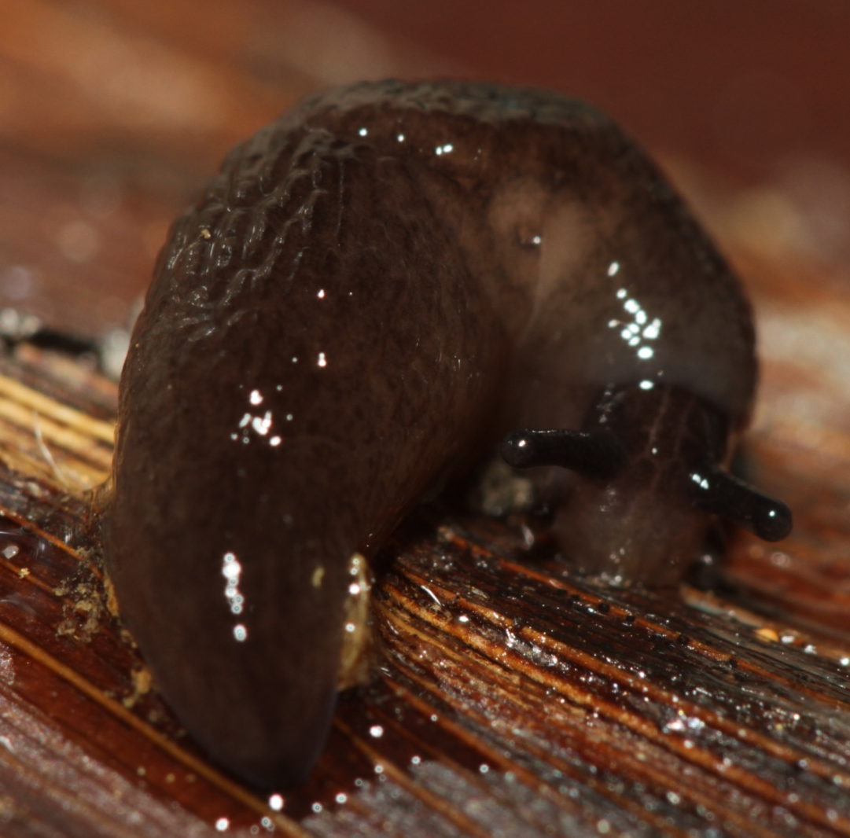
Agriolimacidae
ca. 12 mm in length
From Park Office
Notes:
Resembles Deroceras laeve from the United States.
Non-native species.

Slide 4
Ariophantidae
10 mm in diameter, 4.5 whorls
Notes:
Anal spine and mucous gland present.
Crawls rapidly.
Shell highly polished.

Slide 5
Ariophantidae
ca. 10 mm in diameter, 6 whorls
crawls rapidly
Notes:
Anal spine and mucous gland present.
Crawls rapidly.
Shell highly polished.
Seems to extend part of mantle onto shell.

Slide 6
Ariophantidae
17 mm in diameter, 4.5 whorls
Notes:
Anal spine and mucous gland present.
Sculpture of transverse wrinkles and longitudinal ridges.

Slide 7
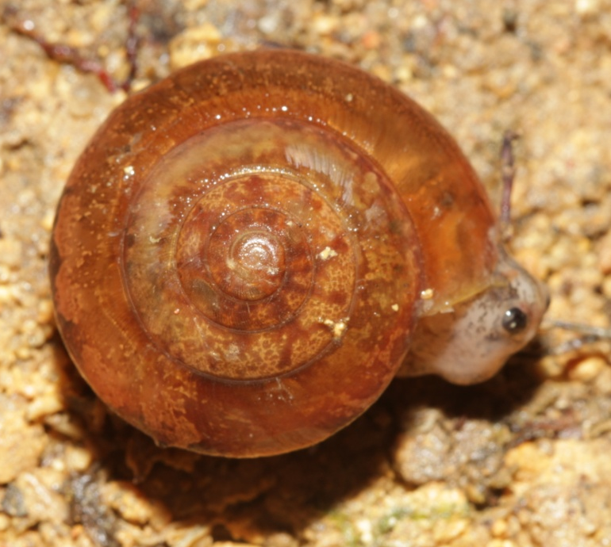
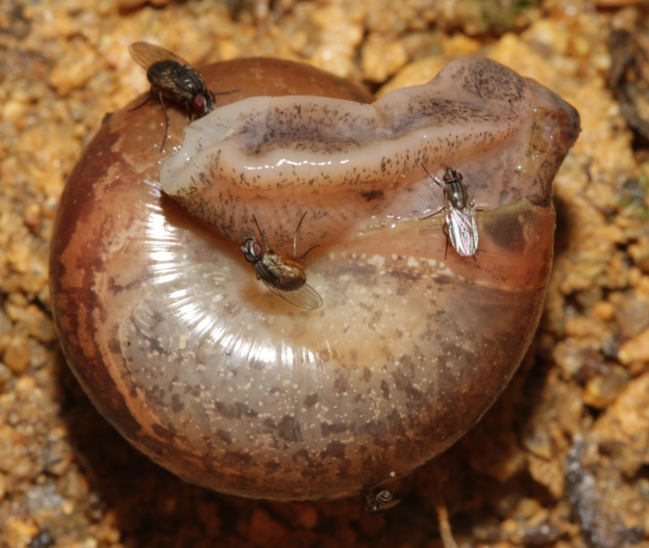
Ariophantidae
23 mm in diameter, 5 whorls
Notes:
Anal spine and mucous gland present.
Distinctive pattern of internal organs.
Umbilicus is perforate.

Slide 8
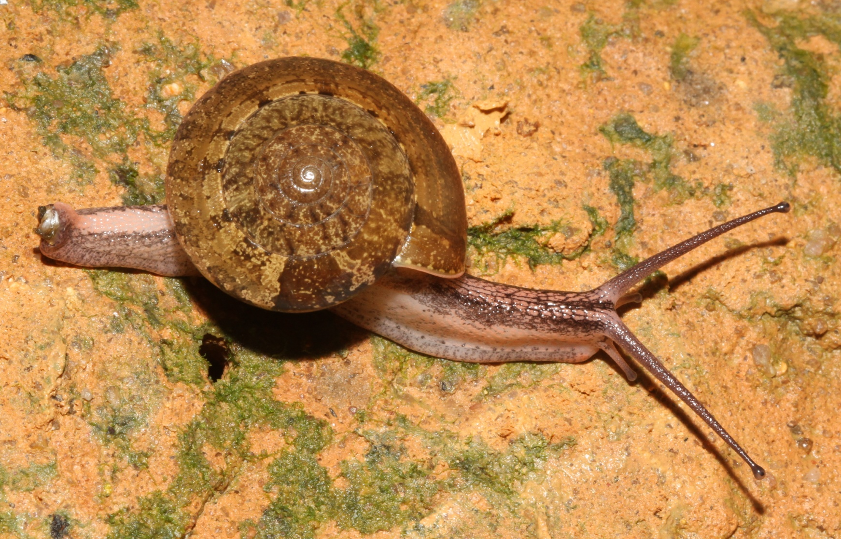
Ariophantidae
ca. 25 mm in diameter, 5.5 whorls
Notes:
Anal spine and mucous gland present.
Distinctive pattern of internal organs.
Umbilicus is perforate.

Slide 9
Ariophantidae
50 mm in diameter, 5.5 whorls
Notes:
Anal spine and mucous gland present.
Distinctive pattern of internal organs.
Umbilicus is perforate.

Slide 10
Ariophantidae
Small, elongate semislug
Notes:
Very elongate with relatively small mantle area.
Shell partially exposed.
Tail strongly compresses laterally.
Paired dark stripes border rufous area anteriorly.

Slide 11
Ariophantidae
Semislug 1
Notes:
Rather compact with bulging shell cavity.
Shell not partially exposed when observed.
Tail strongly compressed laterally.
Foot plain.

Slide 12
Ariophantidae
Semislug 2
Notes:
Rather compact with bulging shell cavity.
Shell not partially exposed when observed.
Tail strongly compressed laterally.
Foot with light and dark banding.

Slide 13
Ariophantidae
Semislug 3
Notes:
Very elongate with relatively small mantle area boldly mottled.
Shell barely visible when crawling.
Tail strongly compresses laterally.
No stripes anteriorly.
Foot with alternating light and dark bands.

Slide 14
Ariophantidae
Semislug, 14 mm shell diameter
Notes:
Rather compact with bulging shell cavity.
Shell partially exposed when crawling.
Tail strongly compressed laterally.
Foot with some dark banding.
May be dark stripes on anterior.

Slide 15
Ariophantidae
Semislug with eggs
Notes:
Rather compact with bulging shell cavity.
Shell not partially exposed when observed.
Tail strongly compressed laterally.
Foot with light and dark banding.
Egg mass produced after capture.
Eggs pinkish.

Slide 16
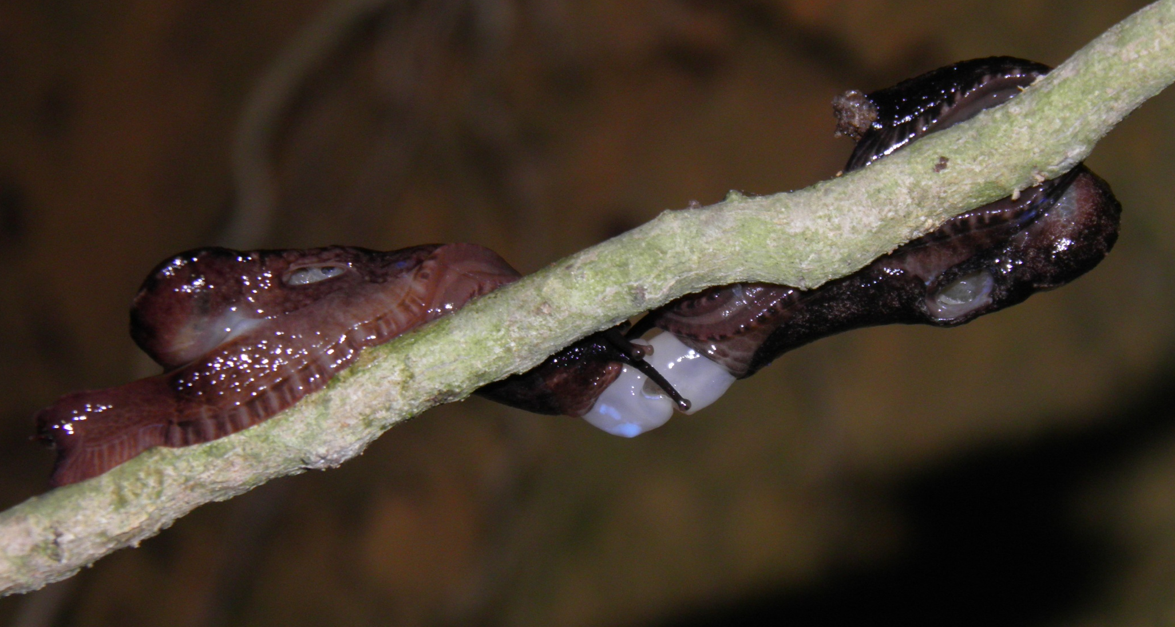
Ariophantidae
Semislugs mating
Notes:
Rather compact with bulging shell cavity.
Shell not partially exposed when observed.
Tail strongly compressed laterally.
Foot with light and dark banding.
Mating on a root below an overhang in a road cut.

Slide 17
Ariophantidae
Smaller semislug
Notes:
Rather compact with bulging shell cavity.
Shell partially exposed when observed.
Tail strongly compressed laterally.
Foot with light and dark banding.
Probably a juvenile.

Slide 18
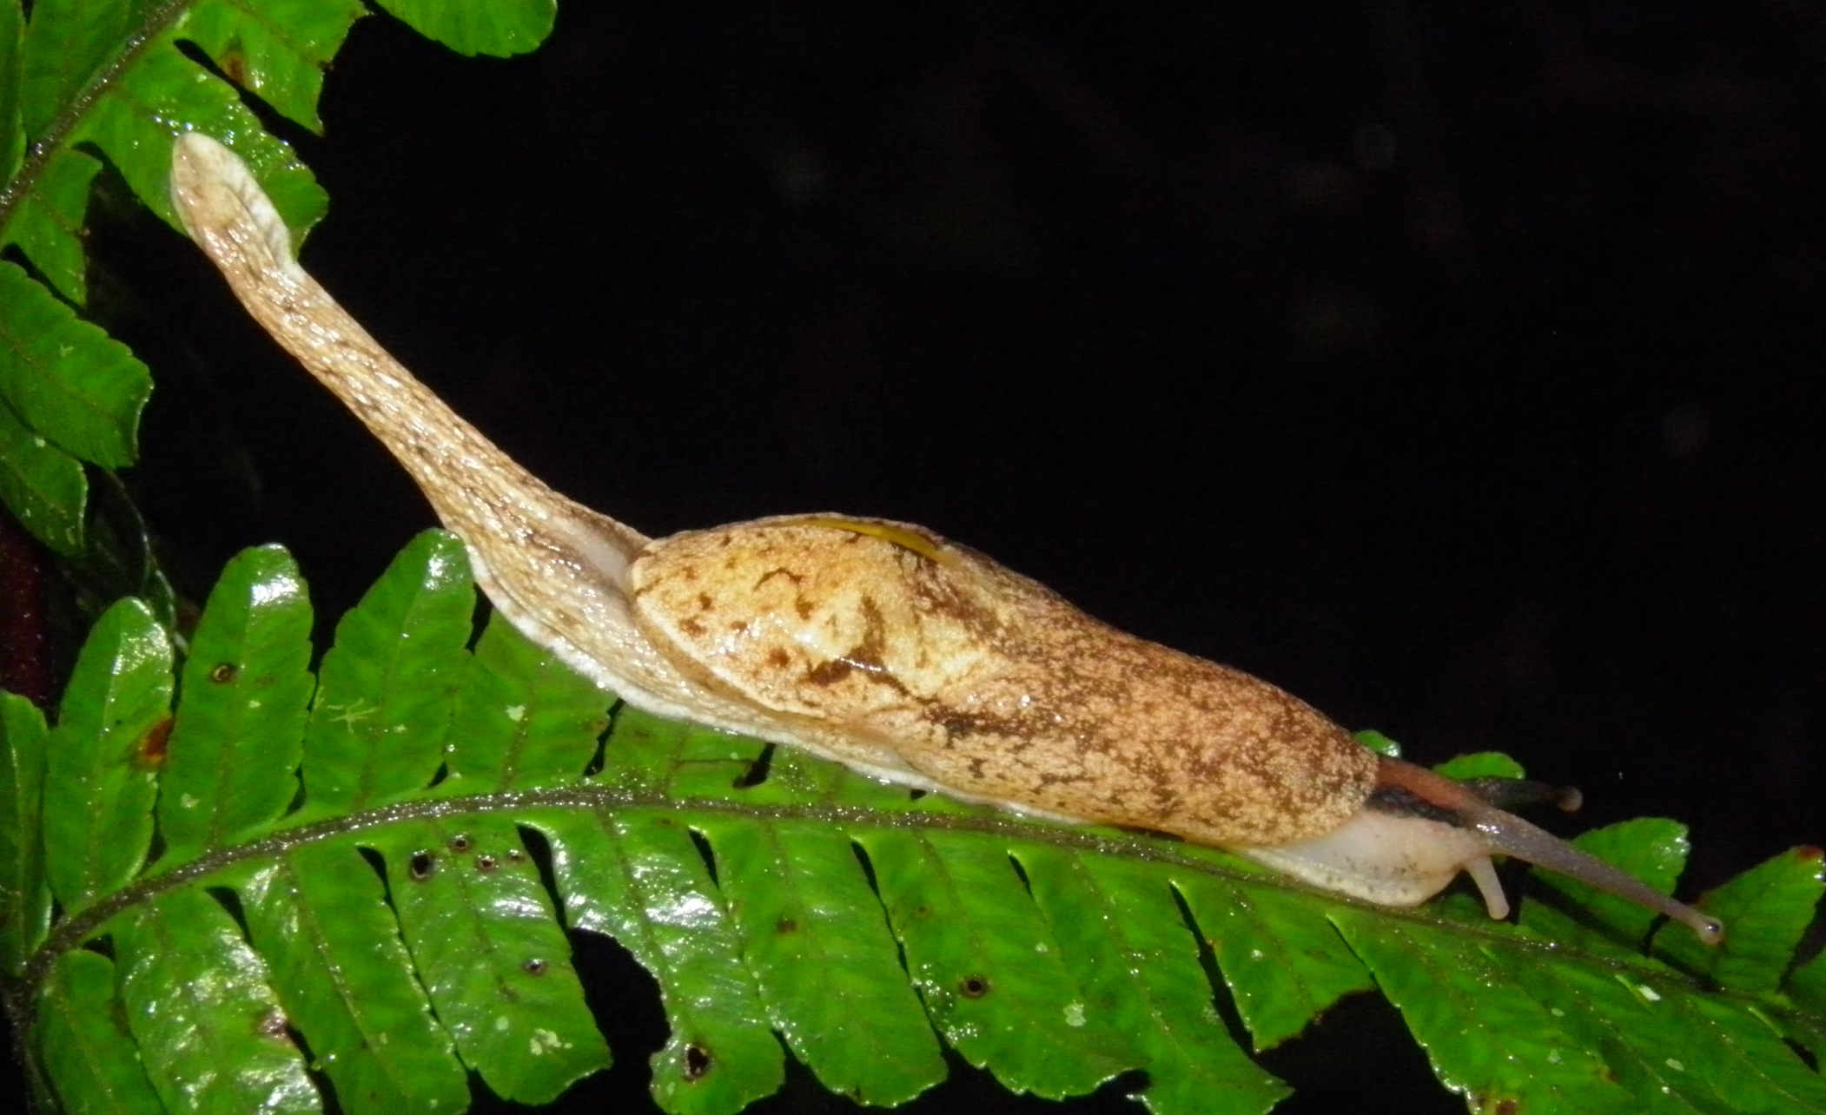
Ariophantidae
Paler semislug
Notes:
Rather compact with bulging shell cavity.
Shell partially exposed when observed.
Tail strongly compressed laterally.
Foot with faint crossbands.
Overall coloration pale.
Anterior dark stripes contain central rufous area.

Slide 19
Bradybaenidae
12 mm diameter
14 mm diameter
From park office
Notes:
Found in abundance around Park Office,
Adults have reflected lip and open umbilicus.
Some individuals have lateral stripes.
Probably an invasive species associated with humans.

Slide 20
Camaenidae – Amphidromus sp.
25 mm shell height
Notes:
Green body whorl after conspicuously banded apical whorls.
Lip deep purple.
Body very pale.

Slide 21
Camaenidae – Amphidromus sp.
20 mm shell height
Notes:
Shell somewhat obese and greenish.
No apical banding
Body pale with darker upper antennae.

Slide 22
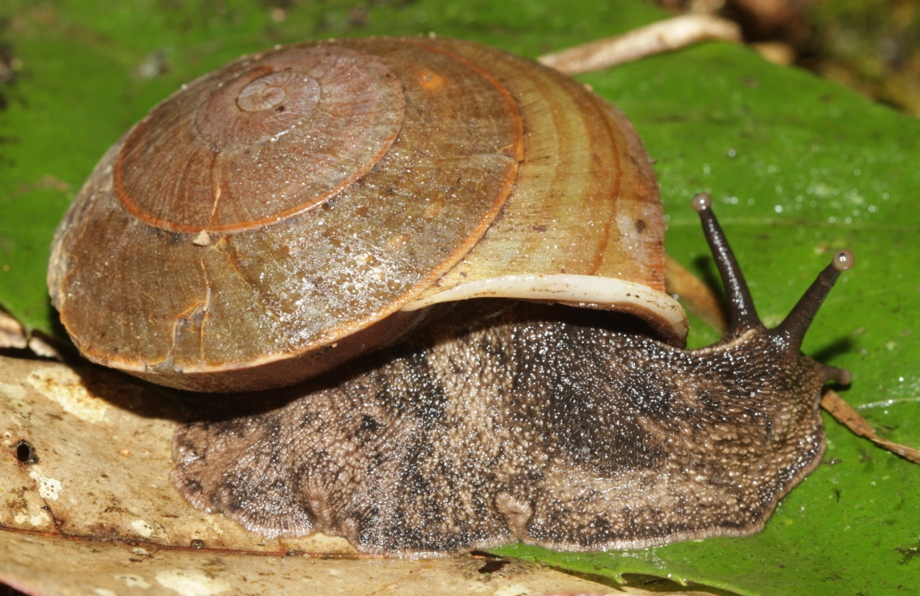
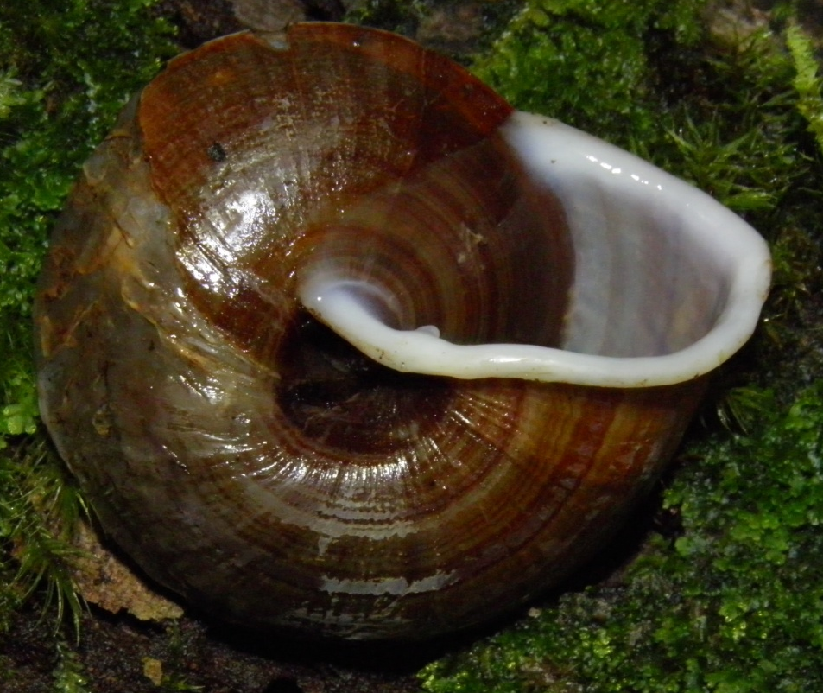
Camaenidae – Nasiohelix sp.
53 mm shell diameter
Notes:
Shell shape and sculpture similar to other Nasiohelix.
Umbilicus open.
Lip is reflected and bears a small tooth.
Periphery is angulate.
Pinkish mid-dorsal stripe present.

Slide 23
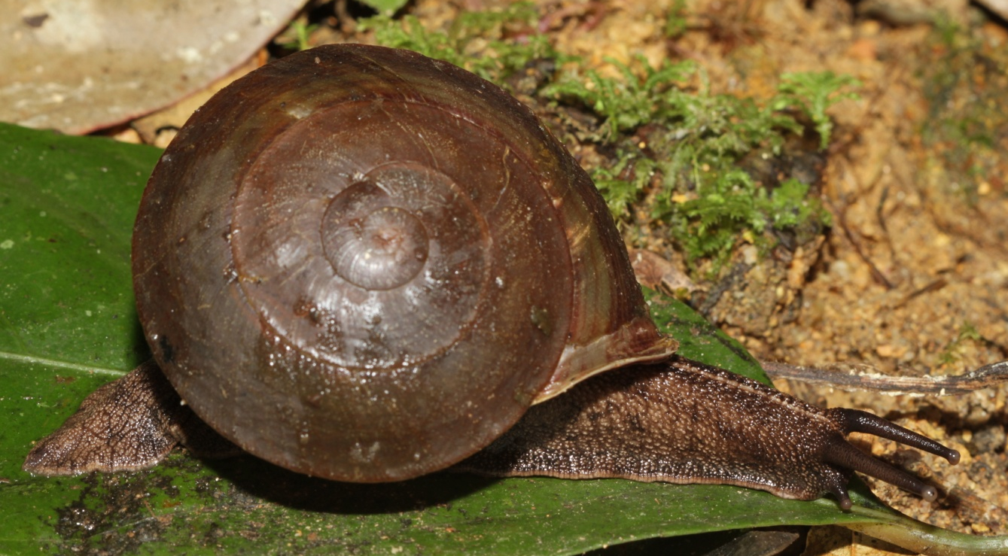
Camaenidae – Nasiohelix sp.
55 mm shell diameter
Notes:
Shell shape and sculpture similar to other Nasiohelix.
Umbilicus open.
Lip is reflected and without a small tooth.
Periphery is angulate.
Pinkish mid-dorsal stripe present.

Slide 24
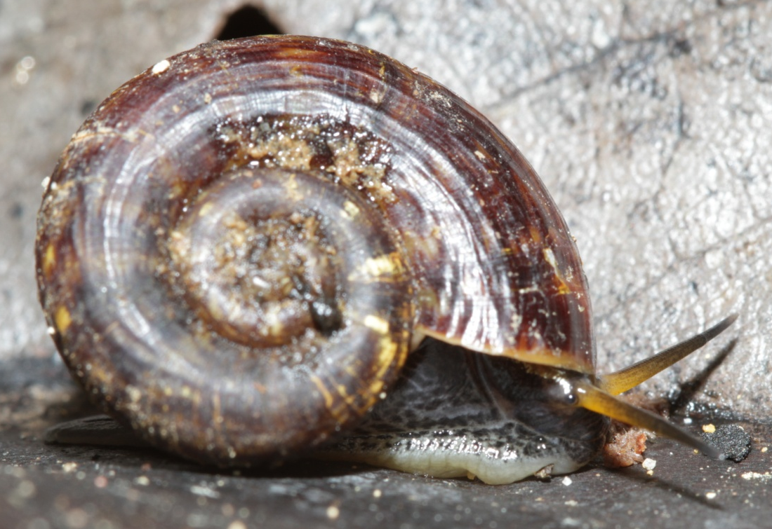
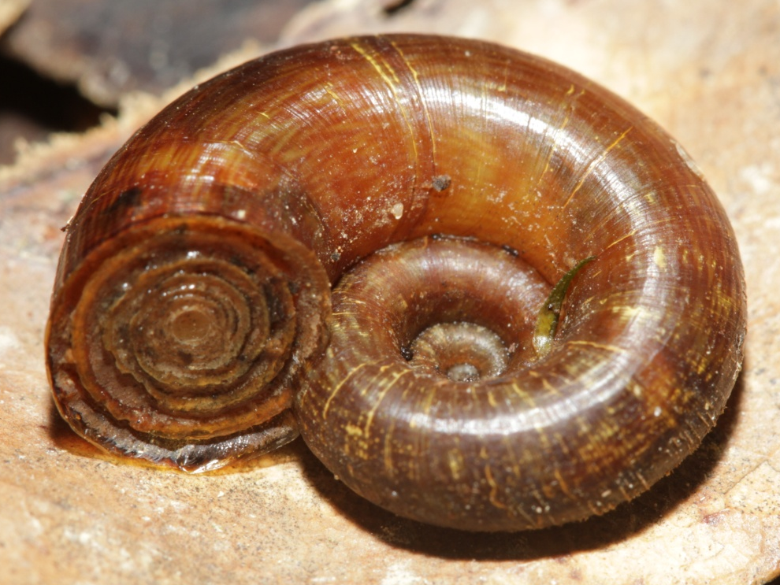
Cyclophoridae
18 mm shell diameter
Notes:
Very flat and widely umbilicate.
Lip is simple and unreflected.
Operculum with concentric ridges.
Longitudinal ridging present.

Slide 25
Cyclophoridae
ca. 20 mm shell diameter
Notes:
Very flat and widely umbilicate.
Lip is simple and unreflected.
Operculum with concentric ridges.
Longitudinal ridging present.

Slide 26
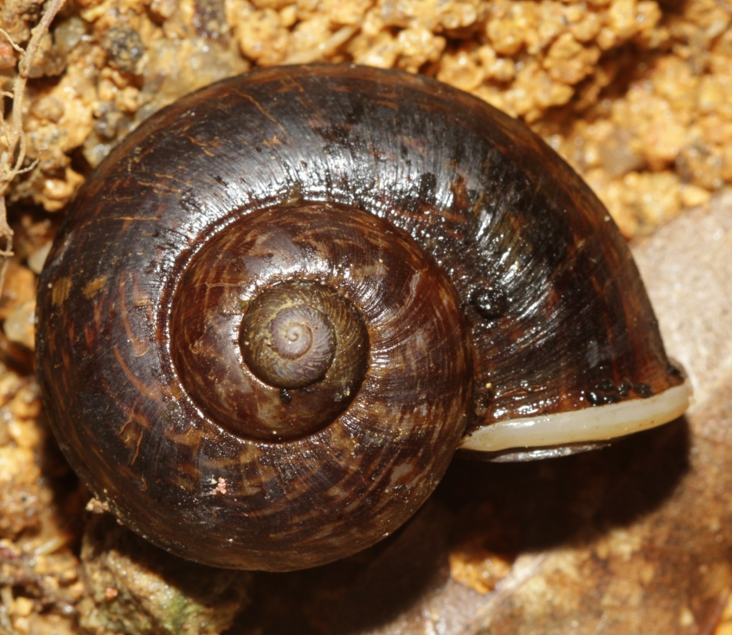
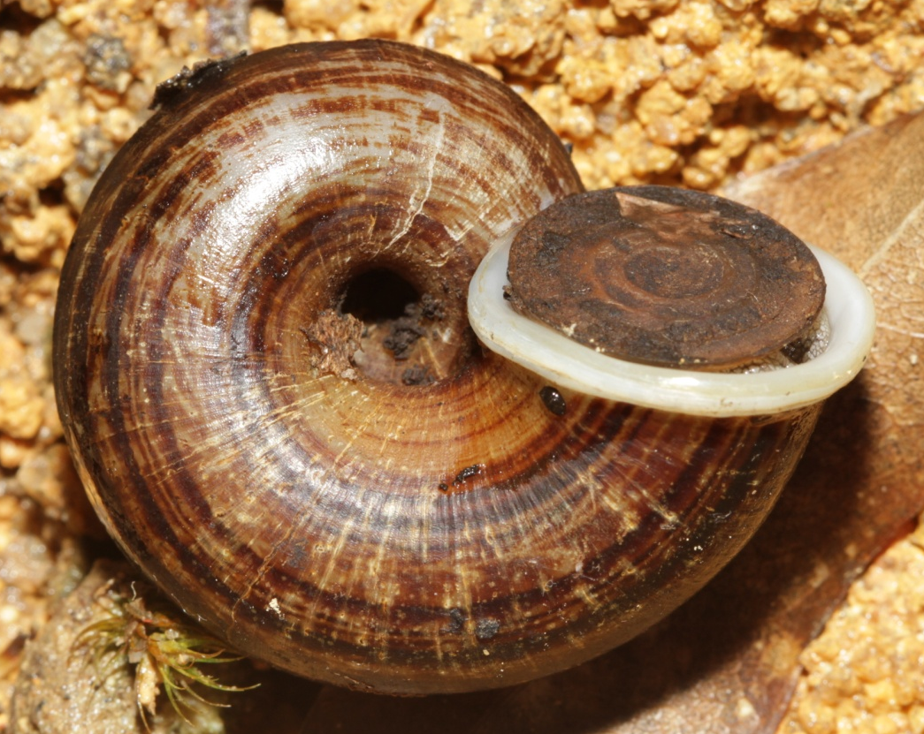
Cyclophoridae – Cyclophorus sp.
35 mm shell diameter, almost 5 whorls
Notes:
Larger snail with somewhat elevated spire.
Umbilicus fairly small.
Lip is reflected.
Operculum shows apiral ridges.

Slide 27
Cyclophoridae – Cyclophorus sp.
35 mm shell diameter
Notes:
Spire elevated.
Antennae very long and active.
Umbilicus moderaly large.

Slide 28
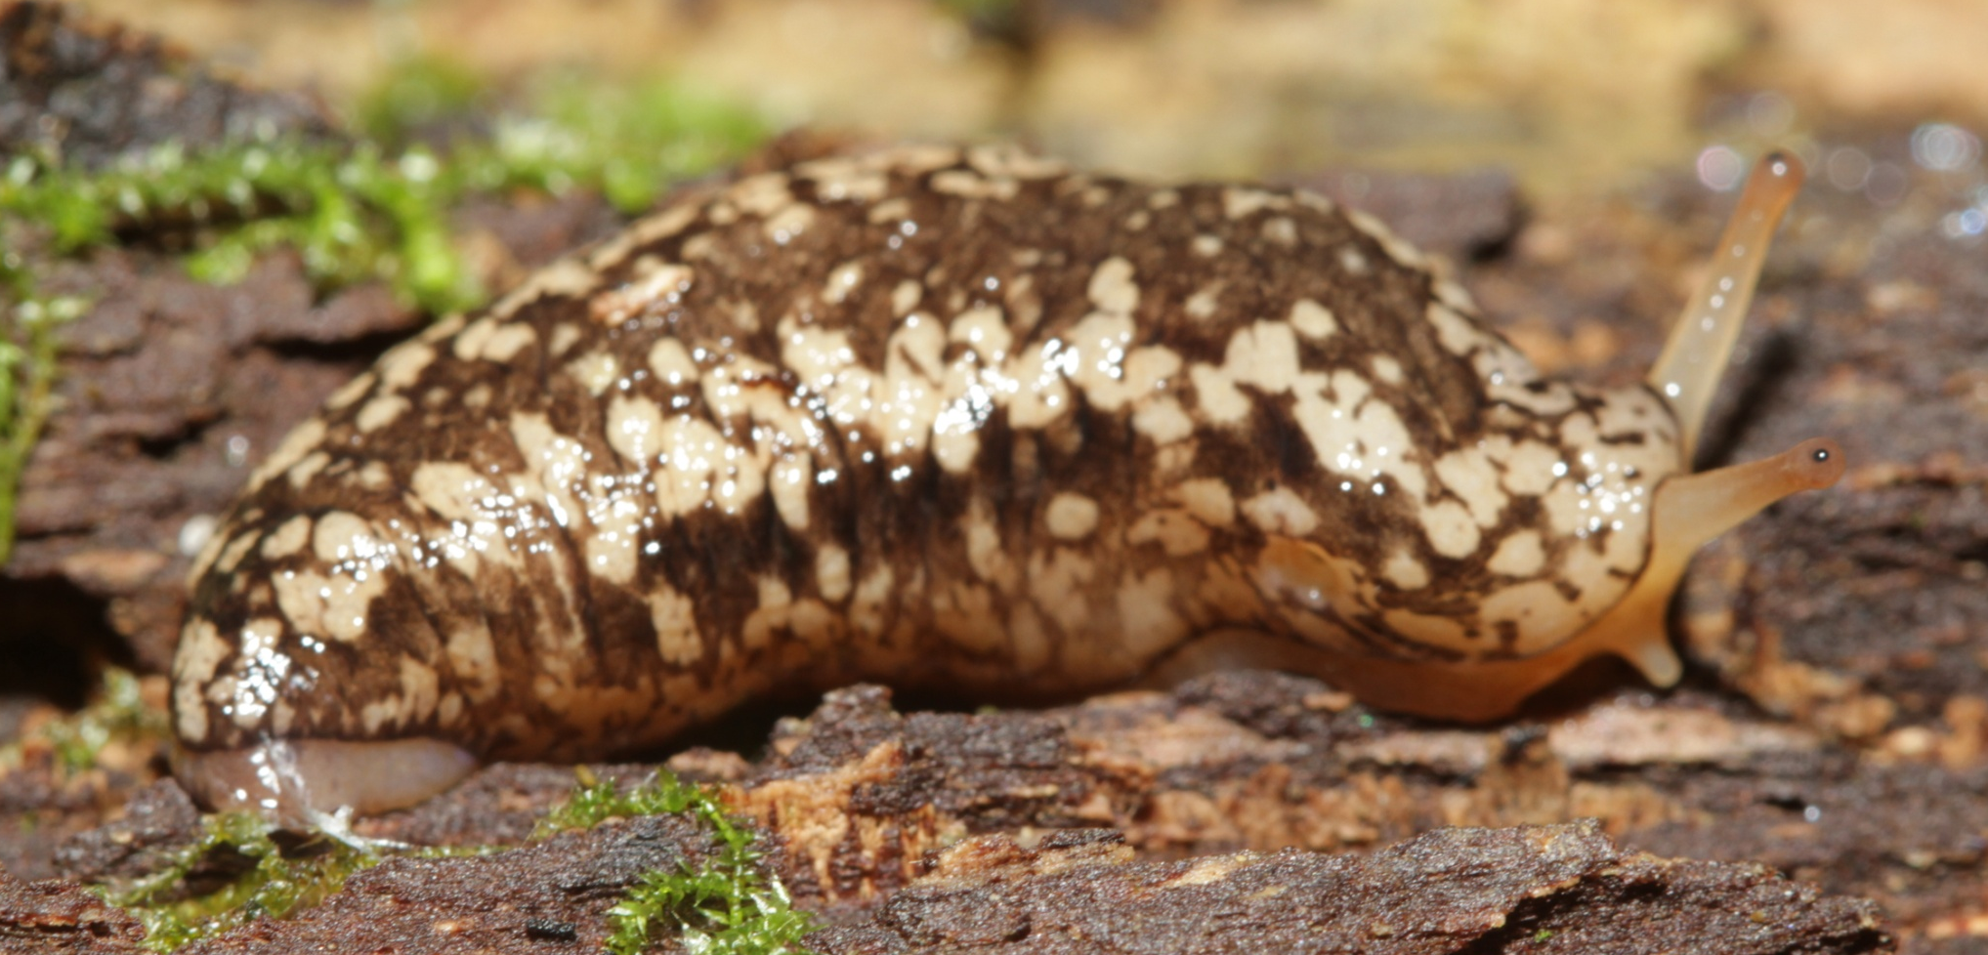
Philomycidae
>33 mm in length
Notes:
Mantle covers most of the body.
Mottled pattern includes a somewhat darker lateral band.

Slide 29
Philomycidae
>33 mm in length
Notes:
Mantle covers most of the body.
Mottled pattern includes an indistinct lateral band.

Slide 30
Philomycidae
Notes:
Mantle covers most of the body.
Mottled pattern includes a darker lateral band.
Found commonly on rotting stumps and logs.

Slide 31
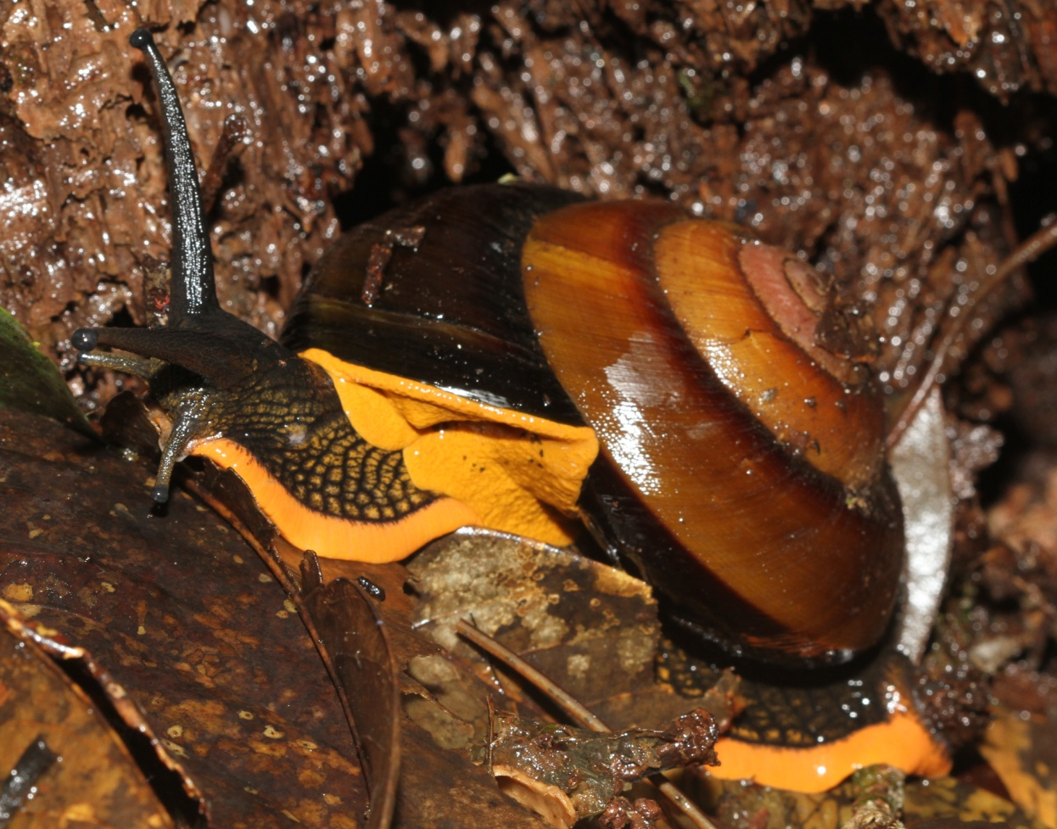
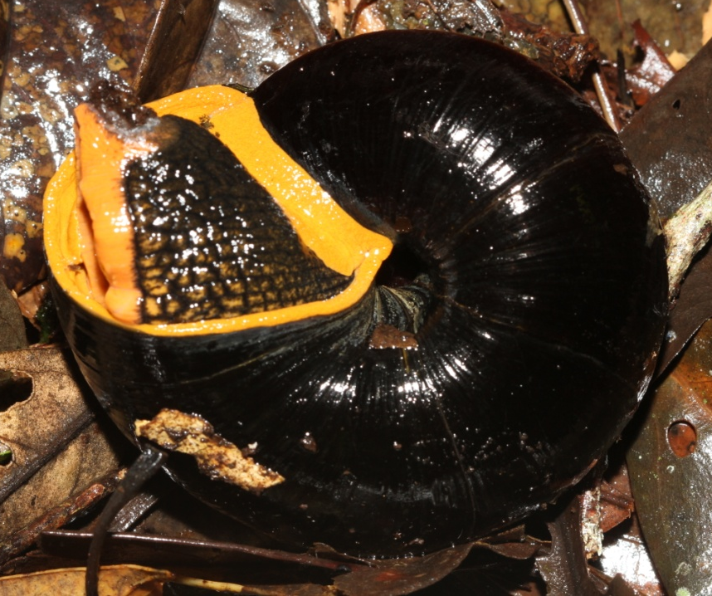
Bertia species
90 mm shell diameter
Notes:
Immense, sinistral snail with orange foot and mantle.
Mucous gland is immense and produces copious amounts of yellow slime.
May be a new species related to Bertia cambojiensis.

Slide 32
Conic snails
9-10 mm shell diameter
6-7 whorls
Notes:
Family is uncertain.
Distinctly conic with an angular periphery.
Umbilicus is open.

