Slide 1
Is it “Seeing is Believing” or “Believing is seeing”?
Robert Wayne Van Devender
Retired from
Department of Biology
Appalachian State University

Slide 2
What is involved in “Seeing”?
Imaging and image
Image processing
Image scale
Experience of observer
Background information - vocabulary

Slide 3
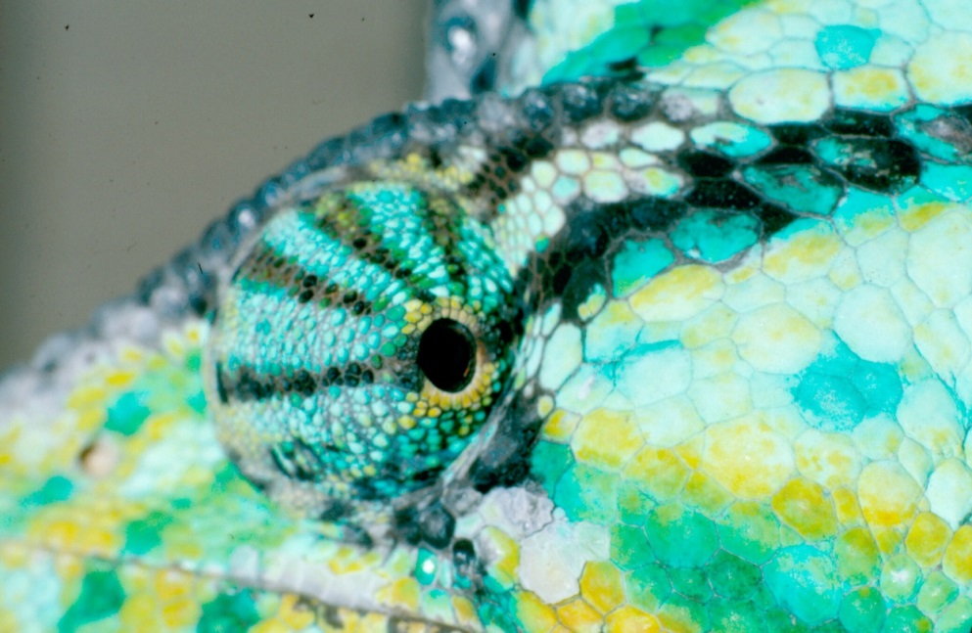
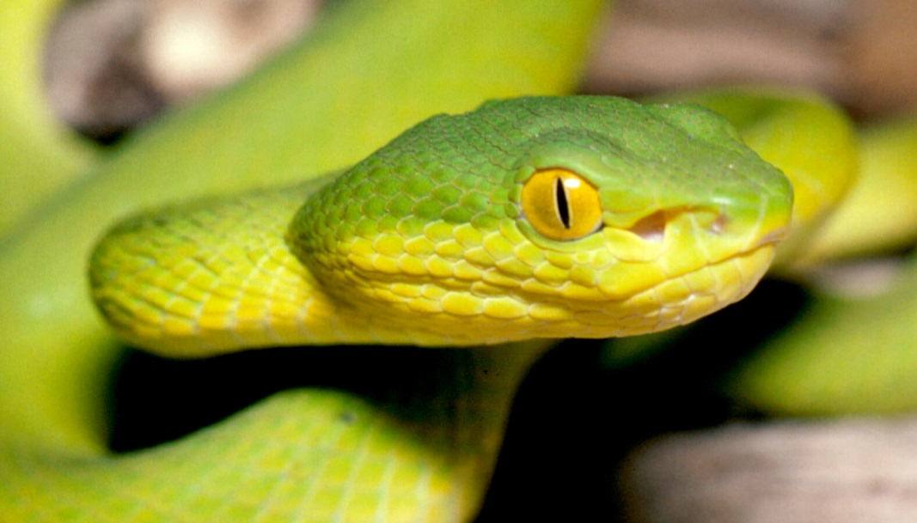

Slide 4
Three case studies
Eastern Tennessee hillside
South Carolina roadside snails
Cat Tien National Park, Vietnam

Slide 5
Case study one Ocoee Gorge, Tennessee, USA

Slide 6
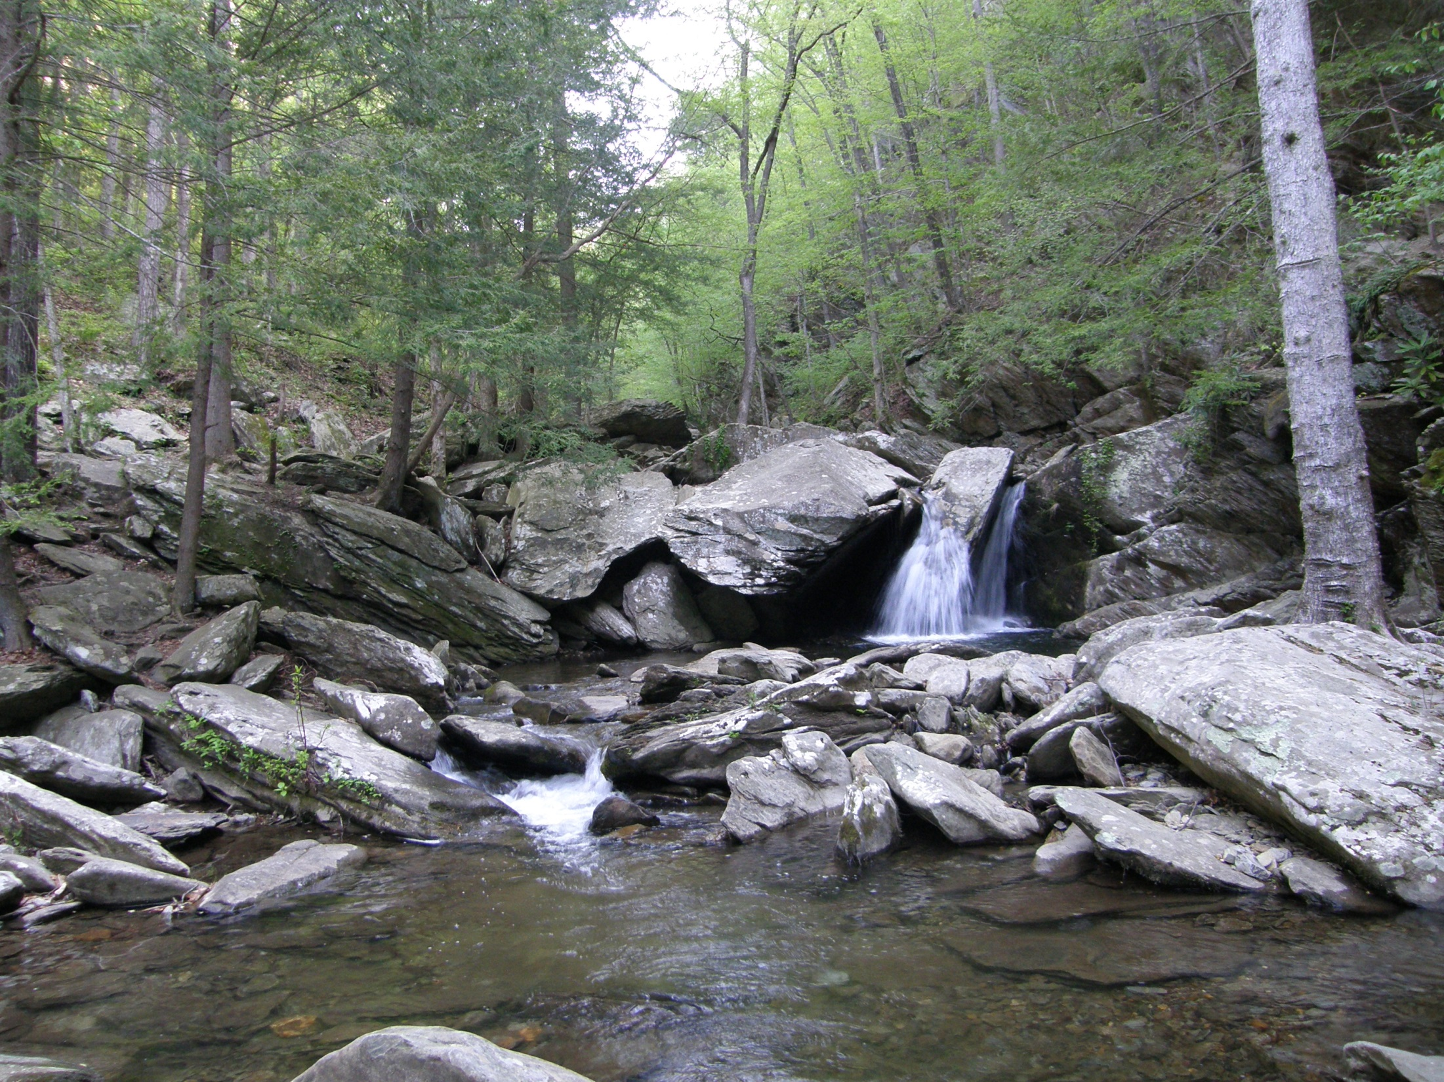

Slide 7
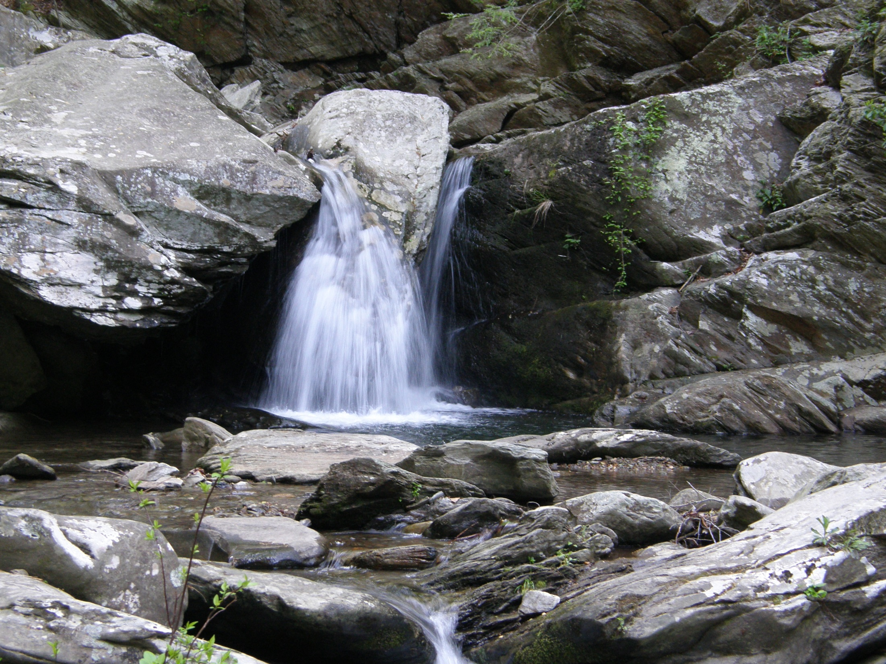

Slide 8
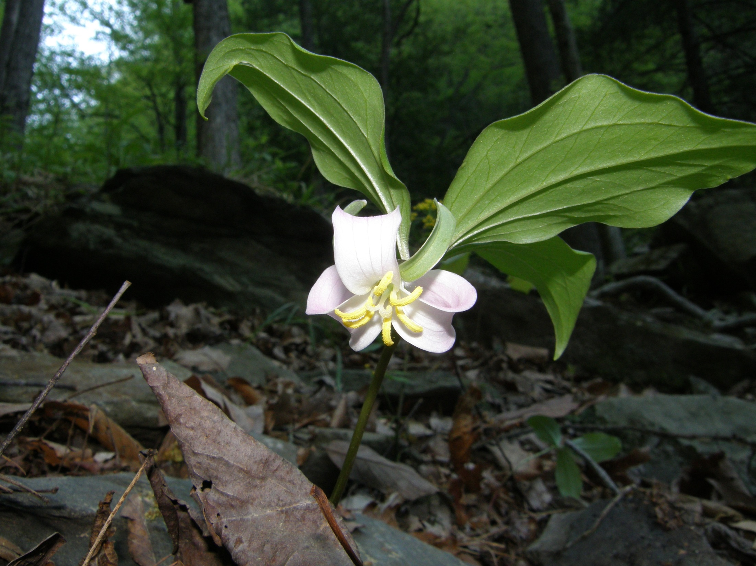

Slide 9
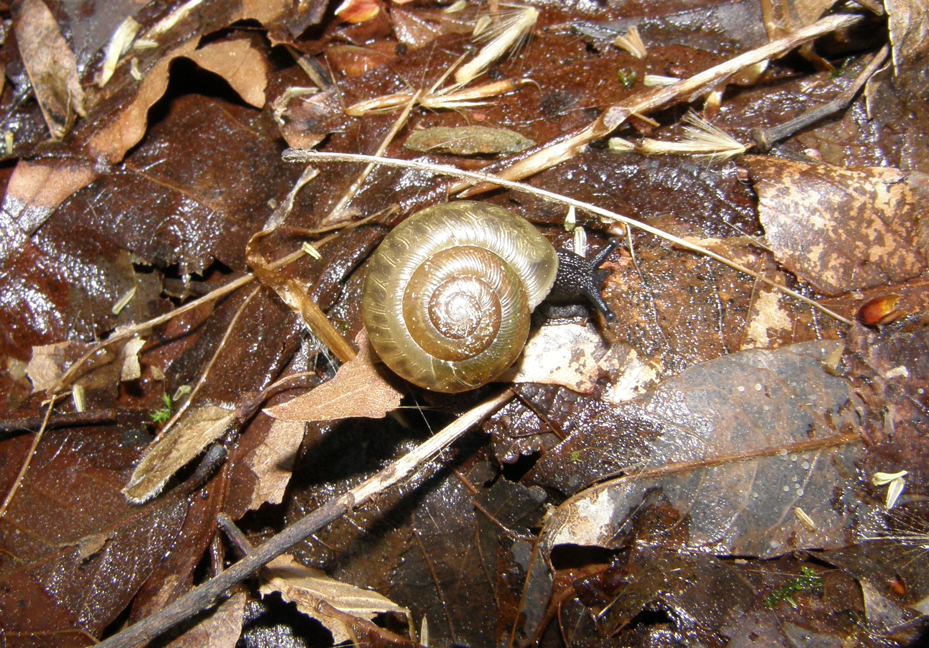

Slide 10
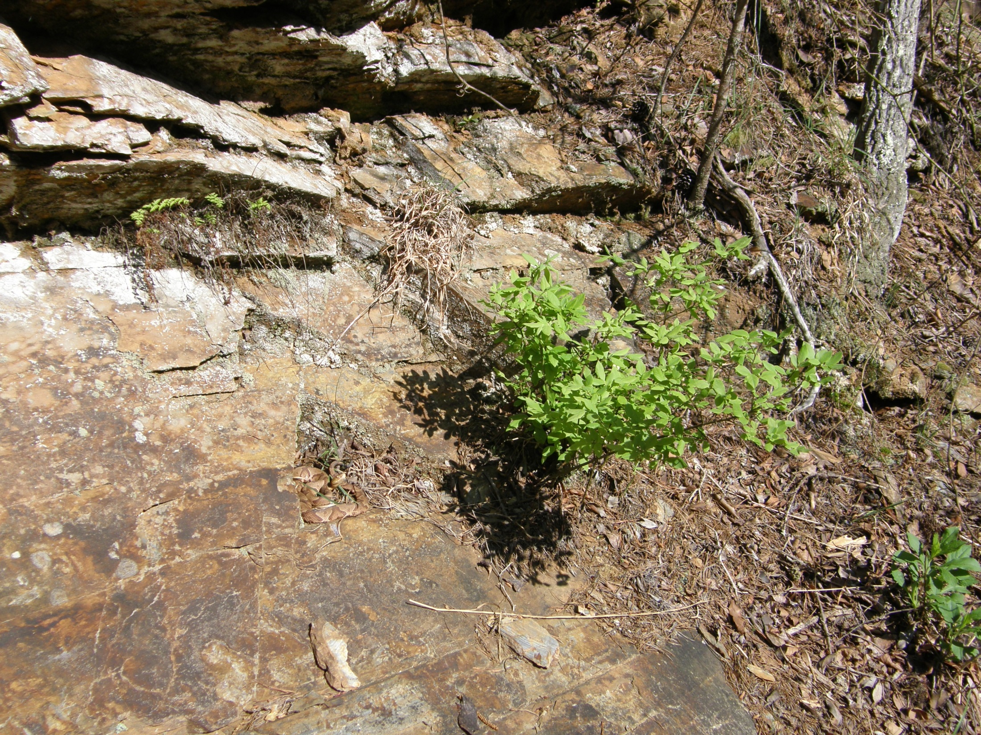

Slide 11
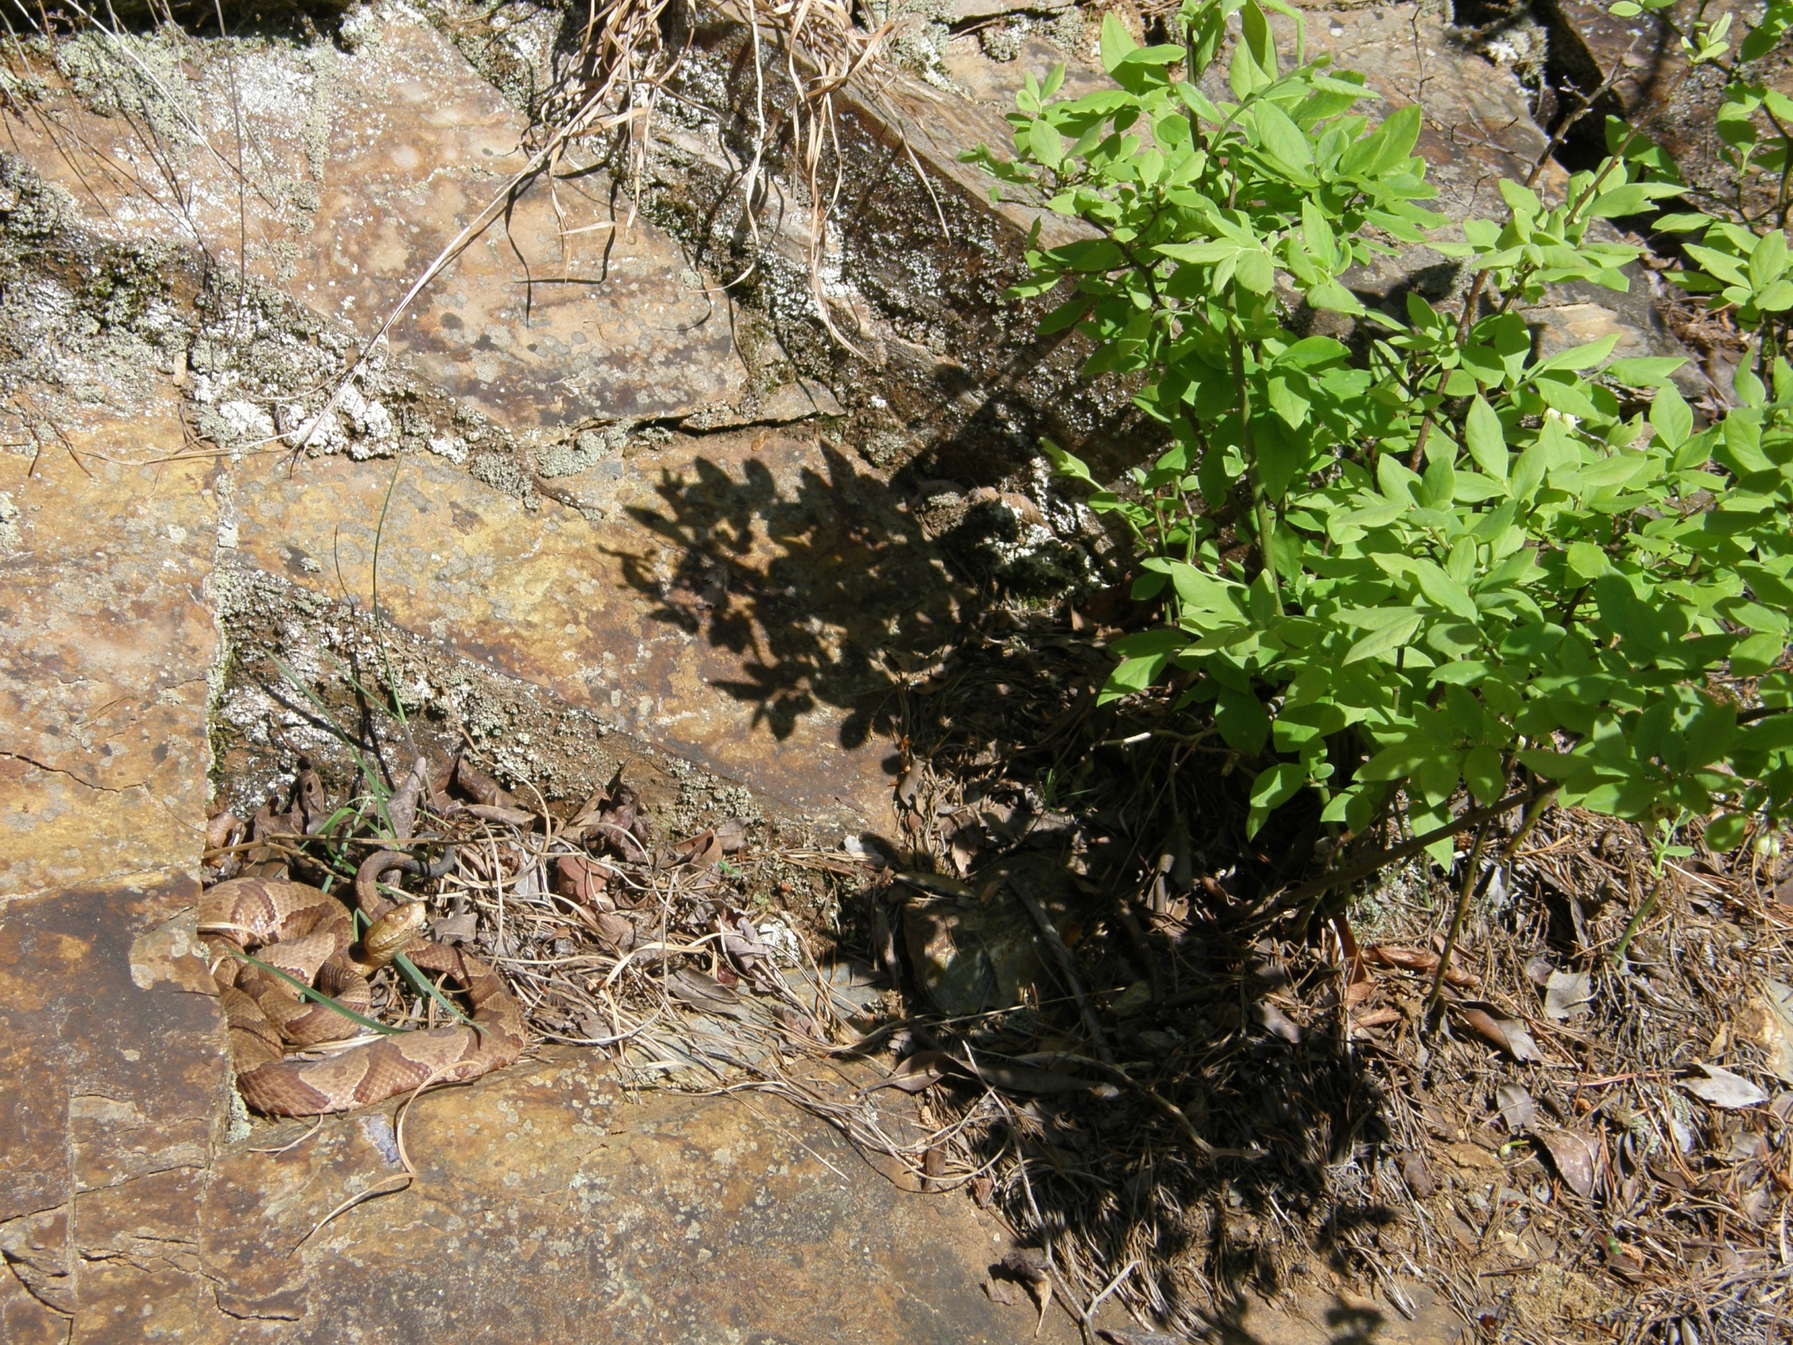

Slide 12
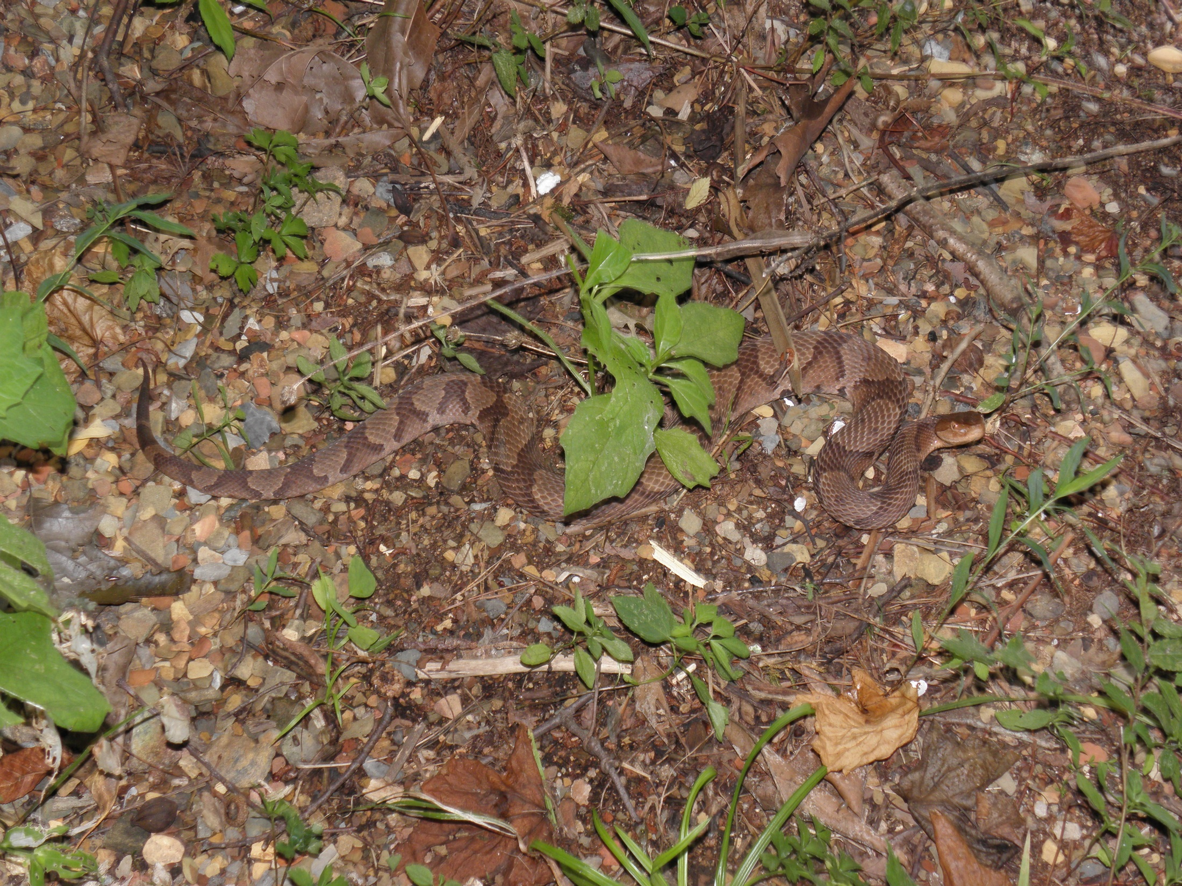

Slide 13
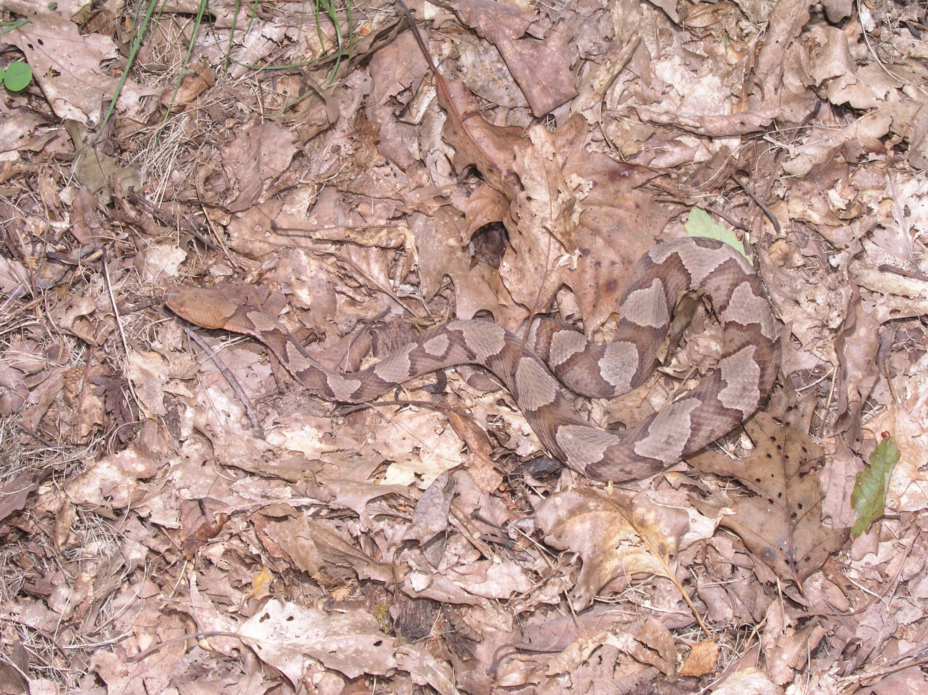

Slide 14
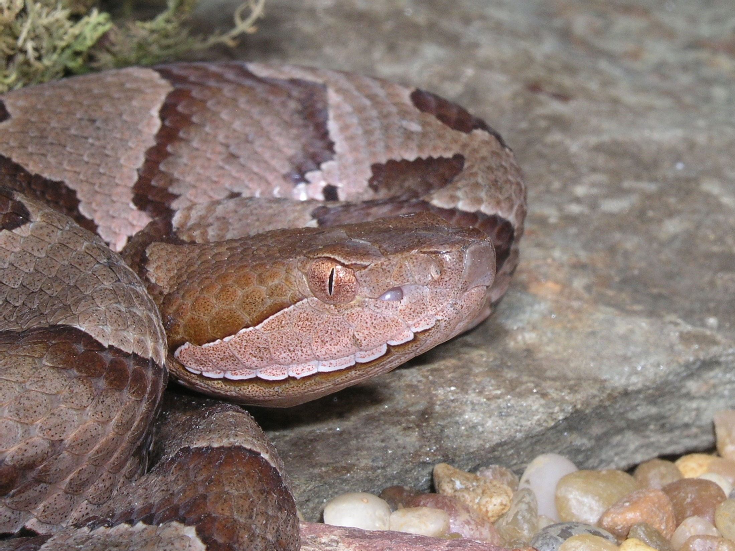

Slide 15
Case study two roadside snails North Carolina & South Carolina, USA

Slide 16
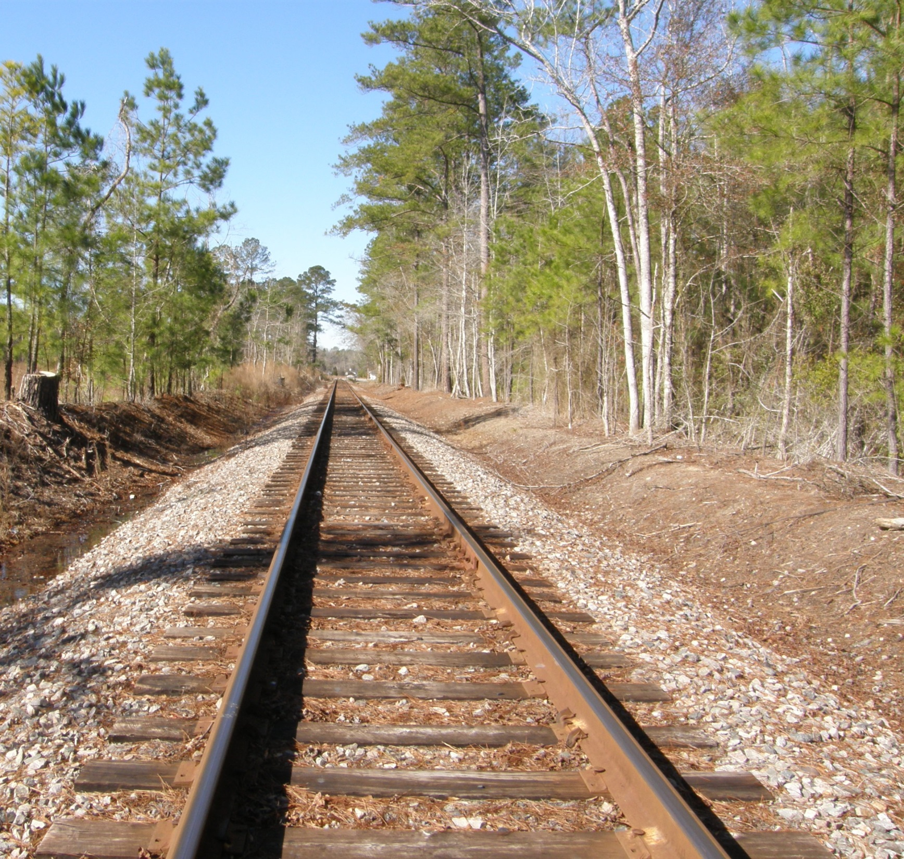

Slide 17
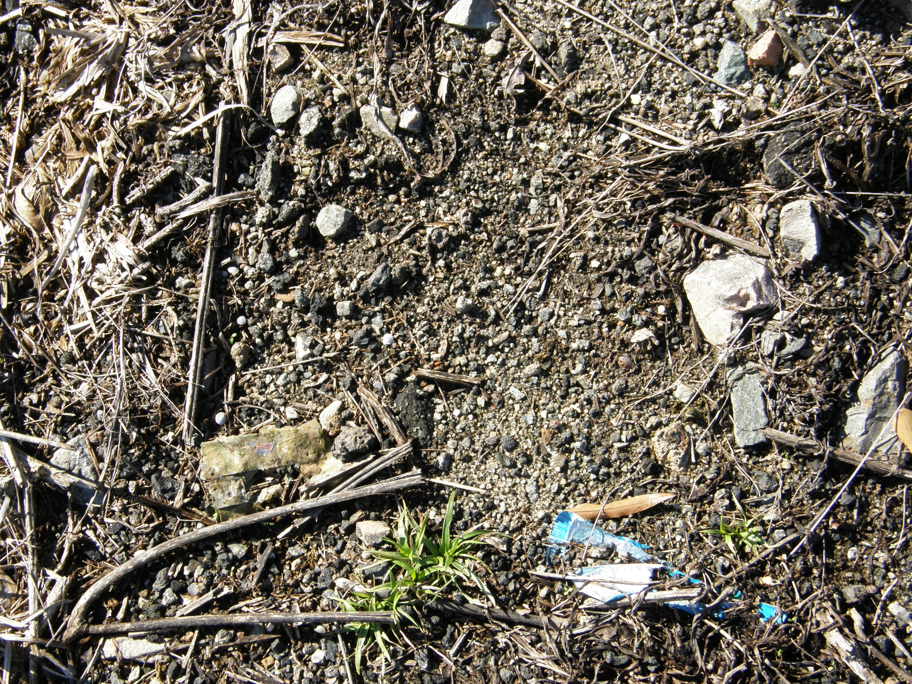

Slide 18
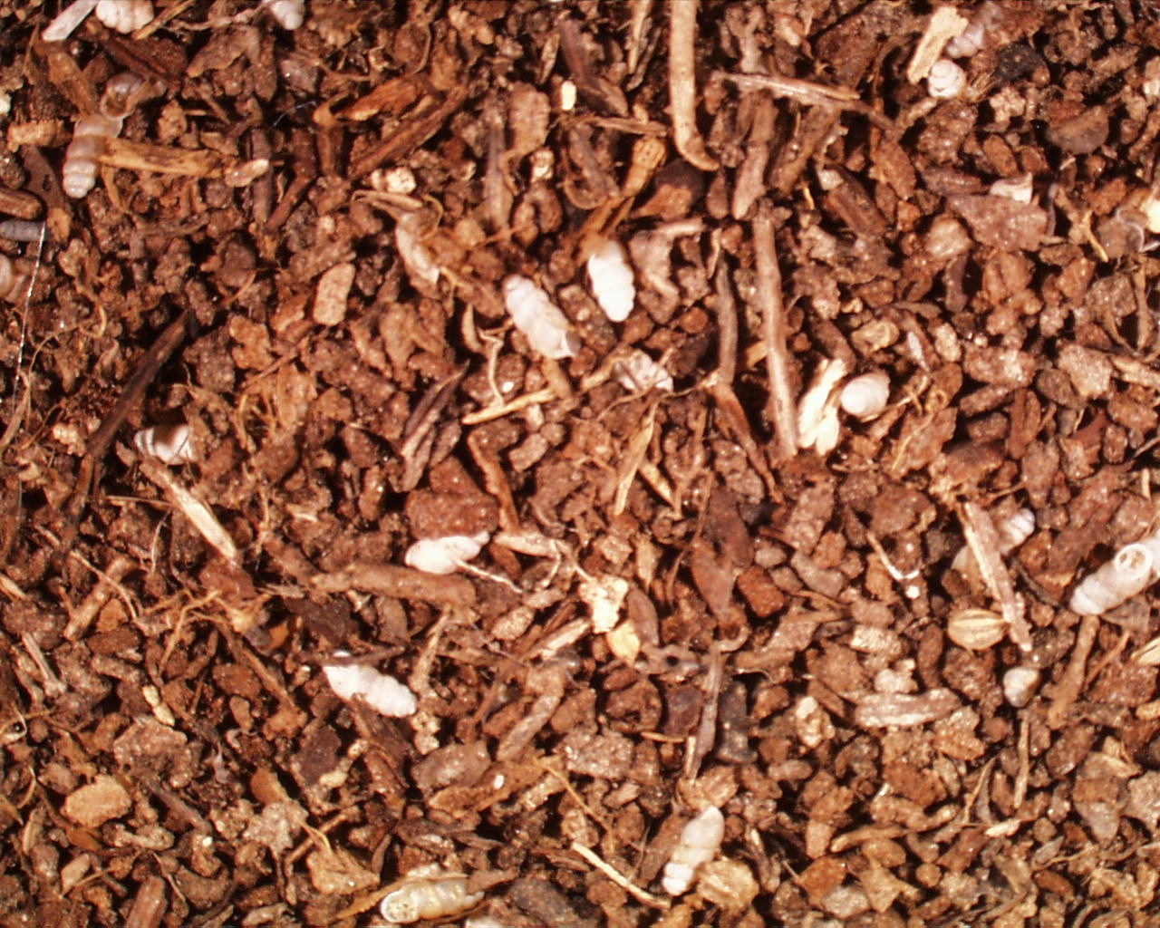

Slide 19
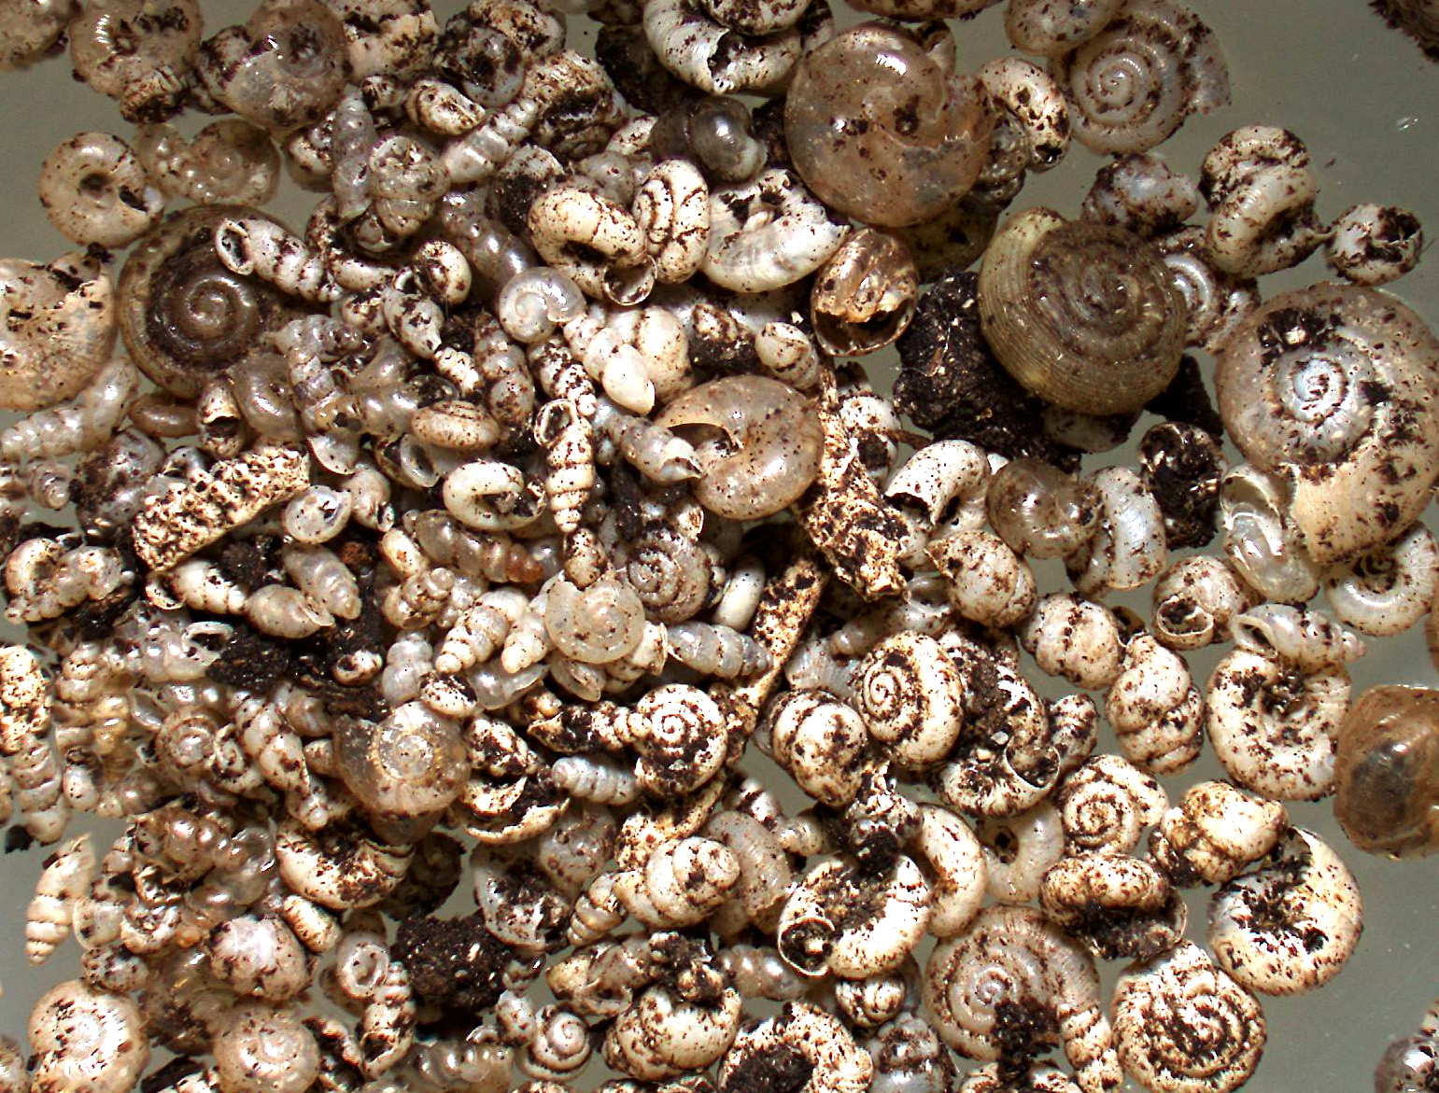

Slide 20
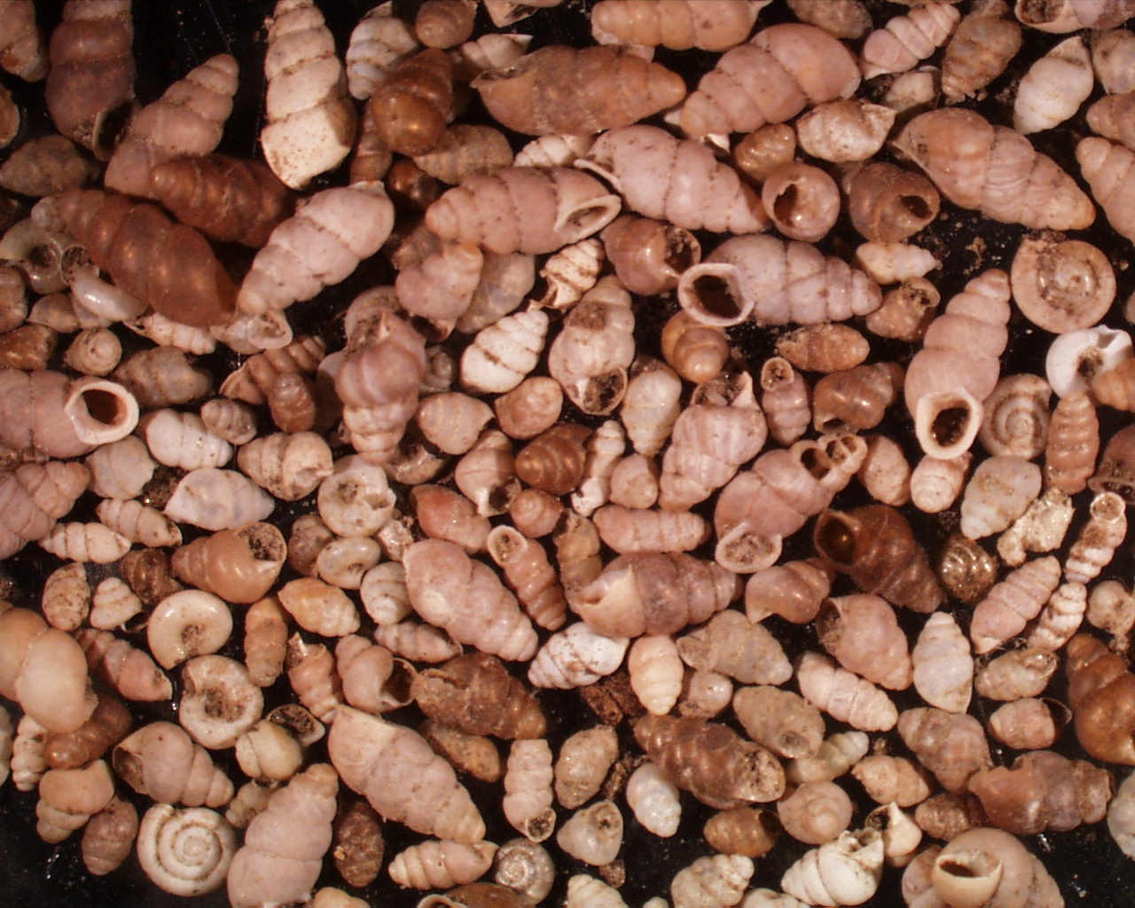

Slide 21
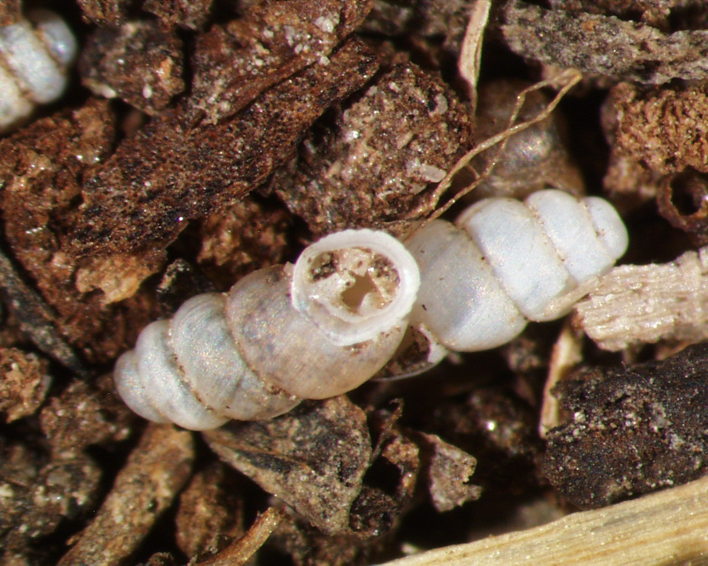

Slide 22
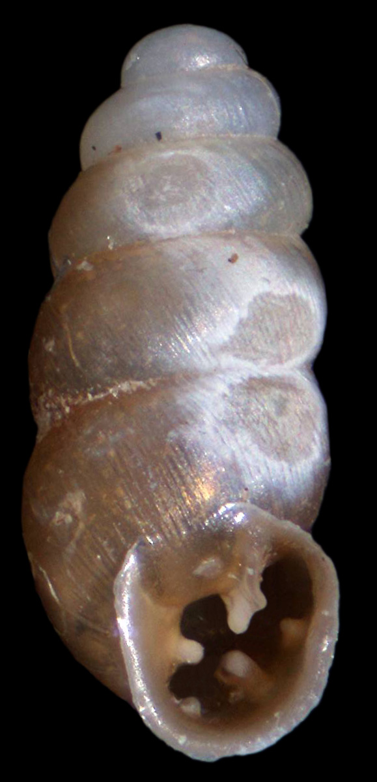

Slide 25
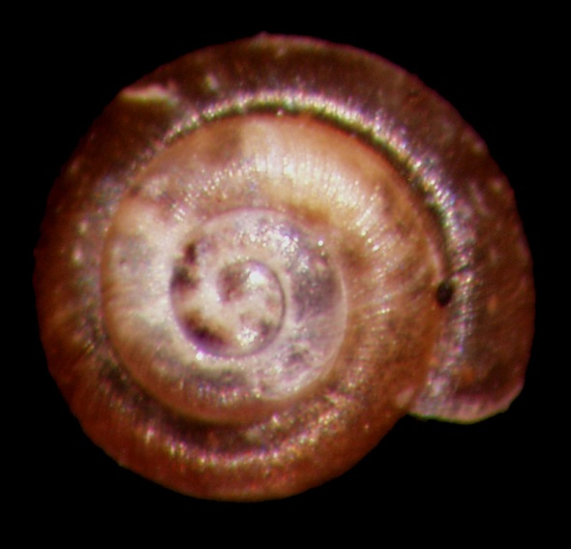
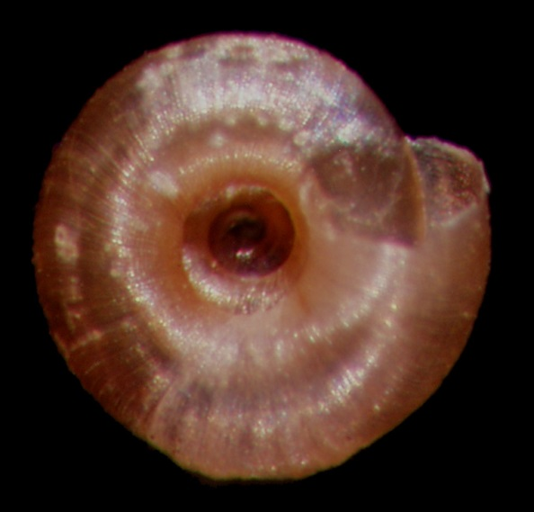
Microscope
Image stacks
SEM micrographs
Punctum minutissimum

Slide 27
Helicodiscus fimbriatus

Slide 28
Case study three Cat Tien National Park Vietnam

Slide 29
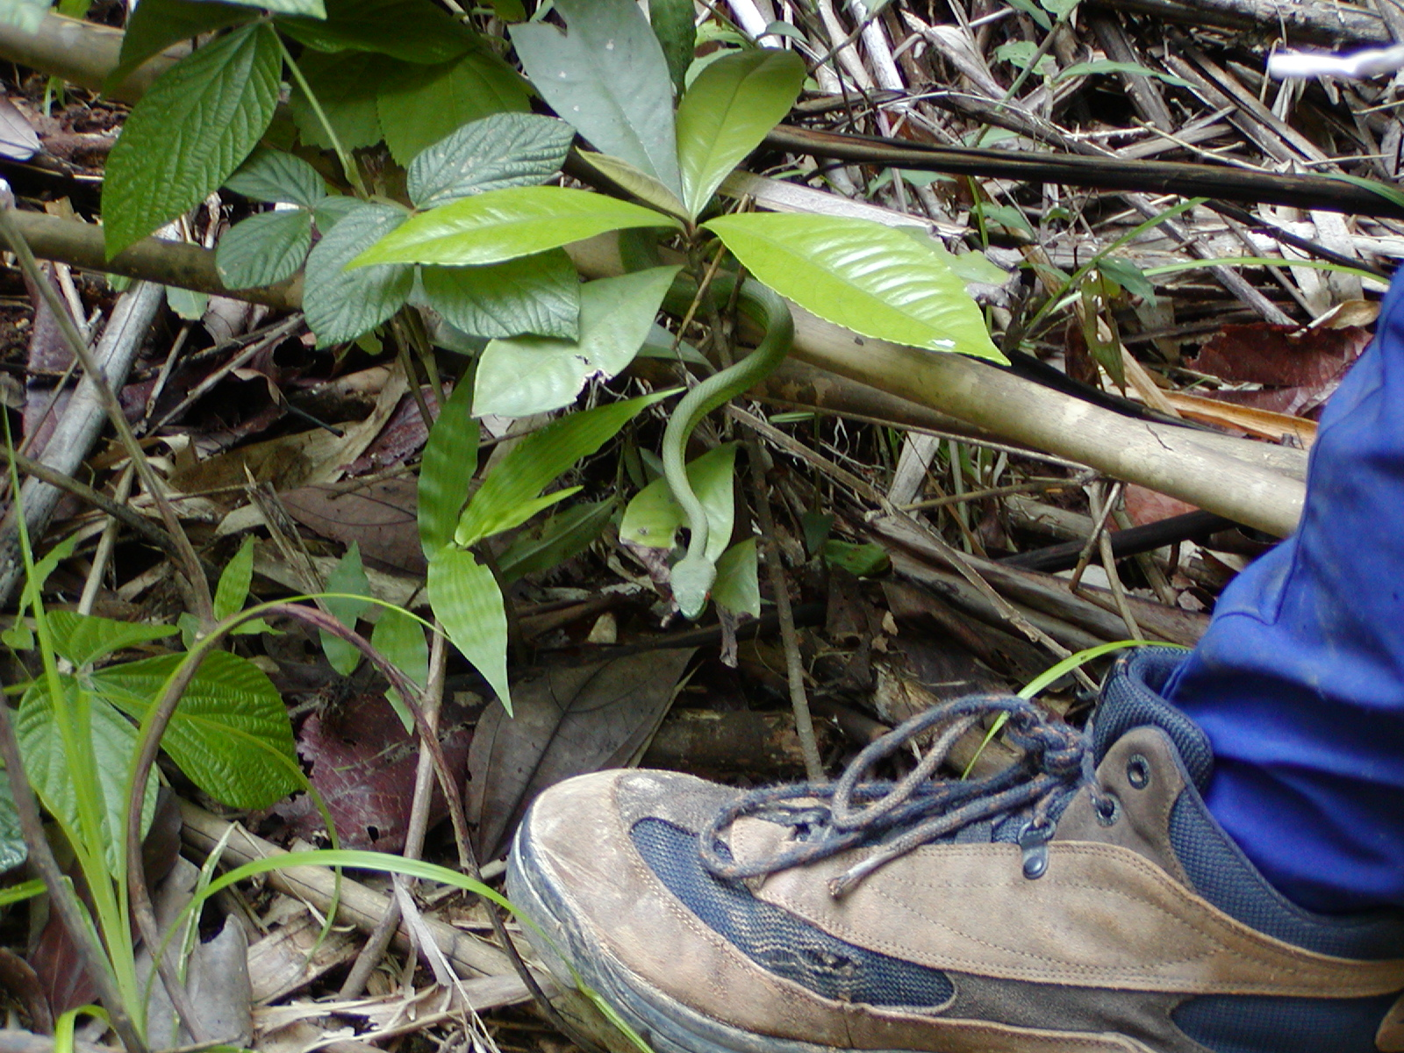

Slide 30
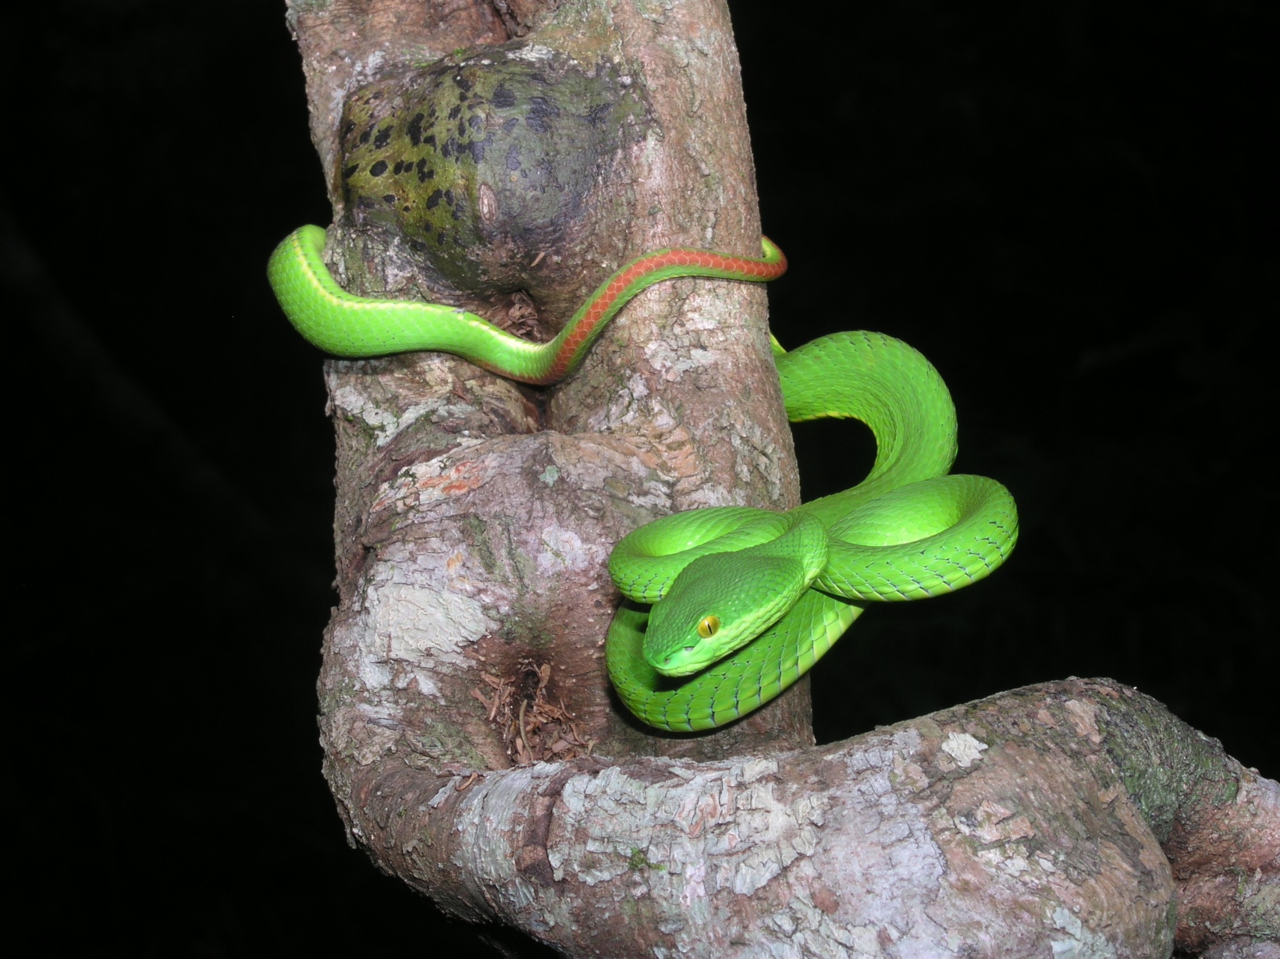

Slide 31
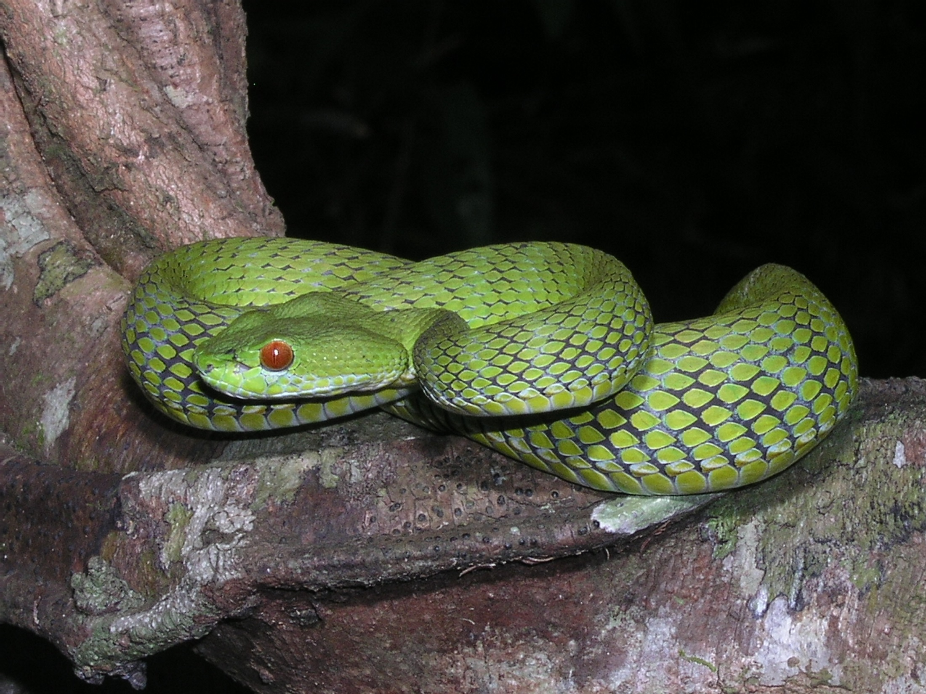

Slide 32
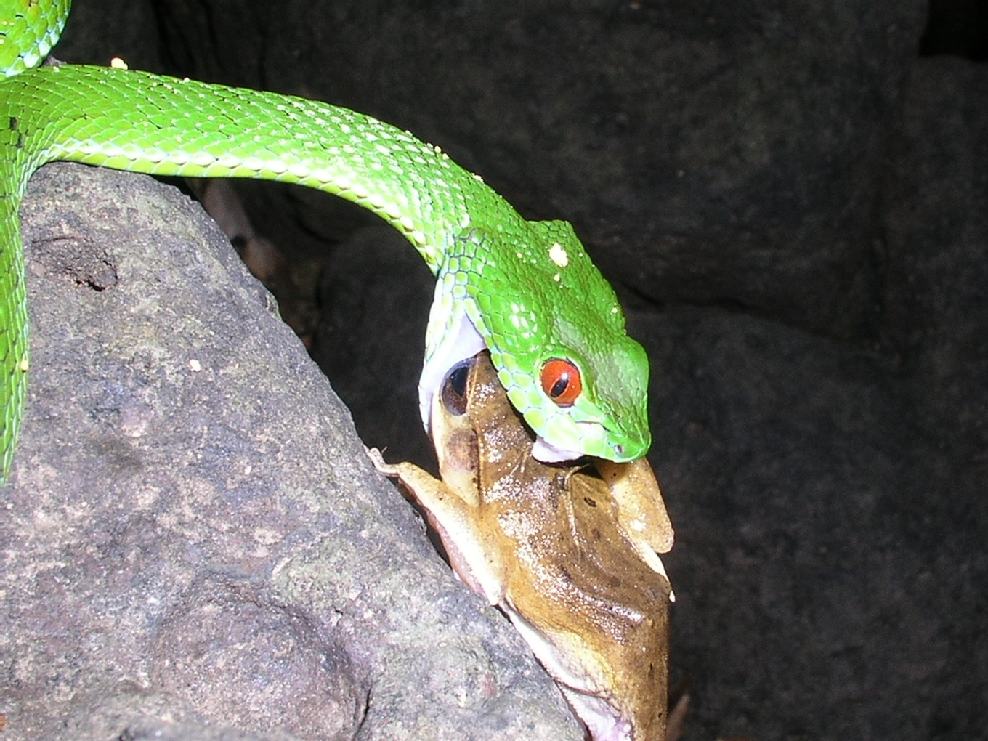
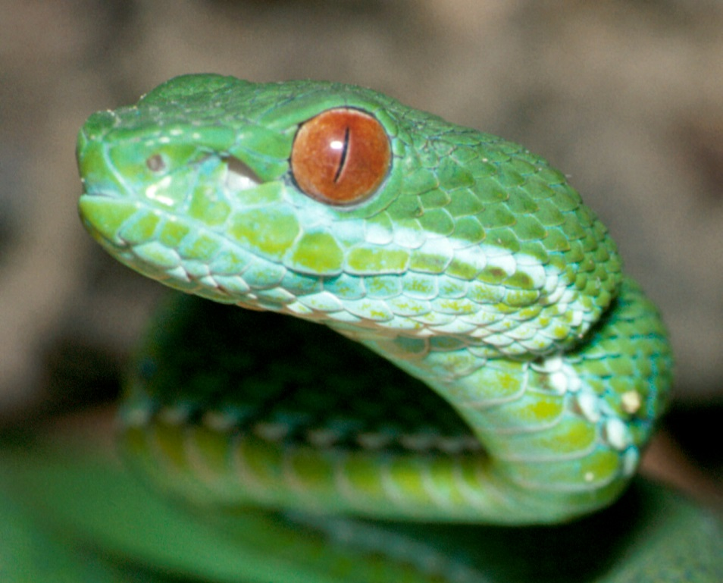
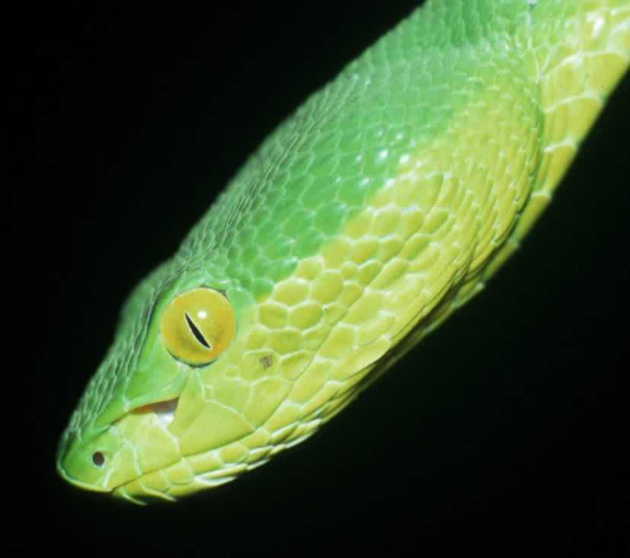
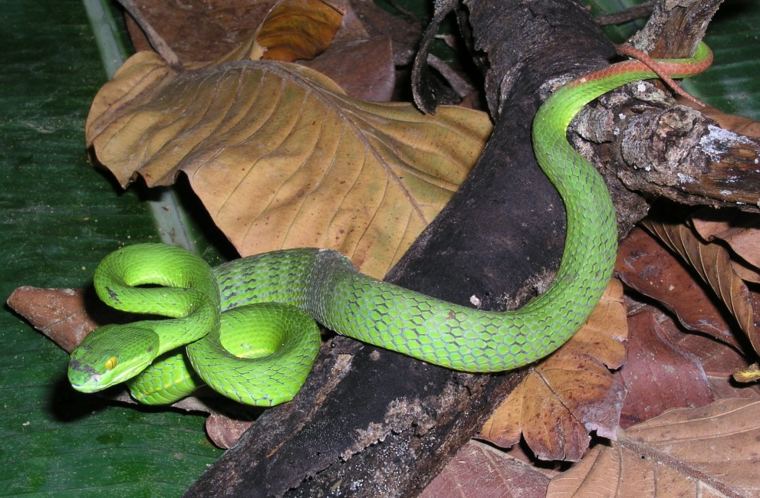

Slide 33
What determines what we see?
Actual image and details
Mental constructs already present terminology & vocabulary
Experience in relating the above two (search image?)

Slide 34
What determines what we know?
Actual image and details = data
Mental constructs already present hypotheses and history
Experience in relating the above two hypothesis testing
Beware of preconceived notions!
Better tools are helpful!

Slide 35
Acknowledgements
Dr. Ab Abercrombie
United Methodist Church
Bill and Ruth Dewel Microscopy Center
Department of Biology, ASU
Amy Van Devender
World Wildlife Fund International

