Slide 1
Land Snails of Goose Creek State Park, Beaufort County, North Carolina
Robert Wayne Van Devender
Department of Biology
Appalachian State University

Slide 2
Families of Land Snails
Discidae – 1 species
Ellobiidae – 1 species
Euconulidae – 1 species
Gastrodontidae – 4 species
Haplotrematidae – 1 species
Helicodiscidae – 1 species
Oxychilidae – 2 species
Philomycidae – 2 species
Polygyridae – 7 species
Pristilomatidae – 1 species
Strobilopsidae – 2 species
Succineidae – 1 species
Vertiginidae – 6 species
TOTAL = 30 species

Slide 3
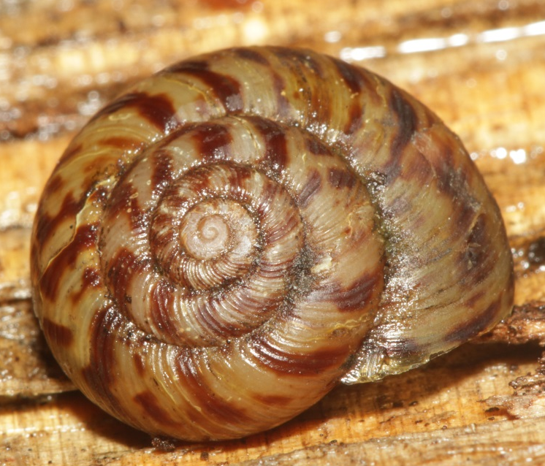
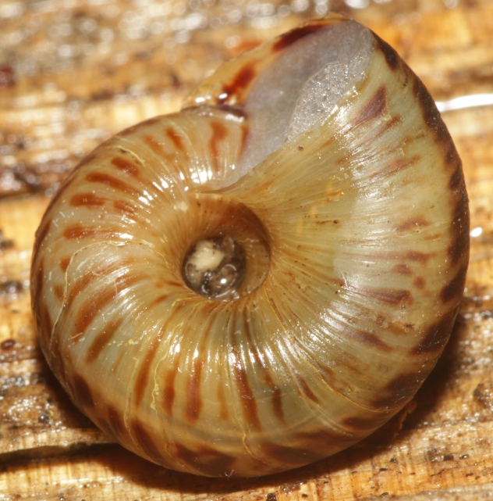
Discidae - Anguispira fergusoni
17 mm
Notes:
Open umbilicus
Simple lip
Bold crossbanding
Moderately large

Slide 4
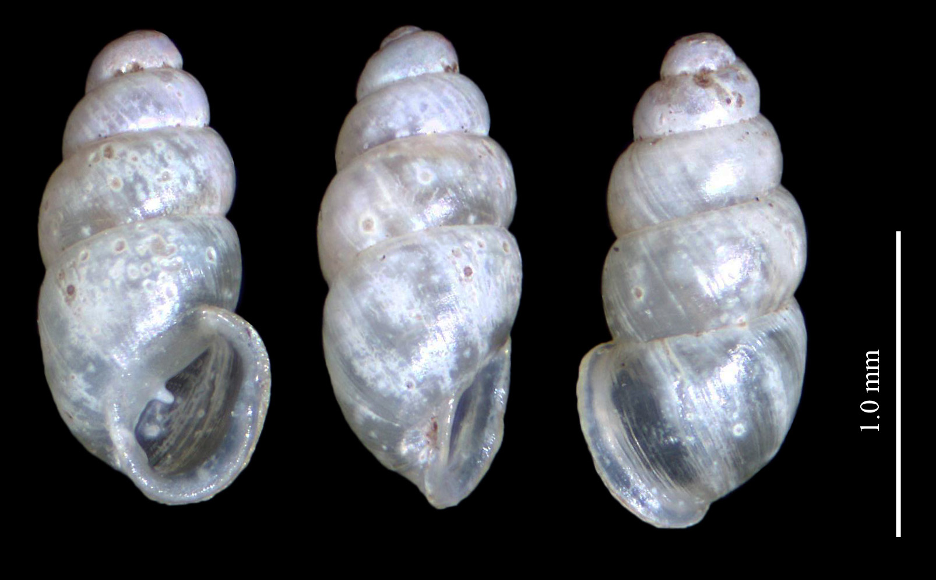
Ellobiidae – Carychium exiguum
1.7 mm
Notes:
High spire
Very small and white
Lip is reflected
Two teeth or lamellae in aperture

Slide 5
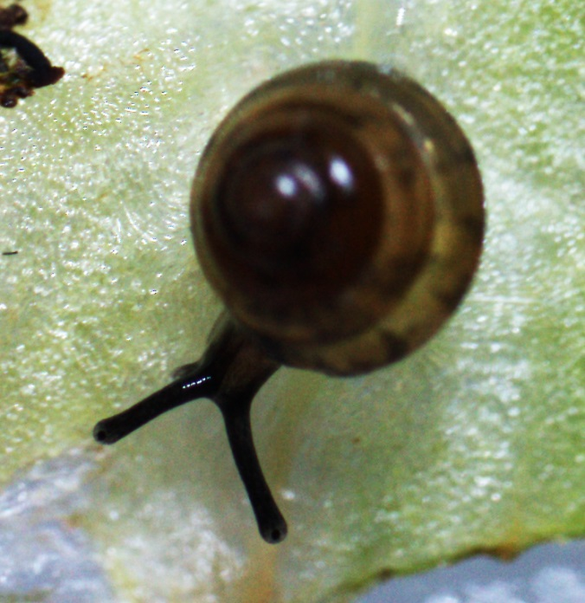
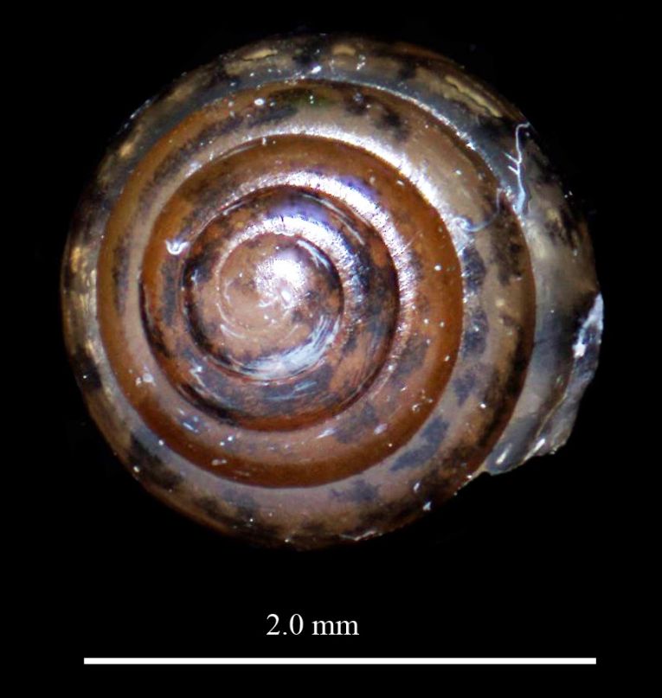
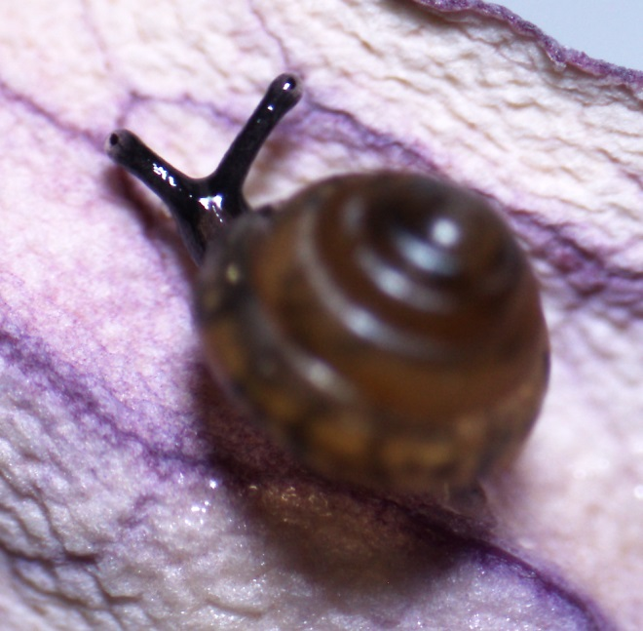
Euconulidae - Euconulus cf. chersinus
2 mm

Slide 6
Gastrodontidae – Striatura meridionalis
From Stanly Co., NC
< 2 mm
Notes:
Very small white shell
Elaborate surface sculpture of crossing ridges
Has a matte finish to the unaided eye
Large umbilicus
Simple aperture

Slide 7
Gastrodontidae - Ventridens cerinoideus
6 mm
Notes:
Shiny shell with up to 7 whorls
Lip simple
Two internal lamellae present at least in juveniles

Slide 8
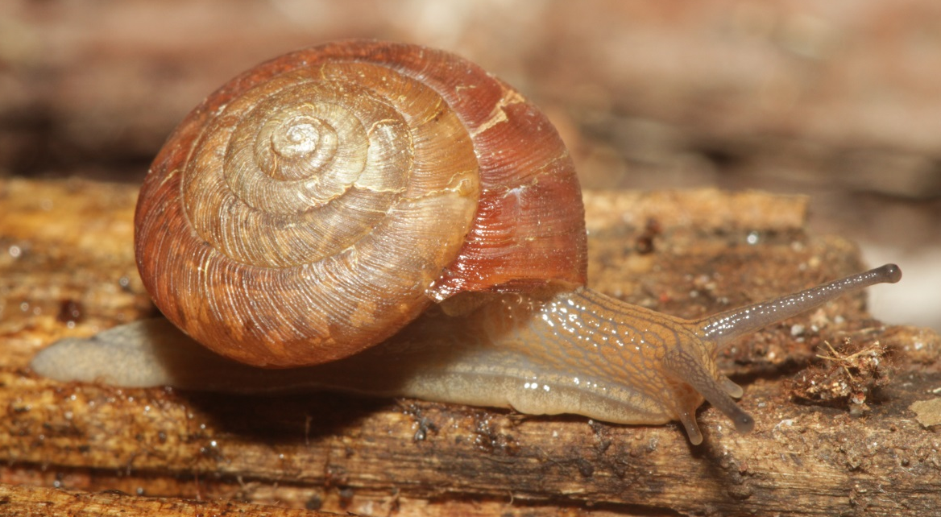
Gastrodontidae - Ventridens intertextus
15 mm
Notes:
Larger Ventridens without lamellae in the aperture
Surface structure a unique checkerboard effect of crossing longitudinal and transverse ridges
Color quite variable and may include lateral stripes

Slide 9
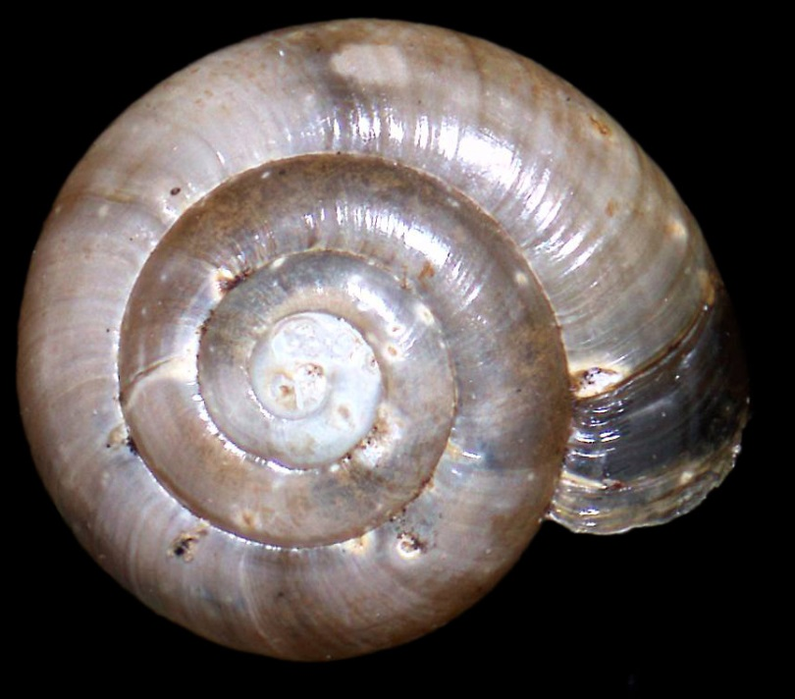
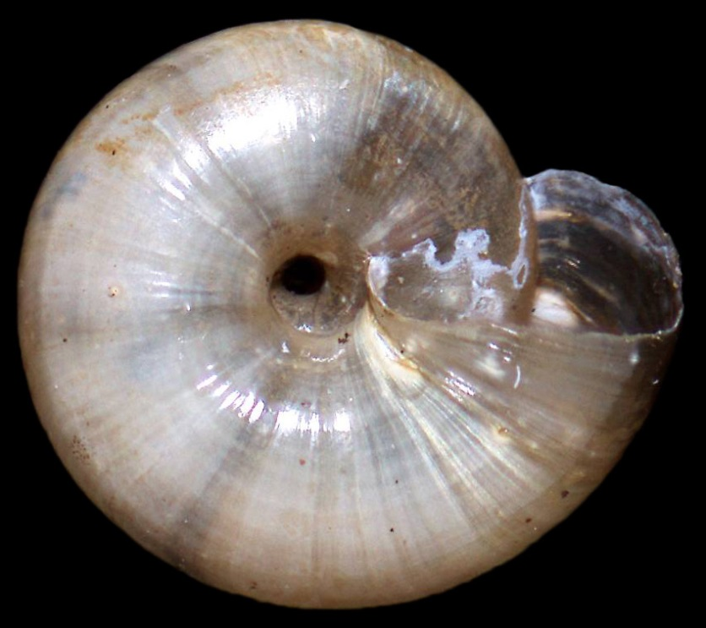
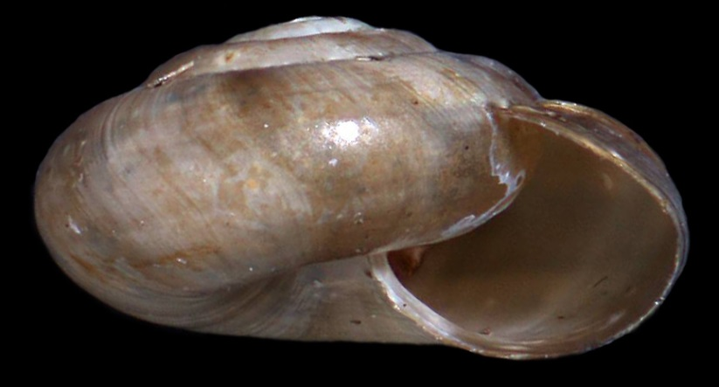
Gastrodontidae - Zonitoides arboreus
4 mm
Notes:
Color variable but usually brown to reddish brown
Umbilicus moderately large
Irregular growth wrinkle but not incised lines or ridges
Lip simple

Slide 10
Haplotrematidae - Haplotrema concavum
14 mm
Specimen from Bertie Co., NC
Notes:
Large, open umbilicus – hence the name concavum
Shell is uniformly pale white to yellowish tan.
Lip is simple but may be slightly flared in large animals.
Seen in the park but shells not available for photography.

Slide 11
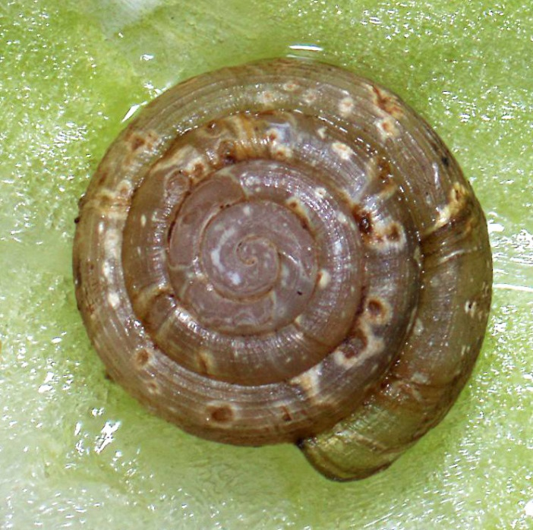
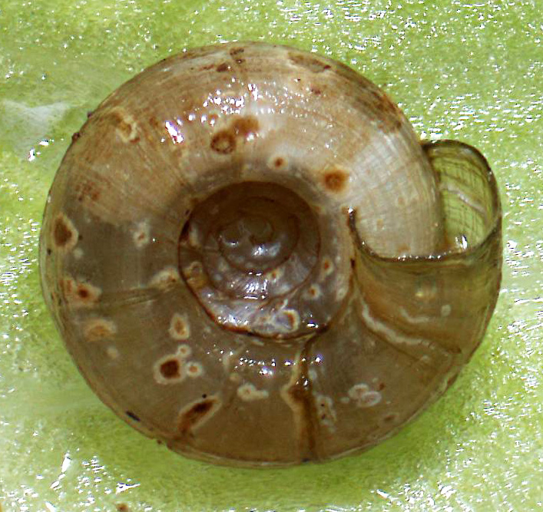
Helicodiscidae - Helicodiscus parallelus
3-4 mm
Notes:
These small, blind snail have longitudinal ridges along the whorls called lirae.
Umbilicus is relatively smaller and deeper than in the related H. notius.
Animals are white without even pigmented eyespots.
Mantle around aperture is bright orange.

Slide 12
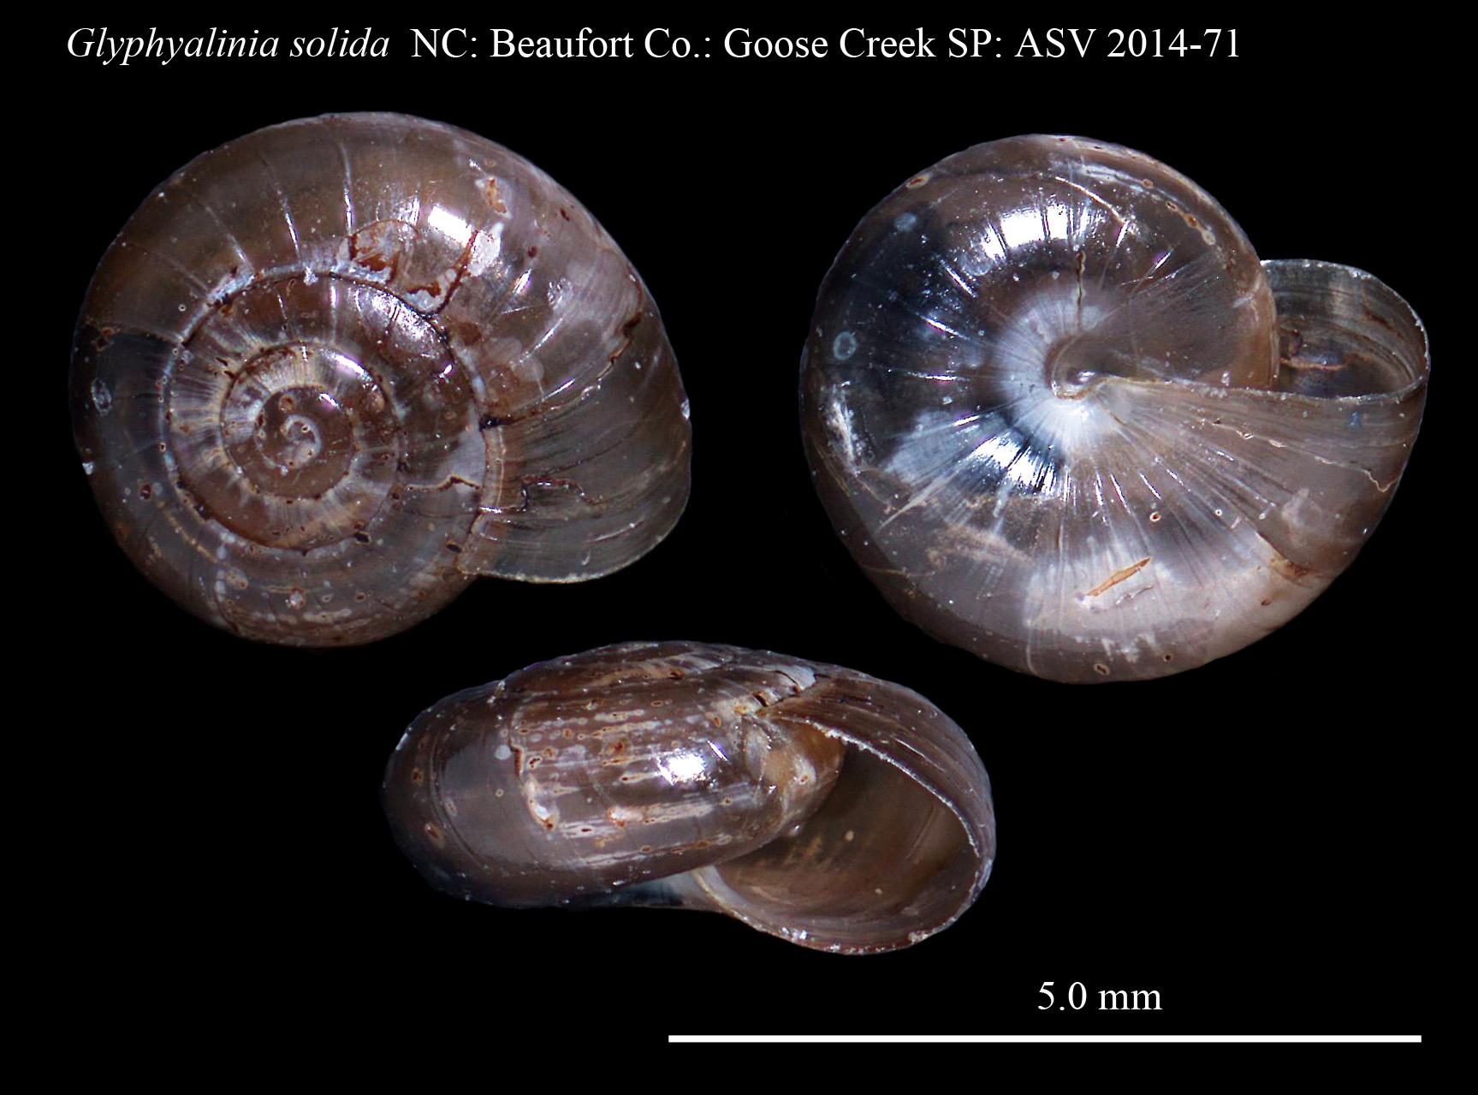
Oxychilidae - Glyphyalinia solida
About 4 mm
Notes:
Shell with few, widely spaced incised lines
Lip is simple
Umbilicus is closed

Slide 13
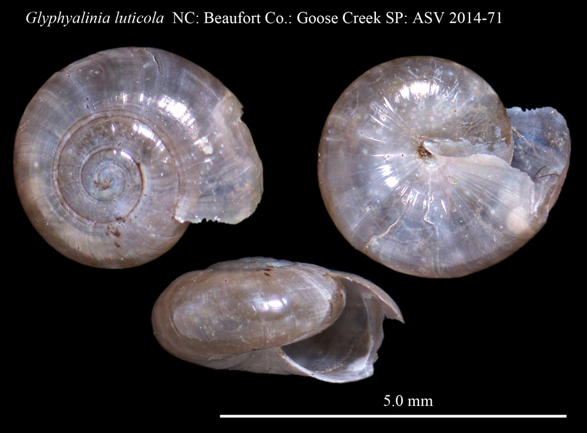
Oxychilidae - Glyphyalinia luticola
4 mm
Notes:
Shell less than about 5 mm wide
Shell dark brown in life
Body bluish gray with a lighter tail
About 24 incised lines in last whorl
Umbilicus almost closed by the reflected edge of the aperture

Slide 14
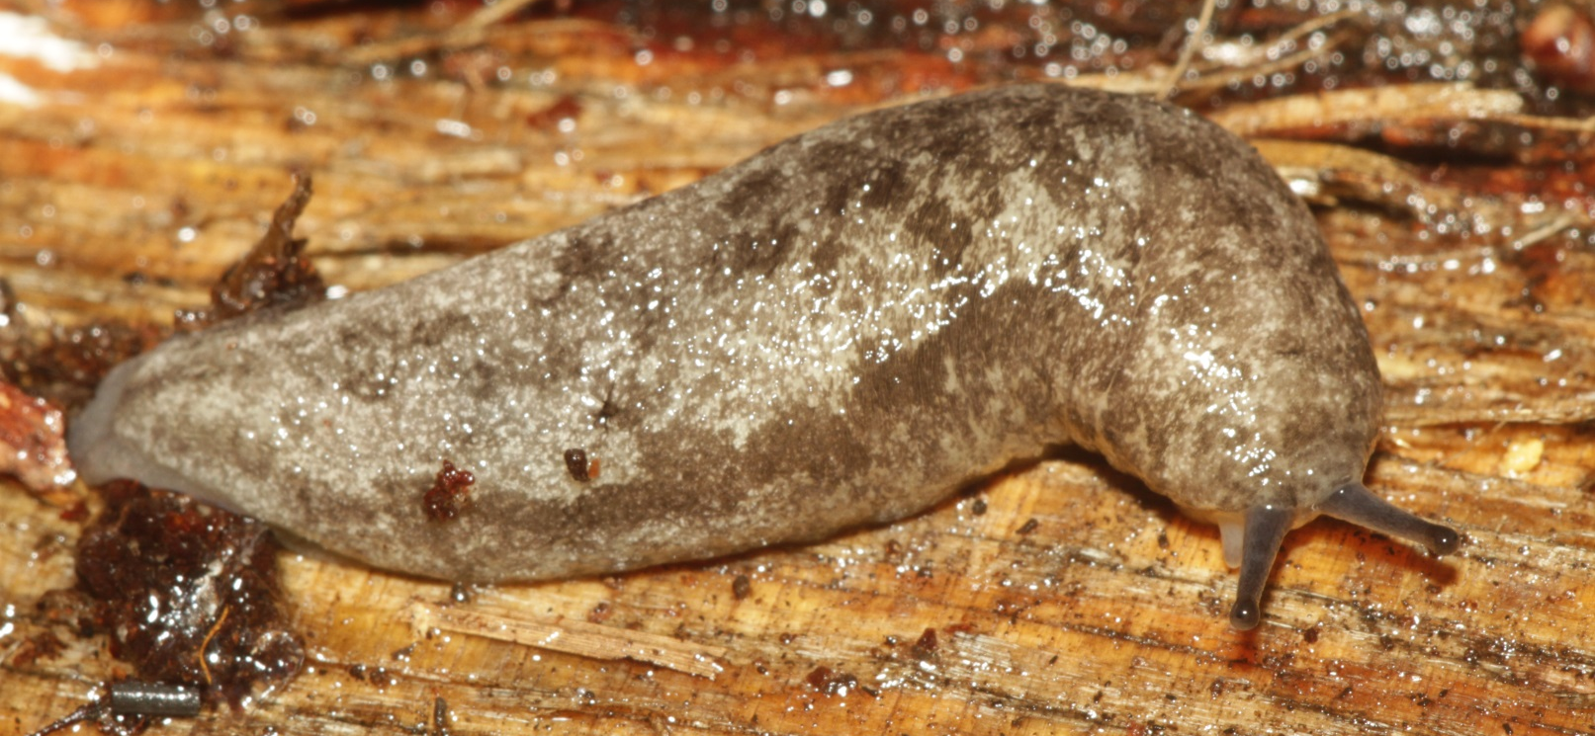
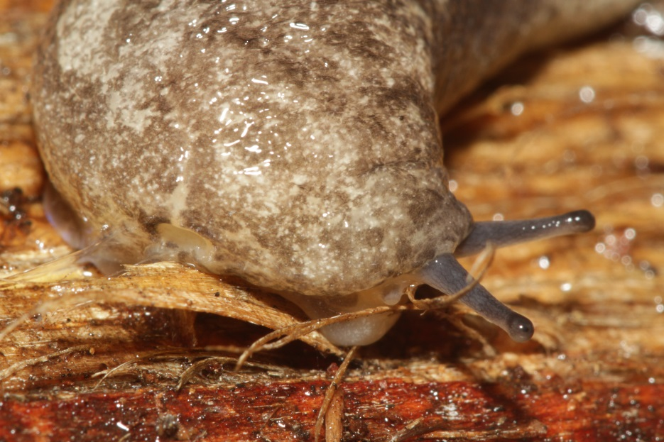
Philomycidae - Megapallifera mutabilis
60 mm
Notes:
Nondescript species usually lacking paired dorsal dark spots.
Dark lateral stripe is usually present.
Defensive slime is pale yellow.
Side of foot is grayish.

Slide 15
Philomycidae - Philomycus carolinianus
adult
juvenile
50 & 15 mm
Notes:
A variable slug with many color phases.
Usually has paired dark spots down the back.
Defensive slime is clear.
Side of foot is pale.

Slide 16
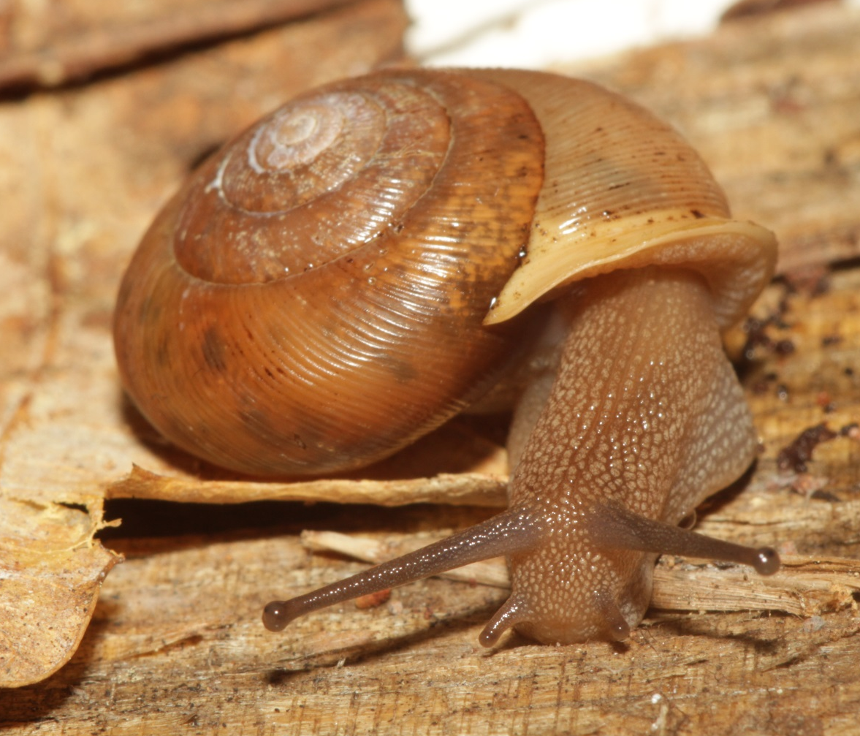
Polygyridae - Mesodon thyroidus
20 mm
Notes:
Umbilicus is always somewhat open.
A single lamella usually present in aperture.
Bold, white reflected lip present in adults.
Shell and animal color somewhat variable from pale to dark brown.

Slide 17
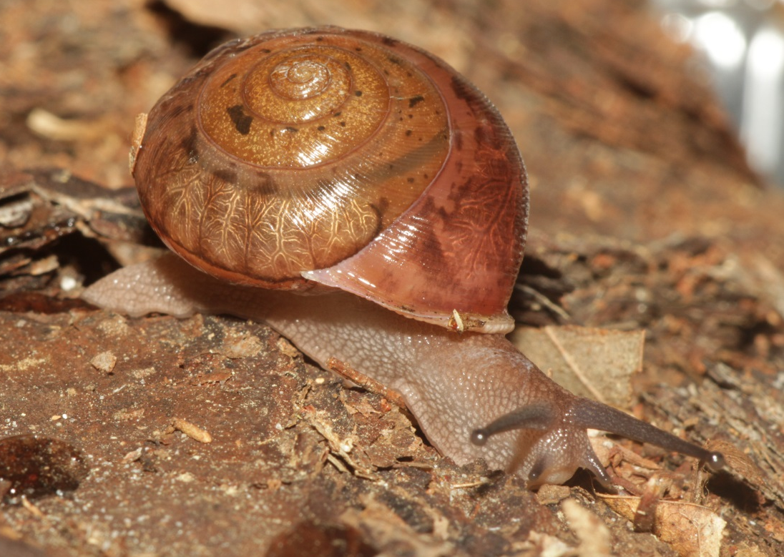
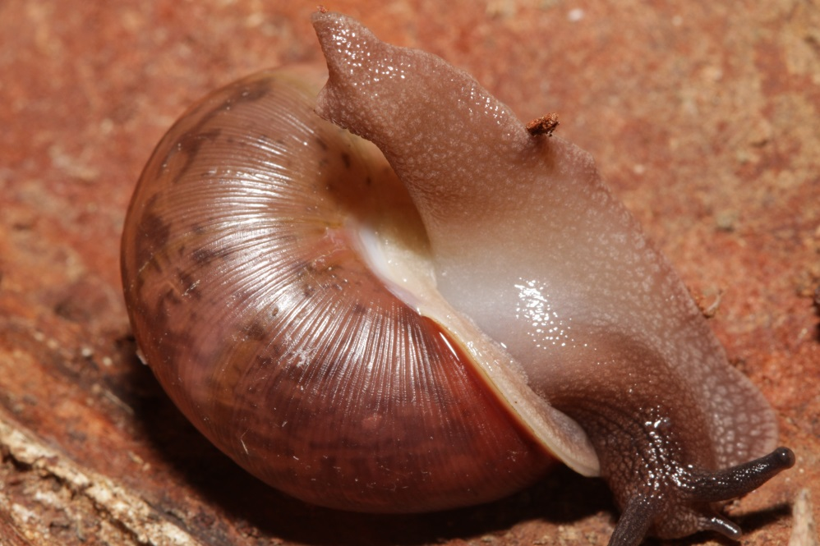
Polygyridae - Neohelix solemi
17 mm
Notes:
Large snail with reflected lip and closed umbilicus.
Aperture contains no lamellae.
Coloration varies from reddish to dark brown to greenish brown.
Similar species to the west have different height to width ratios.

Slide 18
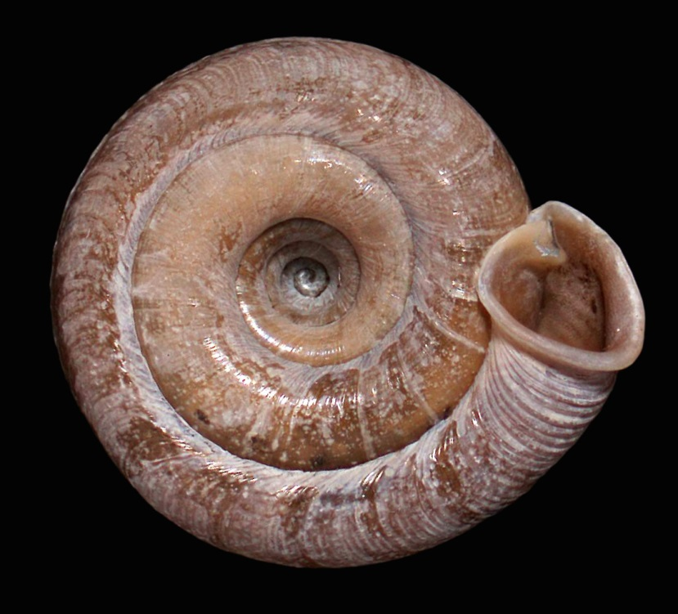
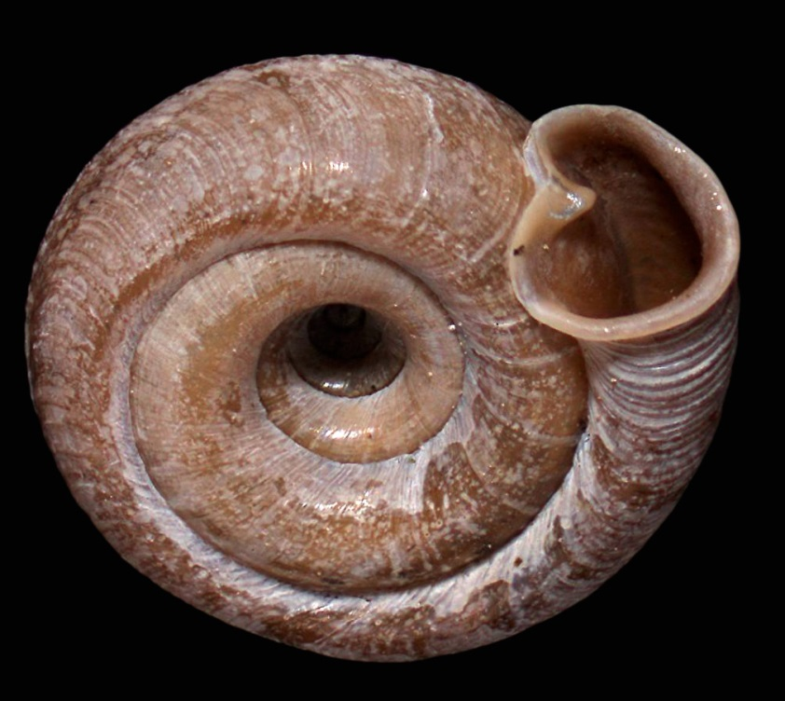
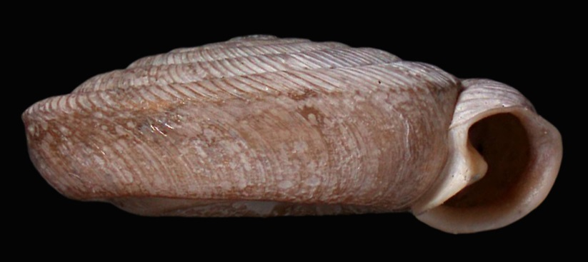
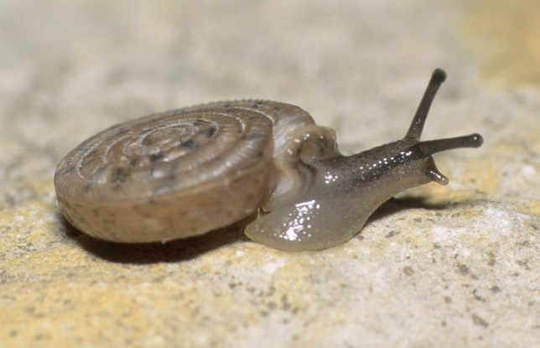
Polygyridae - Polygyra cereolus
7-9 mm
Animal from Dare Co., NC; shell from Craven Co., NC
Notes:
Very flat shell with huge umbilicus
Reflected lip
One lamella in aperture

Slide 19
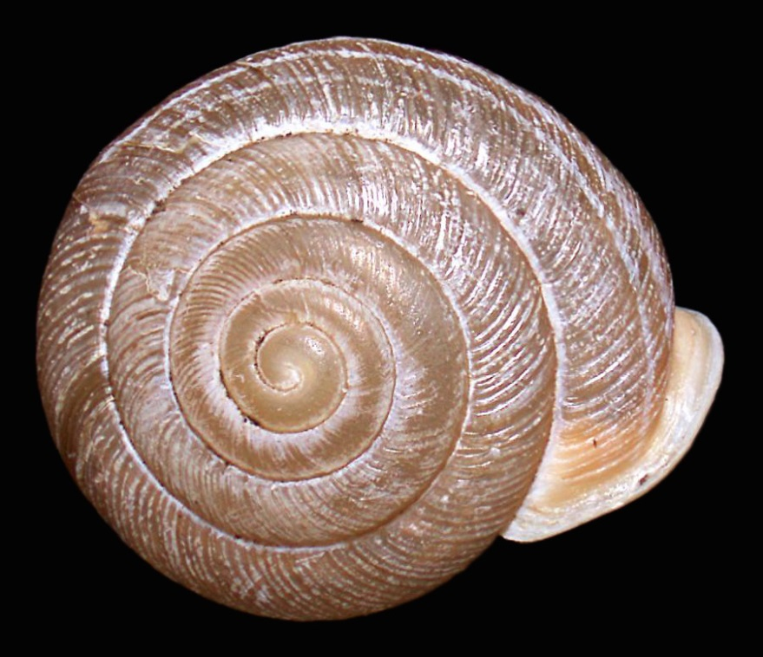
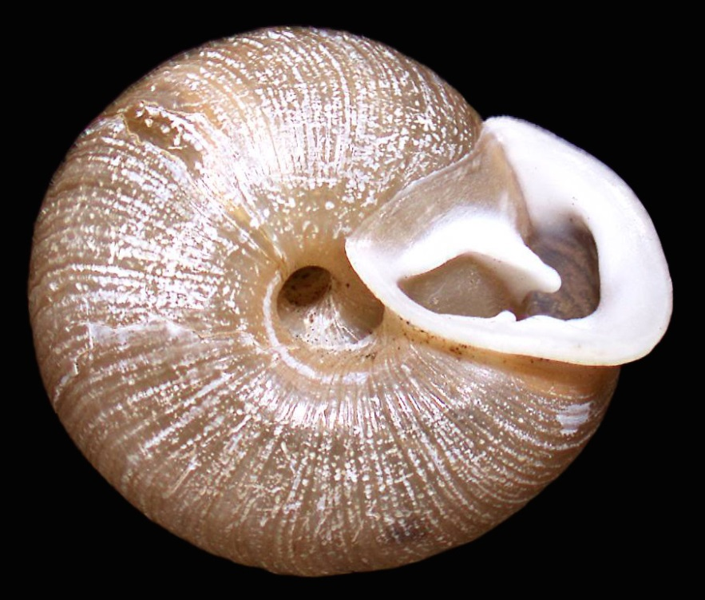
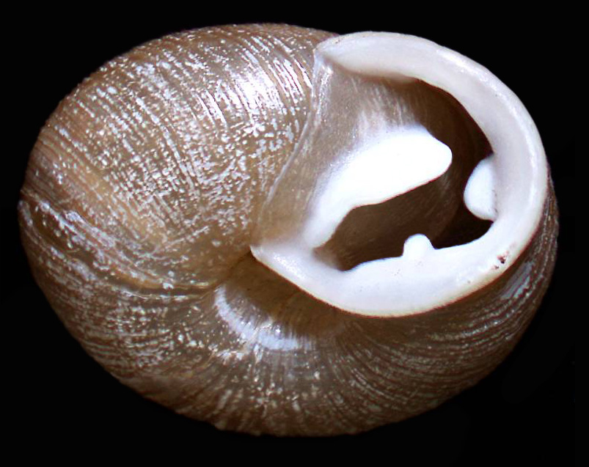
Polygyridae - Triodopsis fallax
11 mm
Notes:
Small Triodopsis with moderately large umbilicus
Parietal lamella curved and points above the outer lamella
Basal lamella on an elongated buttress

Slide 20
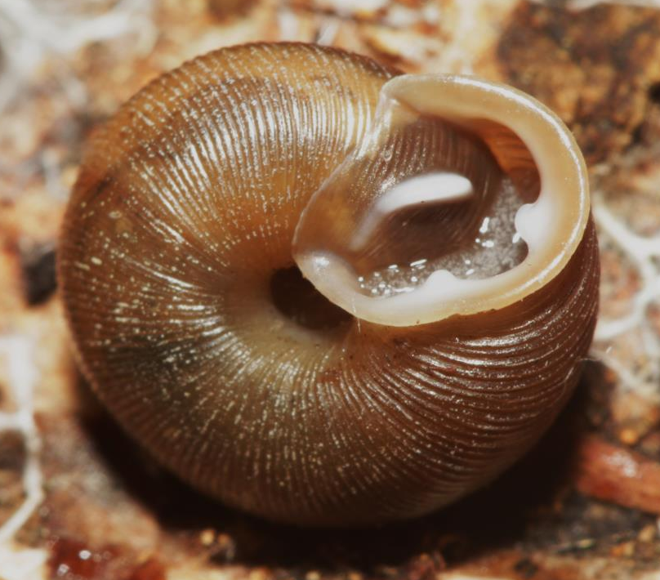
Polygyridae - Triodopsis hopetonensis
11 mm
Notes:
Small Triodopsis with moderately large umbilicus
Parietal lamella curved and points above the outer lamella

Slide 21
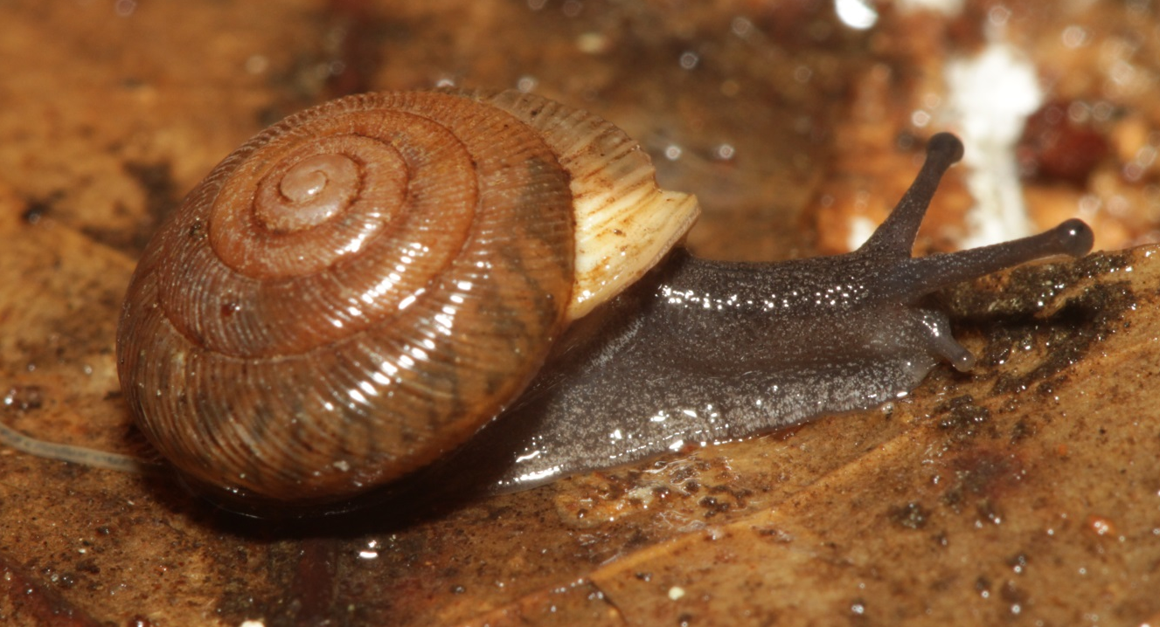
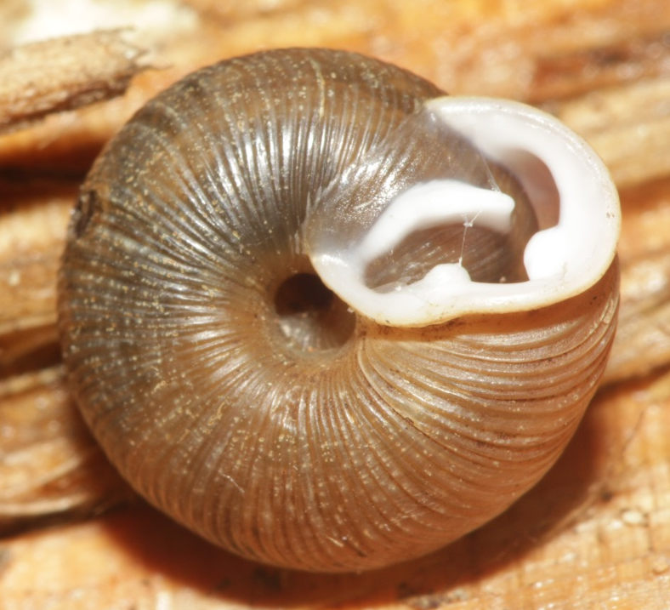
Polygyridae - Triodopsis messana
12 mm
Notes:
1. Small Triodopsis with small umbilicus

Slide 22
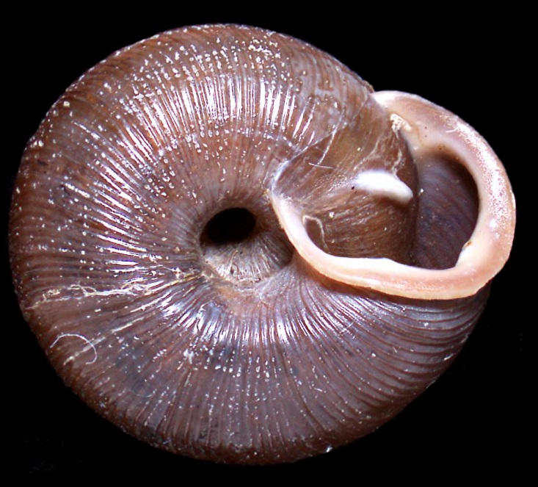
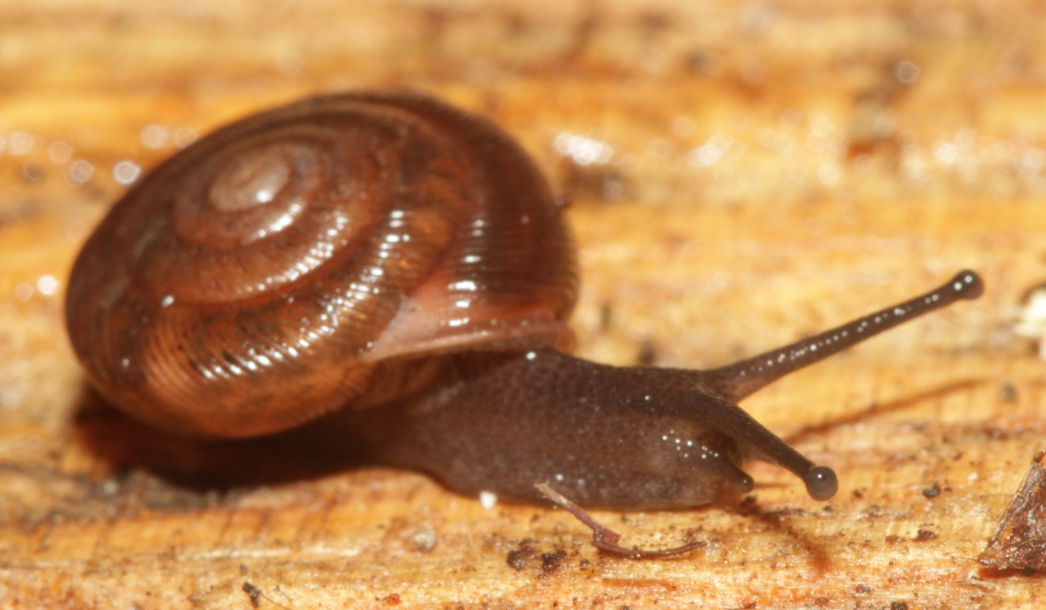
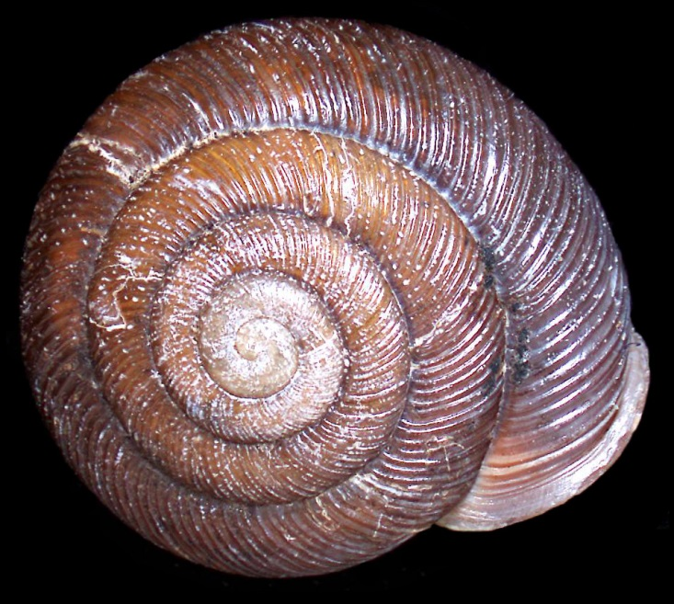
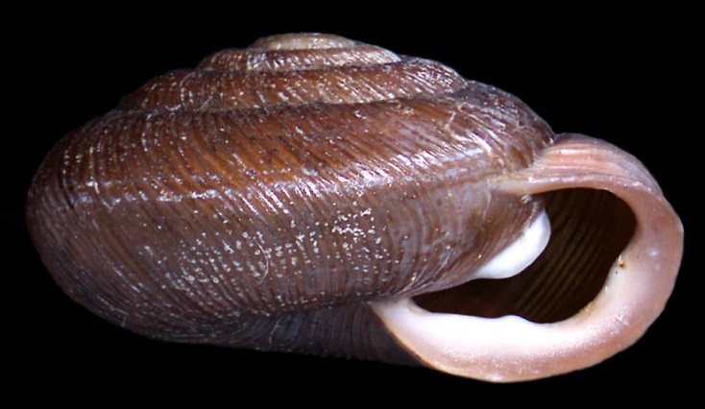
Polygyridae - Triodopsis obsoleta
10 mm
Notes:
Triodopsis have three lamellae in the aperture; but two of these are reduced in this species.
Smaller species very similar to T. hopetonensis in form.
These specimen may be only nearly mature T. hopetonensis.

Slide 23
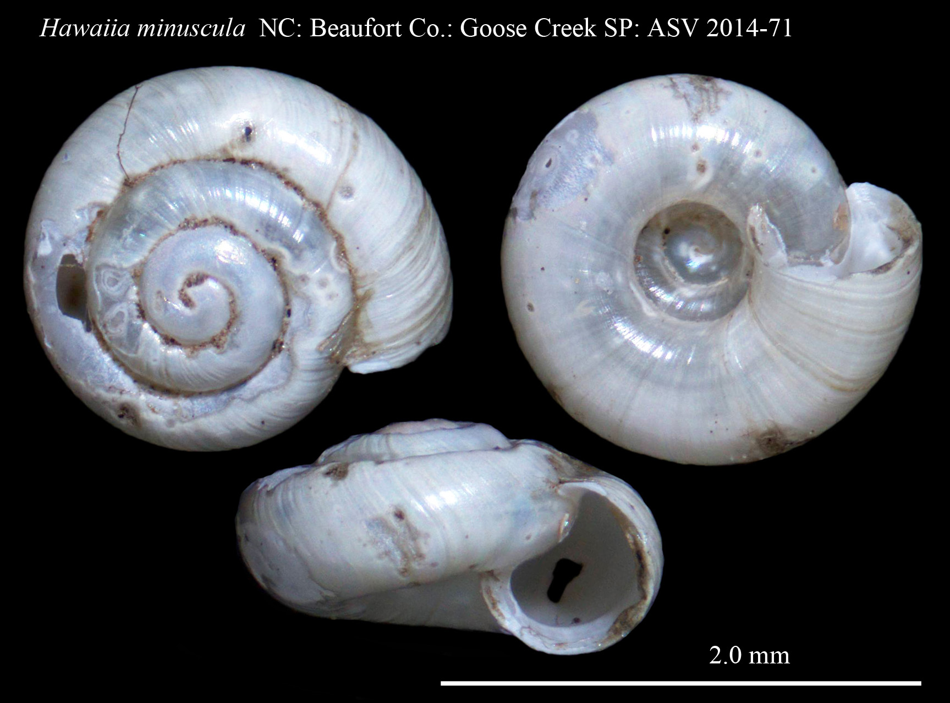
Pristilomatidae - Hawaiia minuscula
About 2 mm
Notes:
Quite small and white to translucent in fresh and live shells
Open umbilicus
Simple lip
Noticeable growth wrinkles across whorls
No incised transverse grooves
Inner edge of last whorl inserts less than halfway to periphery of next-to-last whorl

Slide 24
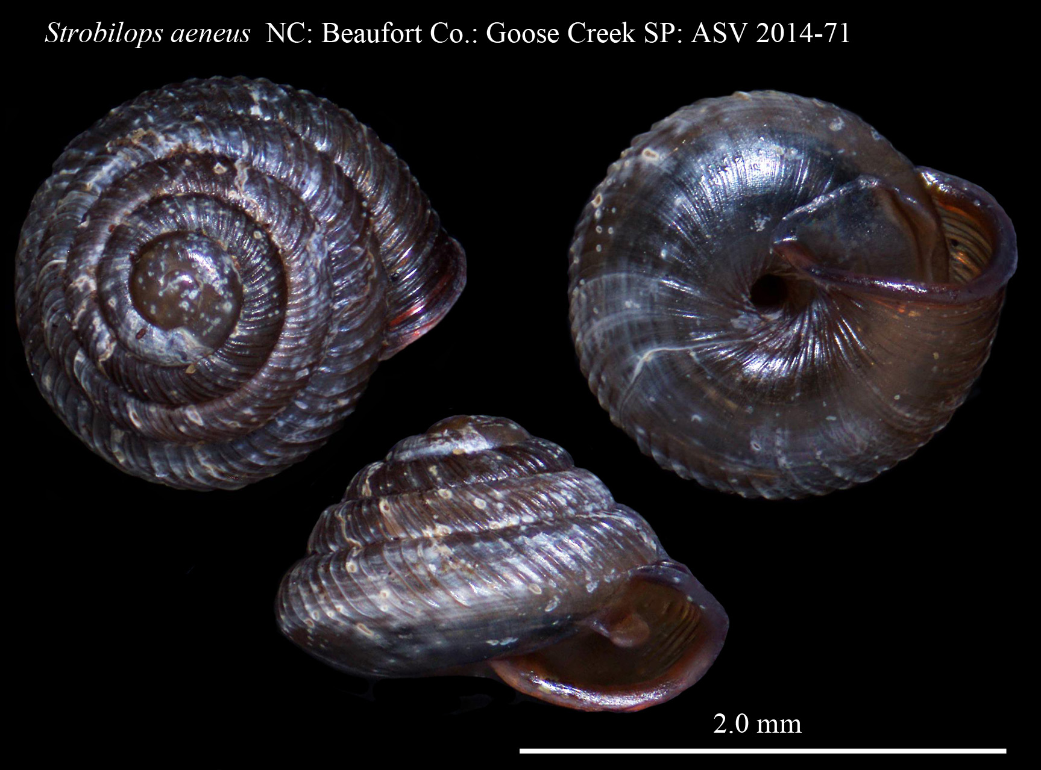
Strobilopsidae - Strobilops aeneus
2-3 mm
Notes:
Dark, reddish shell with bold transverse ribbing and a reflected lip.
Last whorl is distinctly angular.
Venter is relatively smooth without ribbing extending to the umbilicus.

Slide 25
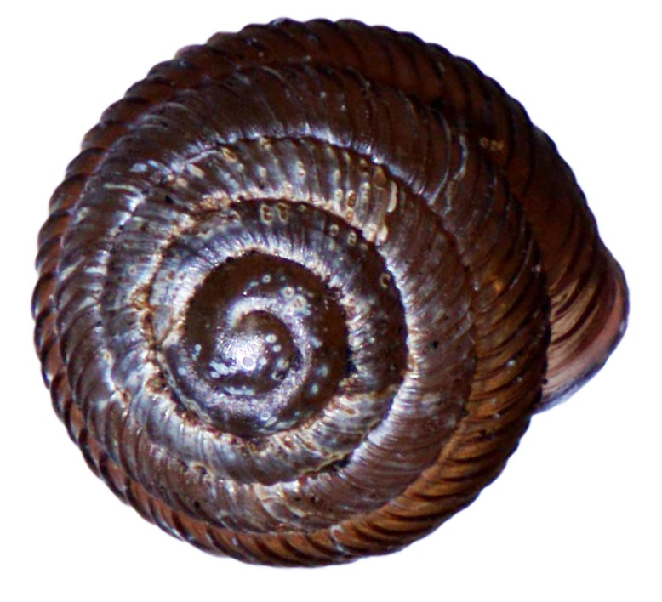
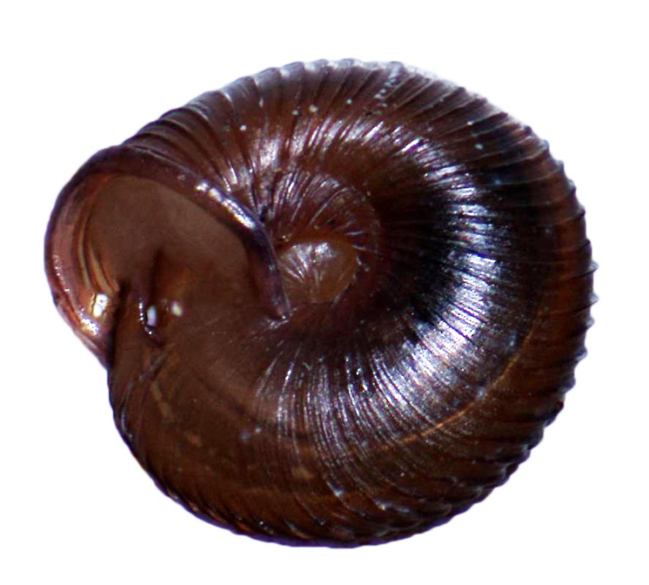
Strobilopsidae - Strobilops labyrinthicus
2-3 mm
Notes:
A pinecone shell with a rounded periphery.
Ribbing usually extends across the venter to the umbilicus.

Slide 26
Succineidae Catinella cf. oklahomarum
5 mm
Notes:
Small amber snail with relatively short spire.
Several similar species can be distinguished only by dissection.
Live animals usually have shells covered with encrusted dirt.

Slide 27
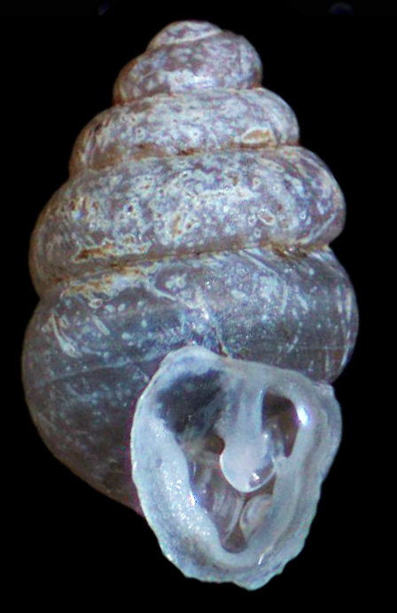
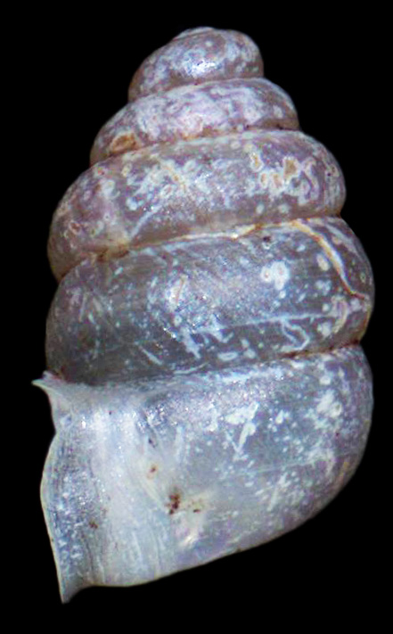
Vertiginidae - Gastrocopta contracta
2 mm
Notes:
Transparent to translucent shell with a trumpet-like aperture
Upper lamella is very large and complicated filling much of the aperture.
Lamellae obscure almost all of the aperture.
Live animals annoint their shells with mucous and are usually covered with glued-on dirt.

Slide 28
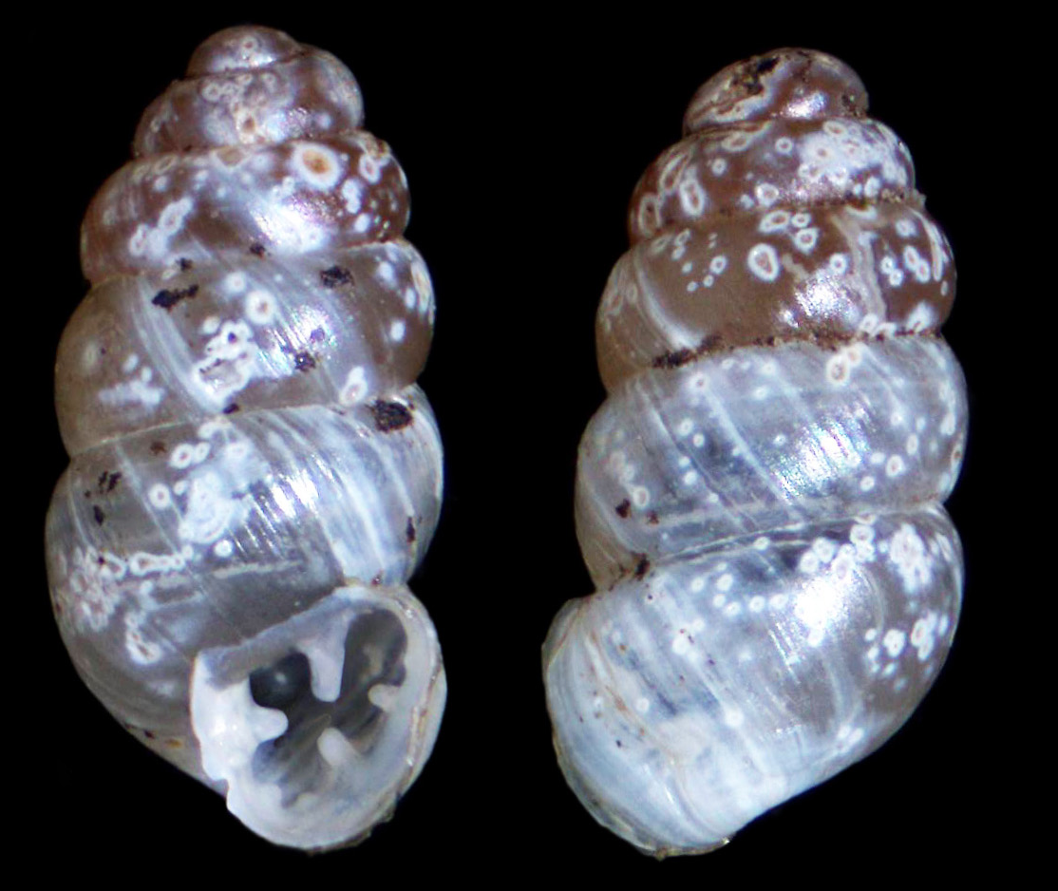
Vertiginidae - Gastrocopta pentodon
< 2 mm
Notes:
Fresh wet shells are transparent, translucent or white
Aperture has only one lamella in the top of the aperture
Lamella on the outer lip sit on an elevated ridge and can number from three to seven
Only the much larger and fatter Vertigo tappaniana shares these characteristics.

Slide 29
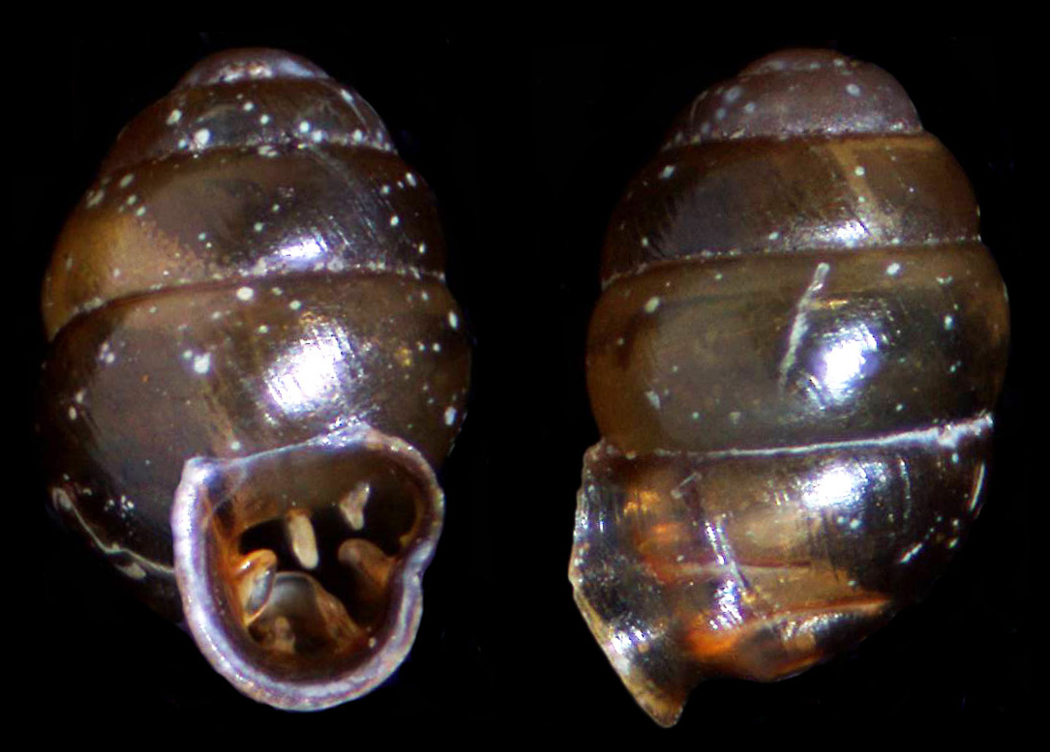
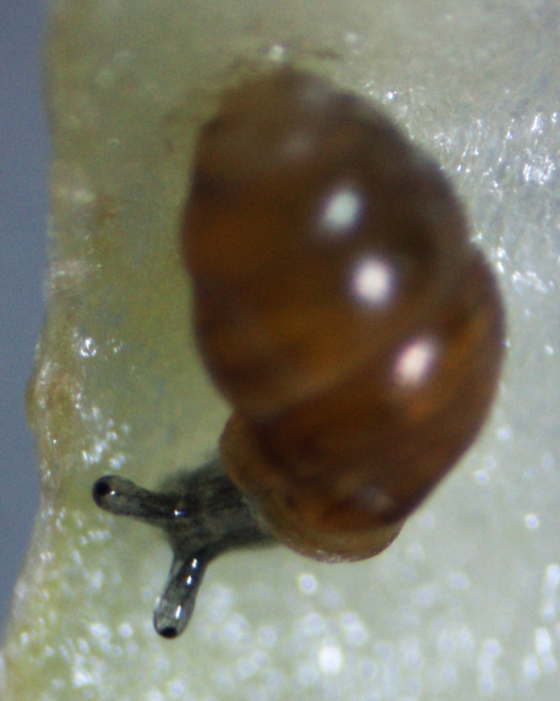
Vertiginidae - Vertigo milium
< 2 mm
Notes:
Very small, rotund snail with reflected lip
Six or more lamellae in aperture
Middle lamella in outer lip (= lower palatal) extends deeply into the aperture and bends around the small lamella to its left
Apparently part of a complex of several species

Slide 30
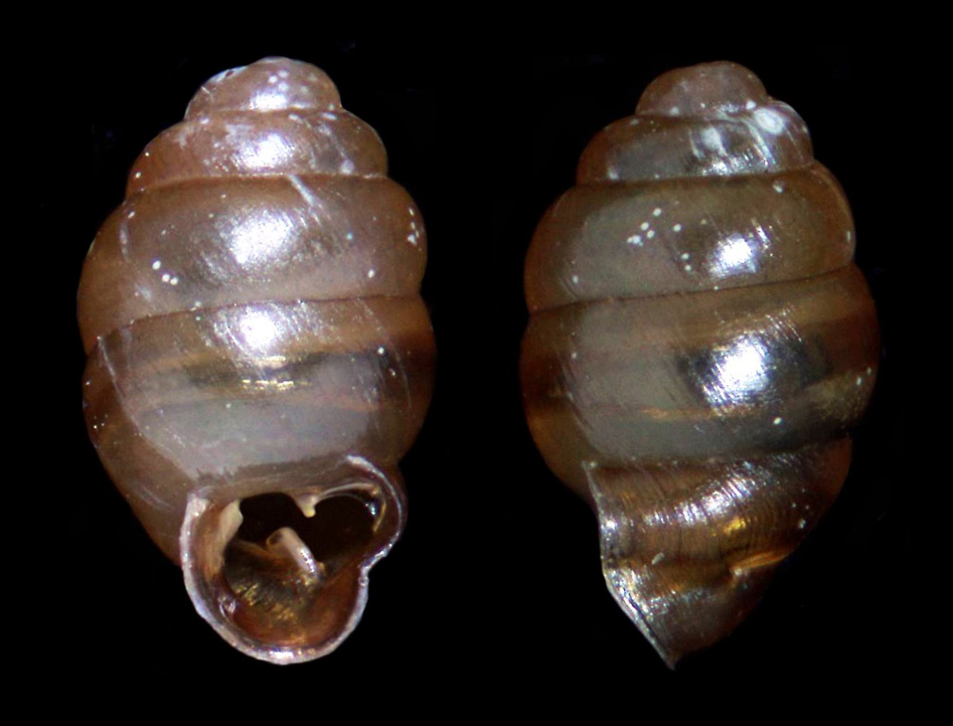
Vertiginidae - Vertigo oscariana
< 2 mm
Notes:
Ovate shell with only 3-4 lamellae in the aperture
Last whorl not as wide as the next-to-last whorl

Slide 31
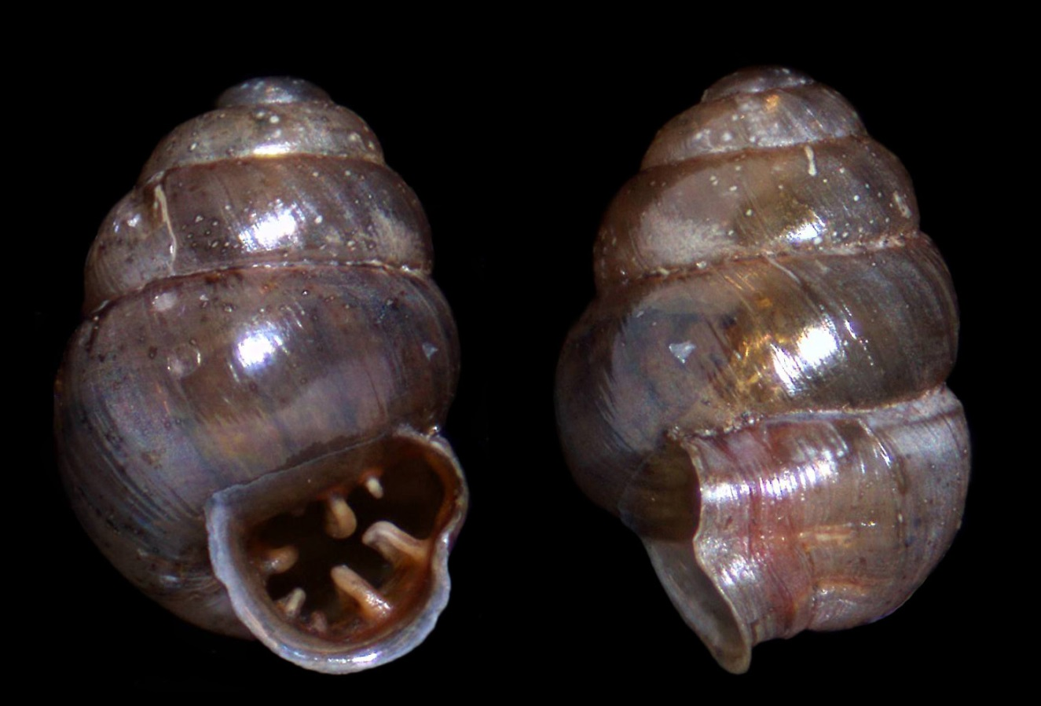
Vertiginidae - Vertigo ovata species complex
About 2 mm
Notes:
Aperture with 6 or more teeth or lamellae
Lip on left side of aperture nearly vertical
Infraparietal lamella (small one on the left side of the top of the aperture)

Slide 32
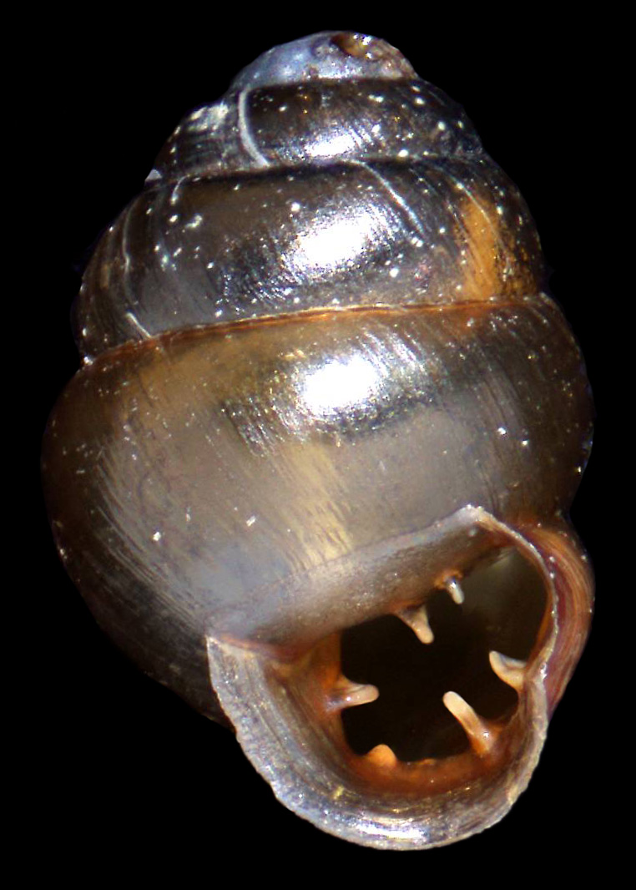
Vertiginidae – Vertigo teskeyae
> 2 mm
Notes:
Moderately large Vertigo with obese form and dark shell
Six or more lamellae in aperture
Lip on the left side of aperture veers to the left of vertical
Rather similar to the Vertigo ovata species

