Slide 1
A few Ecuadorian Birds
Wayne Van Devender

Slide 2
American kestrel

Slide 3
Eared dove

Slide 4
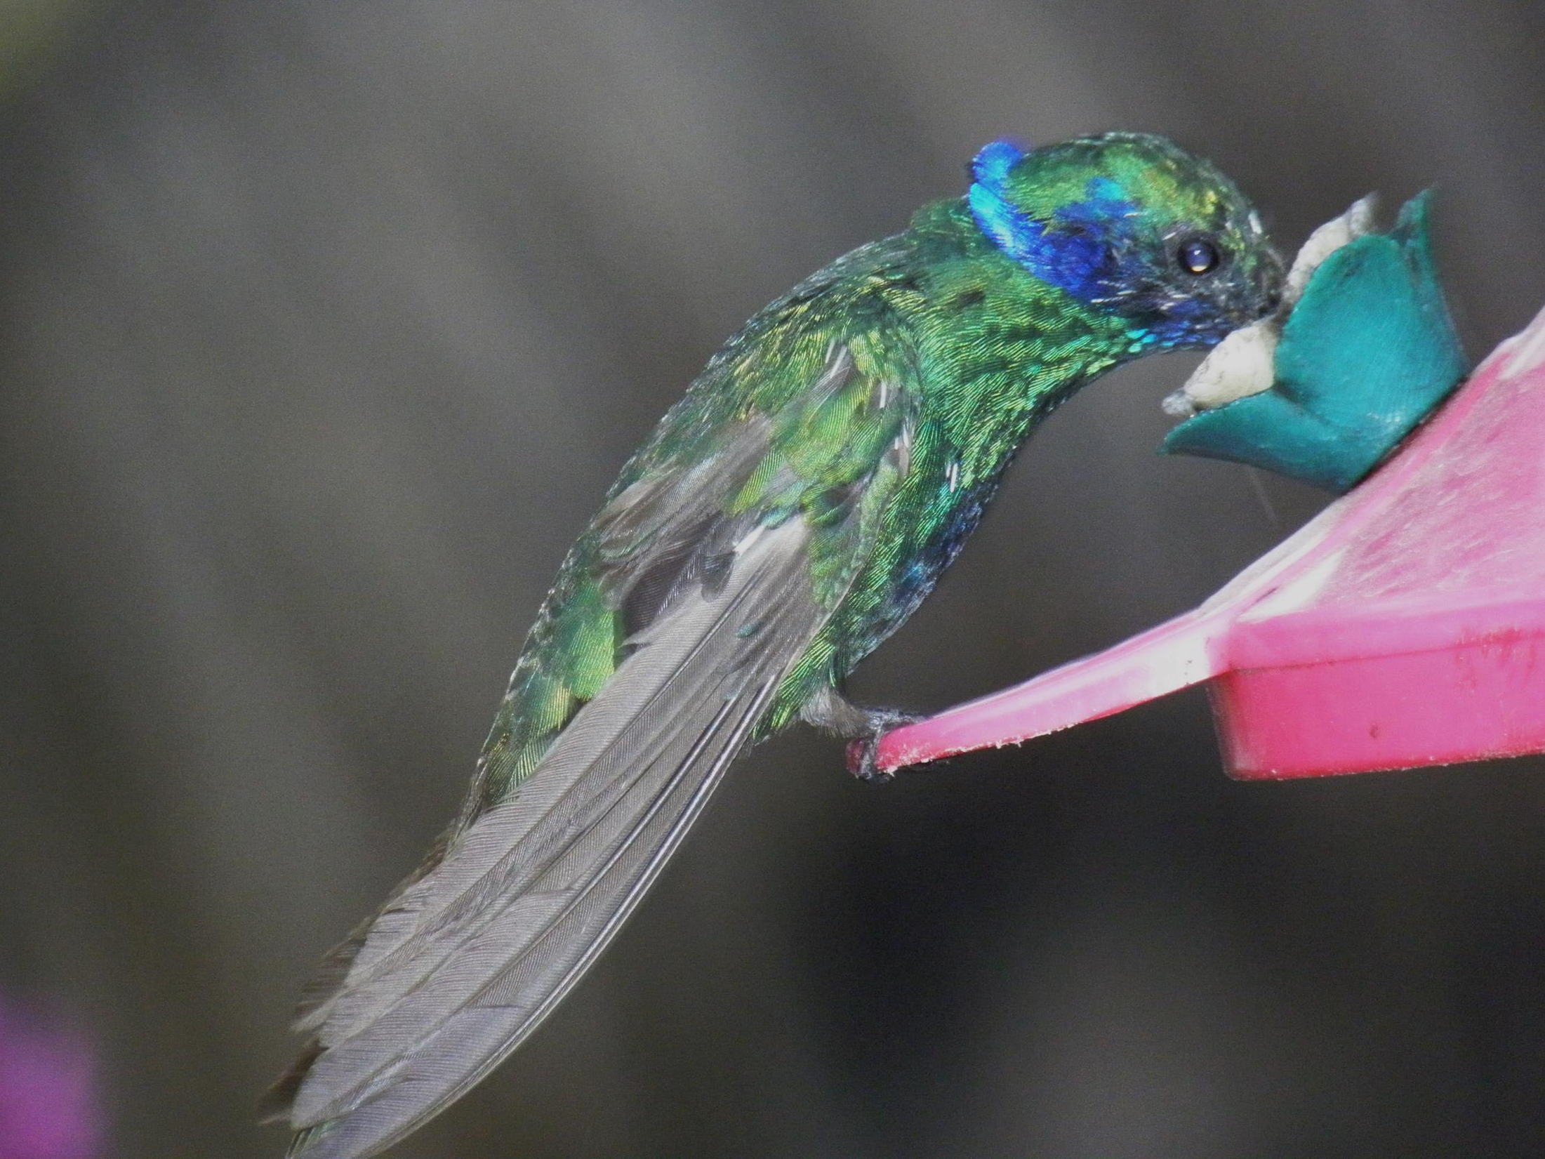

Slide 5
Rufous-naped sparrow

Slide 6
Buff-winged star frontlet

Slide 7
Great saphirewing

Slide 8
Great saphirewing

Slide 9
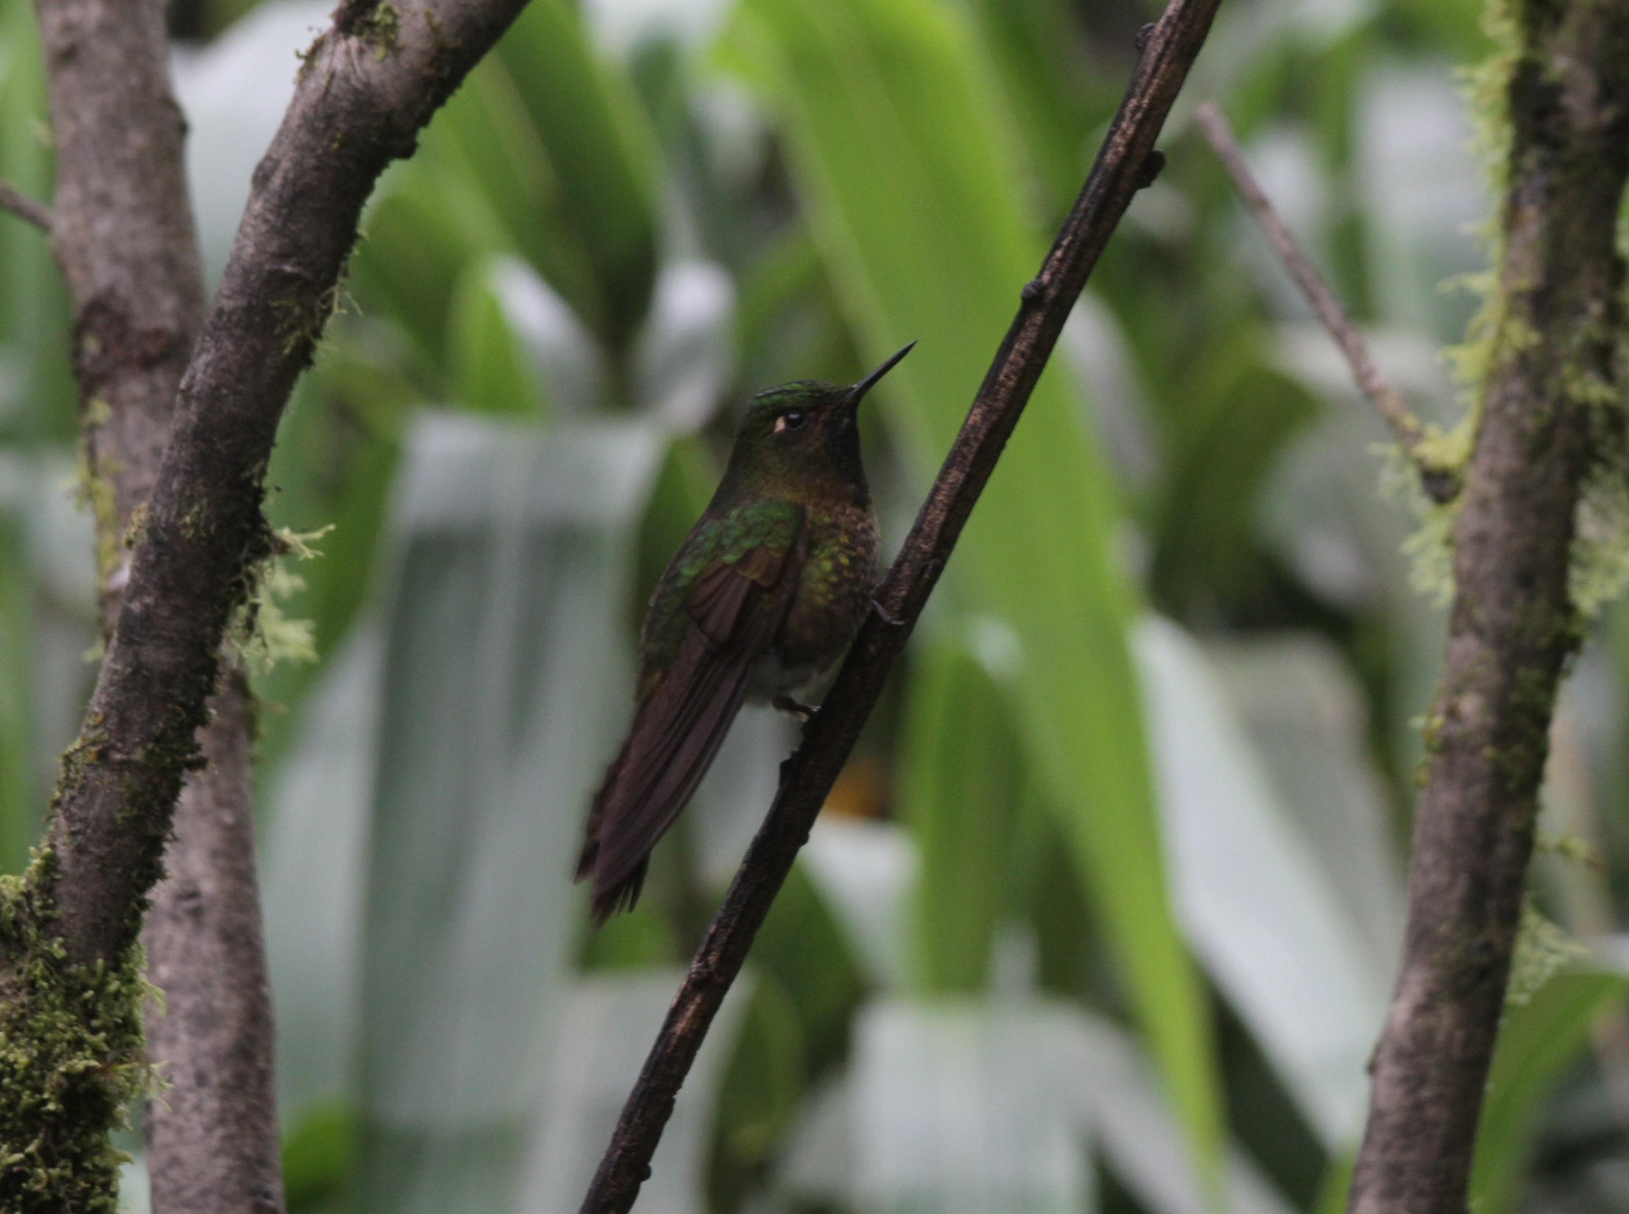
Tyrian metaltail

Slide 10
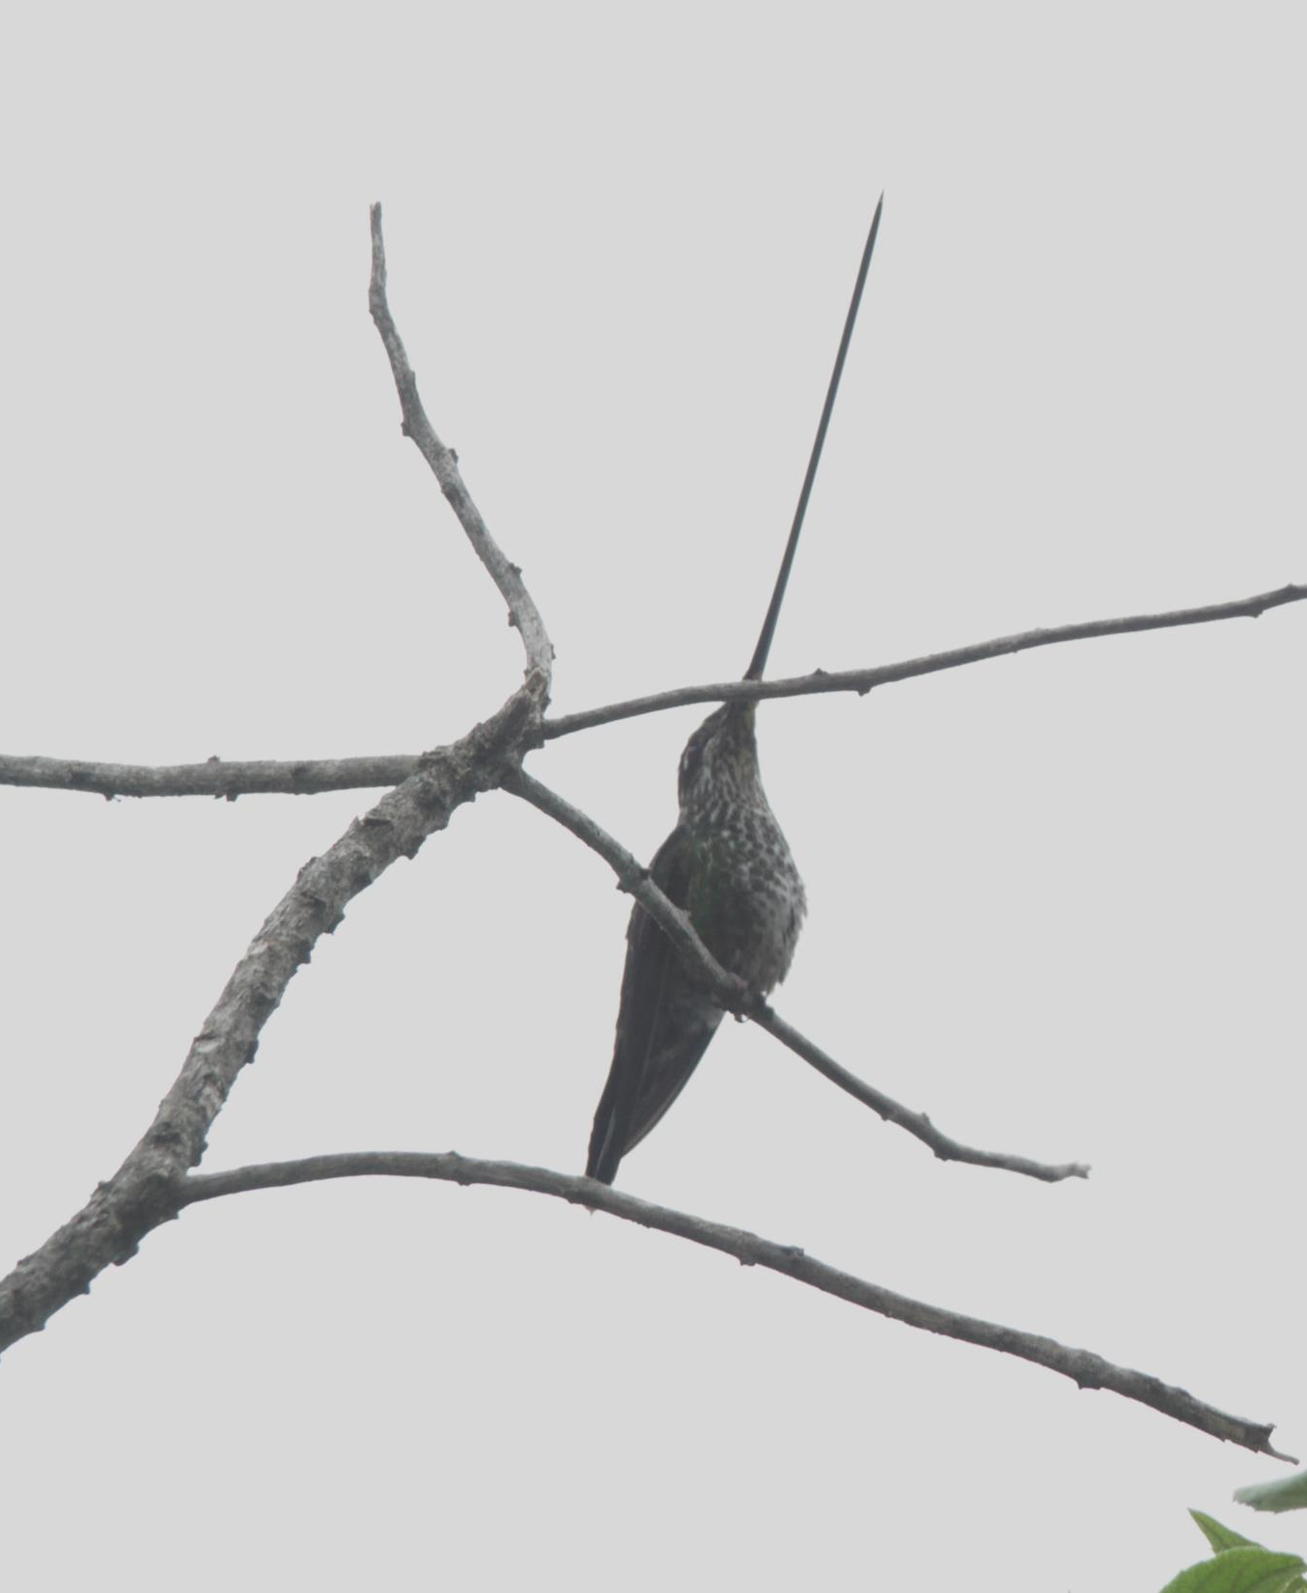
Sword-billed hummingbird

Slide 11
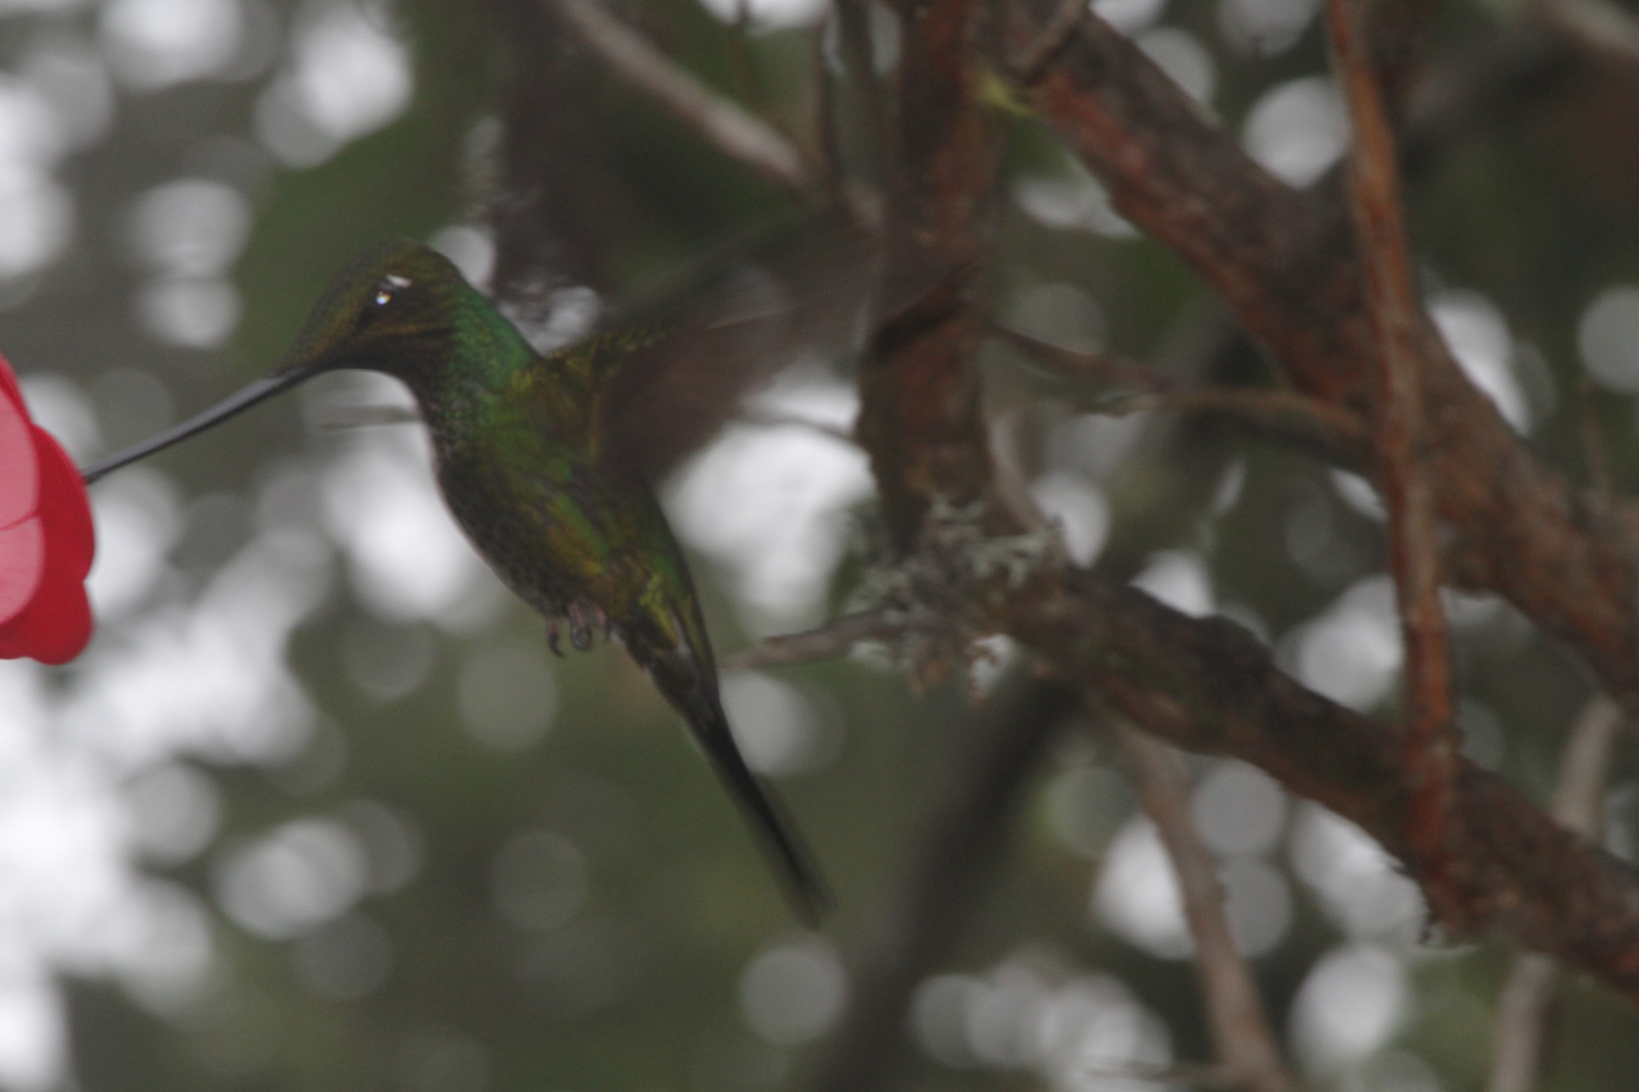
Sword-billed hummingbird

Slide 12
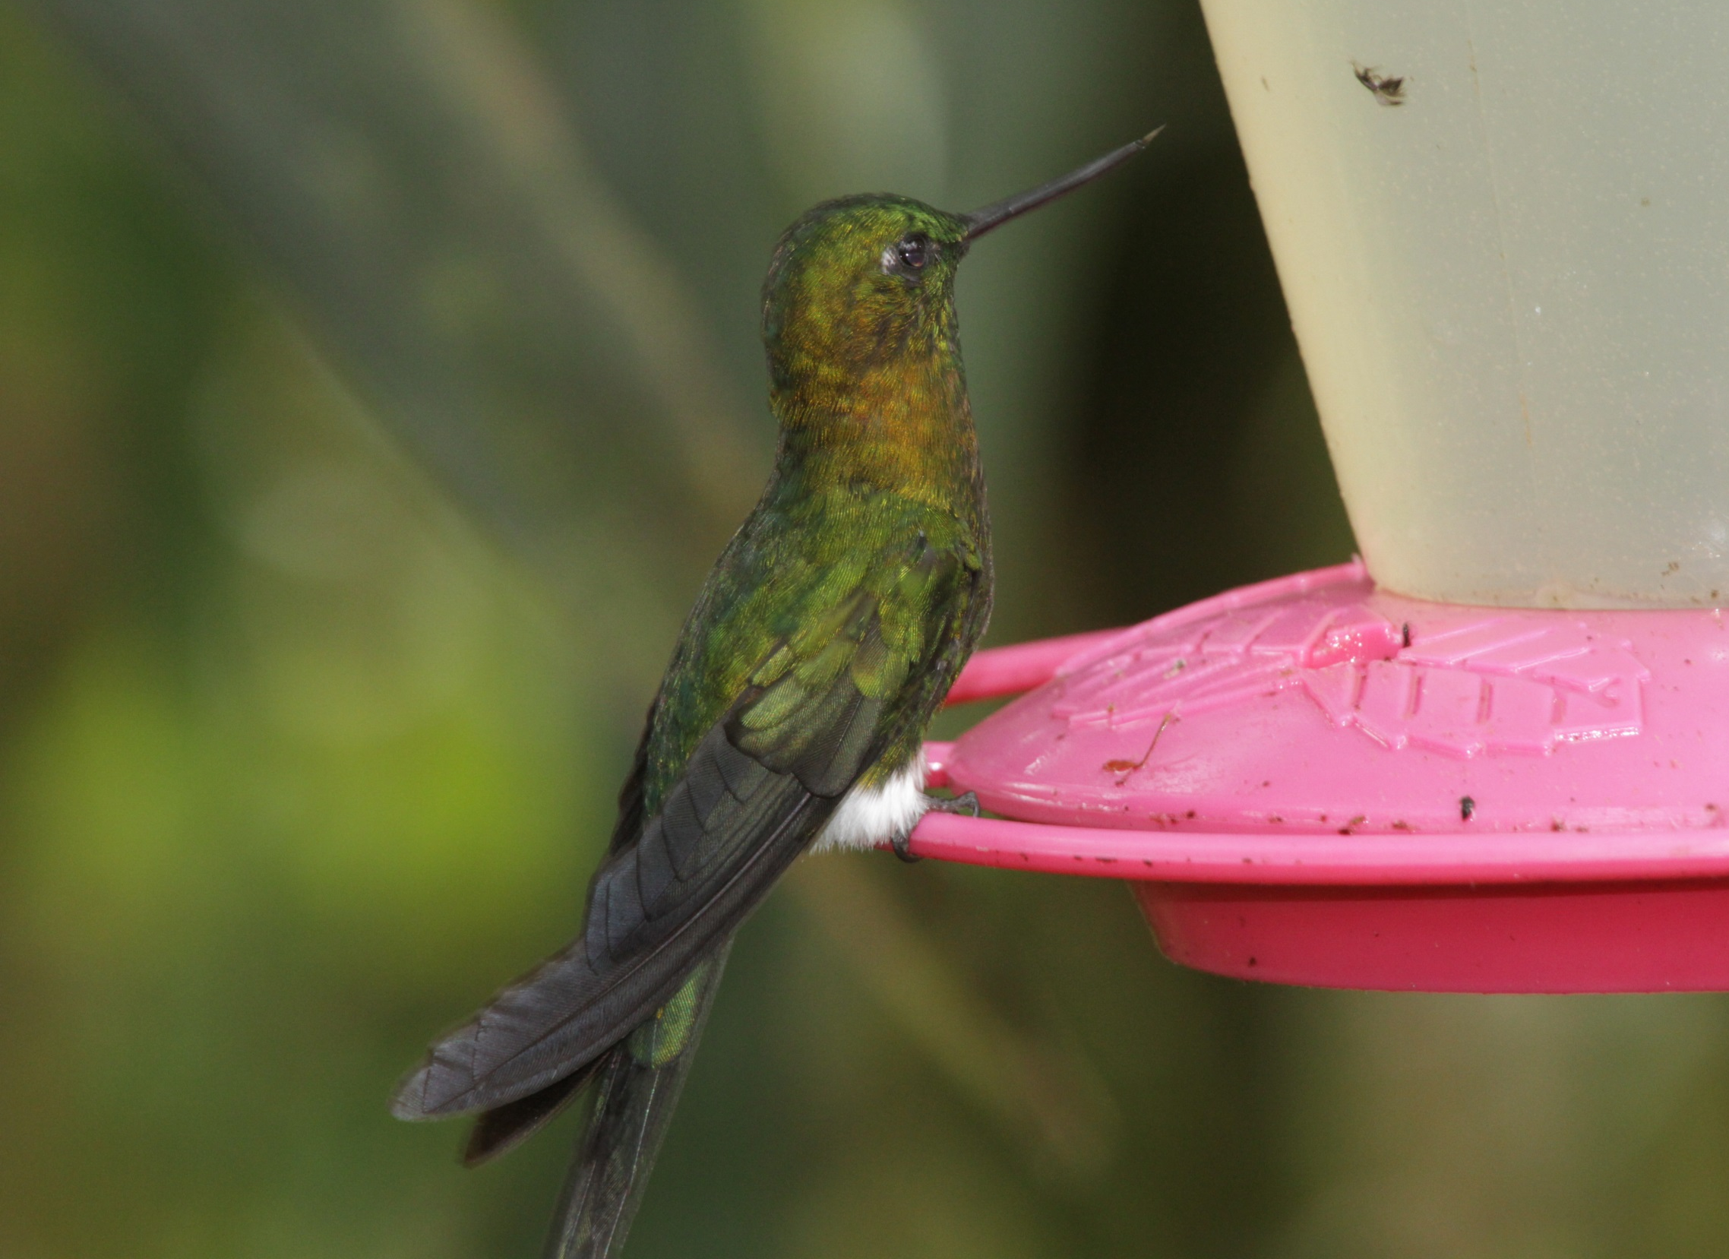
Golden-breasted puffleg

Slide 13
Golden-breasted puffleg

Slide 14
Black-breasted puffleg

Slide 16
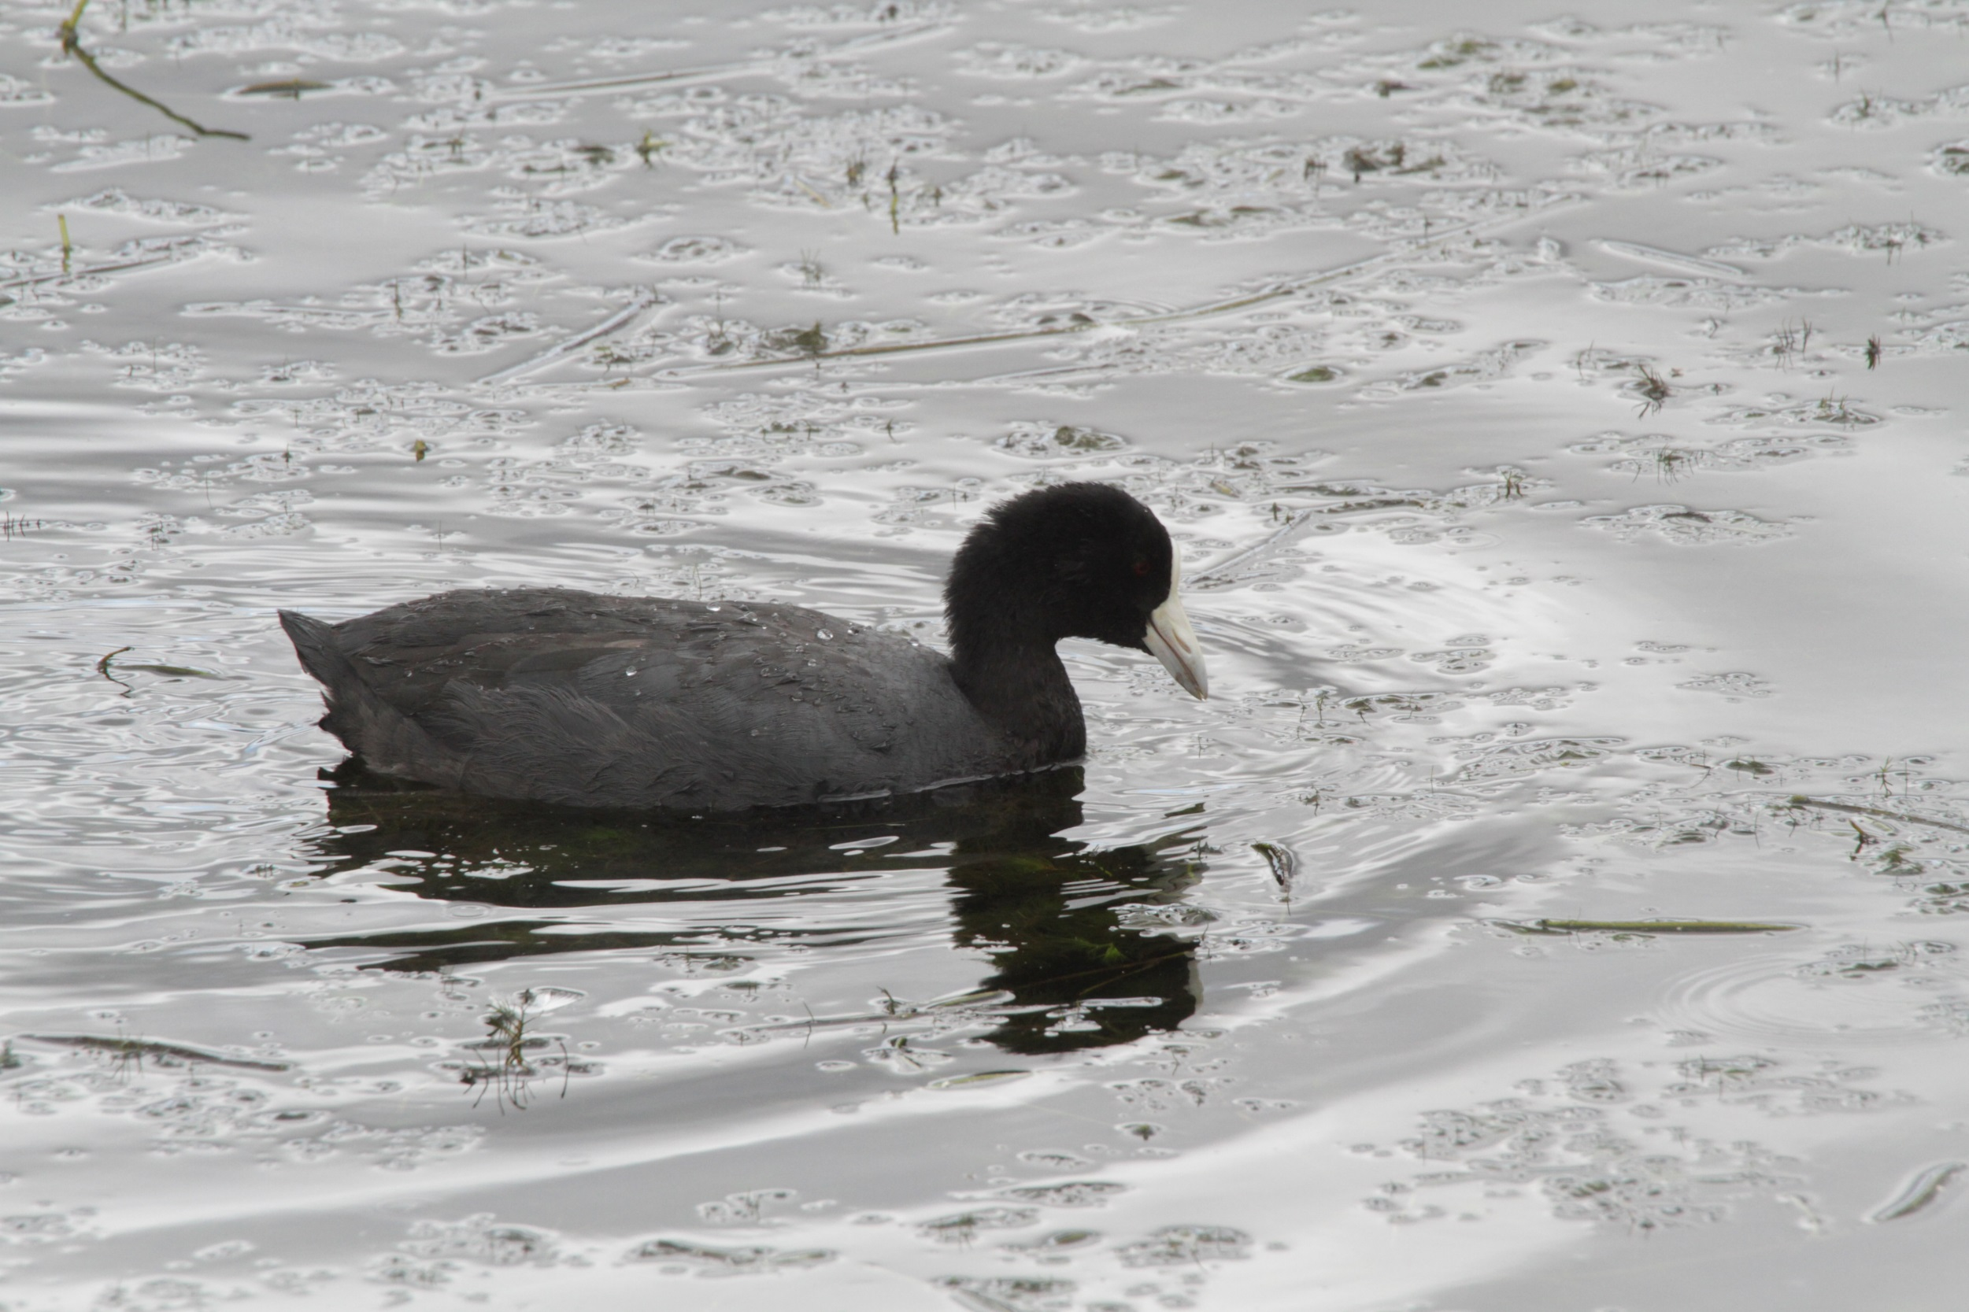
Andean coot

Slide 17
Ruddy duck

Slide 18
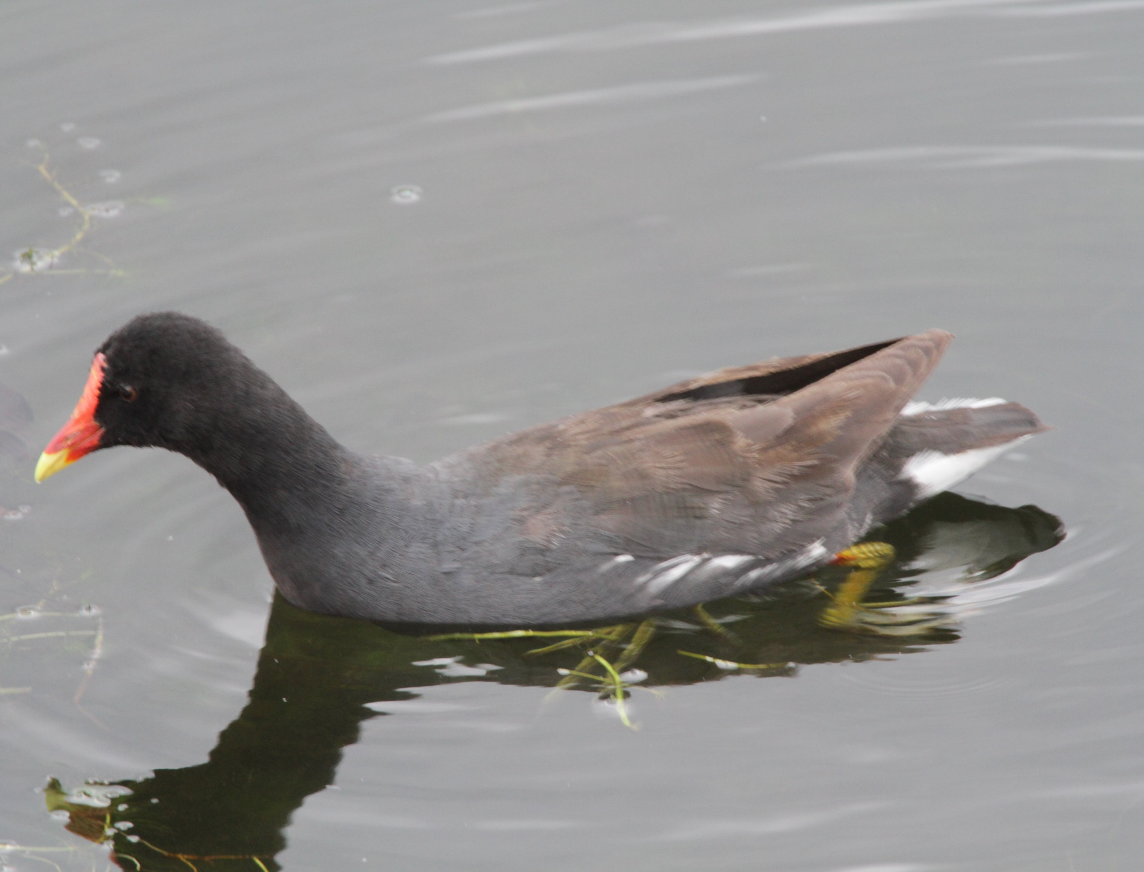
Common moorhen

Slide 19
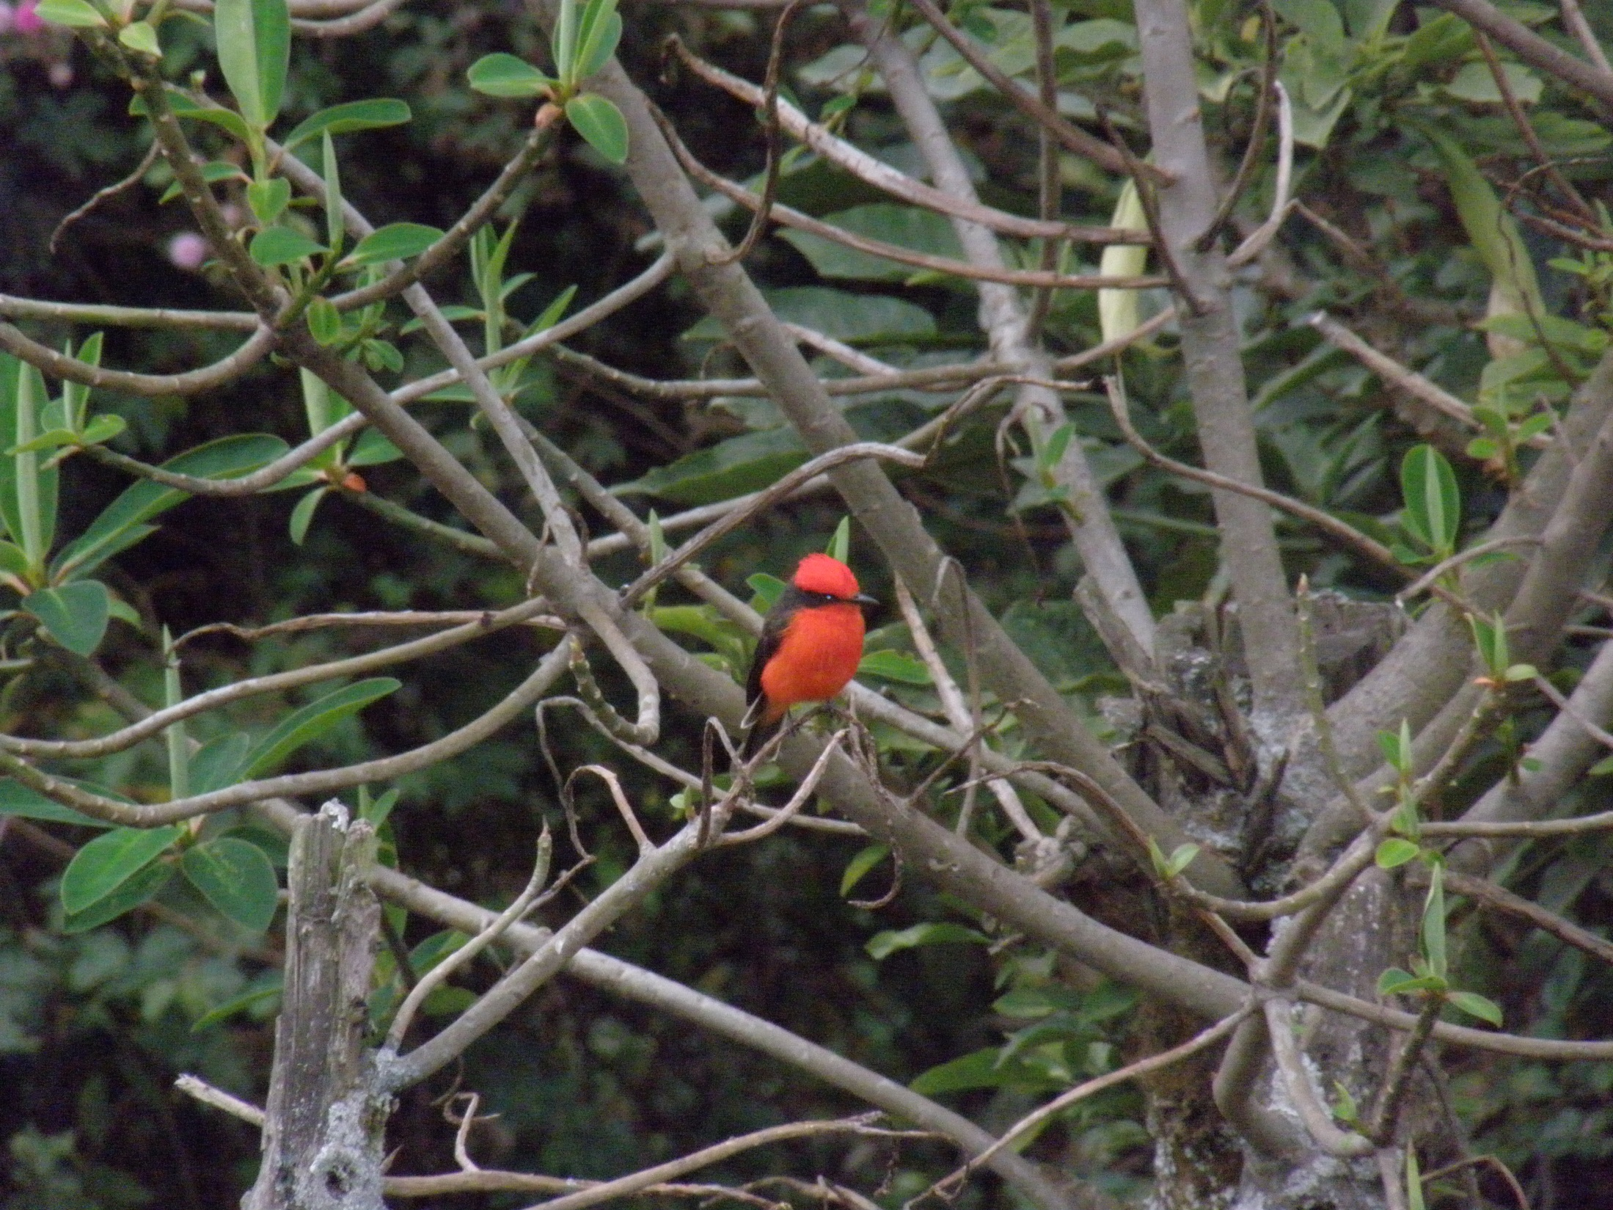

Slide 20
