Slide 1
Land Snails of Raven Rock State Park, Harnett County, North Carolina
Robert Wayne Van Devender
Department of Biology
Appalachian State University

Slide 2
Families of Land Snails
Ellobiidae – 1 species
Euconulidae – 2-3 species
Gastrodontidae – 3 species
Haplotrematidae – 1 species
Oxychilidae – 4 species
Philomycidae – 1 species
Polygyridae – 8 species
Punctidae – 1 species
Strobilopsidae – 1 species
Vertiginidae – 1 species
TOTAL = 23-24 species

Slide 3
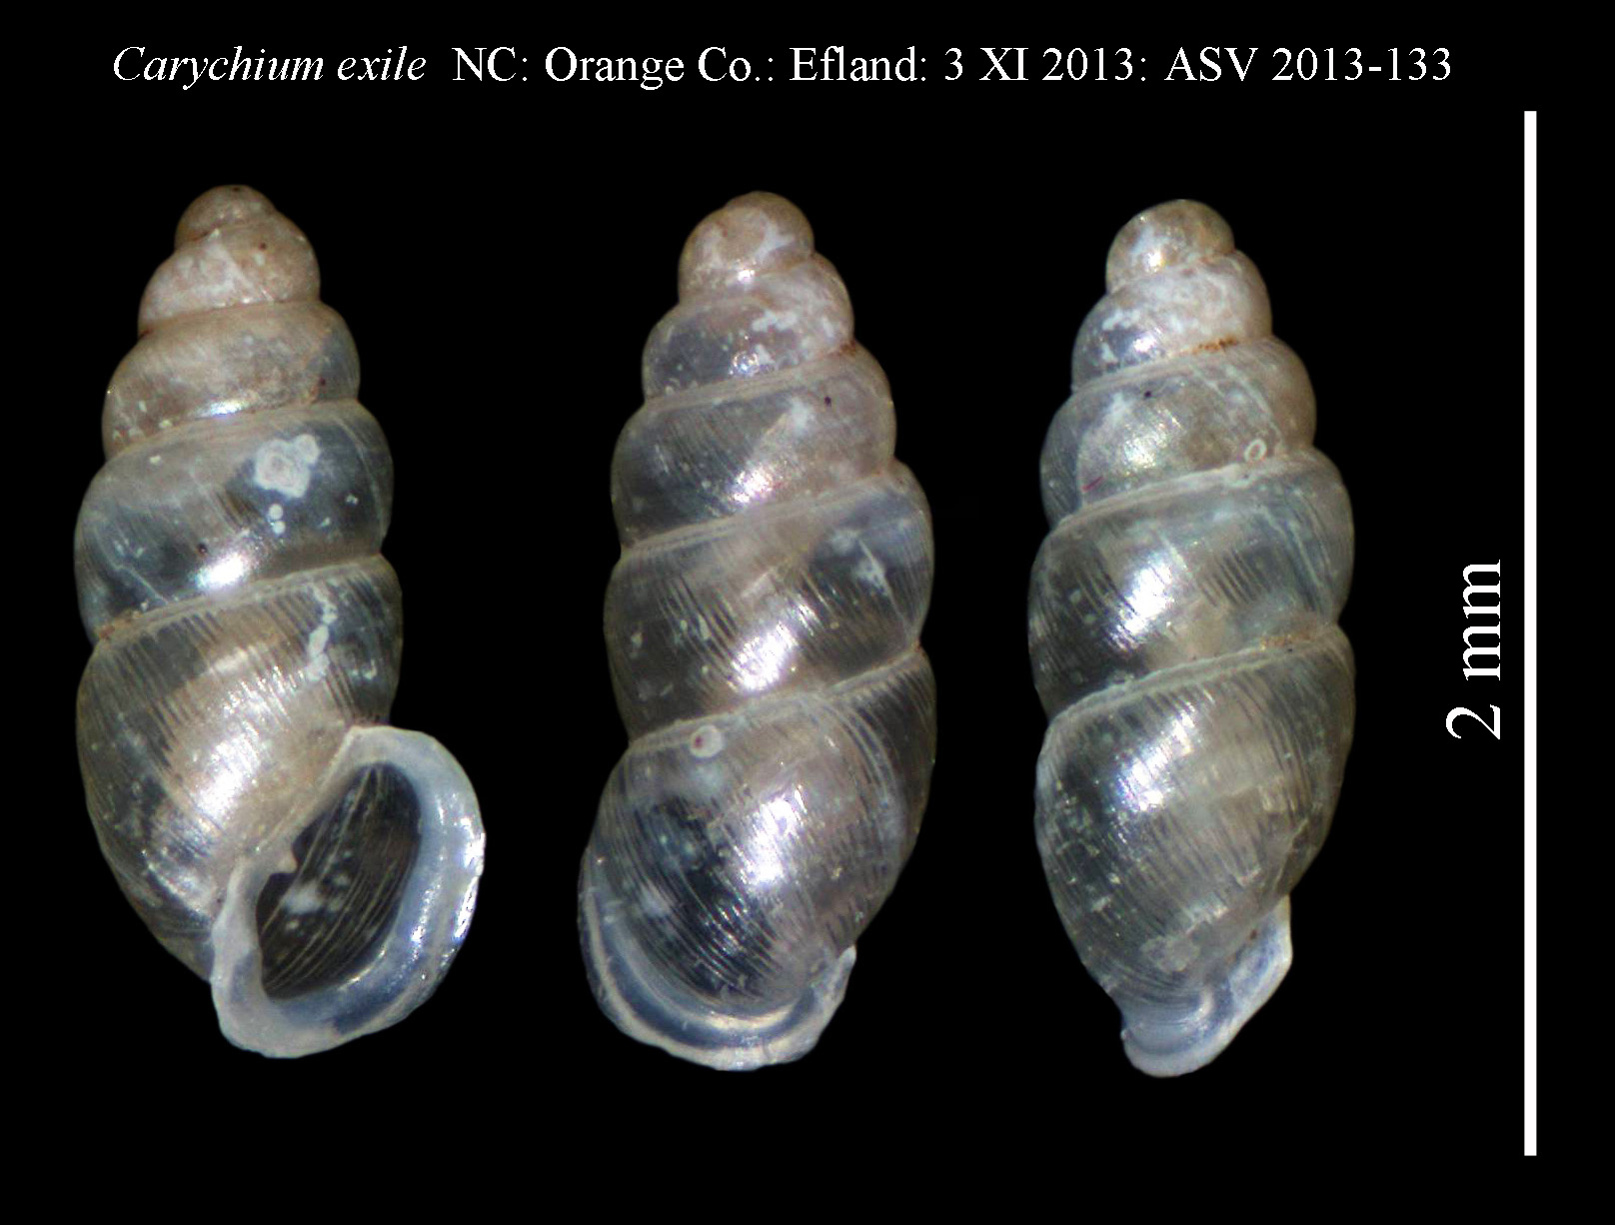
Ellobiidae – Carychium exile
1.7 mm
Notes:
High spire
Very small and white
Lip is reflected
Two teeth or lamellae in aperture

Slide 4
Euconulidae - Euconulus cf. fulvus
2 mm

Slide 5
Euconulidae - Euconulus cf. trochulus
2 mm

Slide 6
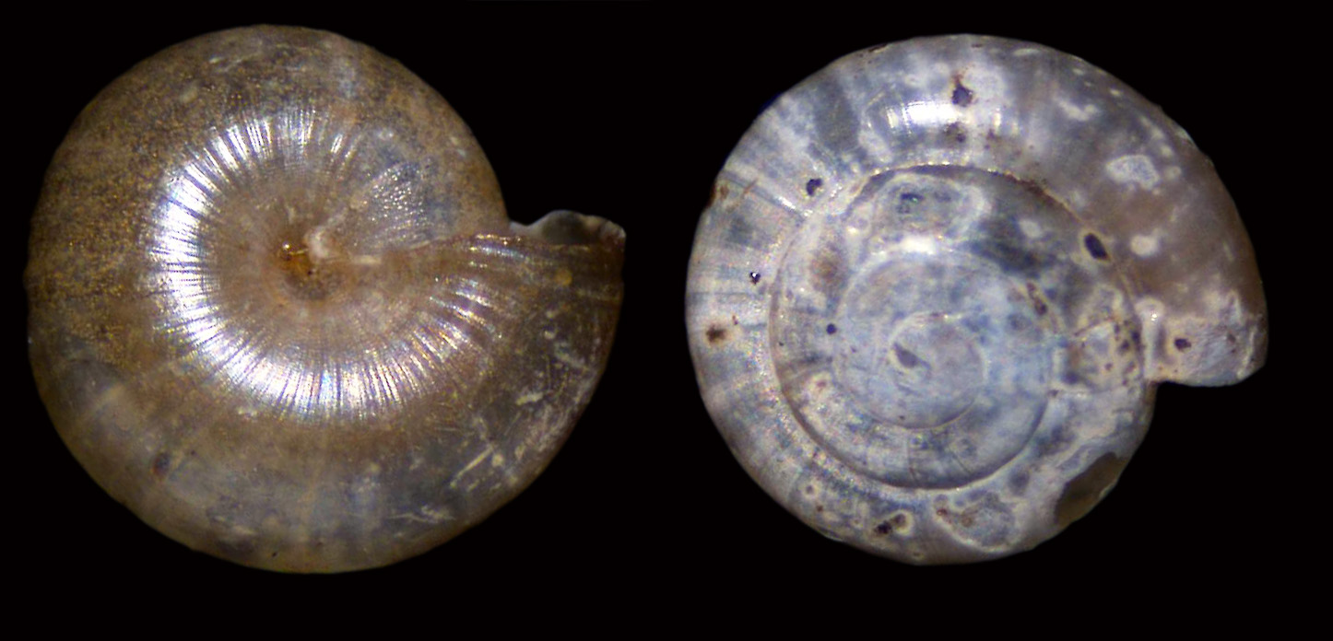
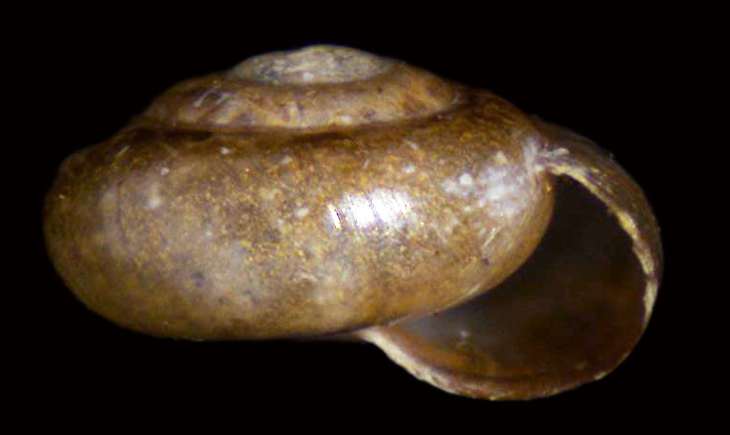
Euconulidae – Guppya sterkii
Specimen from
Stanly Co., NC
1 mm

Slide 7
Gastrodontidae – Striatura meridionalis
< 2 mm
Notes:
Very small white shell
Elaborate surface sculpture of crossing ridges
Has a matte finish to the unaided eye
Large umbilicus
Simple aperture

Slide 8
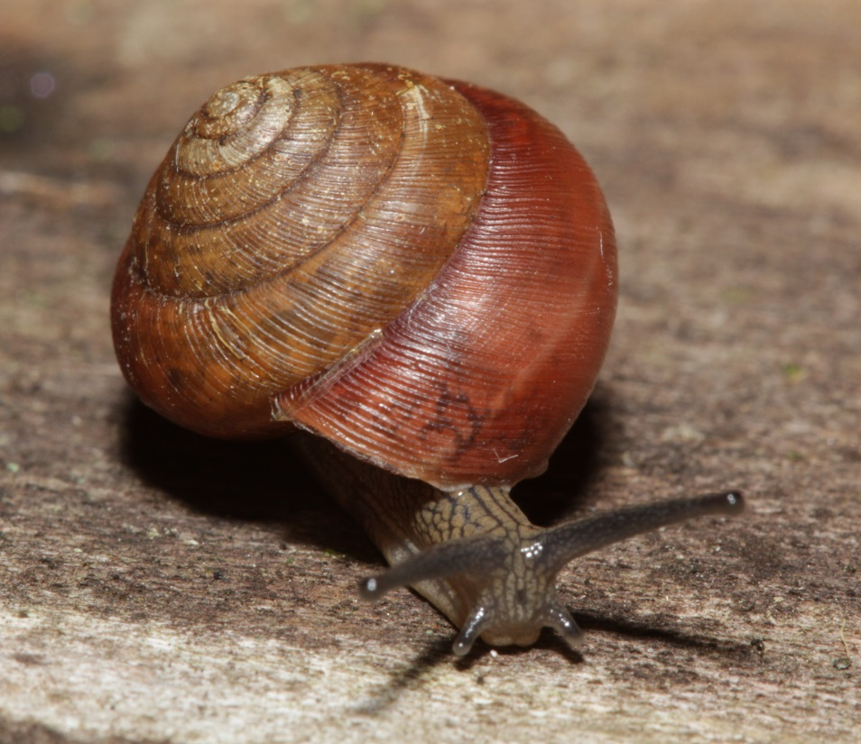
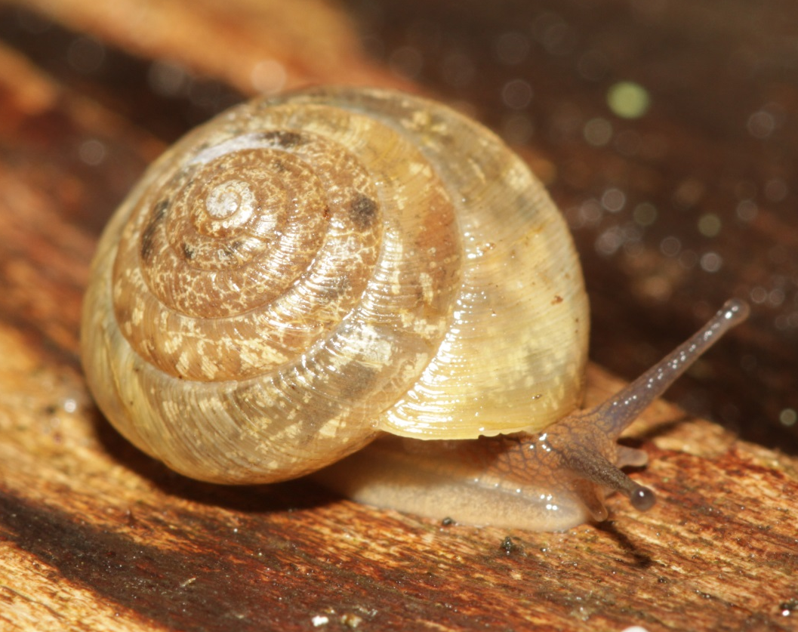
Gastrodontidae - Ventridens intertextus
13 mm
Notes:
Larger Ventridens without lamellae in the aperture
Surface structure a unique checkerboard effect of crossing longitudinal and transverse ridges
Color quite variable and may include lateral stripes

Slide 9
Gastrodontidae - Zonitoides arboreus
4 mm
Notes:
Color variable but usually brown to reddish brown
Umbilicus moderately large
Irregular growth wrinkle but not incised lines or ridges
Lip simple

Slide 10
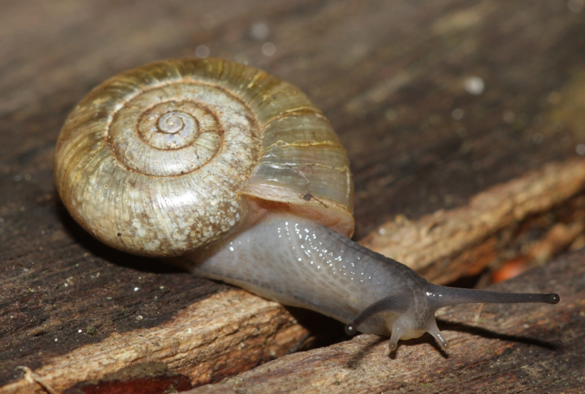
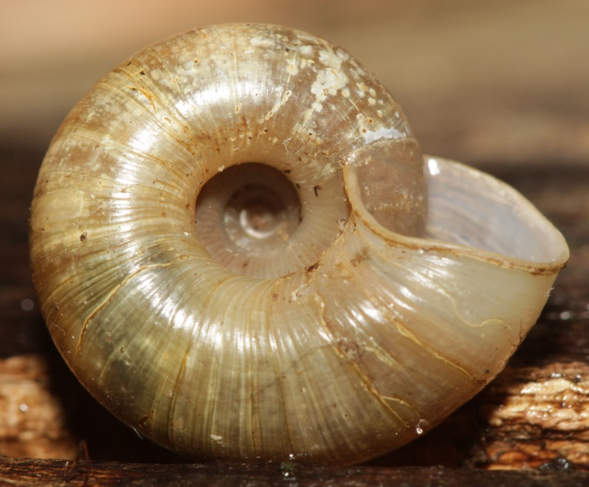
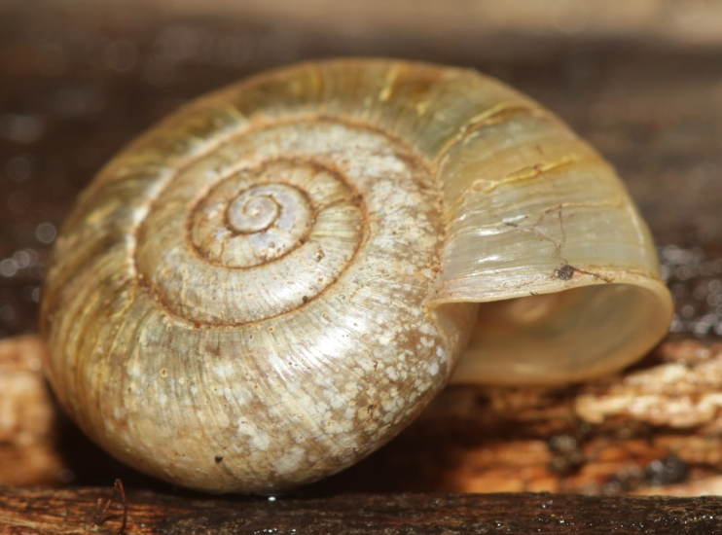
Haplotrematidae - Haplotrema concavum
18 mm
Notes:
Large, open umbilicus – hence the name concavum
Shell is uniformly pale white to yellowish tan.
Lip is simple but may be slightly flared in large animals.
Seen in the park but shells not available for photography.

Slide 11
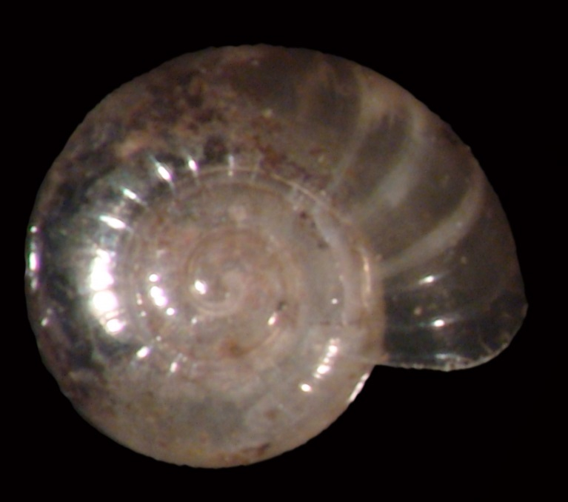
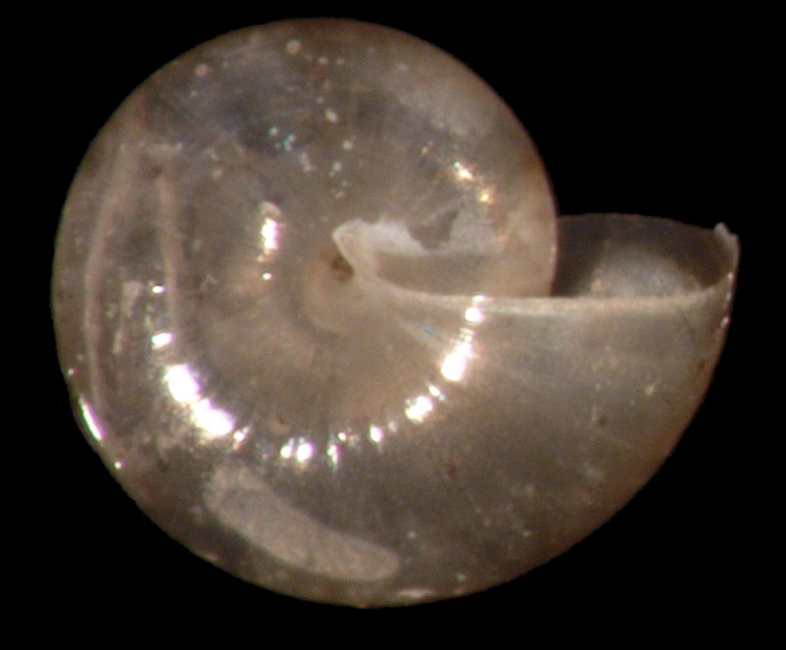
Oxychilidae - Glyphyalinia indentata
About 2 mm
Notes:
Shell with many, closely spaced incised lines
Lip is simple
Umbilicus is small but open
Shell is translucent light tan when fresh

Slide 12
Oxychilidae - Glyphyalinia luticola
4 mm

Slide 13
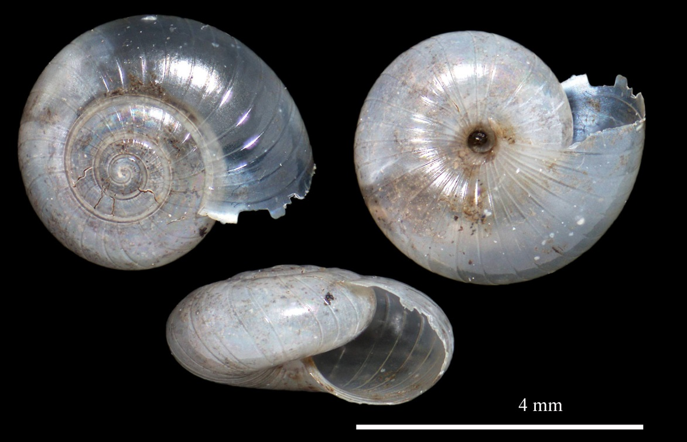
Oxychilidae - Glyphyalinia rhoadsi
Specimens from
Stanly Co., NC
4-5 mm

Slide 14
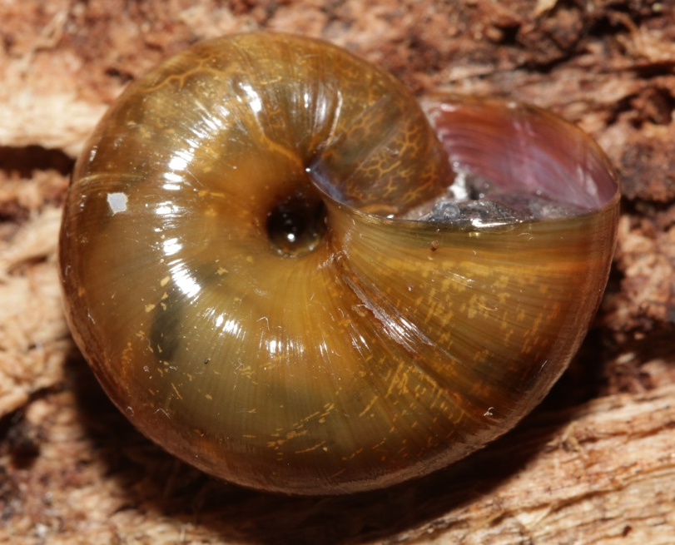
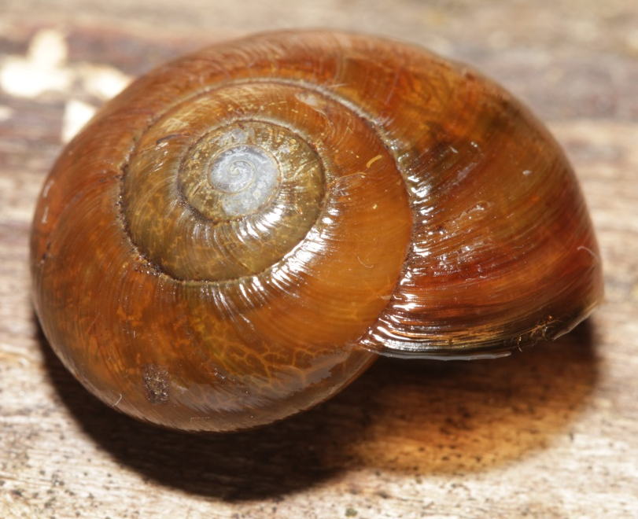
Oxychilidae – Mesomphix pilsbryi
23-25 mm

Slide 15
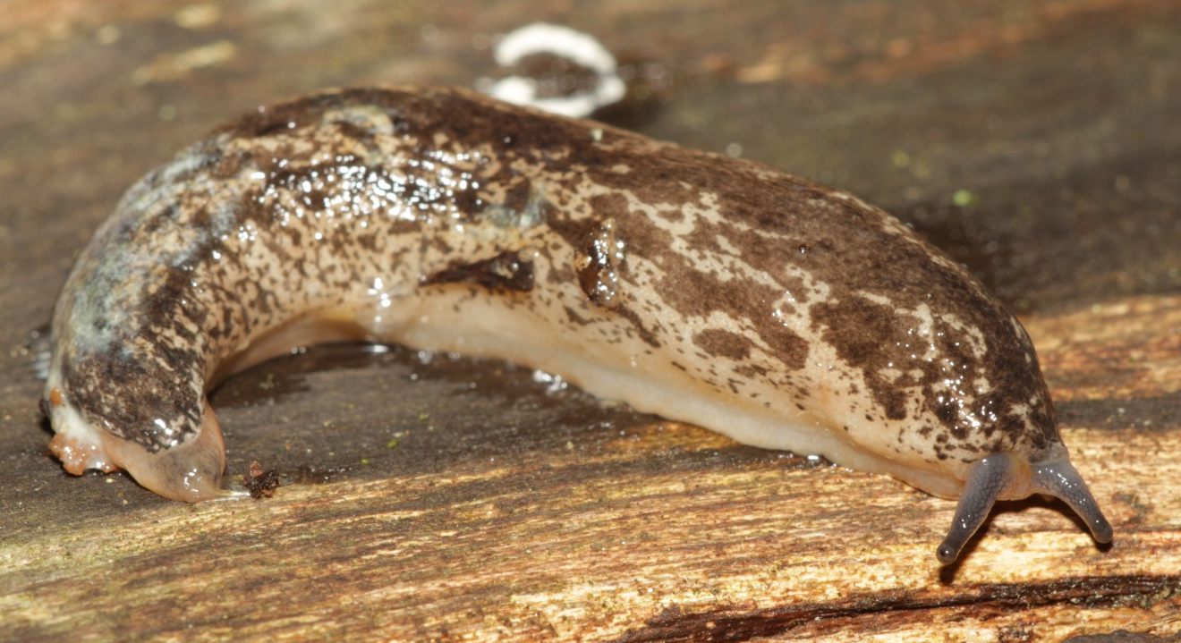
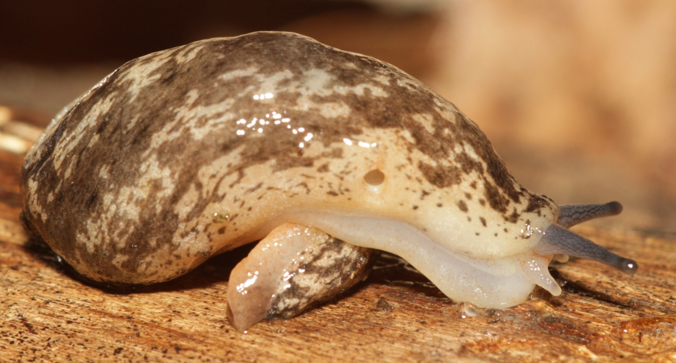
Philomycidae – Philomycus flexuolaris
to >60 mm

Slide 16
Philomycidae - Philomycus carolinianus
52 mm
Notes:
A variable slug with many color phases.
Usually has paired dark spots down the back.
Defensive slime is clear.
Side of foot is pale.

Slide 17
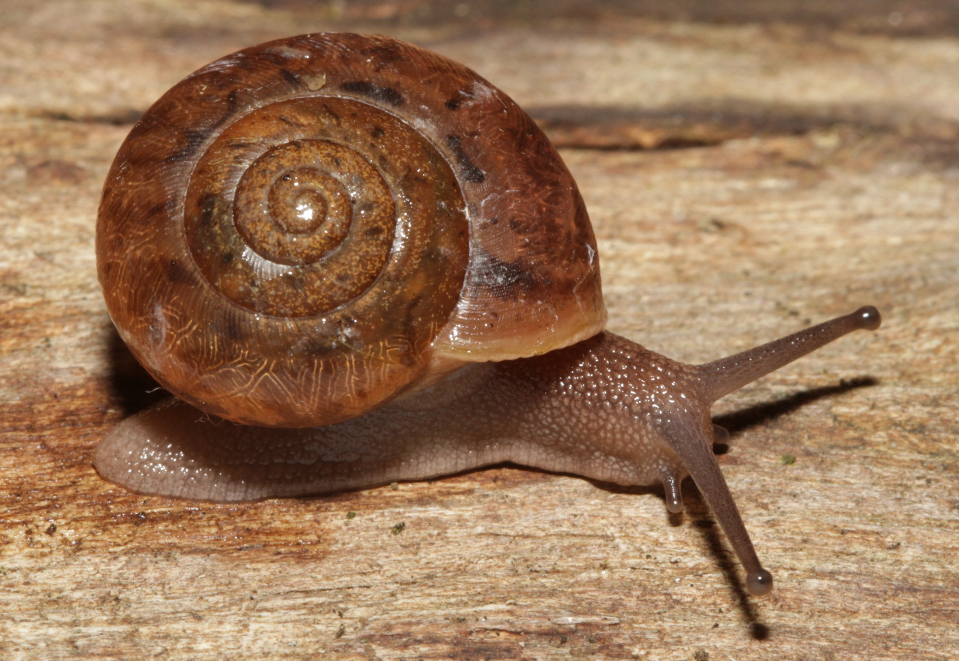
Polygyridae - Mesodon thyroidus
20 mm
Notes:
Umbilicus is always somewhat open.
A single lamella usually present in aperture.
Bold, white reflected lip present in adults.
Shell and animal color somewhat variable from pale to dark brown.

Slide 18
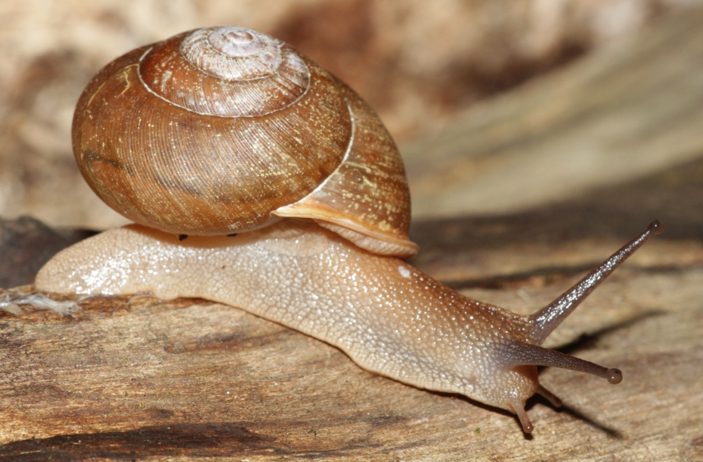
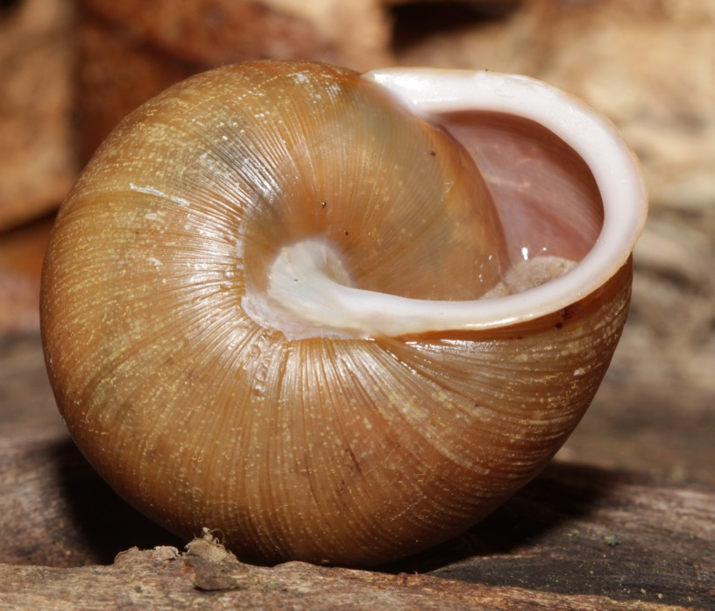
Polygyridae - Neohelix solemi
32 mm
Notes:
Large snail with reflected lip and closed umbilicus.
Aperture contains no lamellae.
Coloration varies from reddish to dark brown to greenish brown.
Similar species to the west have different height to width ratios.

Slide 19
Polygyridae – Stenotrema barbatum
mm

Slide 20
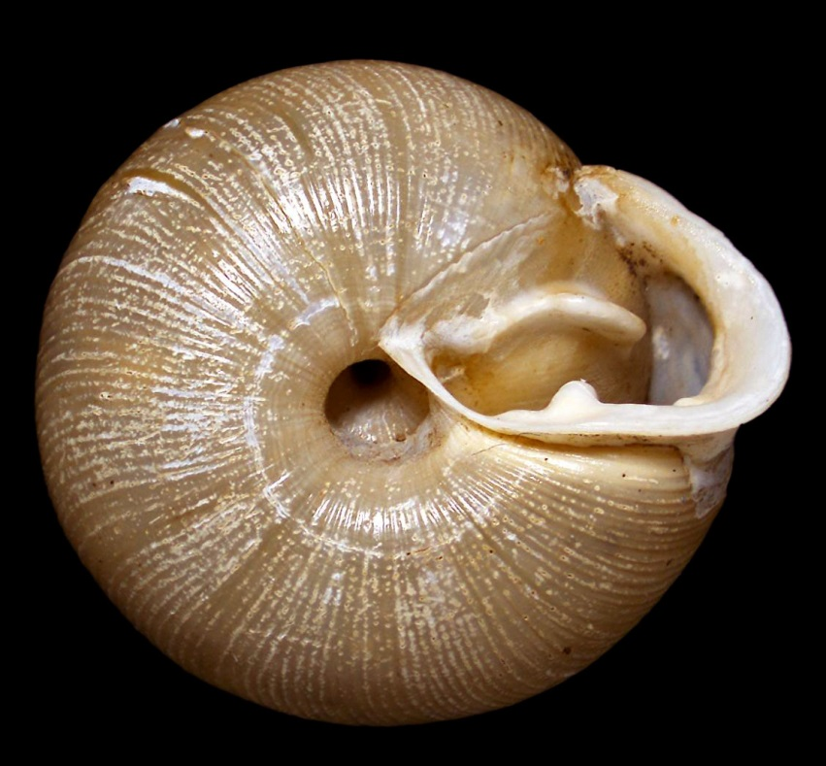
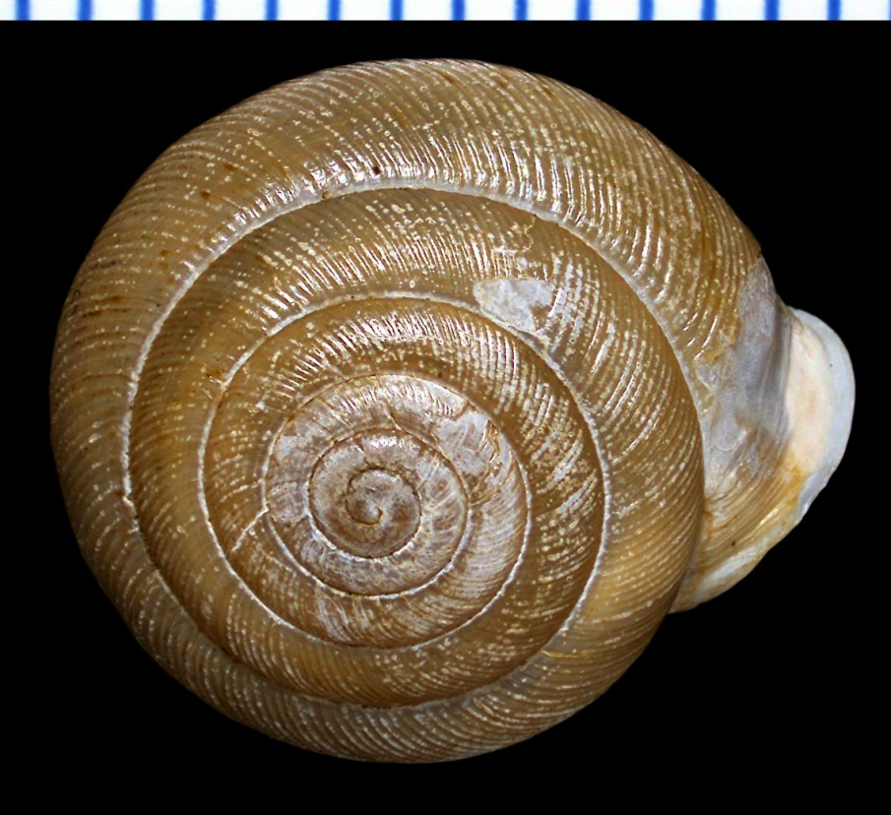
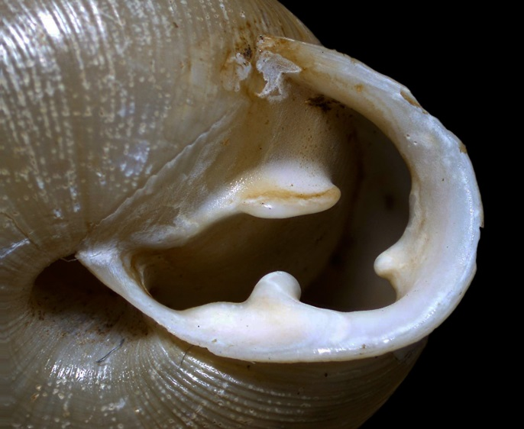
Polygyridae - Triodopsis fallax
13 mm
Notes:
Small Triodopsis with moderately large umbilicus
Parietal lamella curved and points above the outer lamella
Basal lamella on an elongated buttress

Slide 21
Polygyridae - Triodopsis juxtidens
16 mm

Slide 22
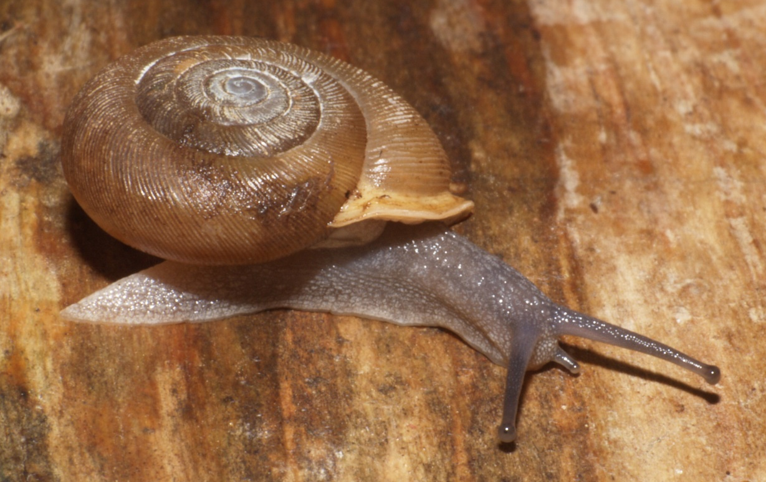
Polygyridae - Triodopsis tridentata
20 mm

Slide 23
Polygyridae - Triodopsis messana
11 mm
Notes:
1. Small Triodopsis with small umbilicus

Slide 24
Polygyridae – Xolotrema caroliniense
21 mm
Notes:
1

Slide 25
Punctidae – Punctum minutissimum
SEM’s of animal from
Halifax Co., NC
1 mm

Slide 26
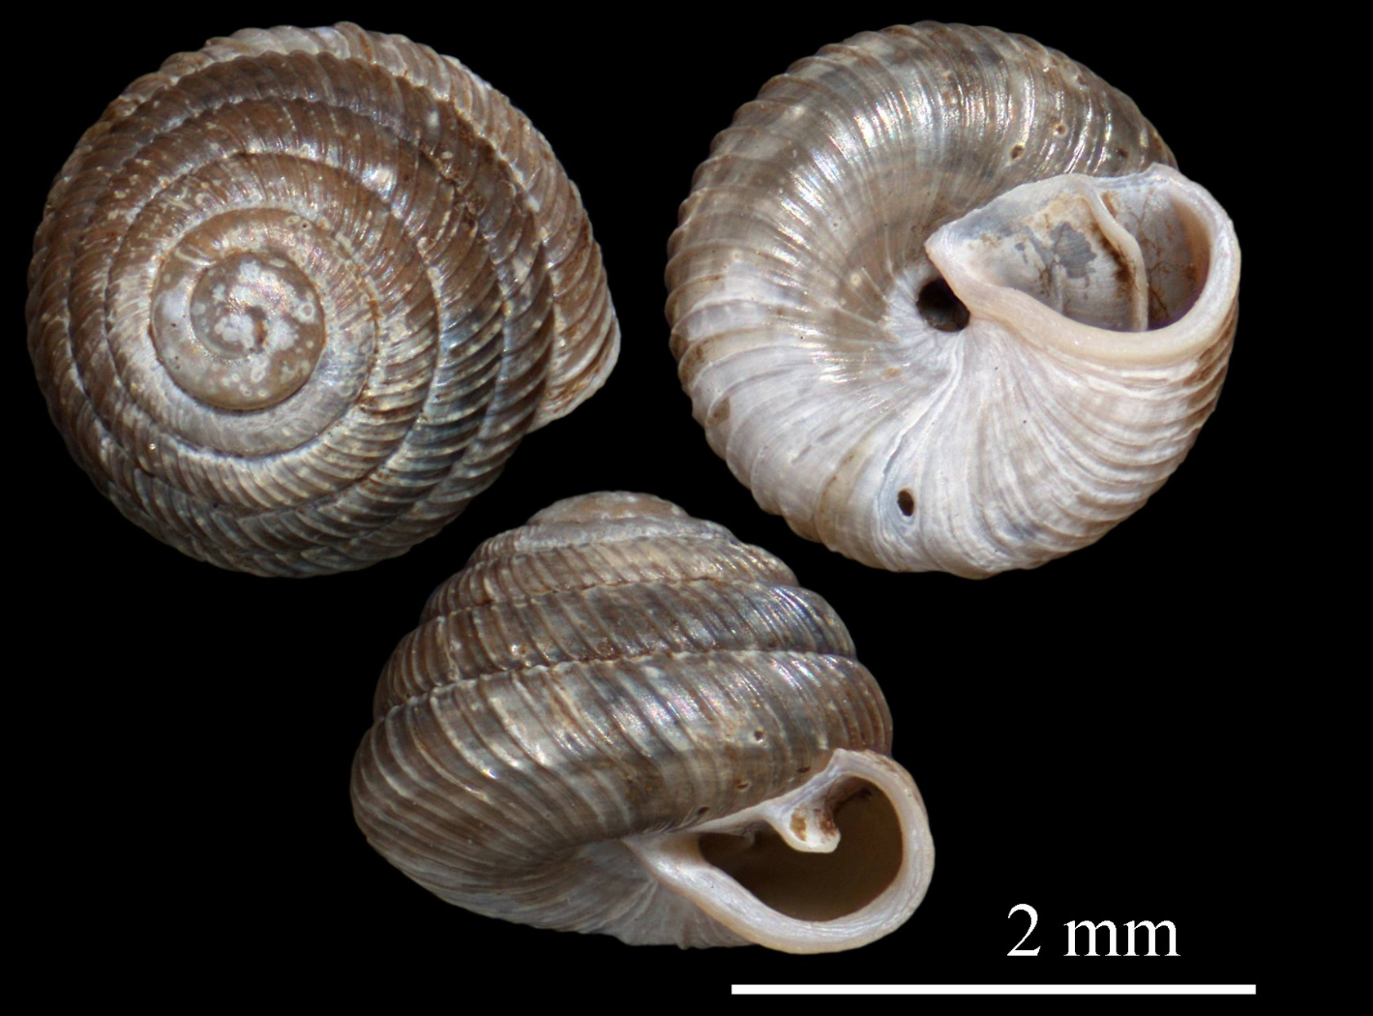
Strobilopsidae - Strobilops labyrinthicus
Specimens from Stanly Co., NC
Notes:
A pinecone shell with a rounded periphery.
Ribbing usually extends across the venter to the umbilicus.

Slide 27
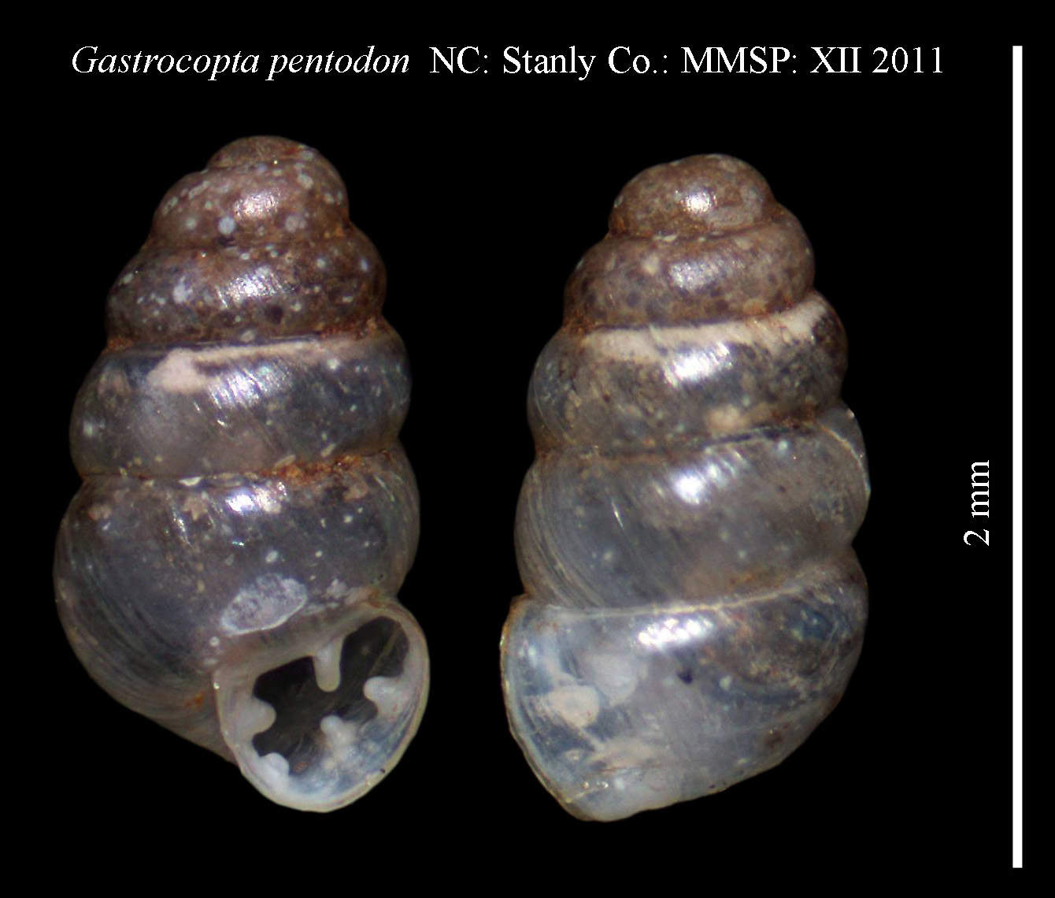
Vertiginidae - Gastrocopta pentodon
Notes:
Fresh wet shells are transparent, translucent or white
Aperture has only one lamella in the top of the aperture
Lamella on the outer lip sit on an elevated ridge and can number from three to seven
Only the much larger and fatter Vertigo tappaniana shares these characteristics.

