Slide 1
Land Snails of Mount Mitchell State Park, North Carolina
Robert Wayne Van Devender
and
Amy S. Van Devender

Slide 2
Land Snails of Mt. Mitchell
Agriolimacidae – 2 species
Arionidae – 1 species
Gastrodontidae – 3 species
Oxychilidae – 7 species
Philomycidae – 2 species
Polygyridae – 4 species
Succineidae – 1 species
Valloniidae – 1 species
Total – 21 species

Slide 3
Deroceras laeve
Mantle short
Less than about 35 mm
Slime clear
Color variable, often dark
24 mm extended
Mt. Mitchell SP, ASV 2011-99

Slide 4
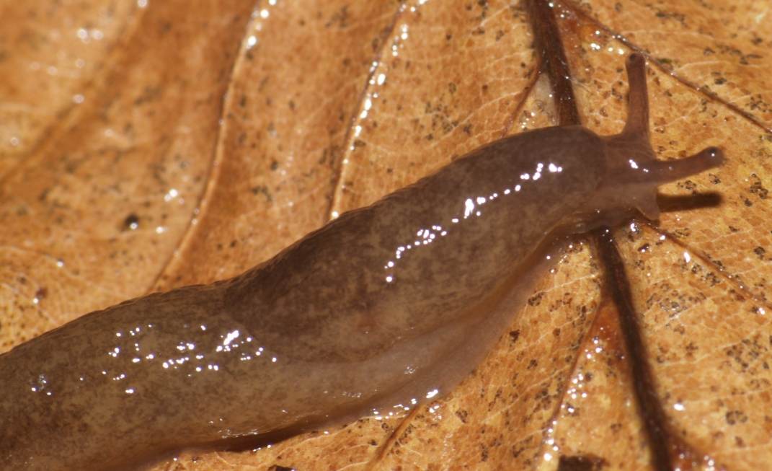
Deroceras reticulatum
Mantle short
Can be more than about 35 mm
Slime milky
Color variable, often pale with reticualtions
25 mm extended
Mt. Mitchell SP, ASV 2007-185

Slide 5
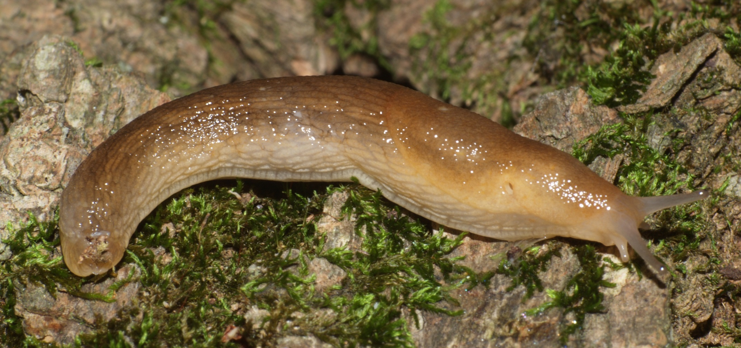
Arion subfuscus
75 mm extended
Mt. Mitchell SP, ASV 2007-185

Slide 6
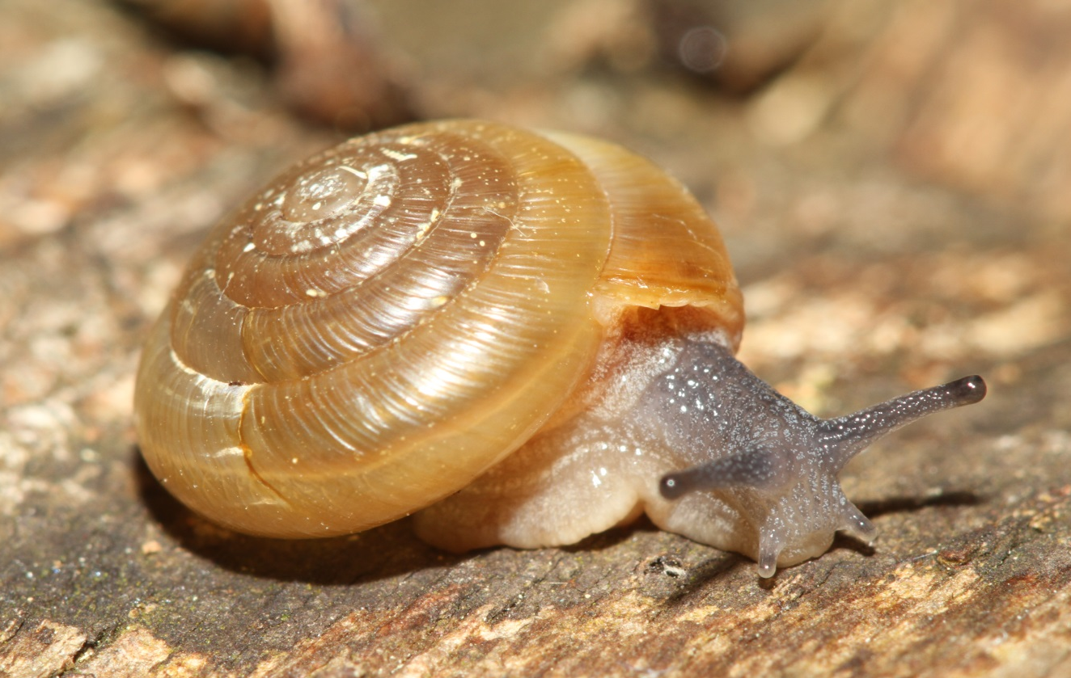
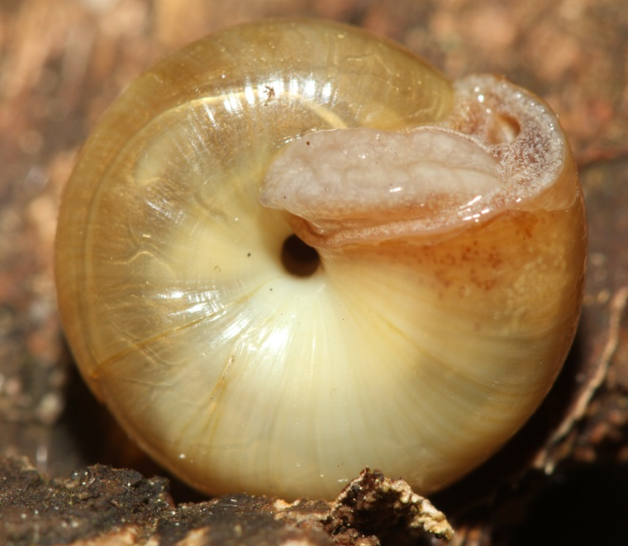
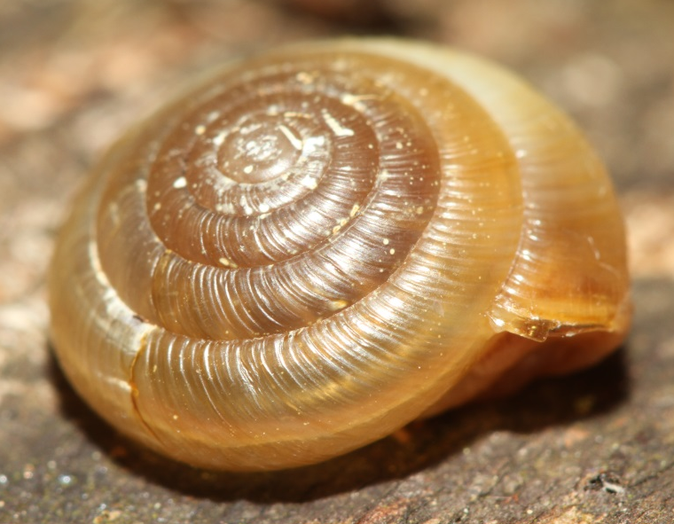
Ventridens acerra
11 mm
Mt. Mitchell SP, ASV 2016-89

Slide 7
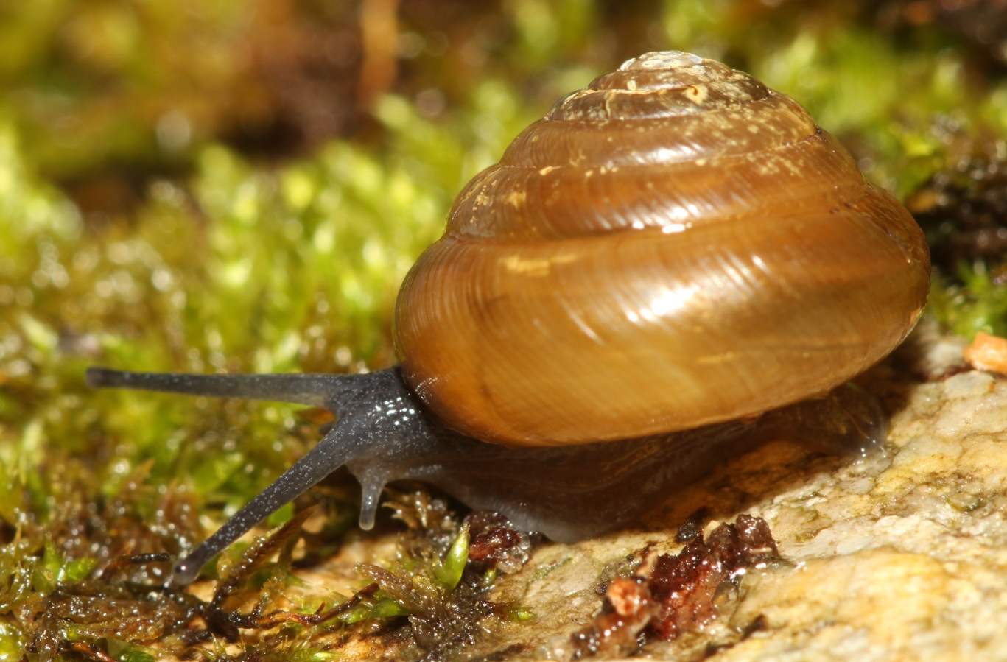
Ventridens arcellus
11 mm
Mt. Mitchell SP, ASV 2016-89

Slide 8
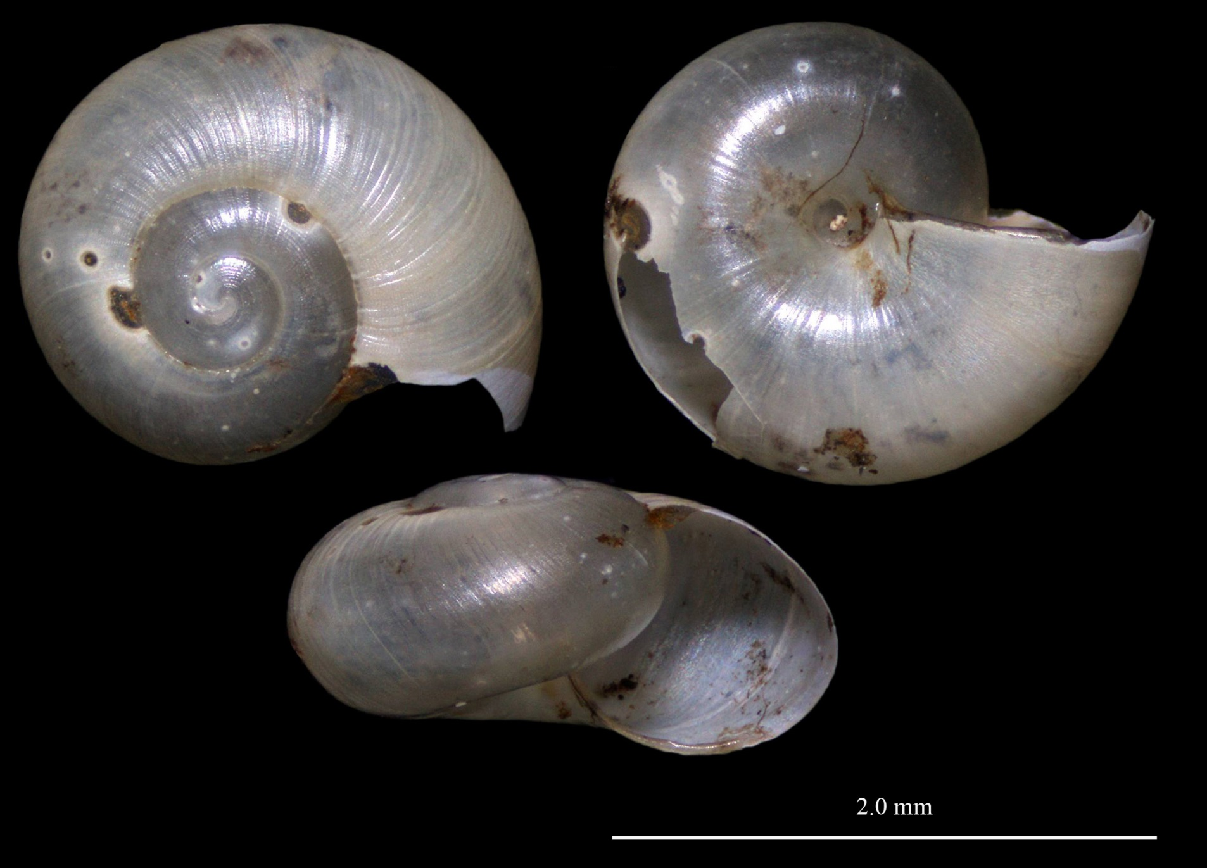
Striatura ferrea
<2mm
Mt. Mitchell SP, ASV 2016-90

Slide 9
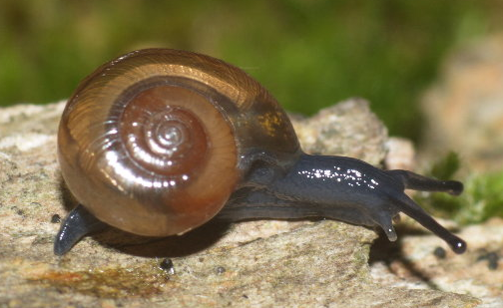
Glyphyalinia clingmani
About 5 mm
Incised lines
Wide umbilicus
Flaring aperture
Mt. Mitchell SP, ASV 2007-185

Slide 10
Glyphyalinia wheatleyi
About 5 mm
Incised lines uneven and stronger above
Wide umbilicus
Rounded aperture
NC: Macon Co., ASV 2010-33

Slide 11
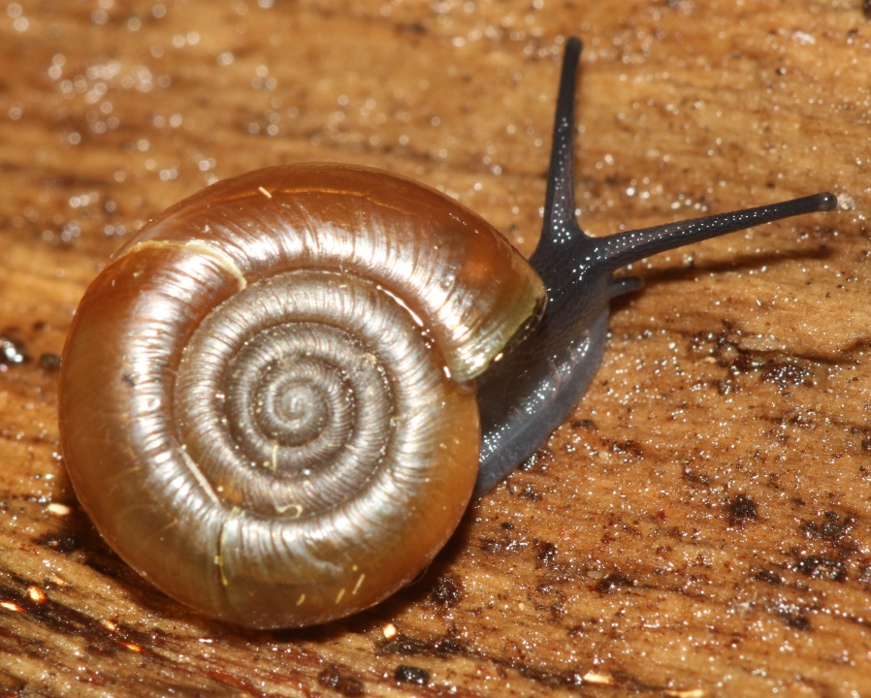
Mesomphix subplanus planus
18 mm
Mt. Mitchell SP, ASV 2016-89 & 94
11 mm

Slide 12
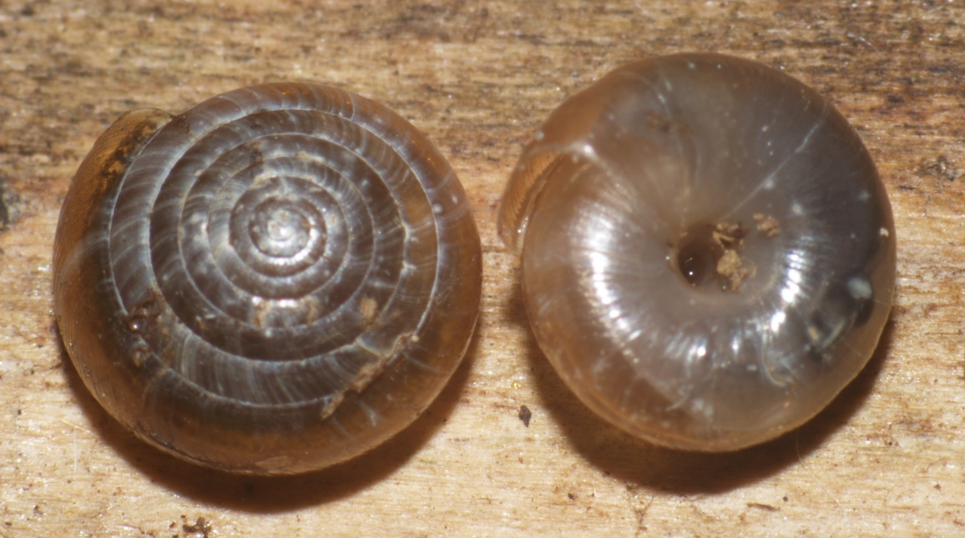
Paravitrea andrewsae
5 mm
Open umbilicus
Many whorls
No teeth
Mt. Mitchell SP, ASV 2007-185

Slide 13
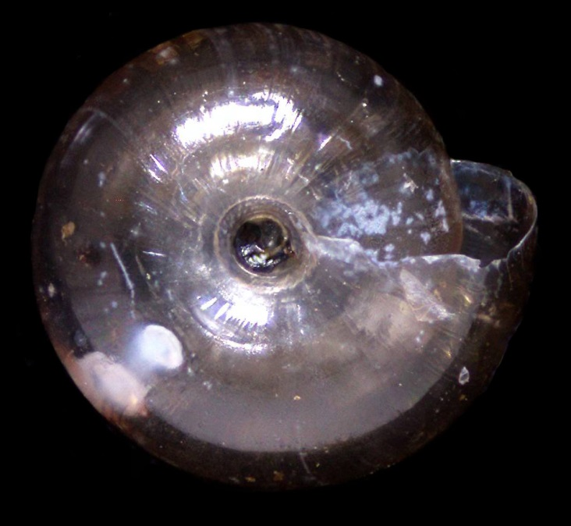
Paravitrea varidens
Mt. Mitchell SP, ASV 2007-185
5 mm
Open umbilicus
Many whorls
Teeth variable in young shells,
usually rows of four teeth
ASV 2016-91

Slide 14
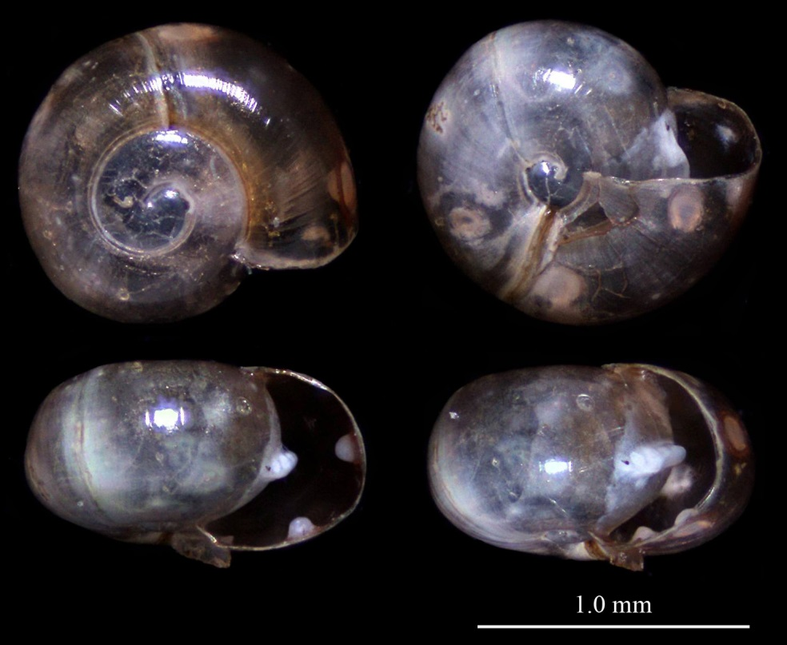
Pilsbryna vanattai
ASV 2016-88
<5 mm
Open umbilicus
Incised lines variable
Teeth in young shells include
parietal and pairs of palatals
ASV 2016-89
Mt. Mitchell SP

Slide 15
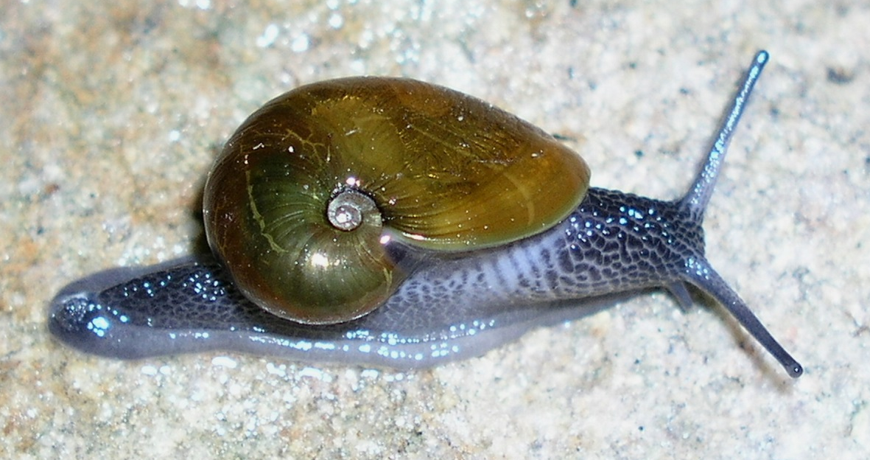
Vitrinizonites latissimus
19 mm
NC: Avery County

Slide 16
Pallifera cf. hemphilli
37 mm extended
Dark body w/o spots
Mt. Mitchell SP, ASV 2011-99

Slide 17
Philomycus venustus
About 30 mm extended
Mantle covers most of body
Mottled coloration with spots
making vague diagonal bands
Slime white and milky
Mt. Mitchell SP, ASV 2016-89

Slide 18
Fumonelix roanensis
Closed umbilicus
Small size – 15 mm
Reflected lip
No teeth
Minute papillae present
Incised lines absent
Mt. Mitchell SP, ASV 2012-5

Slide 19
Mesodon andrewsae
Closed umbilicus
Larger size – 25 mm
Reflected lip w/o teeth
Incised lines present
Very thin shell
Mt. Mitchell SP, ASV 2011-99

Slide 20
Stenotrema altispira
9 mm
Aperture relatively wide
Narrow basal lip
Shallow notch
Mt. Mitchell SP, ASV 2007-185

Slide 21
Stenotrema stenotrema
May be > 10 mm
Aperture relatively narrow
Wide basal lip
Narrow notch
Mt. Mitchell SP, 2004

Slide 22
Novisuccinea ovalis
13 mm
Thin, amber shell
High spire
Mt. Mitchell SP, ASV 2011-99

Slide 23
Vallonia excentrica
About 2 mm
White shells with reflected lip
Smooth shell
Eccentric umbilicus
Mt. Mitchell SP, ASV 2011-99

